Slide 1
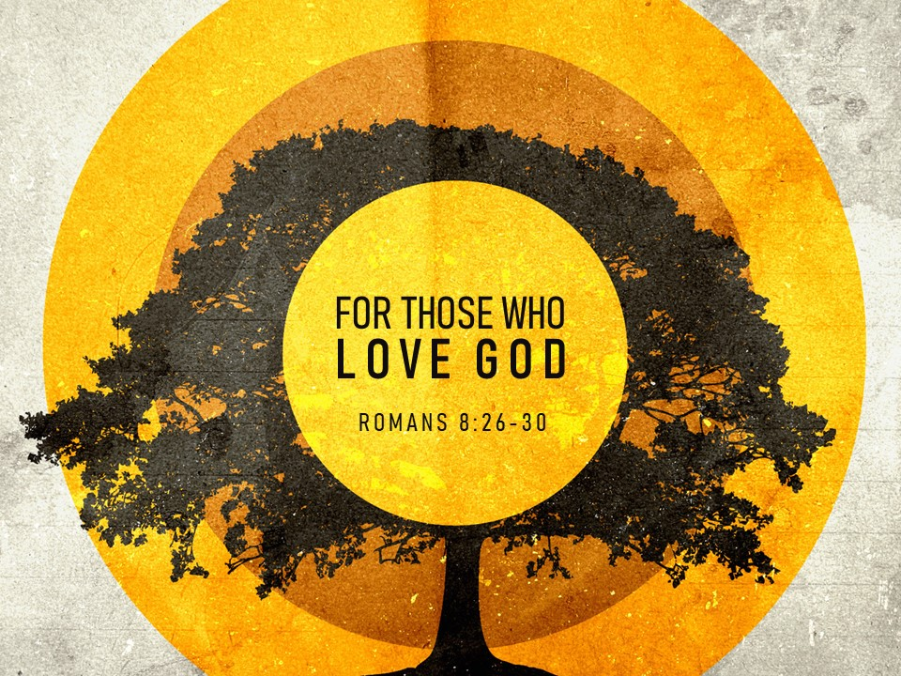

Slide 2
Romans 8:26-27
²⁶ Likewise the Spirit helps us in our weakness. For we do not know what to pray for as we ought, but the Spirit himself intercedes for us with groanings too deep for words. ²⁷ And he who searches hearts knows what is the mind of the Spirit, because the Spirit intercedes for the saints according to the will of God.

Slide 3
Romans 8:28-30
²⁸ And we know that for those who love God all things work together for good, for those who are called according to his purpose. ²⁹ For those whom he foreknew he also predestined to be conformed to the image of his Son, in order that he might be the firstborn among many brothers. ³⁰ And those whom he predestined he also called, and those whom he called he also justified, and those whom he justified he also glorified.

Slide 4
Romans 8:26-27
²⁶ Likewise the Spirit helps us in our weakness. For we do not know what to pray for as we ought, but the Spirit himself intercedes for us with groanings too deep for words. ²⁷ And he who searches hearts knows what is the mind of the Spirit, because the Spirit intercedes for the saints according to the will of God.
God knows what we need!

Slide 5
Romans 8:28
²⁸ And we know that for those who love God all things work together for good, for those who are called according to his purpose.
Even in the chaos and suffering, the good times and the bad times, God is working all things together for the spiritual benefit of His people.

Slide 6
Romans 8:29-30
²⁹ For those whom he foreknew he also predestined to be conformed to the image of his Son, in order that he might be the firstborn among many brothers. ³⁰ And those whom he predestined he also called, and those whom he called he also justified, and those whom he justified he also glorified.

Slide 7
The Promises of Romans 8:26-30:
The Spirit helps us in our weakness by interceding for us in prayer.
For the believer, all things work together for good.
God plan of salvation is in effect and will result in the glorification of His children.
These promises are for
those who love God.

