Slide 1
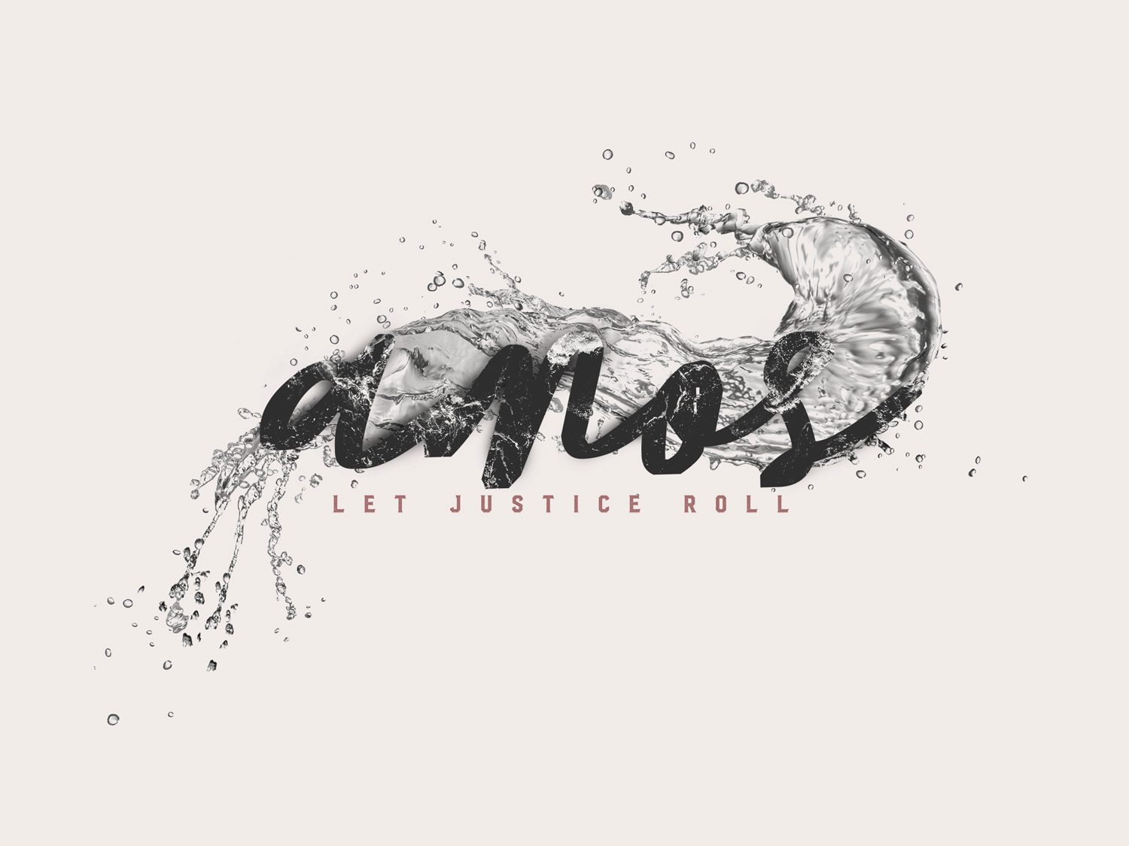

Slide 2
Getting to know Amos
A prophet from Tekoa (1:1)
Prior to prophesying, he was a shepherd and dresser of sycamore figs (7:14)
Prophesied to Israel during the days of Jeroboam II (around 750 B.C.)

Slide 3
Israel during the time of Amos
Lived in peace and prosperity
A spiritual wreck
3:10 – “they do not know how to do right.”
Full of injustice (5:11-12)
Full of Pride (6:4-6)
Full of hypocritical and idolatrous worship (5:21-27)

Slide 4
The fate of Israel
God would bring judgment by way of the Assyrians.
Amos 6:7
Therefore they shall now be the first of those who go into exile, and the revelry of those who stretch themselves out shall pass away.”

Slide 5
Getting to know Amos
A prophet from Tekoa (1:1)
Prior to prophesying, he was a shepherd and dresser of sycamore figs (7:14)
Prophesied to Israel during the days of Jeroboam II (around 750 B.C.)
A blunt speaker (4:1-2; 7:17)

Slide 6
Amos the Book
Chapters 1-2 – Judgements on Israel’s neighbors
Chapters 3-6 – Speeches focused on Israel’s sin and impending judgement.
Chapters 7-9 – Visions about Israel and a message of hope.

Slide 7
Amos the Book
Chapters 1-2 – Judgements on Israel’s neighbors
“for three transgressions and for four…”
God is concerned about all people.
Israel is the focal point of these nations.

Slide 8
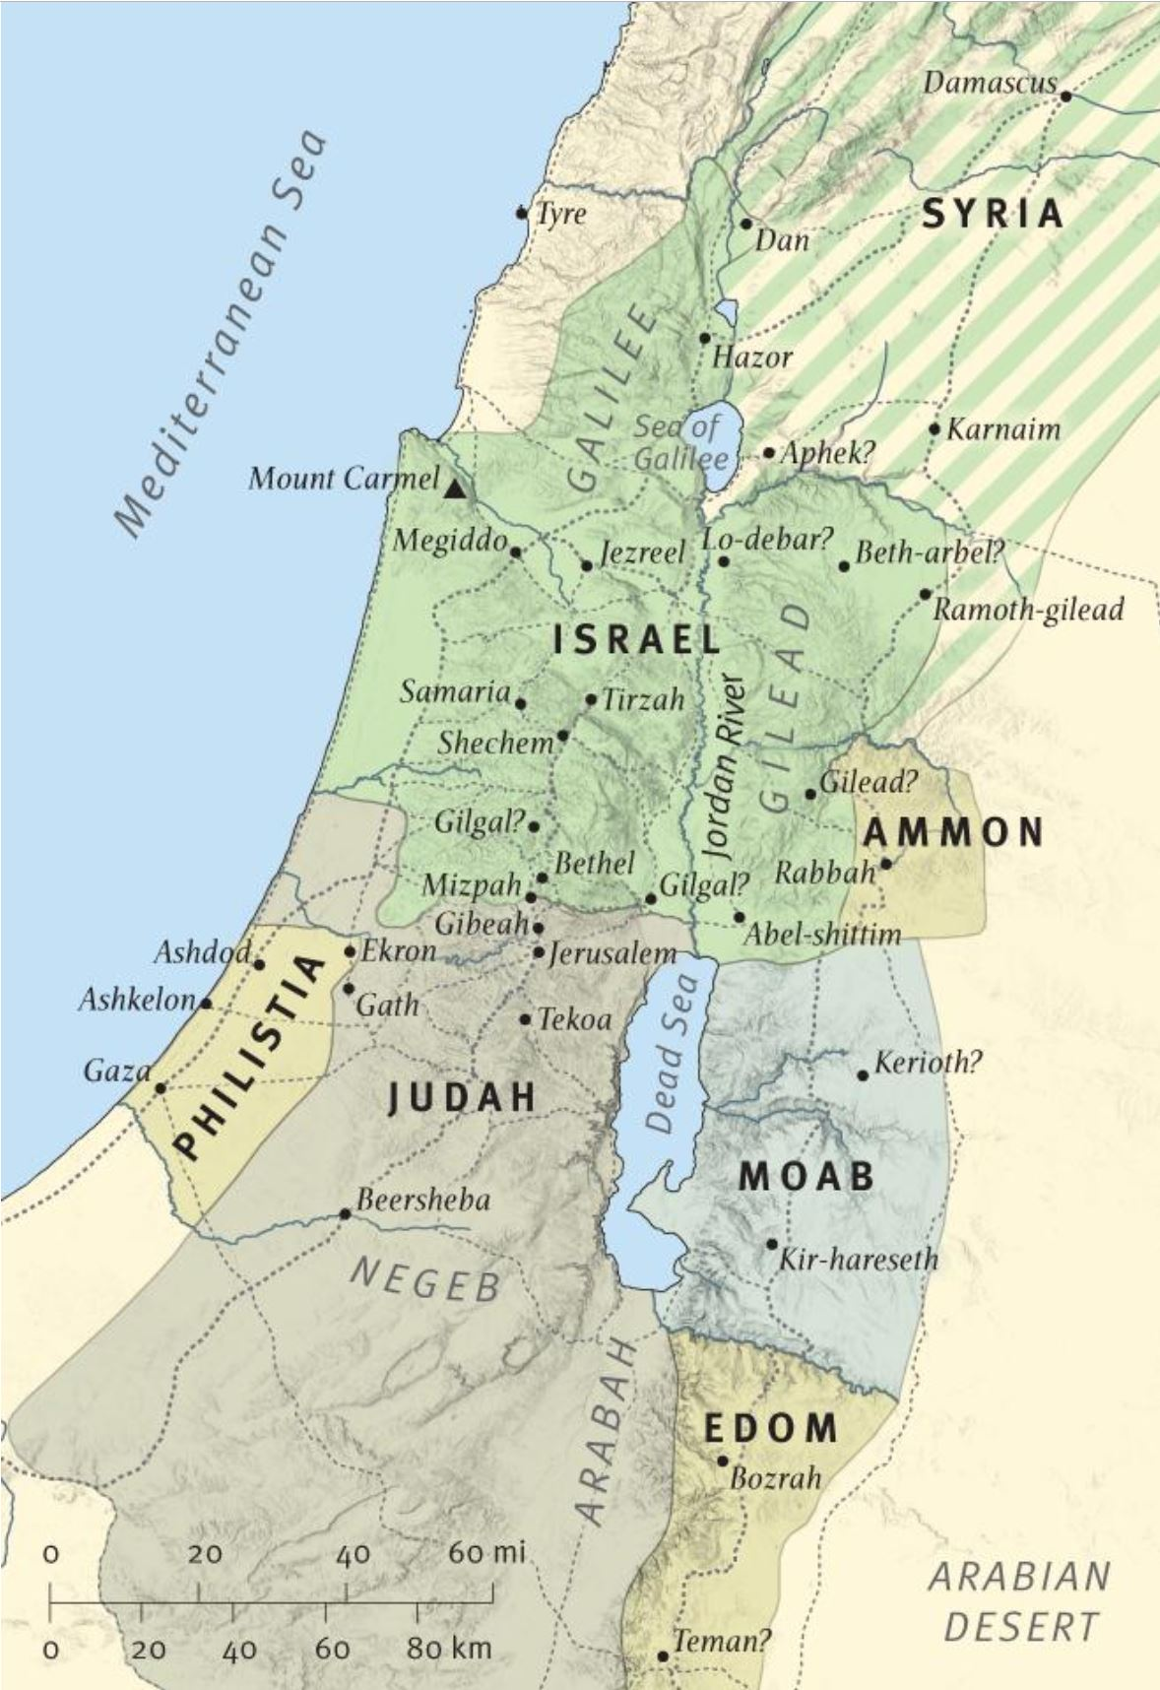

Slide 9
Amos the Book
Chapters 3-6 – Speeches focused on Israel’s sin and impending judgement.
They were God’s chosen people (3:1-2), but failed to live up to their calling.
Turned to false gods (5:5. 25-27)

Slide 10
Amos the Book
Chapters 7-9 – Visions of judgement and a message of hope.
Swarm of locust (7:1-5)
Consuming fire (7:4-6)
Plumb line (7:7-9)
Summer fruit (8:1-2)

Slide 11
Amos the Book
Chapters 7-9 – Visions of judgement and a message of hope.
They’d heard enough! (7:12-13)
A silver lining (9:8, 11-15)
A remnant would remain (8)
the house of David would be restored (the Messiah would come)
Gentiles would be called by God
(see Acts 15:15-17)

Slide 12
Seek the Lord and Live!
(Amos 5:4, 6)

