Slide 2
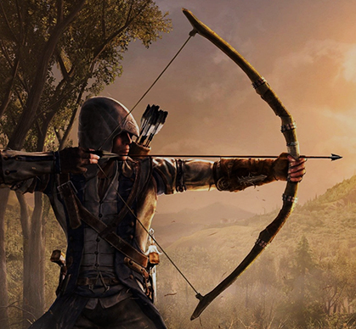
Arrows In The Hand Of A Warrior

Slide 3
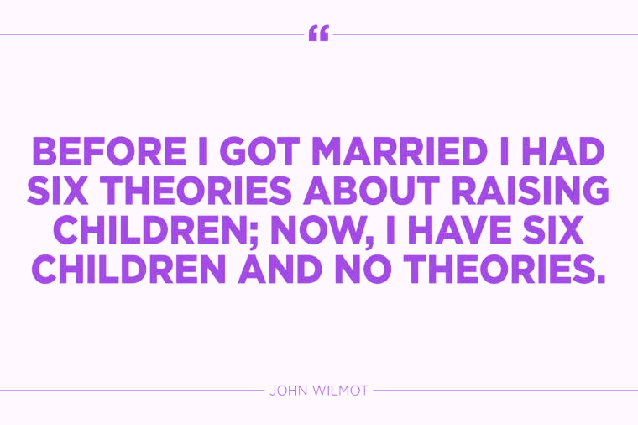

Slide 4
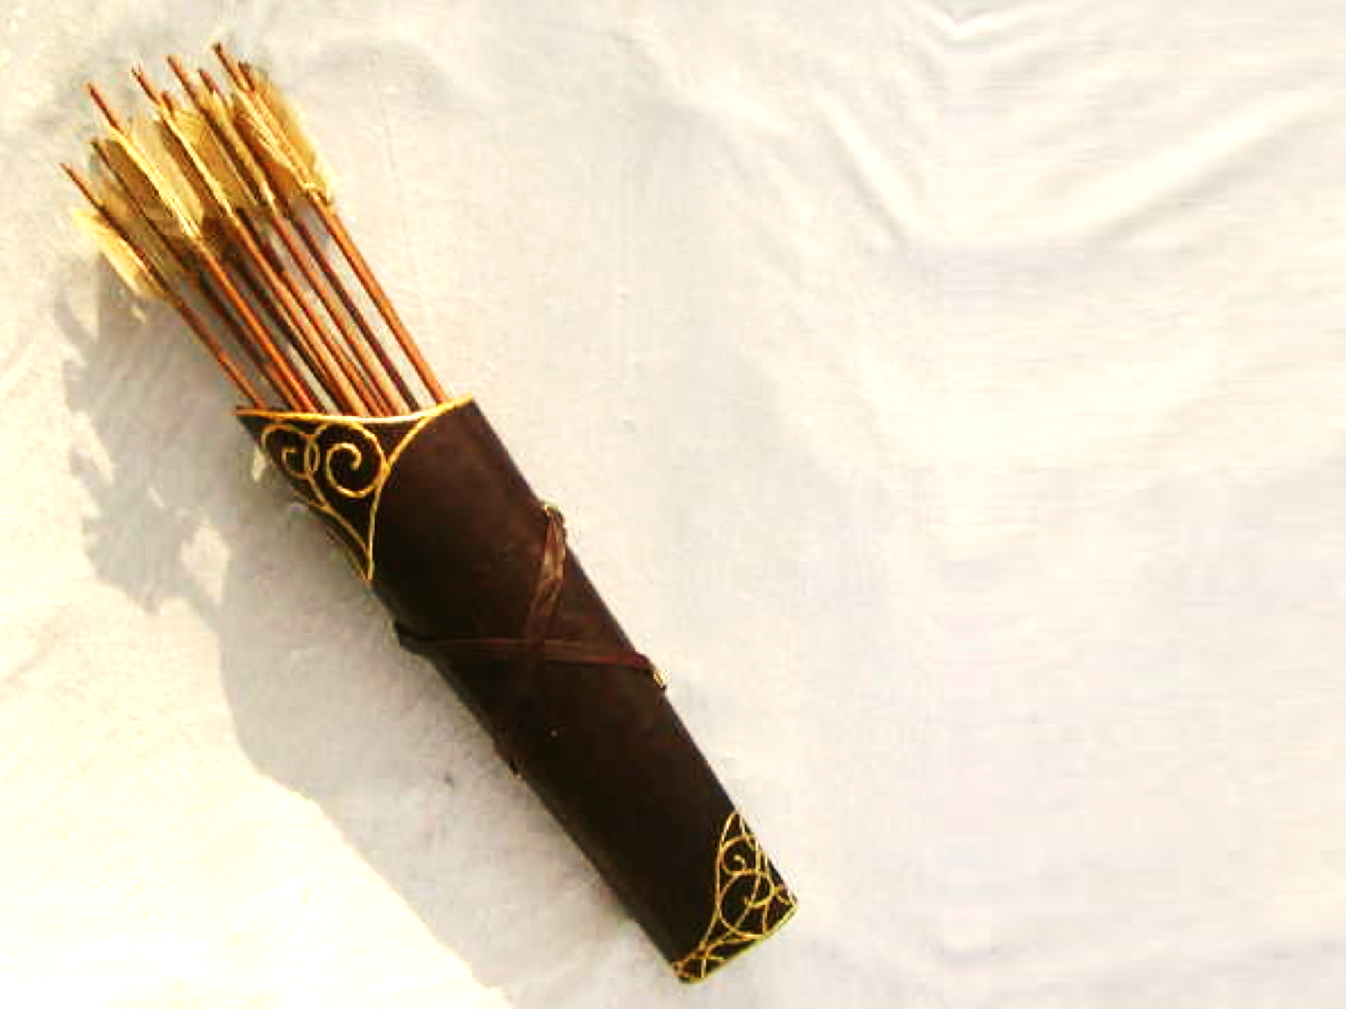
Children are a gift from the Lord; they are a reward from him. Children born to a young man are like arrows in a warrior’s hands. How joyful is the man whose quiver is full of them!

Slide 5
All are similar…
All are intended for flight
And yet different

Slide 6
You are our epistle written in our hearts, known by all men.
2 Corinthians 3:2

Slide 7
Arrows In A Warrior’s Hand
Nock
Fletching
Shaft
Arrowhead
The Structure Of An Arrow

Slide 8
Arrows In A Warrior’s Hand
Character
Relationships
Identity
Mission or Goal
Arrows & Our Children

Slide 9
Thought
Destiny
Sowing
&
Reaping
Action
Character
Habit

Slide 10
Identity
Psalm 139:14
I praise you, for I am fearfully and wonderfully made. Wonderful are your works; my soul knows it very well.
Arrows In A Warrior’s Hand

Slide 11
Identity
Genesis 1:27
So God created mankind in his own image, in the image of God he created them; male and female he created them.
Arrows In A Warrior’s Hand

Slide 12
Identity
Psalm 139:14
Your children have intrinsic value
Arrows In A Warrior’s Hand

Slide 13
Character
Proverbs 1:10-16
My child, if sinners entice you, turn your back on them! They may say, “Come and join us… Think of the great things we’ll get! We’ll fill our houses with all the stuff we take. Come, throw in your lot with us; we’ll all share the loot.” My child, don’t go along with them! Stay far away from their paths.
Arrows In A Warrior’s Hand

Slide 14
Character
1 Corinthians 16:13
Be on your guard; stand firm in the faith; be courageous; be strong.
Arrows In A Warrior’s Hand

Slide 15
Character
Ephesians 6:10-11
A final word: Be strong in the Lord and in his mighty power. Put on all of God's armor so that you will be able to stand firm against all strategies of the devil.
Arrows In A Warrior’s Hand

Slide 16
Character
Proverbs 1:10-16
Don’t be afraid to go against the flow.
Be alert and well prepared.
Arrows In A Warrior’s Hand

Slide 17
Relationships
Proverbs 3:3, 27-28
Do not withhold good from those who deserve it when it's in your power to help them. If you can help your neighbor now, don't say, "Come back tomorrow, and then I'll help you."
Arrows In A Warrior’s Hand

Slide 18
Relationships
Proverbs 11:25
The generous will prosper; those who refresh others will themselves be refreshed.
Arrows In A Warrior’s Hand

Slide 19
Relationships
Proverbs 11:25
Be Compassionate
Be A Servant
Be Generous
Arrows In A Warrior’s Hand

Slide 20
Mission
Philippians 3:13-15
Brothers, I do not consider that I have made it my own. But one thing I do: forgetting what lies behind and straining forward to what lies ahead, I press on toward the goal for the prize of the upward call of God in Christ Jesus. Let those of us who are mature think this way,
Arrows In A Warrior’s Hand

Slide 21
Mission
Philippians 1:20
For I fully expect and hope that I will never be ashamed, but that I will continue to be bold for Christ, as I have been in the past. And I trust that my life will bring honor to Christ, whether I live or die.
Arrows In A Warrior’s Hand

Slide 22
Mission
Philippians 1:20
Have worthy goals
Plan to stick with them
Arrows In A Warrior’s Hand

Slide 24
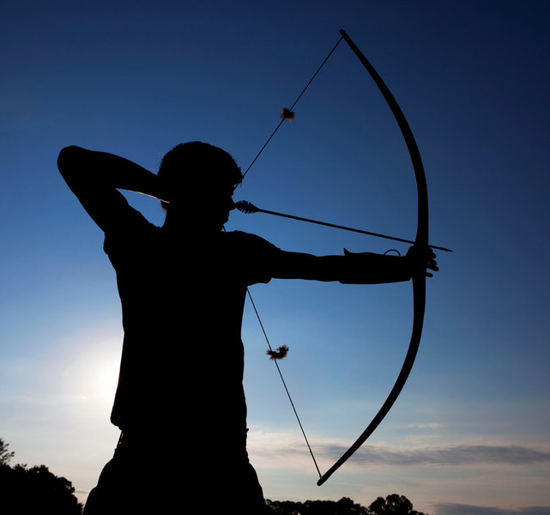
Arrows In The Hand Of A Warrior

Slide 25
What They Need To See In Us…
Our Identity
See what great love the Father has lavished on us, that we should be called children of God! And that is what we are!
1 John 3:1-2

Slide 26
What They Need To See In Us…
Our Identity
Blessed are the poor in spirit, for theirs is the kingdom of heaven.
Blessed are those who mourn, for they shall be comforted.

Slide 27
What They Need To See In Us…
Our Identity
I am a child of God
Forgiven & Dependent
I am a husband or wife
I am a father or mother

Slide 28
What They Need To See In Us…
Our Character
Blessed are the meek, for they shall inherit the earth.
Blessed are those who hunger and thirst for righteousness, for they shall be satisfied.
Blessed are the pure in heart, for they shall see God.

Slide 29
What They Need To See In Us…
Our Character
Meekness – bridled strength, control, gentleness with strength
Avoiding an issue? That’s not meek.
Demanding your way? That’s not meek.
Afraid to rock the boat? That’s not meek.
Trying to win the fight? That’s not meek

Slide 30
What They Need To See In Us…
Our Character
Hungering & Thirsting
Praying, Studying, Worshipping
Honesty & integrity
Respect for authority
Pure – Cleansed, Not mixed, Loyal
What we watch – What we say
Set Boundaries

Slide 31
What They Need To See In Us…
Our Character
For we know that our old self was crucified with him so that the body ruled by sin might be done away with, that we should no longer be slaves to sin.
Romans 6:6

Slide 32
What They Need To See In Us…
Our Character
Since, then, you have been raised with Christ, set your hearts on things above, where Christ is, seated at the right hand of God. Set your minds on things above, not on earthly things. For you died, and your life is now hidden with Christ in God.
Colossians 3:1-3

Slide 33
What They Need To See In Us…
Our Relationships
Blessed are the merciful, for they shall see mercy.
Blessed are the peacemakers, for they shall be called sons of God.

Slide 34
What They Need To See In Us…
Our Relationships
Both traits are actions not feelings
Mercy says, “I forgive you”
Peacemaking seeks ways to bring healing
Both value relationships over rights

Slide 35
What They Need To See In Us…
Our Relationships
Make allowance for each other’s faults, and forgive anyone who offends you. Remember, the Lord forgave you, so you must forgive others.
Colossians 3:13

Slide 36
What They Need To See In Us…
Our Relationships
For all of you who were baptized into Christ have clothed yourselves with Christ. There is neither Jew nor Gentile, neither slave nor free, nor is there male and female, for you are all one in Christ Jesus.
Galatians 3:27-28

Slide 37
What They Need To See In Us…
Our Relationships
Beloved, let us love one another, for love is from God, and whoever loves has been born of God and knows God.
1 John 4:7

Slide 38
What They Need To See In Us…
Our Mission
“Blessed are you when others revile you and persecute you and utter all kinds of evil against you falsely on my account. Rejoice and be glad, for your reward is great in heaven, for so they persecuted the prophets who were before you.”

Slide 39
What They Need To See In Us…
Our Mission
What is our goal in life?
Money
Job
Sports – hobbies
Fame

Slide 40
What They Need To See In Us…
Our Mission
But you are a chosen people, a royal priesthood, a holy nation, God’s special possession, that you may declare the praises of him who called you out of darkness into his wonderful light.
1 Peter 2:9

