Slide 1
Colossians 3:16
Let the word of Christ dwell in you richly, teaching and exhorting one another with all wisdom, singing psalms, hymns, and spiritual songs, all with grace in your hearts to God.

Slide 2
Exalted
“Known before the world; Seen in future days; Glimpsed by righteous men; Son of God. Sent as David’s heir; Named an ageless king; Granted all the earth.”
Jesus was with the Father from the beginning
John 1:1-3,14, Genesis 1:26
The life of Jesus was foretold by prophets
Isaiah 7:14, Isaiah 53, Jeremiah 23:5
All power and authority was given to Him
Ephesians 1:20-21, John 17:1-2

Slide 3
Exalted
“Seen with blinded eyes; Heard by heedless ears; Met with wicked hearts; Son of God. Worshipped with contempt; Crowned with blood and thorns; Throned upon a cross.”
The Jews rejected Jesus, failing to recognize Him as the Messiah
Mark 12:10, Acts 4:11
Jesus was “worshipped” and mocked as King of the Jews
Matthew 27:27-31

Slide 4
Exalted
“Scorned by those who watched; Mocked by all the wise; Loved within belief; Son of God. Born to take my death; Slain to give me life; Jesus, Son of God.”
Jesus was mercilessly mocked
Mark 15:29-32
Jesus died in our place
Romans 5:8

Slide 5
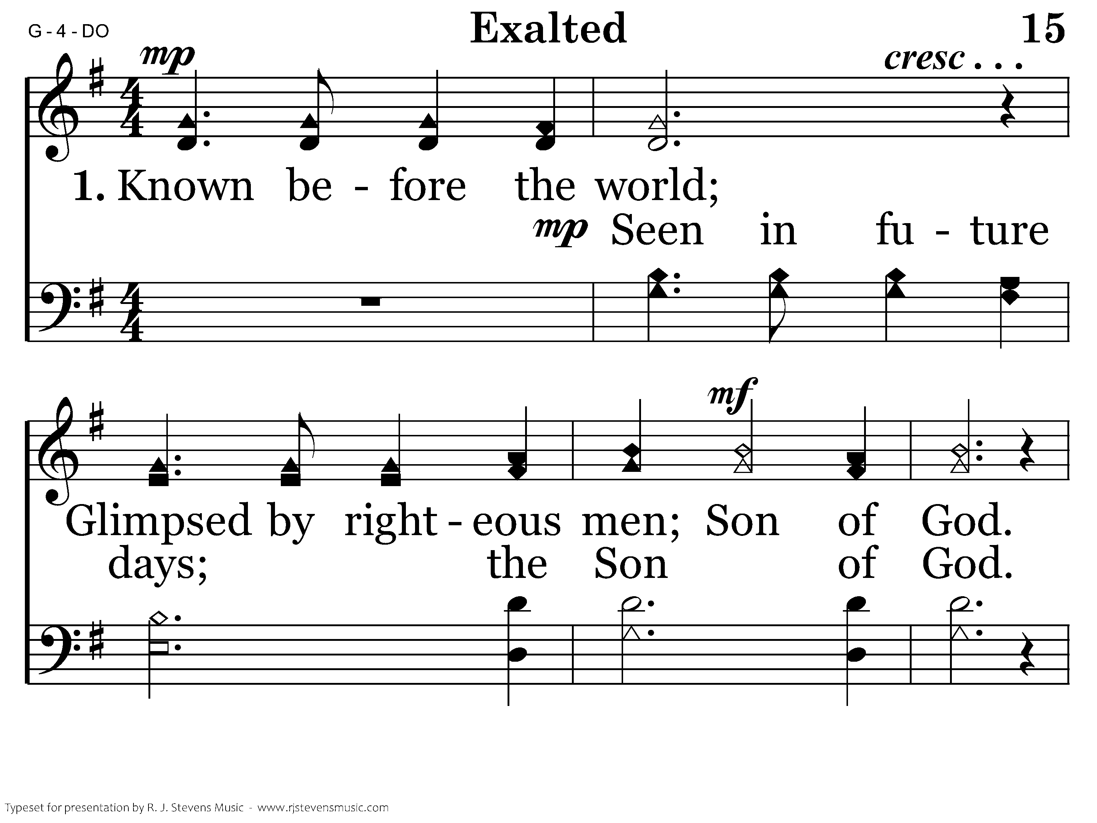
1015 - Exalted - 1.1

Slide 6
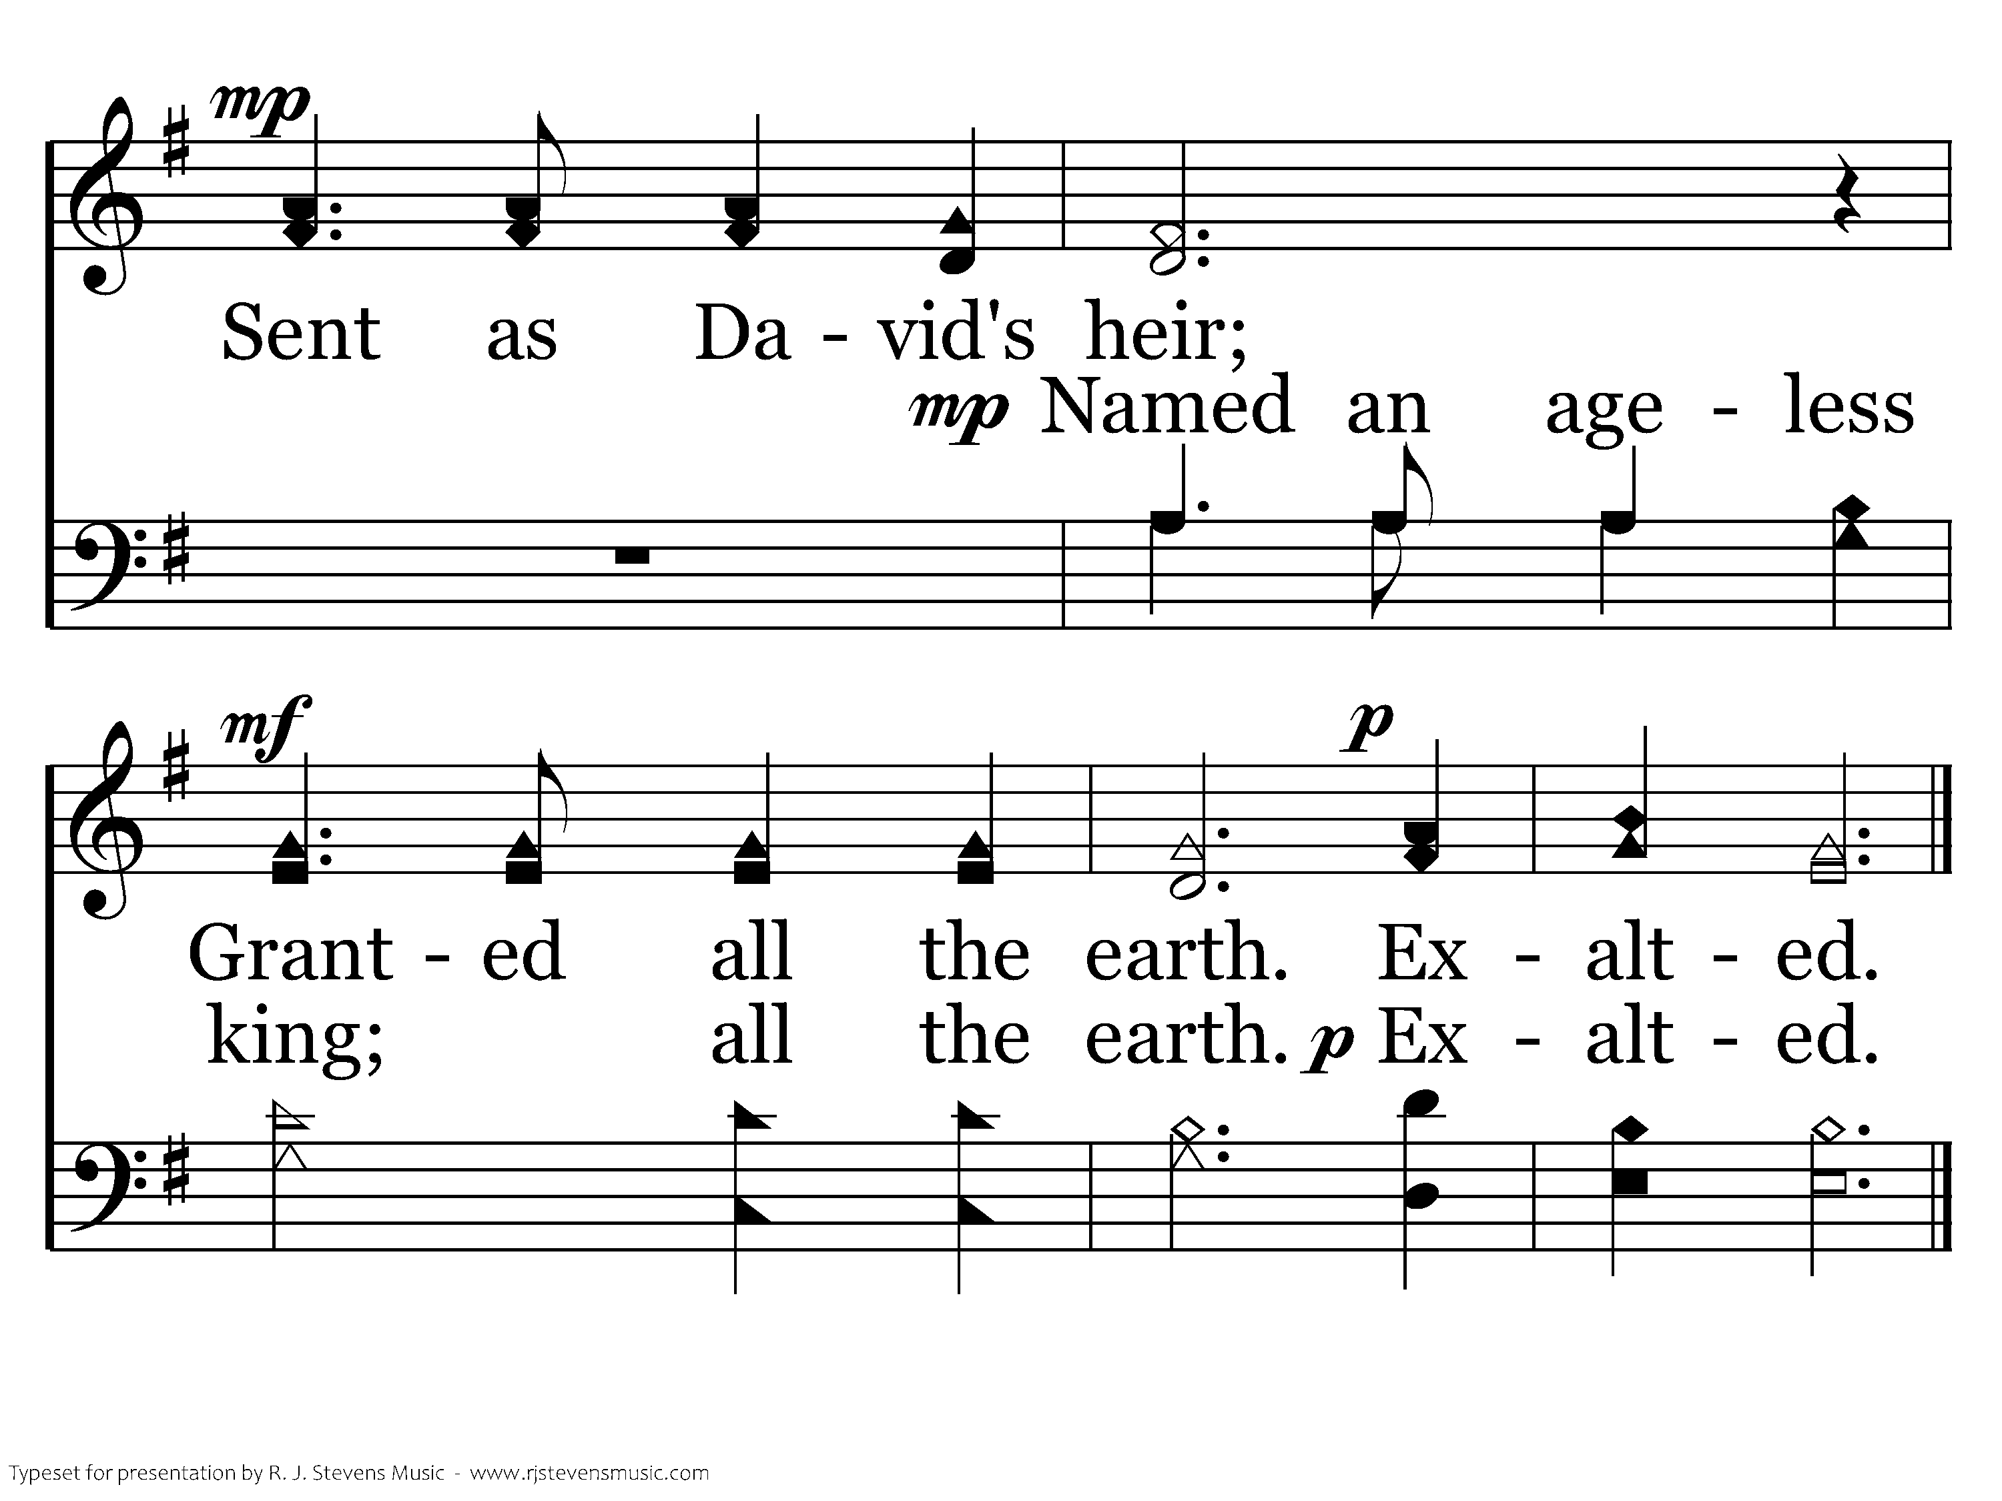
1015 - Exalted - 1.2
End of Verse 1

Slide 7
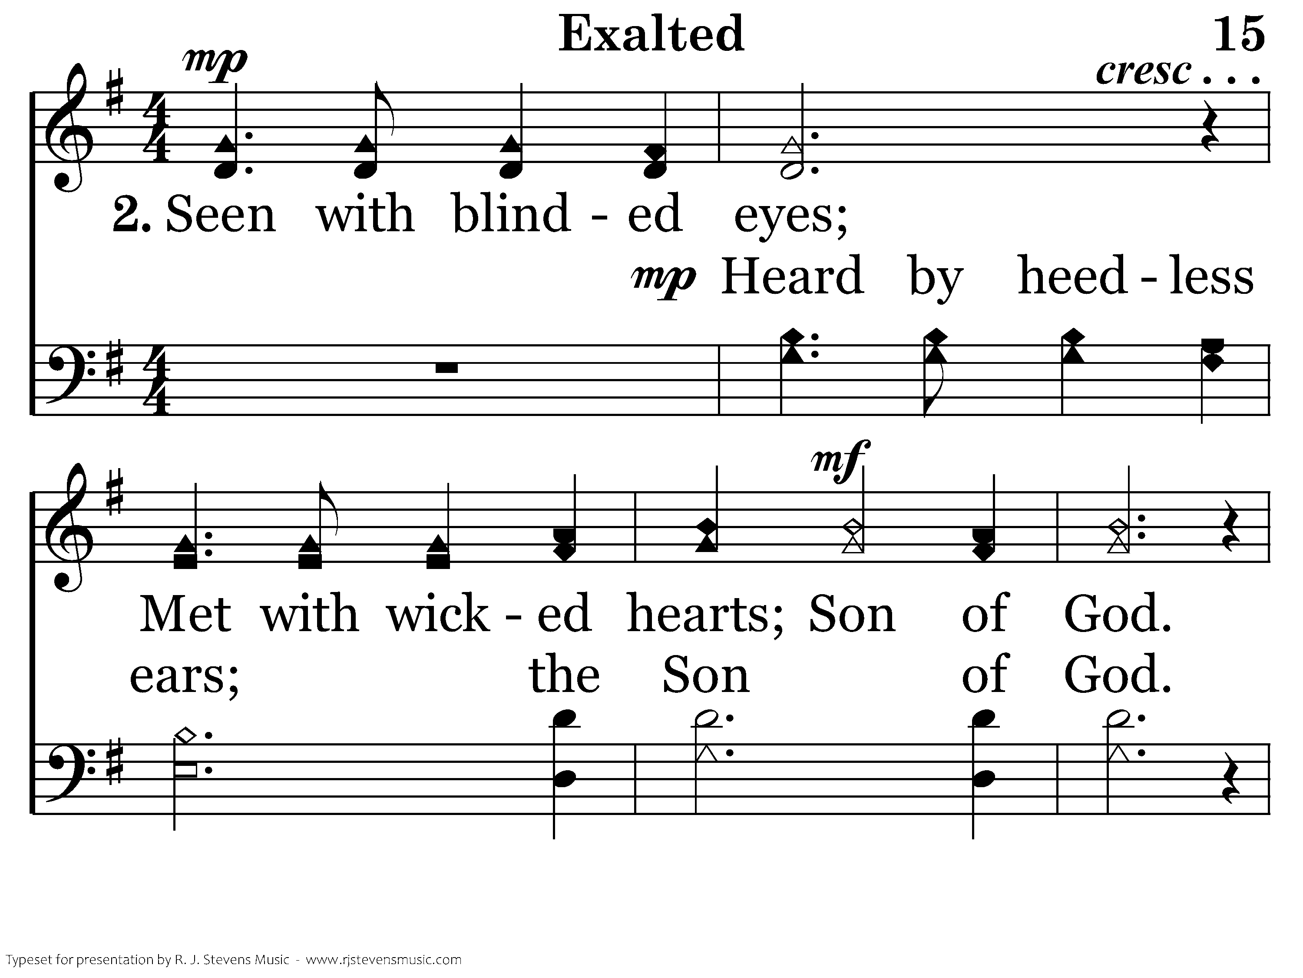
1015 - Exalted - 2.1

Slide 8
1015 - Exalted - 2.2
End of Verse 2

Slide 9
1015 - Exalted - 3.1

Slide 10
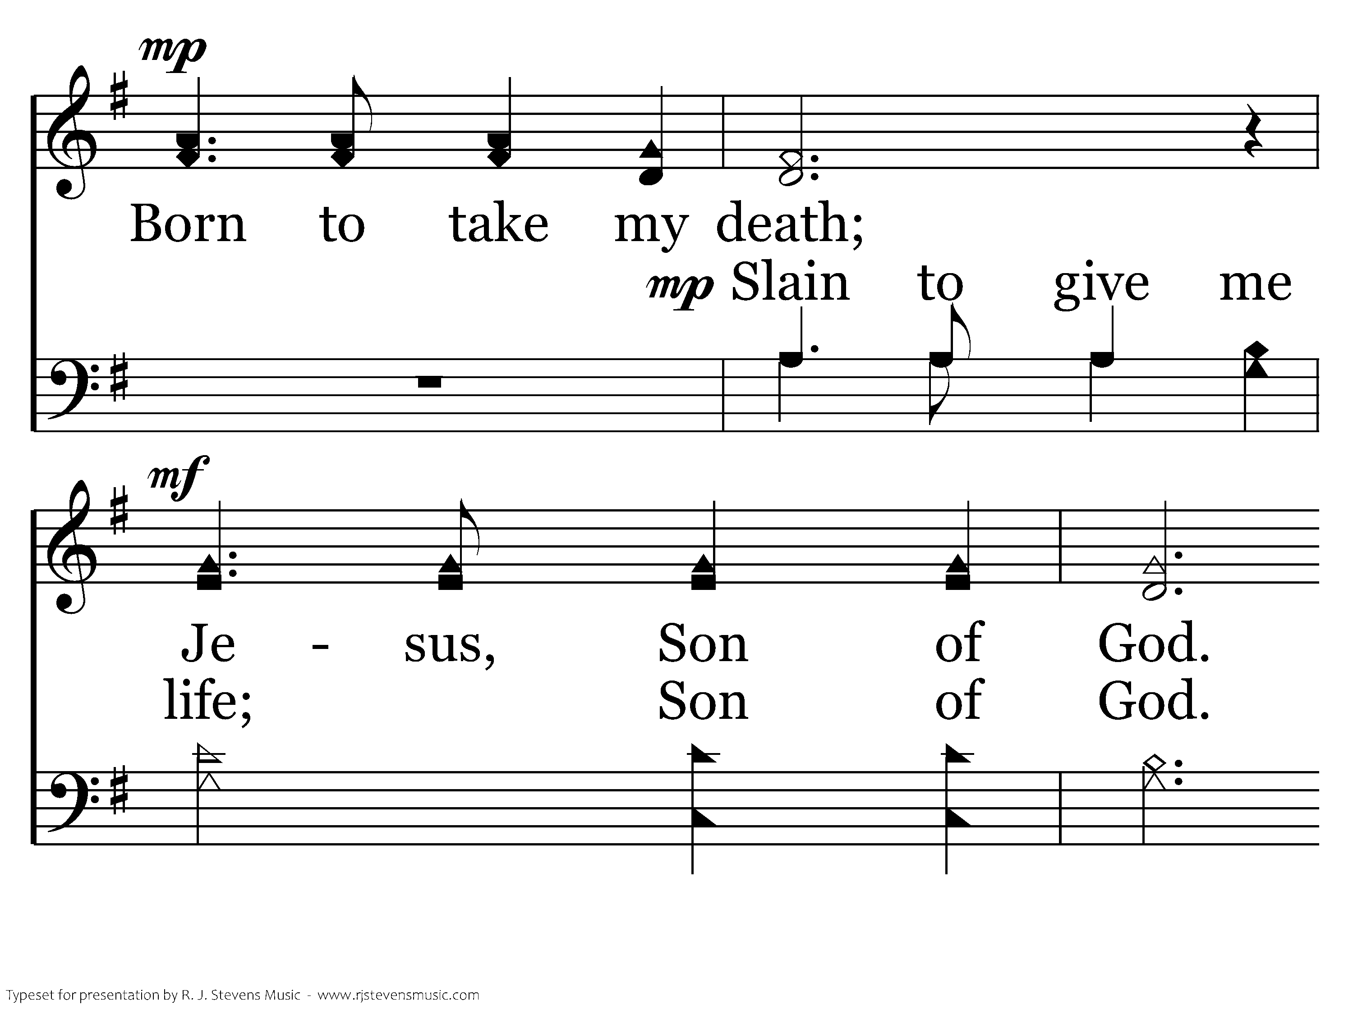
1015 - Exalted - 3.2

Slide 11
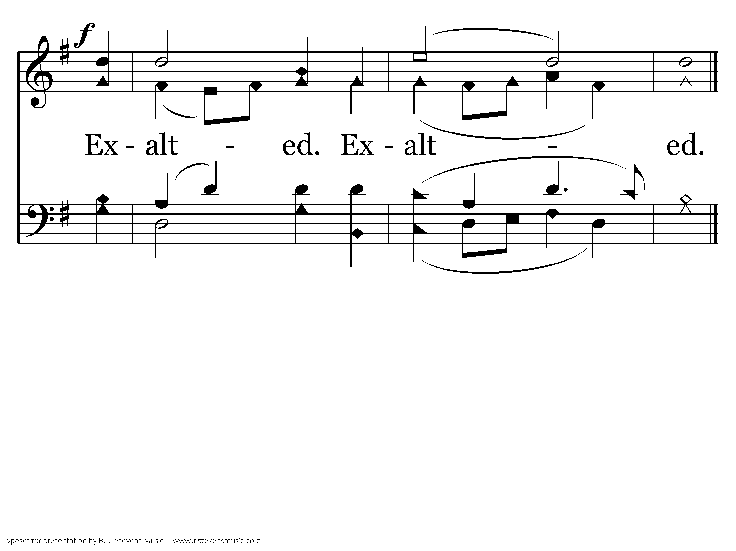
1015 - Exalted - 3.3
End of Song

Slide 12
Be Still My Soul
“Be still, my soul; the Lord is on thy side.”
With God on our side, how can we fail?
Psalm 118:6, Romans 8:31

Slide 13
Be Still My Soul
“Be still, my soul; thy best, thy heavenly Friend thru thorny ways leads to a joyful end.”
“Be still, my soul; when change and tears are past, all safe and blessed, O we shall meet at last.”
Jesus is our best friend because he died for us
John 15:12-14
The godly will suffer trials, but will receive a much greater reward
2 Timothy 3:12, James 1:12

Slide 14
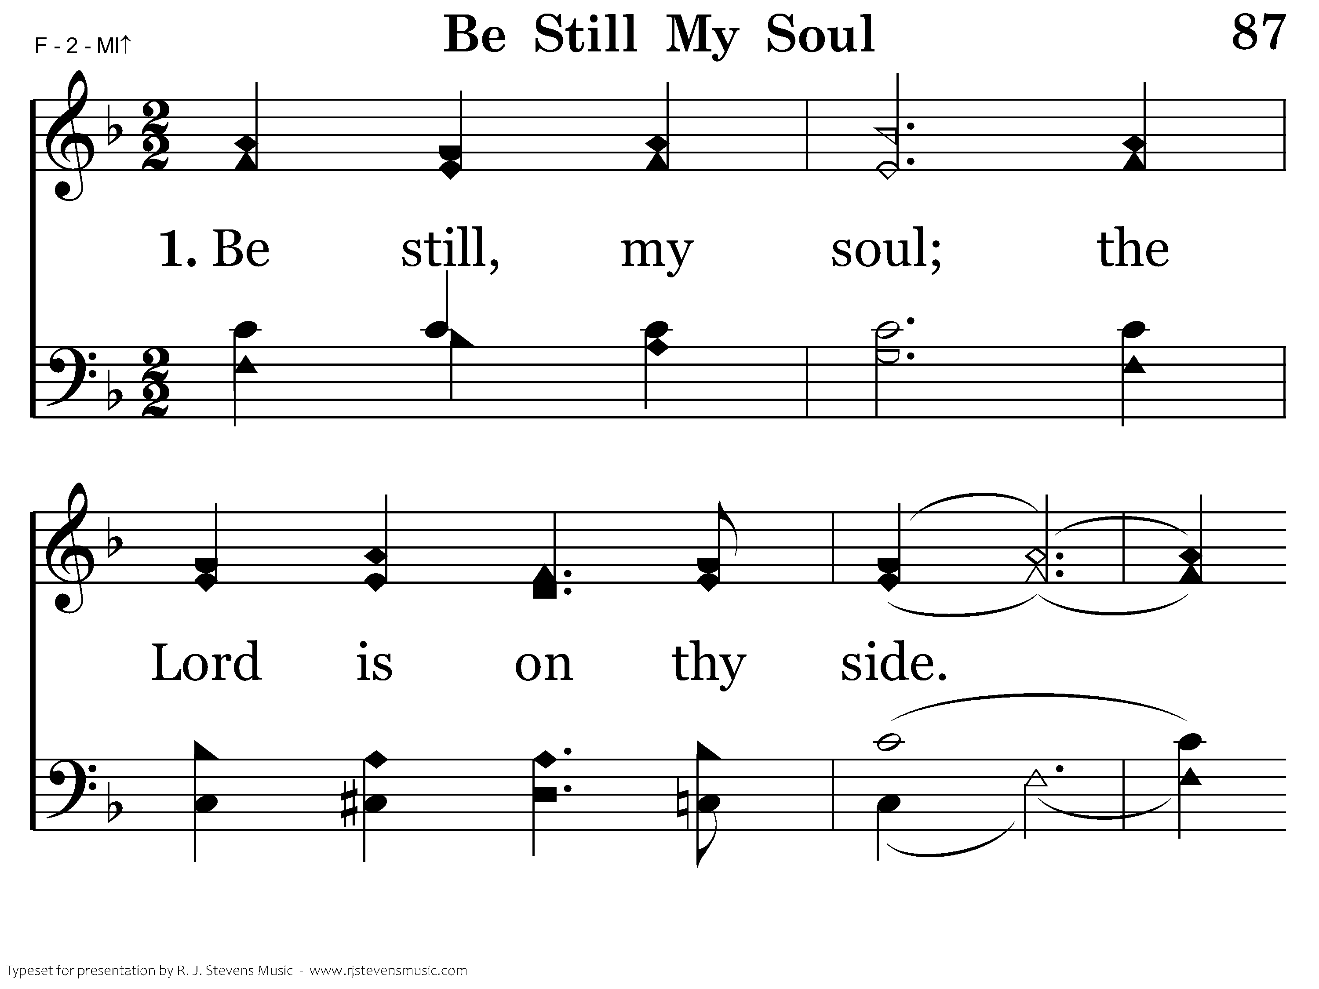
087 - Be Still My Soul - 1.1

Slide 15
087 - Be Still My Soul - 1.2

Slide 16
087 - Be Still My Soul - 1.3

Slide 17
087 - Be Still My Soul - 1.4

Slide 18
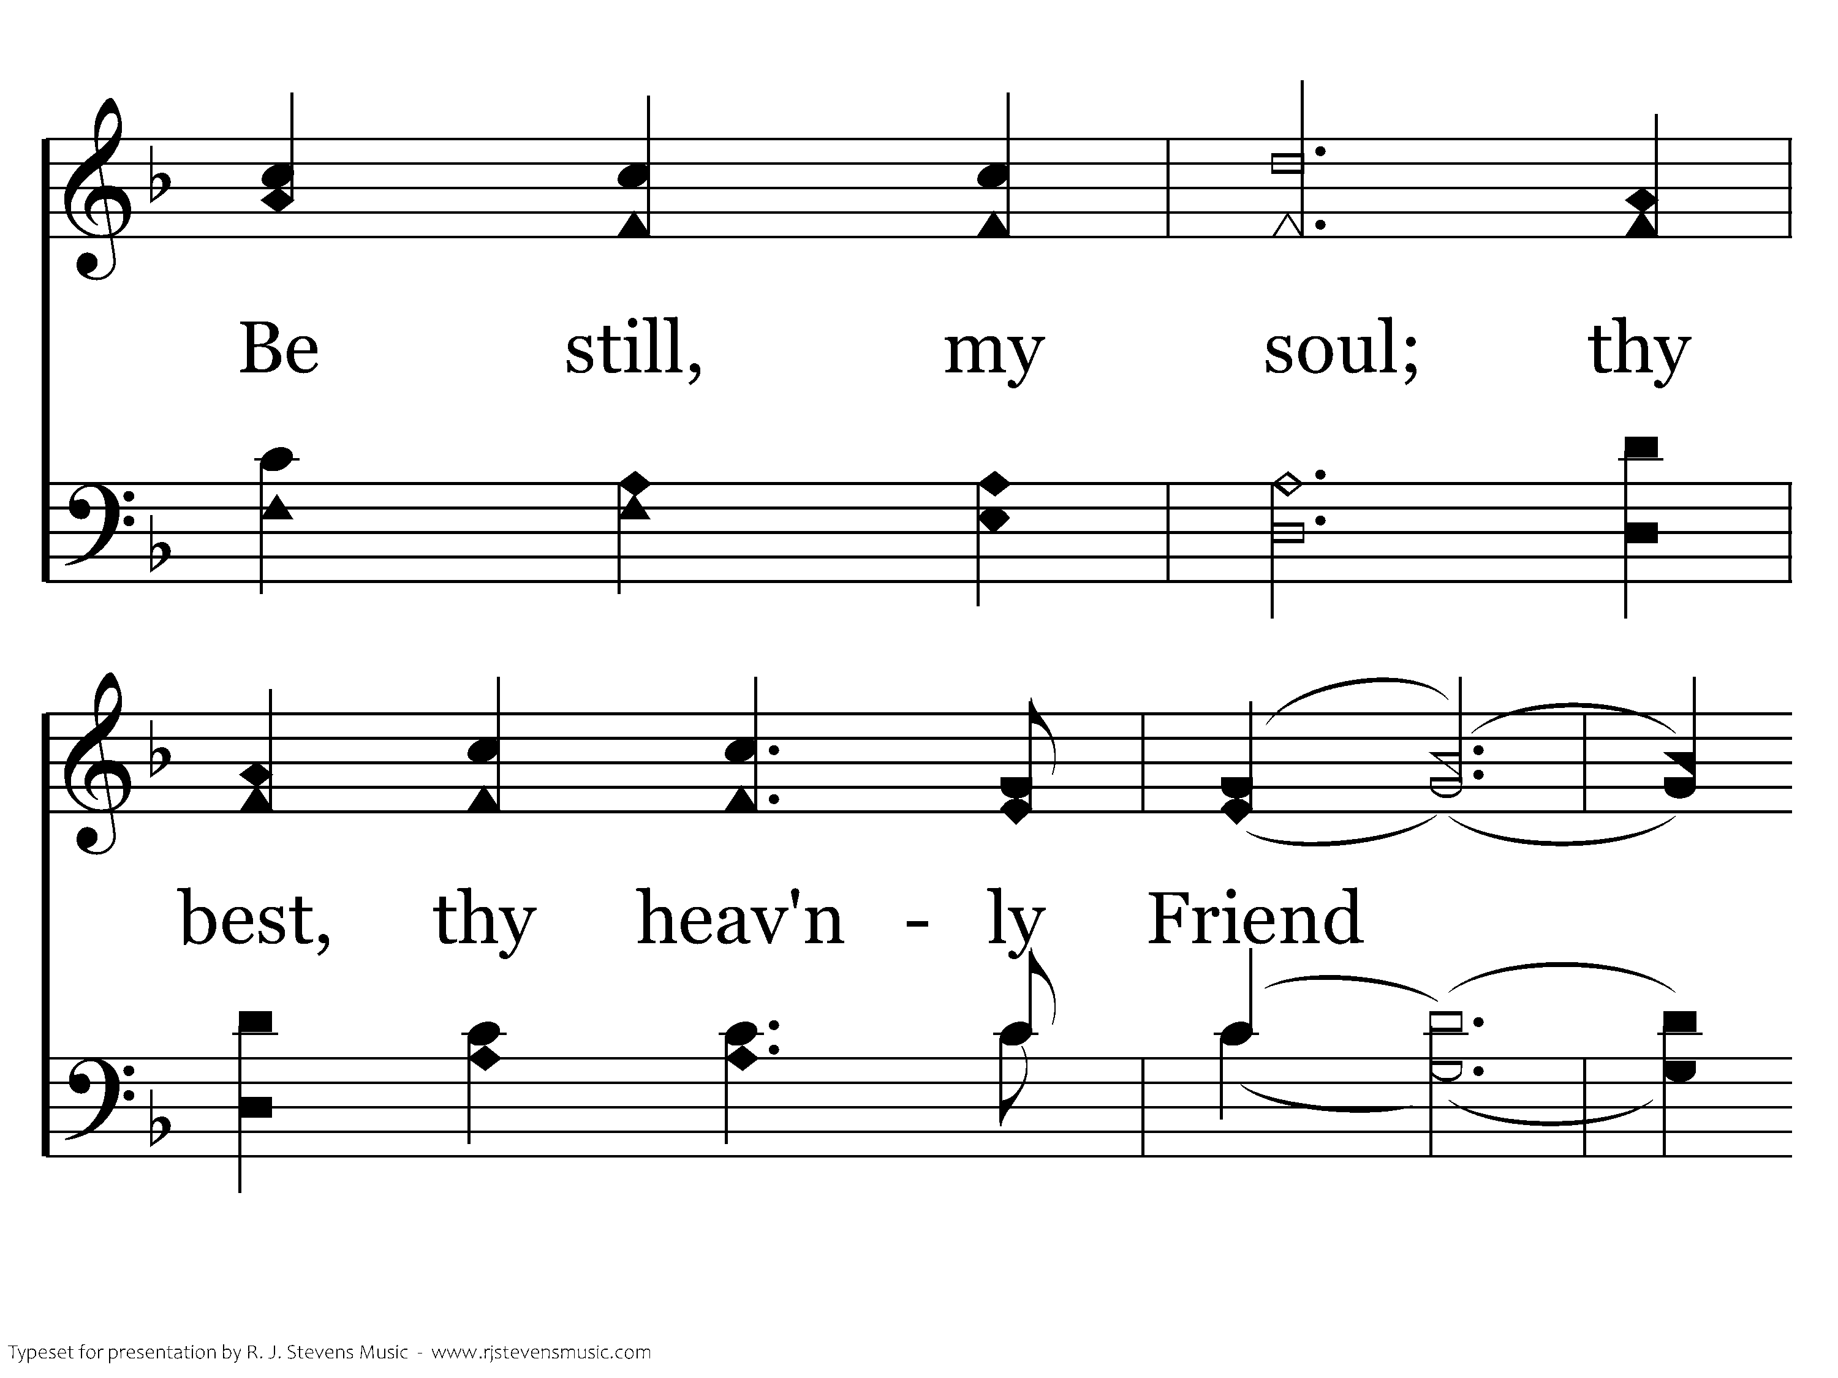
087 - Be Still My Soul - 1.5

Slide 19
087 - Be Still My Soul - 1.6
End of Verse 1

Slide 20
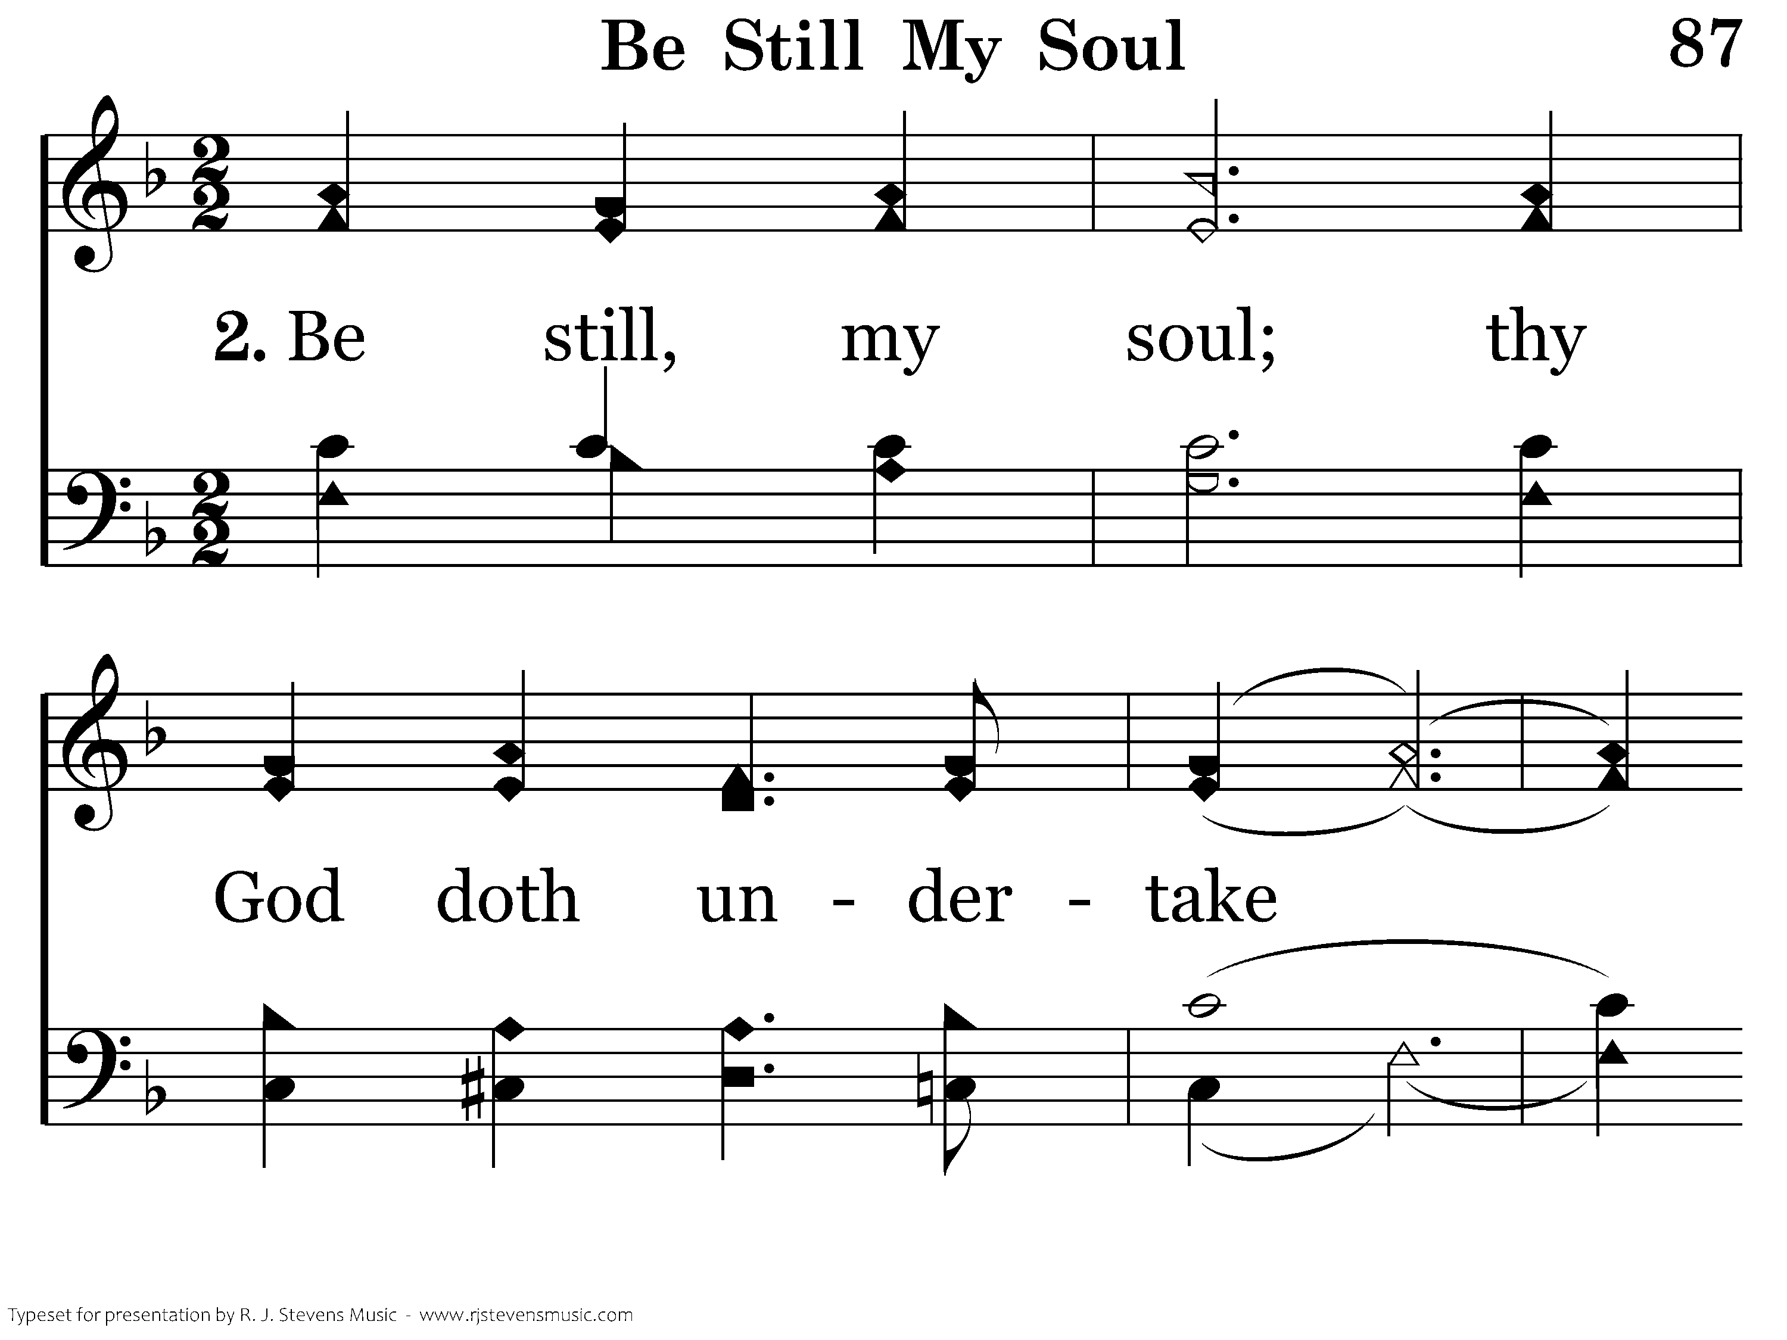
087 - Be Still My Soul - 2.1

Slide 21
087 - Be Still My Soul - 2.2

Slide 22
087 - Be Still My Soul - 2.3

Slide 23
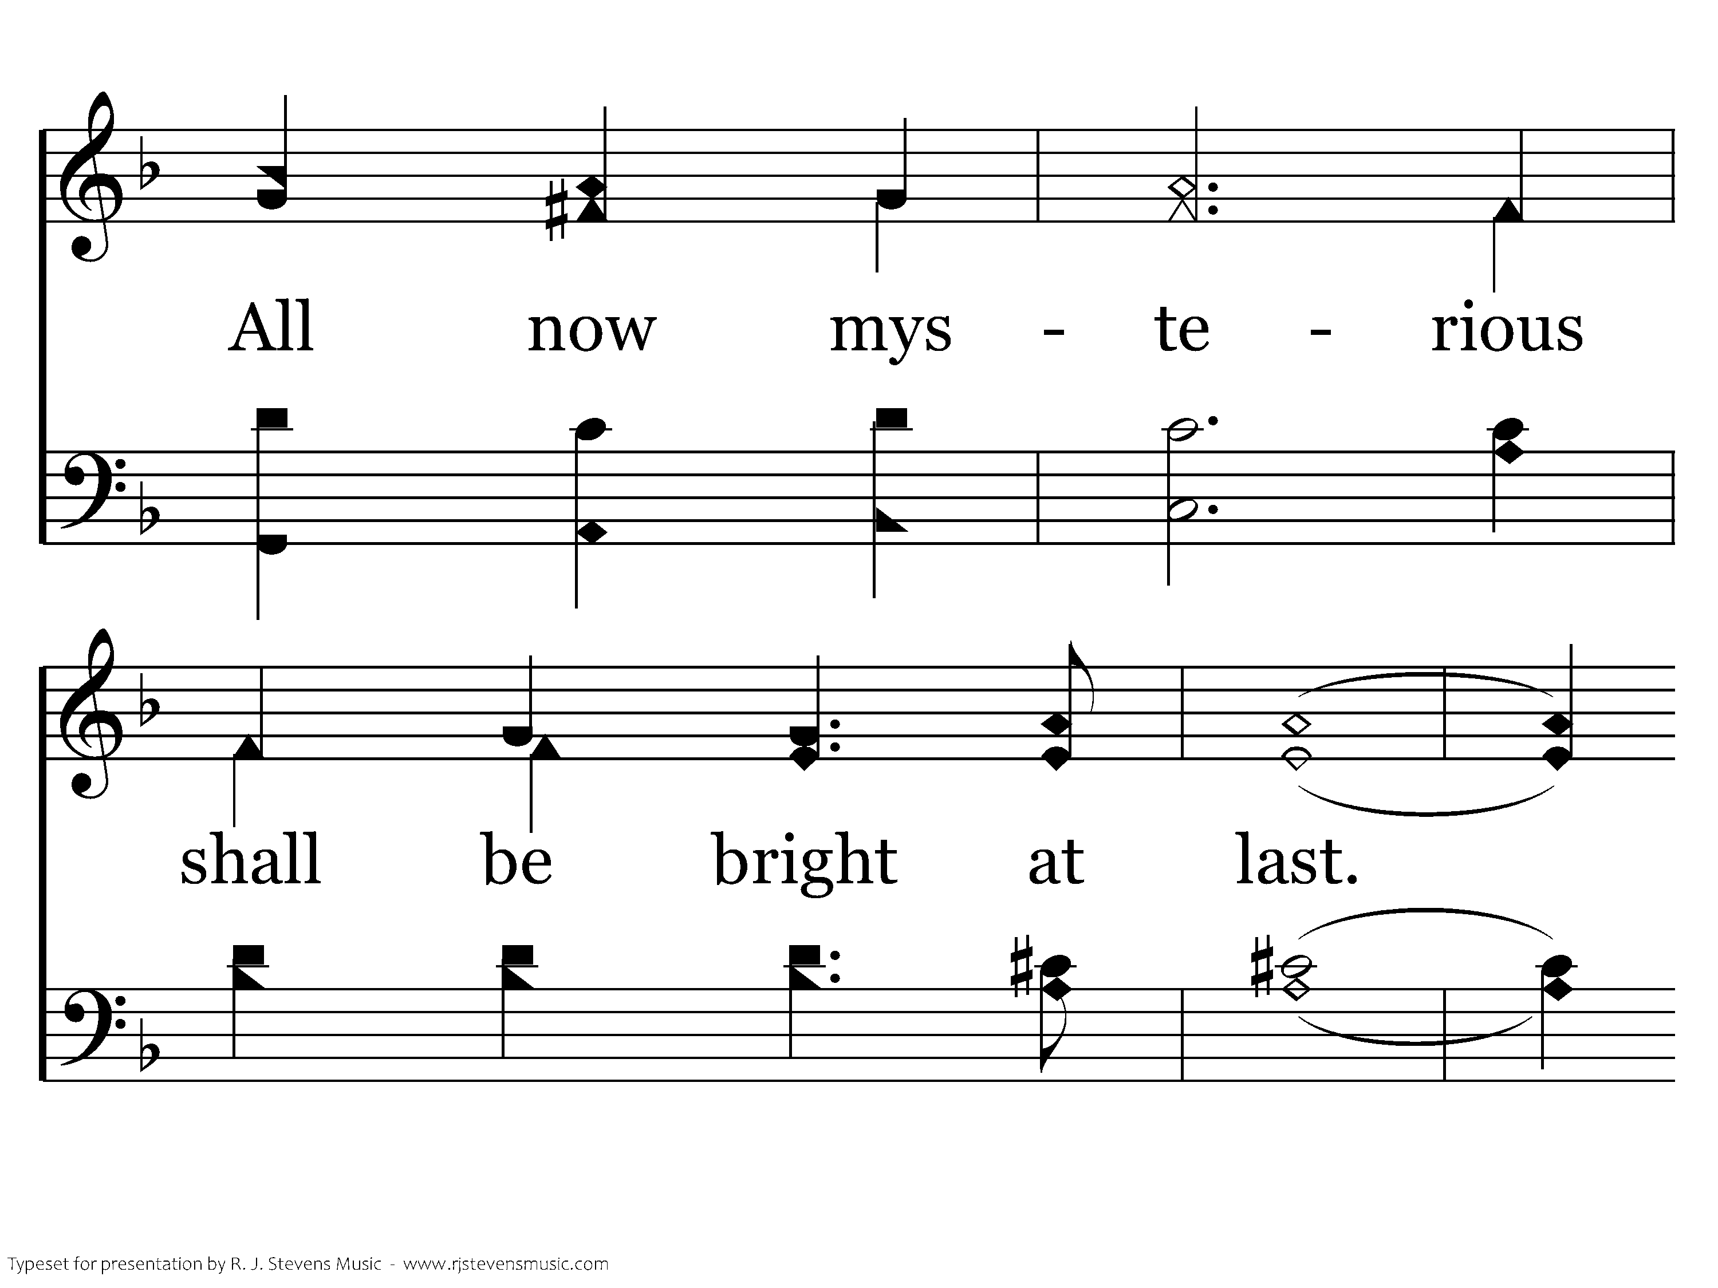
087 - Be Still My Soul - 2.4

Slide 24
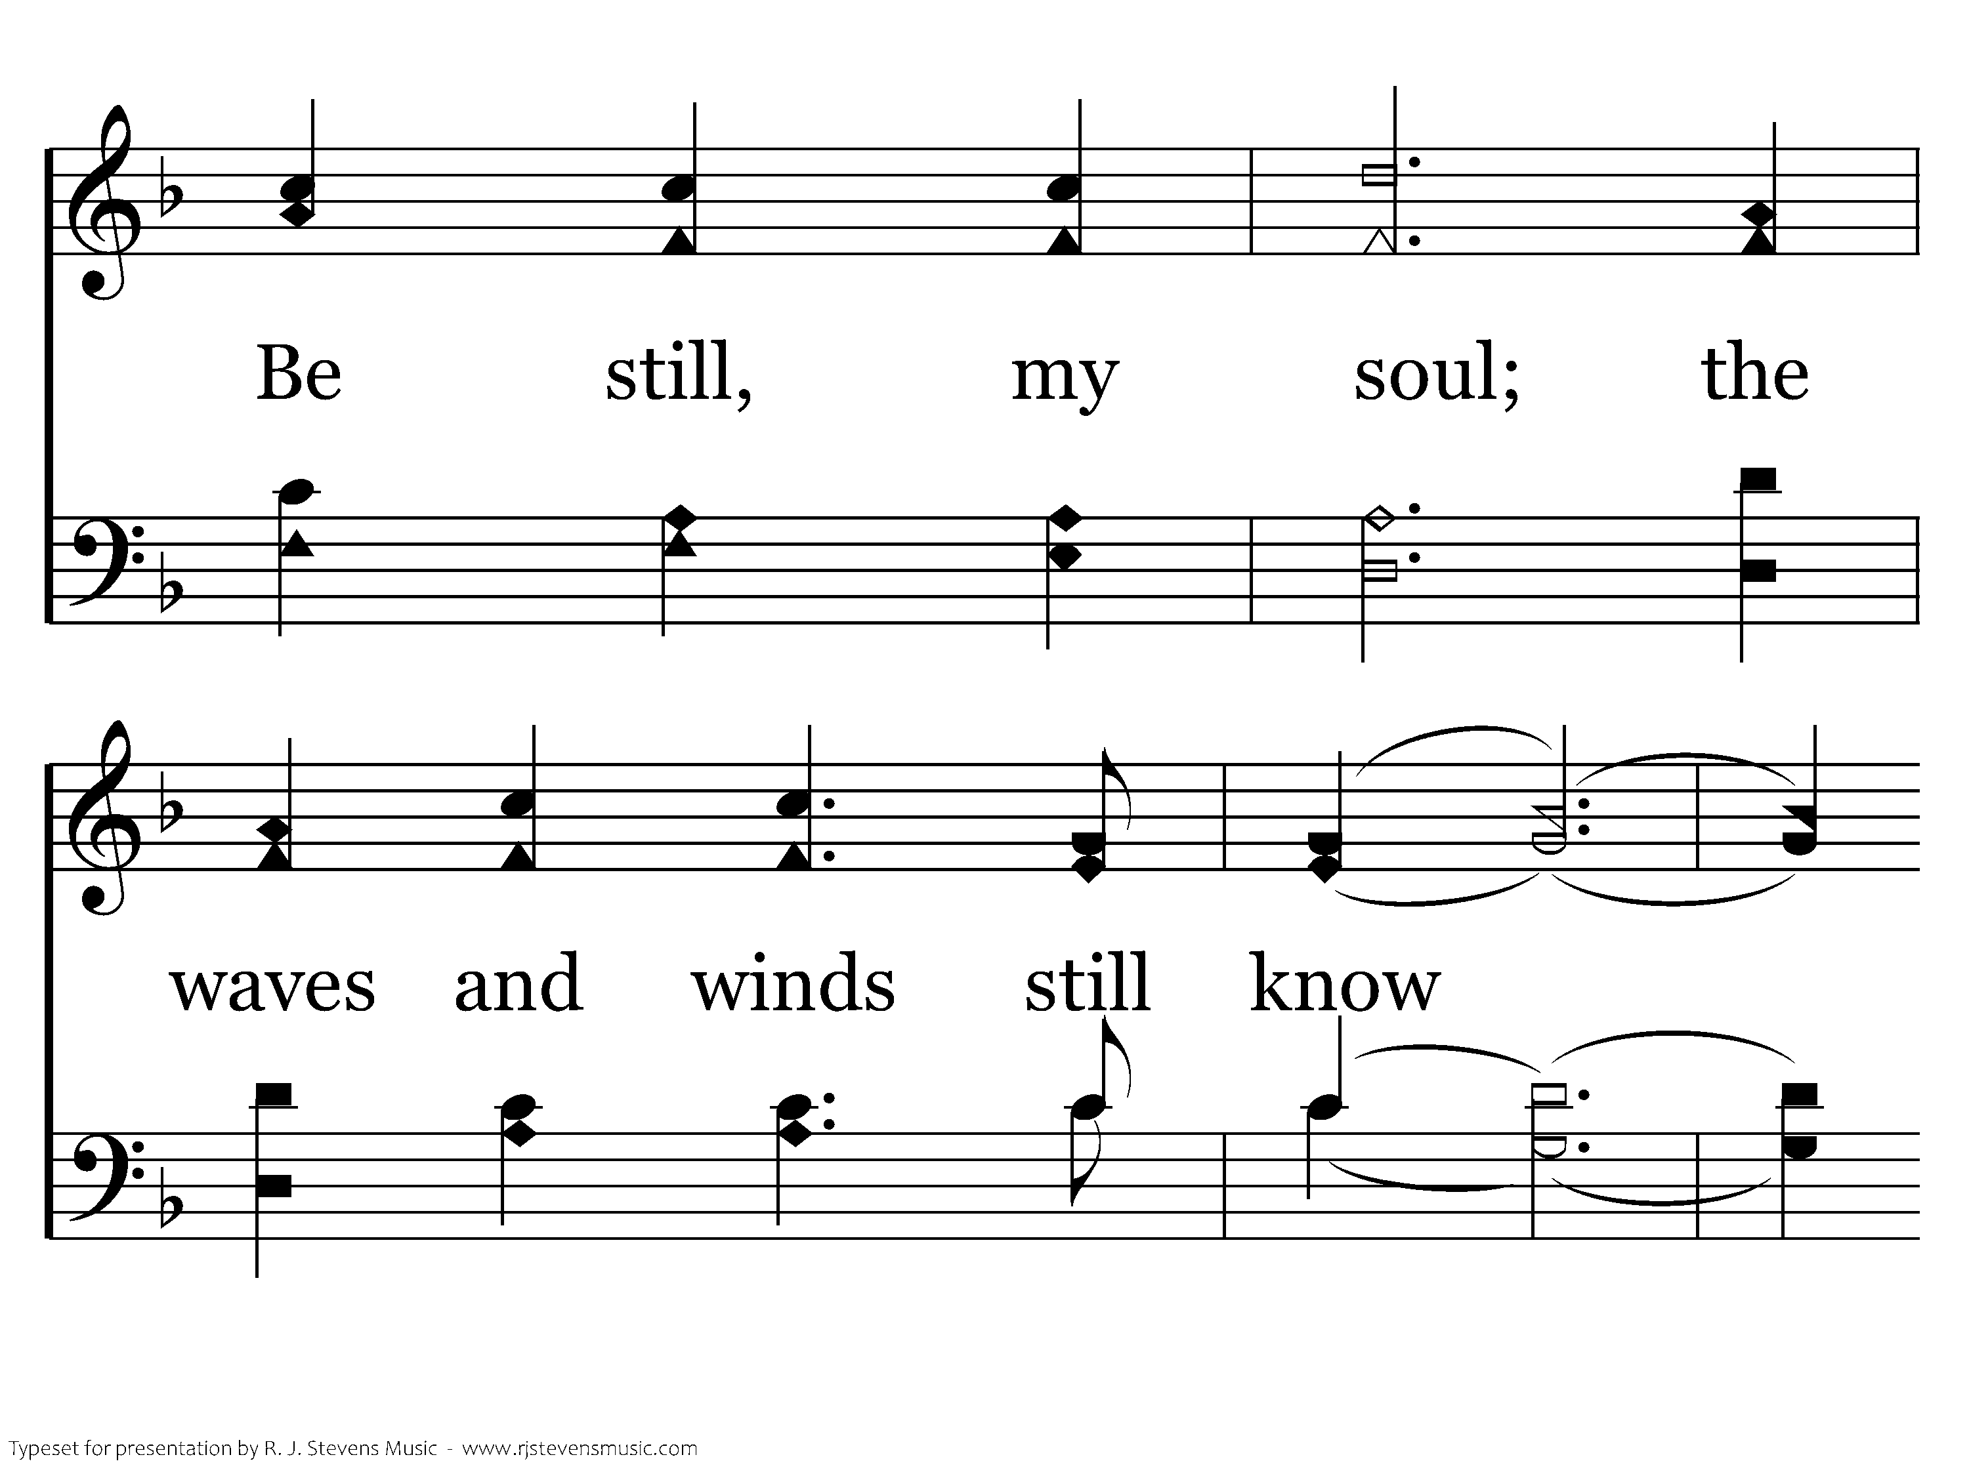
087 - Be Still My Soul - 2.5

Slide 25
087 - Be Still My Soul - 2.6
End of Verse 2

Slide 26
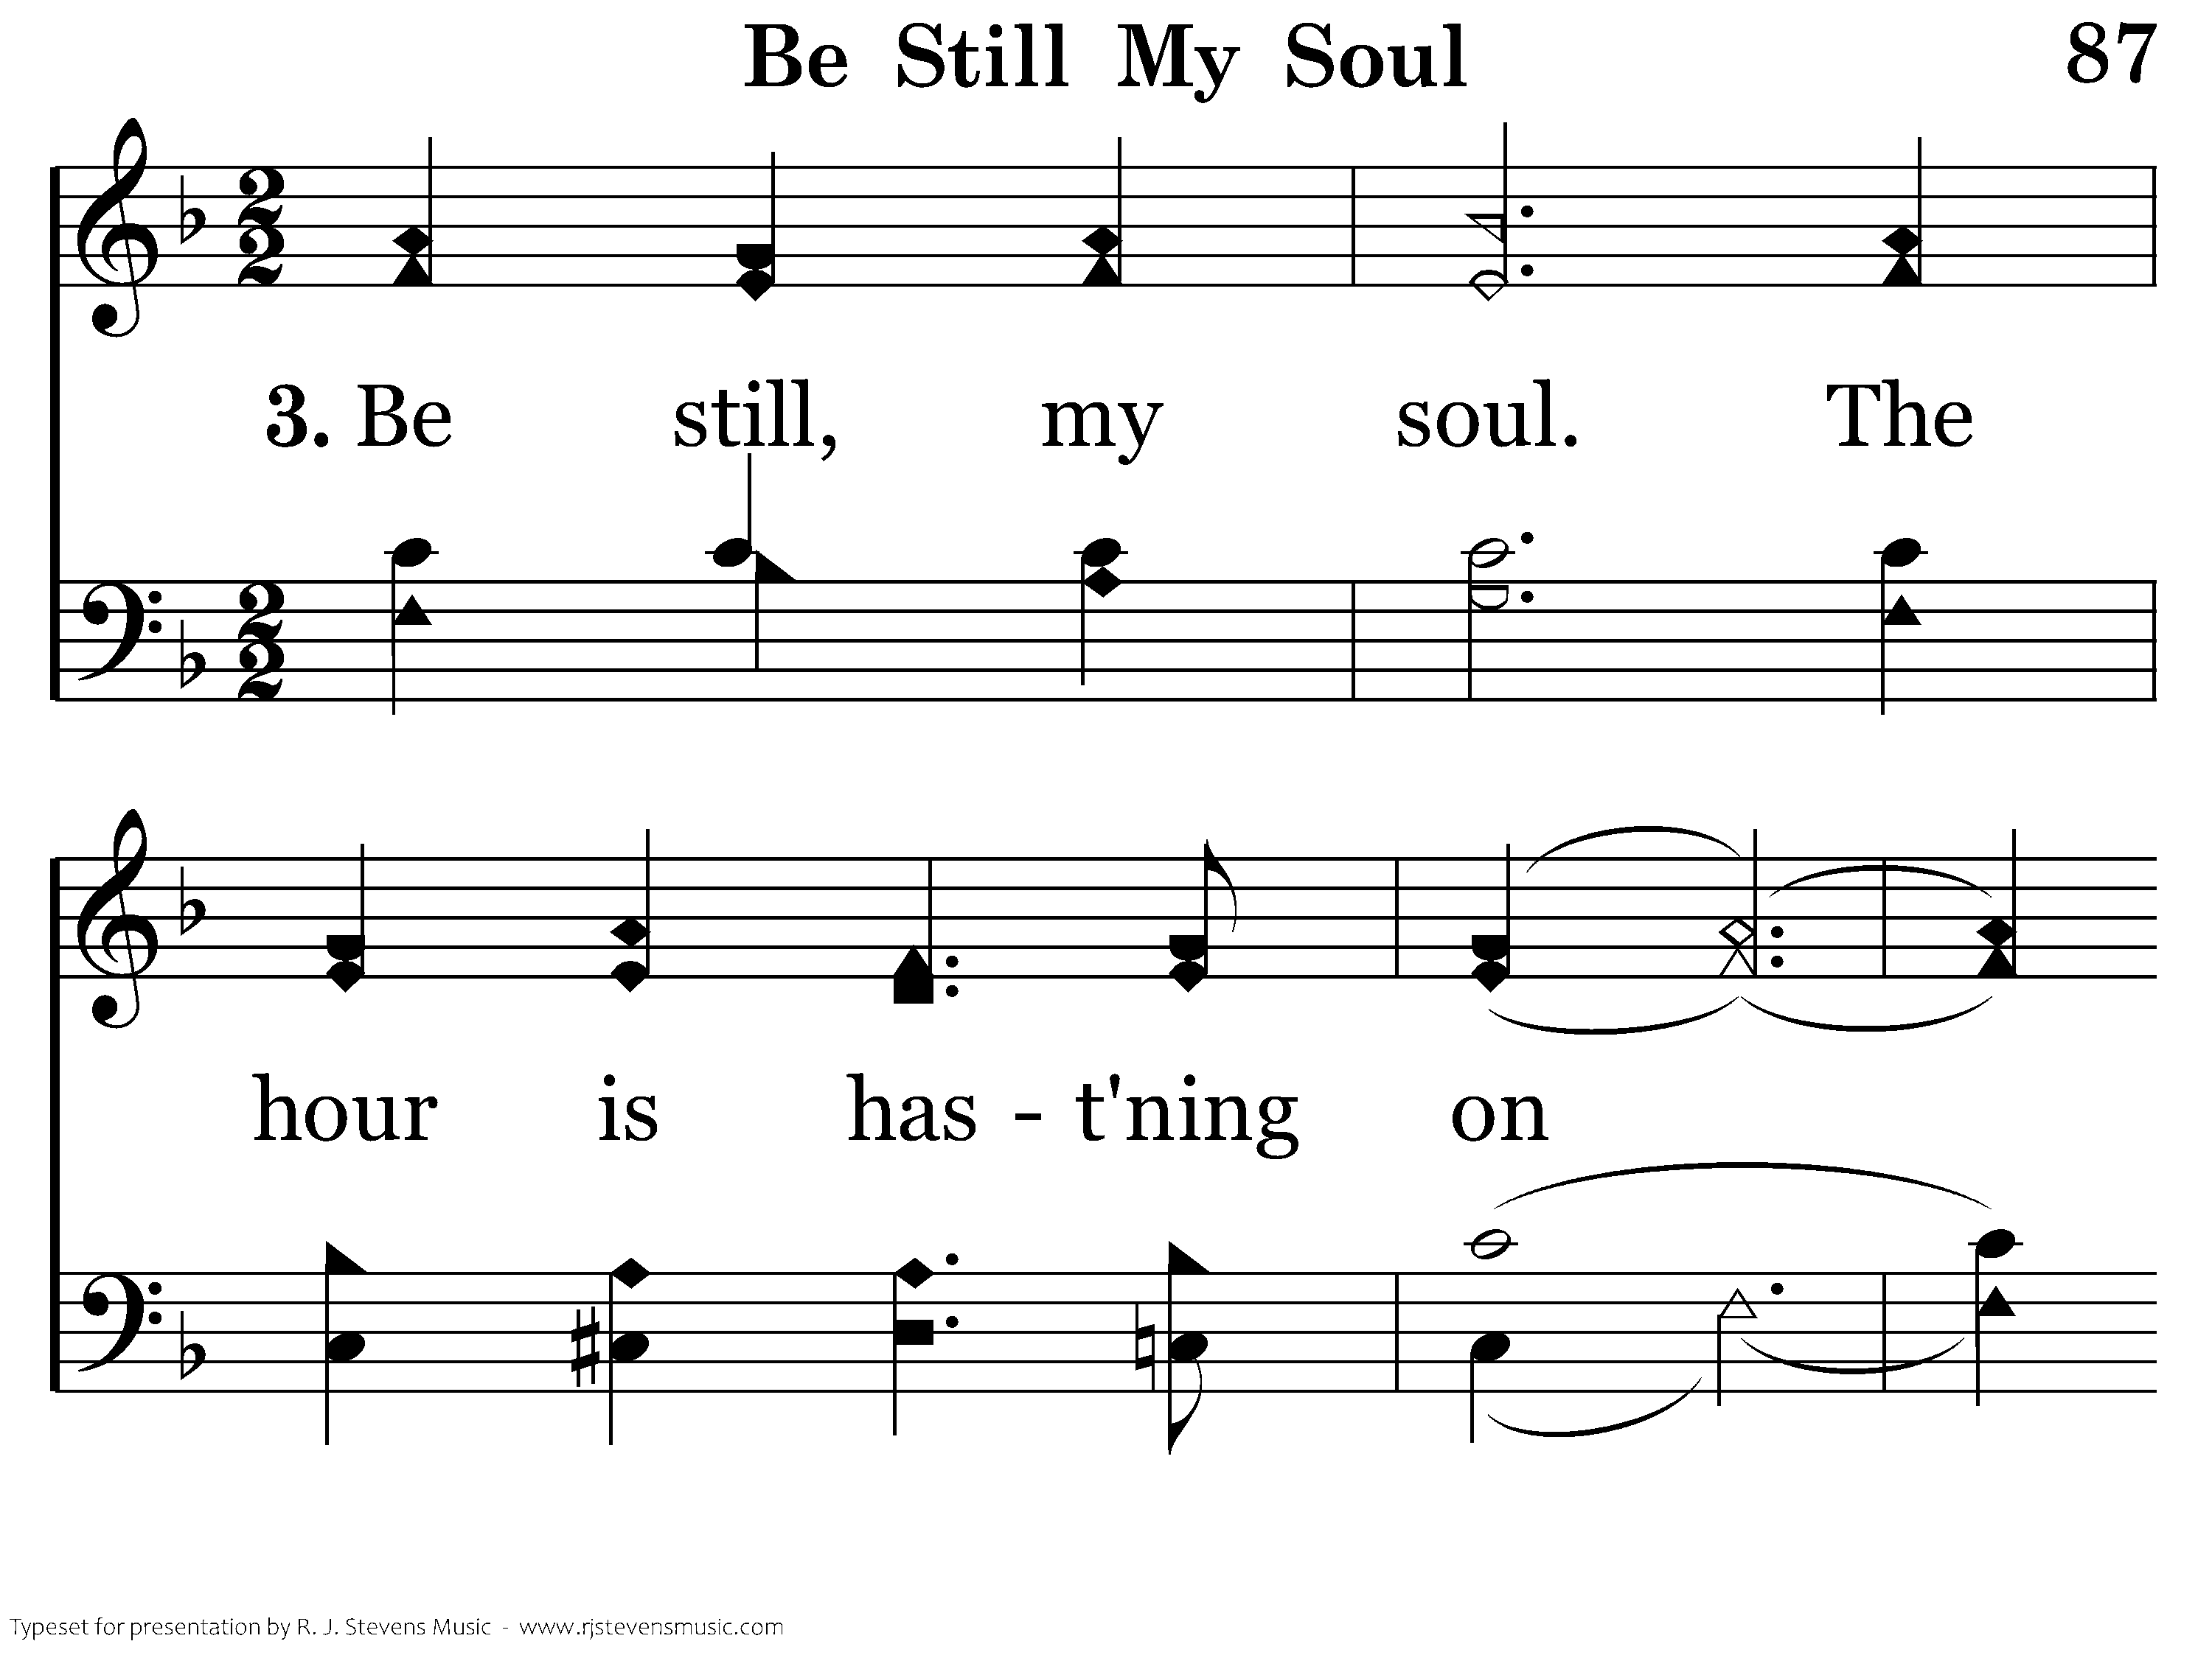
087 - Be Still My Soul - 3.1

Slide 27
087 - Be Still My Soul - 3.2

Slide 28
087 - Be Still My Soul - 3.3

Slide 29
087 - Be Still My Soul - 3.4

Slide 30
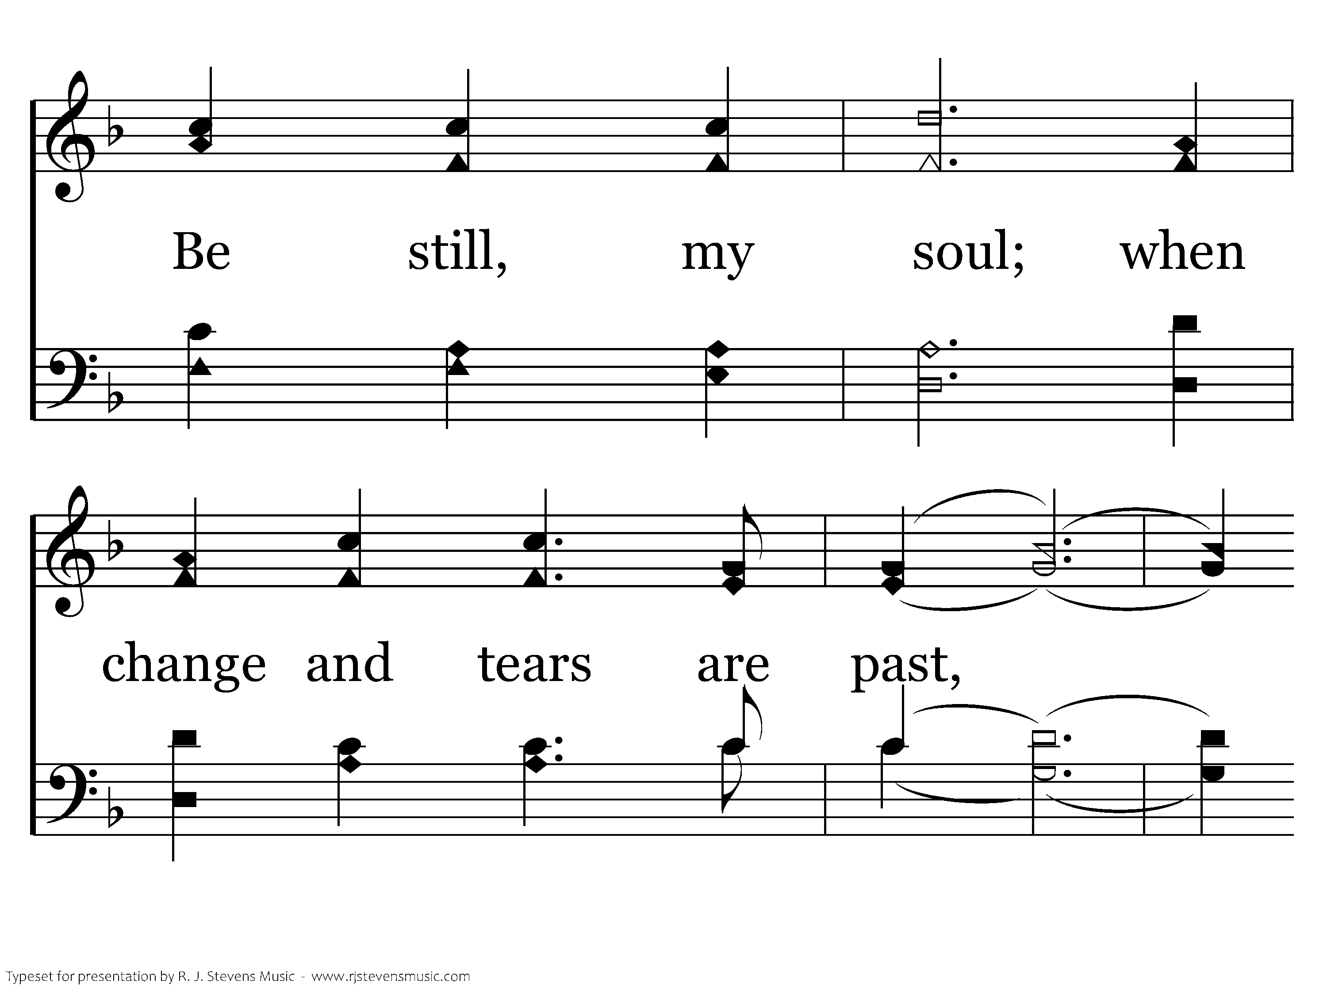
087 - Be Still My Soul - 3.5

Slide 31
087 - Be Still My Soul - 3.6
End of Song

Slide 32
Blest Be The Tie
“Our fears, our hopes, our aims are one”
“Our mutual burdens bear; And often for each other flows the sympathizing tear. ”
We have the strength of our spiritual family to lean on
Galatians 6:2, Romans 12:15

Slide 33
Blest Be The Tie
“When we asunder part, it gives us inward pain; But we shall still be joined in heart, and hope to meet again.”
We can have hope to meet again with those who died in Christ
1 Thessalonians 4:13-18

Slide 34
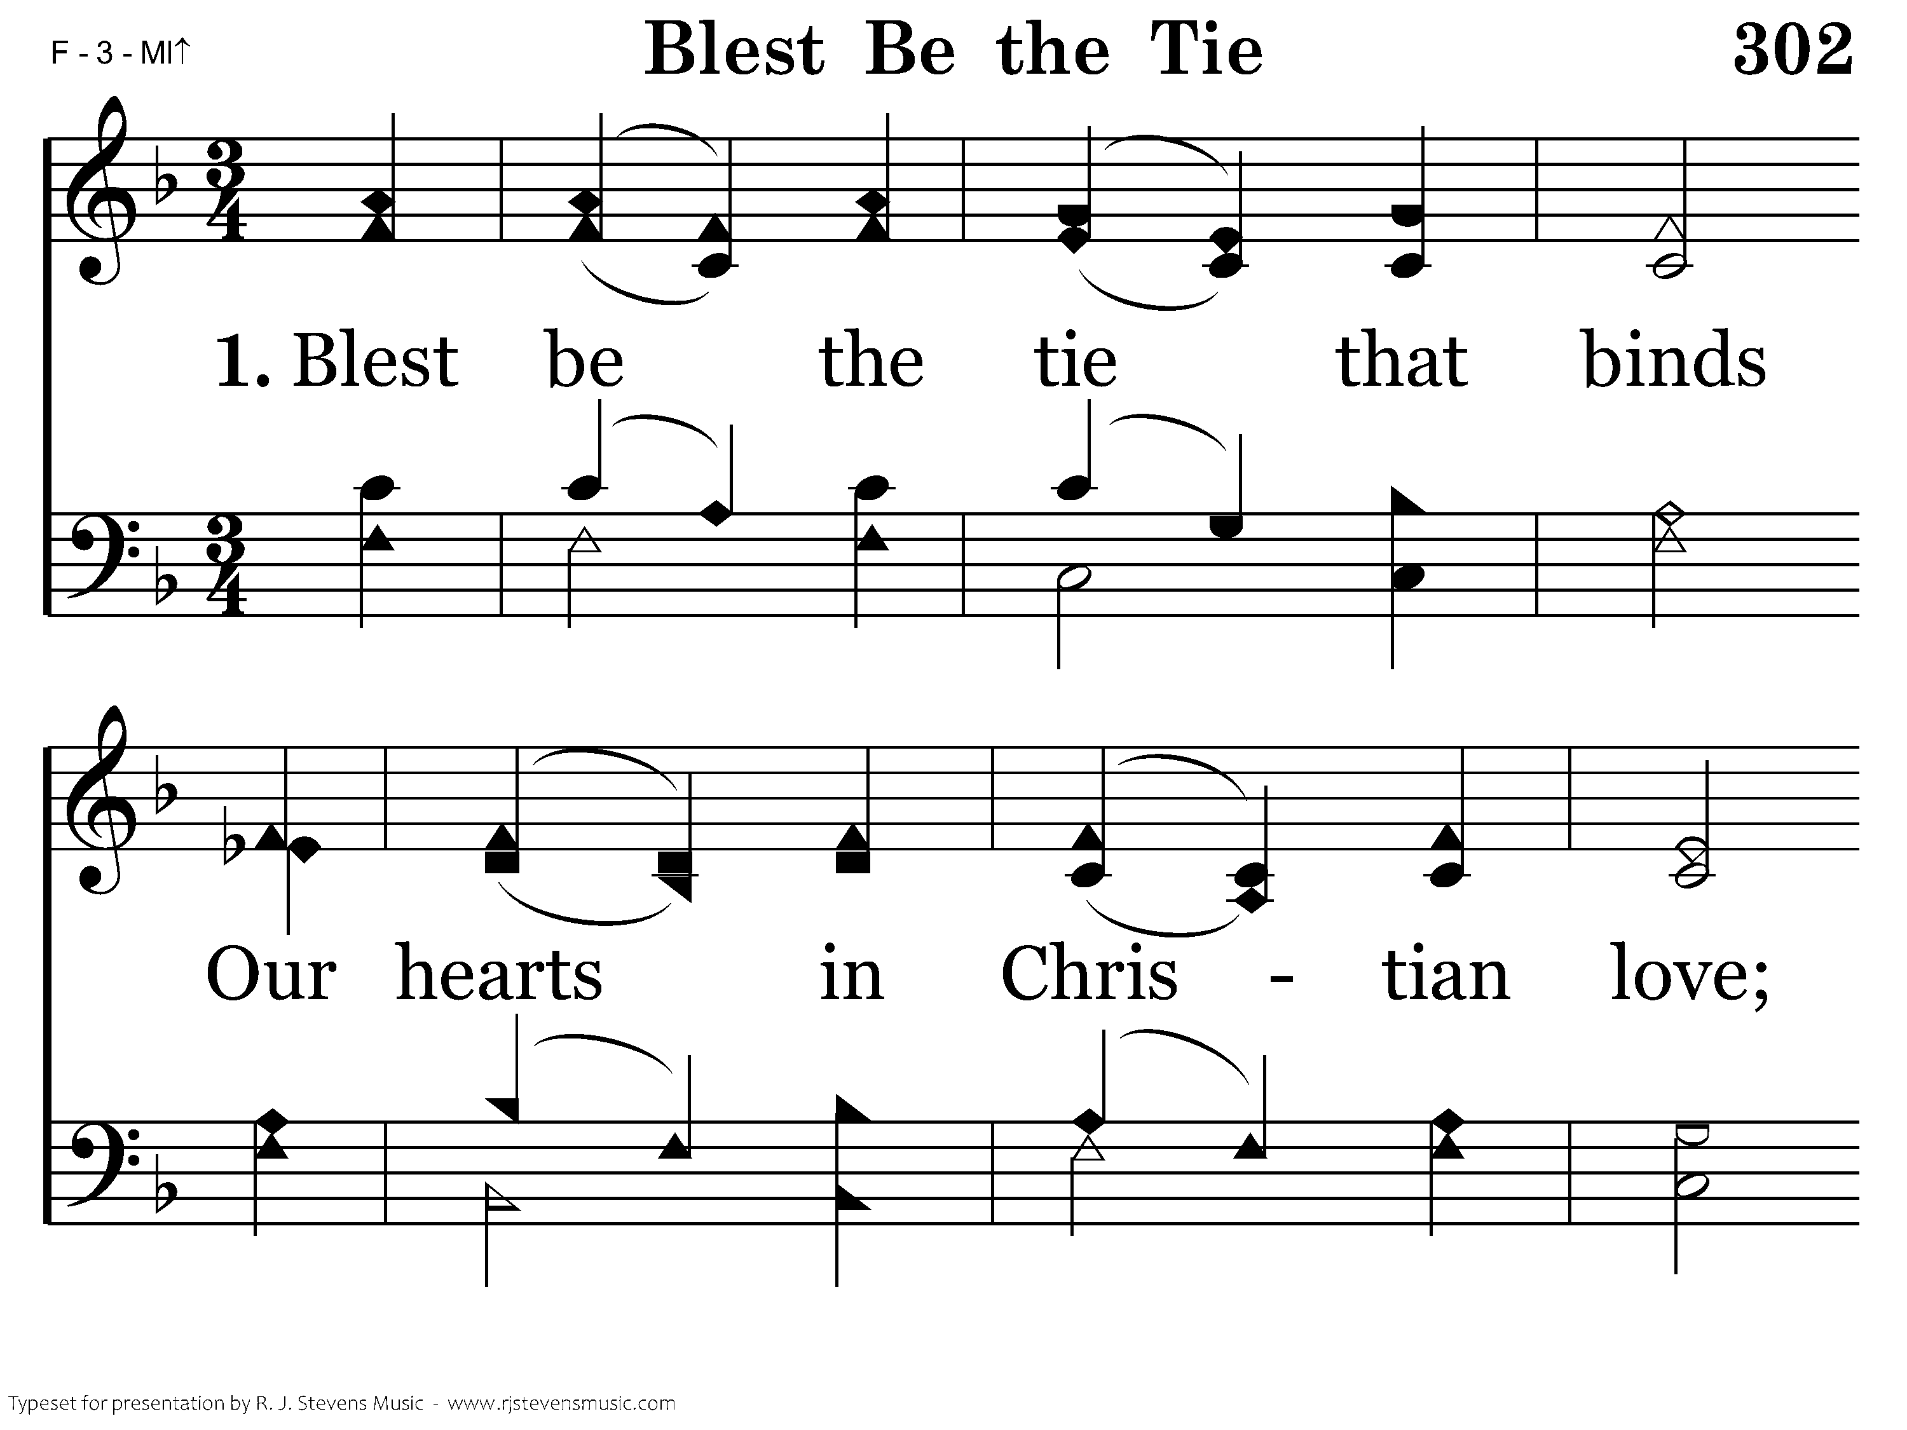
302 - Blest Be The Tie - 1.1

Slide 35
302 - Blest Be The Tie - 1.2
End of Verse 1

Slide 36
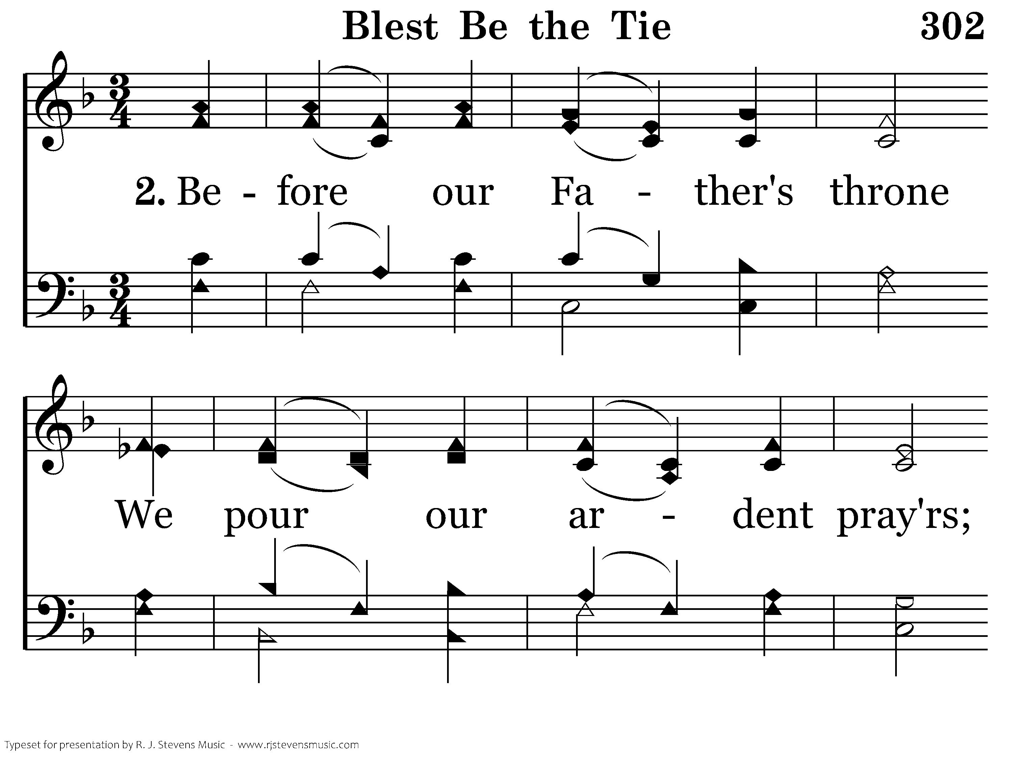
302 - Blest Be The Tie - 2.1

Slide 37
302 - Blest Be The Tie - 2.2
End of Verse 2

Slide 38
302 - Blest Be The Tie - 3.1

Slide 39
302 - Blest Be The Tie - 3.2
End of Verse 3

Slide 40
302 - Blest Be The Tie - 4.1

Slide 41
302 - Blest Be The Tie - 4.2
End of Song

Slide 42
How Deep The Father’s Love For Us
“How deep the Father’s love for us! How vast beyond all measure! That He should give His only Son to make a wretch His treasure!”
God loves us enough to sacrifice His Son for us
Romans 5:8, John 3:16
God treasures us as His children and His people
1 John 3:1, 1 Peter 2:9

Slide 43
How Deep The Father’s Love For Us
“Behold the Man upon the cross, my sin upon His shoulders. Ashamed I hear my mocking voice call out among the scoffers. It was my sin that held Him there until it was accomplished.”
Our sins are the reason Jesus’ sacrifice was necessary
1 John 2:2

Slide 44
How Deep The Father’s Love For Us
“Why should I gain from His reward? I cannot give an answer. But this I know with all my heart; His wounds have paid my ransom.”
Only through the grace of God are we saved
Romans 3:23-24, Ephesians 2:4-9

Slide 45
1-1 How Deep the Father’s Love
How Deep the Father’s Love
362
Soprano

Slide 46
1-2 How Deep the Father’s Love
How Deep the Father’s Love
362
Soprano

Slide 47
1-3 How Deep the Father’s Love
How Deep the Father’s Love
362
Soprano & Tenor

Slide 48
1-4 How Deep the Father’s Love
How Deep the Father’s Love
362
Soprano, Alto, Tenor

Slide 49
2-1 How Deep the Father’s Love
How Deep the Father’s Love
362
All parts

Slide 50
2-2 How Deep the Father’s Love
How Deep the Father’s Love
362

Slide 51
2-3 How Deep the Father’s Love
How Deep the Father’s Love
362

Slide 52
2-4 How Deep the Father’s Love
How Deep the Father’s Love
362

Slide 53
3-1 How Deep the Father’s Love
How Deep the Father’s Love
362

Slide 54
3-2 How Deep the Father’s Love
How Deep the Father’s Love
362

Slide 55
3-3 How Deep the Father’s Love
How Deep the Father’s Love
362

Slide 56
3-4 How Deep the Father’s Love
How Deep the Father’s Love
362

Slide 57
Tag How Deep the Father’s Love
How Deep the Father’s Love
362
How Deep the Father’s Love
362

