Slide 3
Ultimate Truth is Not Found In…
Culture
Majorities
Preachers and Elders
Ourselves
Universities
Creeds
Socially Elite
Government

Slide 4
Ultimate Truth is Found In…
The Bible

Slide 5
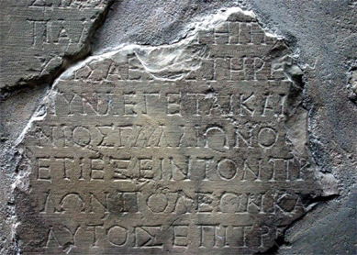
External Evidence
Acts 18:12 – But when Gallio was proconsul of Achaia…
Delphi Inscription

Slide 6
External Evidence
Acts 18:2 – …because Claudius had commanded all the Jews to leave Rome.
Suetonius – “He [Claudius] expelled the Jews from Rome on account of the riots on which they were constantly indulging at the instigation of Christus.”

Slide 7
Internal Evidence
Prophecy of King Cyrus
Isaiah 44:28 – [I am the Lord] who says of Cyrus, ‘He is my shepherd, and he shall fulfill all my purpose’; saying of Jerusalem, ‘She shall be built,’ and of the temple, ‘Your foundation shall be laid.’”
Fulfilled in Ezra 1-6

Slide 8
Observational Evidence
Physical things don’t come from nothing
Nature has a purpose and function
Nature points to an Eternal,
Intelligent Designer
Gen. 1:1; Ps. 19:1; Rom. 1:19-23

Slide 9
We Can Trust the Claims of the Bible
Direct Revelation from God
2 Tim. 3:16-17; 2 Pet. 1:19-21
The Word of God is Truth
John 8:31-32; 17:17
All Have Sinned and Are in Need of a Savior
Rom. 3:23; 6:23
Jesus is That Savior
John 14:6

Slide 10
We Can Trust the Claims of the Bible
Those Who Respond in Faithful Obedience to Him can Have Eternal Life
John 3:16; Rom. 10:10; Acts 2:38; 1 Cor. 15:58

