Slide 1
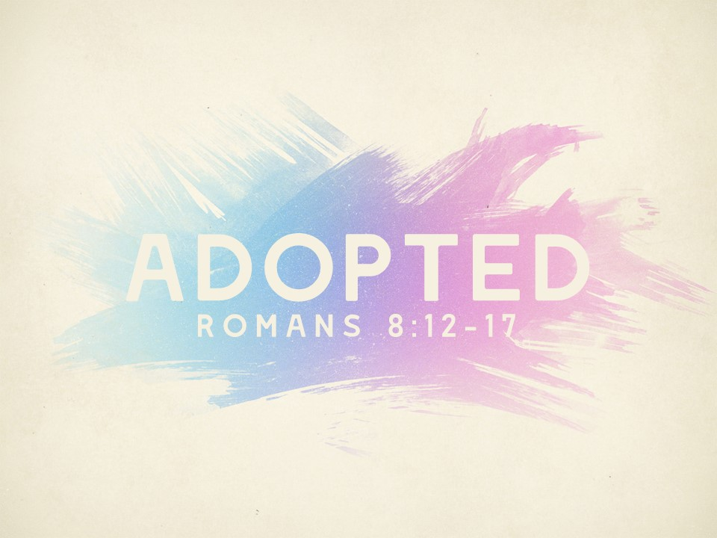

Slide 2
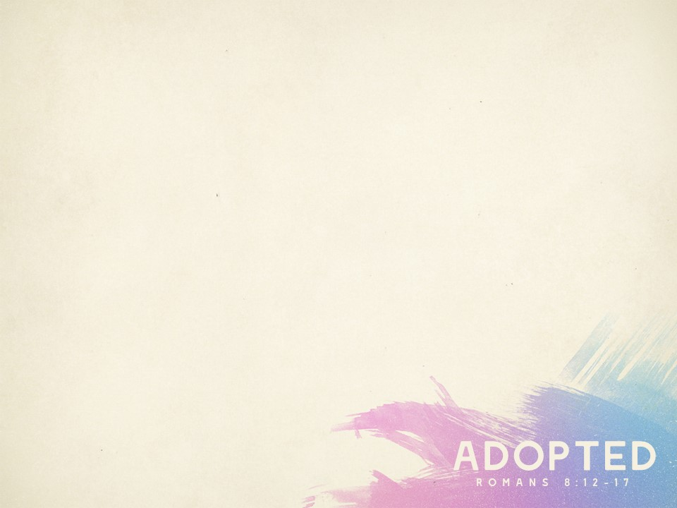
Romans 8:12-13 (Page 944)
We are debtors (“under obligation,” NASB)
Not to the flesh, but to God (see 8:10-11; 7:6)
This is a blessing!
A warning: fleshly living leads to spiritual death
1 Cor. 10:1-5; Rom. 11:22; Gal. 5:1-4; Heb. 10:26-39)

Slide 3
Romans 8:14 (Page 944)
We are led by the Spirit
Certainly through the Word (1 Pet. 1:20-21; 2 Tim. 3:16; Col. 3:16)
Through the Word He directs our steps (Ps. 119:104-105)
We are sons of God
John 1:11-13; Hos. 1:10

Slide 4
Romans 8:15 (Page 944)
We have “received the Spirit of adoption”
Gal. 4:4-7
No longer slaves to fear, sin, and death
Now have comfort and confidence with our heavenly Father
Have access to the Father as Jesus does (Mk. 14:36)

Slide 5
Romans 8:16 (Page 944)
Spirit of God testifies with our spirit that we are God’s children
John 8:17; Deut. 19:15; 17:6; Gal. 4:6
How? Certainly through the Word
Our conviction is upheld by the witness of Scripture (i.e., Gal 3:26-27; see also Heb. 10:15-17 and 1 Jn. 5:13)

Slide 6
Things to Remember
We should gladly serve God in response to all He has blessed us with (v. 12)
As children of God we should imitate our Holy Father (v. 14)
As adopted children, we’ve been given access to that which did not belong to us (v. 17)

