Slide 1
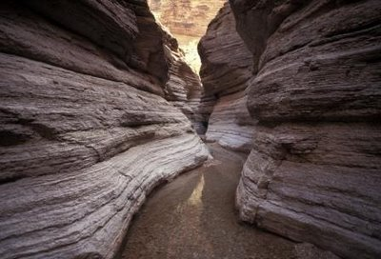

Slide 2
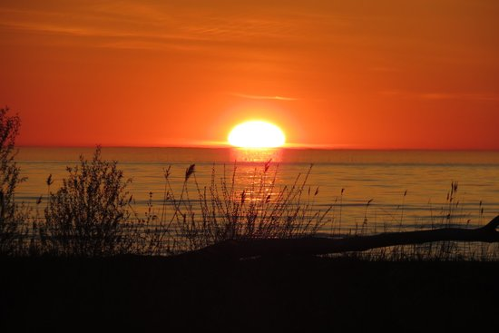
“Our Father who art in heaven,
Hallowed be Thy name.”
Matthew 6:9
hallowed = to make holy, sanctify

Slide 3
They will sanctify My name...And will stand in awe of the God of Israel.
Isaiah 29:23

Slide 4
O magnify the Lord with me,
And let us exalt His name together.
Psalms 34:3

Slide 5
Come, you children, listen to me;
I will teach you the fear of the Lord.
Psalms 34:11

Slide 6
Respect
and
Reverence

Slide 7
Respect
fear, terror, reverence
appreciate, admire, honor
ant. disregard, dishonor
Acts 9:31
Rom. 3:18
2 Cor. 5:11
Phil. 2:12
*deer stand and a bear

Slide 8
Reverence
piety, fear of God, respect
high regard, great respect, appreciate
ant. scorn, not take seriously
Jesus - Heb. 5:7
Noah - Heb. 11:7
*antique china

Slide 9
Respect and Reverence
for holy things
Ezekiel 22:26
“to set apart for God”
“religious awe, reverance
The Lord’s Day (Rev. 1:10)
Worship (Ax. 2:42; Psa.2:11)
God’s Word (I Thes. 2:13)
Christ’s Kingdom (Heb.12:28)

Slide 10
Respect and Reverence
parable of Jesus speaks of rulers of His day and ours
wicked judge (Luke 18:1-8)
v.2 “a judge who did not fear God, and did not respect man.”
v.4 “I do not fear God nor respect man.”

Slide 11
Respect and Reverence
rulers and every soul will be judged
good and bad deeds (2 Cor. 5:10)
every careless word (Mat. 12:35-37)
how we help each other (Mat. 25:31-46)

Slide 12
Respect and Reverence
summed up
Matthew 22:36-40

Slide 13
O magnify the Lord with me,
And let us exalt His name together.
Psalms 34:3

Slide 14
“Our Father who art in heaven,
Hallowed be Thy name.”
Matthew 6:9

Slide 15
Obeying the Gospel
Hear the gospel (Romans 10:17)
Believe (Mark 16:16; Hebrews 11:6)
Repent (Acts 2:38; Acts 17:30)
Confess (Romans 10:9-10; Acts 8:37)
“I believe that Jesus Christ is the Son of God.”
Be baptized (Mark 16:16; Acts 2:38)
Live faithfully (Hebrews 10:36)

