Slide 2
2 Peter 1:1
¹ Simeon Peter, a servant and apostle of Jesus Christ,
To those who have obtained a faith of equal standing with ours by the righteousness of our God and Savior Jesus Christ:

Slide 3
2 Peter 1:1-2
¹ Simeon Peter, a servant and apostle of Jesus Christ,
To those who have obtained a faith of equal standing with ours by the righteousness of our God and Savior Jesus Christ:
² May grace and peace be multiplied to you in the knowledge of God and of Jesus our Lord.

Slide 4
2 Peter 1:3-4
³ His divine power has granted to us all things that pertain to life and godliness, through the knowledge of him who called us to his own glory and excellence, ⁴ by which he has granted to us his precious and very great promises, so that through them you may become partakers of the divine nature, having escaped from the corruption that is in the world because of sinful desire.

Slide 5
2 Peter 1:5-7
⁵ For this very reason, make every effort to supplement your faith with virtue, and virtue with knowledge, ⁶ and knowledge with self-control, and self-control with steadfastness, and steadfastness with godliness, ⁷ and godliness with brotherly affection, and brotherly affection with love.

Slide 6
Spiritual Growth Should Never Stop!
1 Pet. 2:2-3; 2 Pet. 3:18;
1 Tim. 4:11-15; 1 Cor. 3:1-3

Slide 7
ADD TO YOUR FAITH
Virtue
Phil. 4:8; 1 Pet. 2:9; 2 Pet. 1:3
Knowledge
Pr. 1:7; 2:6; Rom. 10:17; Col. 1:9; 2 Pet. 3:18
Self-Control
Pr. 25:28; 1 Cor. 9:27; 1 Pet. 4:7
Steadfastness
James 1:12; Gal. 6:9; Rom. 5:3-5

Slide 8
ADD TO YOUR FAITH
Godliness
Ps. 1:1-3; 1 Tim. 4:8; Col. 3:17; 2 Pet. 3:11-12
Brotherly Affection
Rom. 12:10; John 13:34-35; 1 Pet. 1:22; Heb. 13:1
Love
1 Cor. 13:4-8; Gal. 5:22; Eph. 4:1-3

Slide 9
2 Peter 1:8
⁸ For if these qualities are yours and are increasing, they keep you from being ineffective or unfruitful in the knowledge of our Lord Jesus Christ.

Slide 10
2 Peter 1:8-9
⁸ For if these qualities are yours and are increasing, they keep you from being ineffective or unfruitful in the knowledge of our Lord Jesus Christ.
⁹ For whoever lacks these qualities is so nearsighted that he is blind, having forgotten that he was cleansed from his former sins.

Slide 11
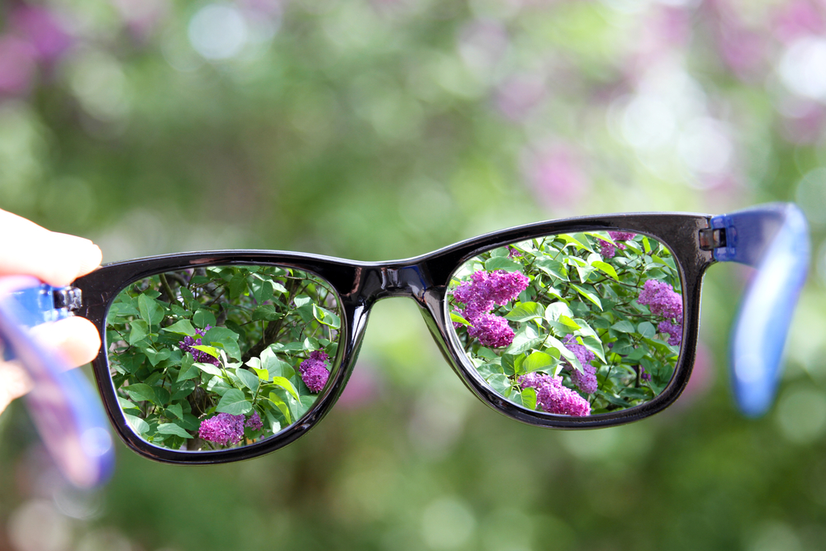

Slide 12
2 Peter 1:10-11
¹⁰ Therefore, brothers, be all the more diligent to confirm your calling and election, for if you practice these qualities you will never fall. ¹¹ For in this way there will be richly provided for you an entrance into the eternal kingdom of our Lord and Savior Jesus Christ.

