Slide 1
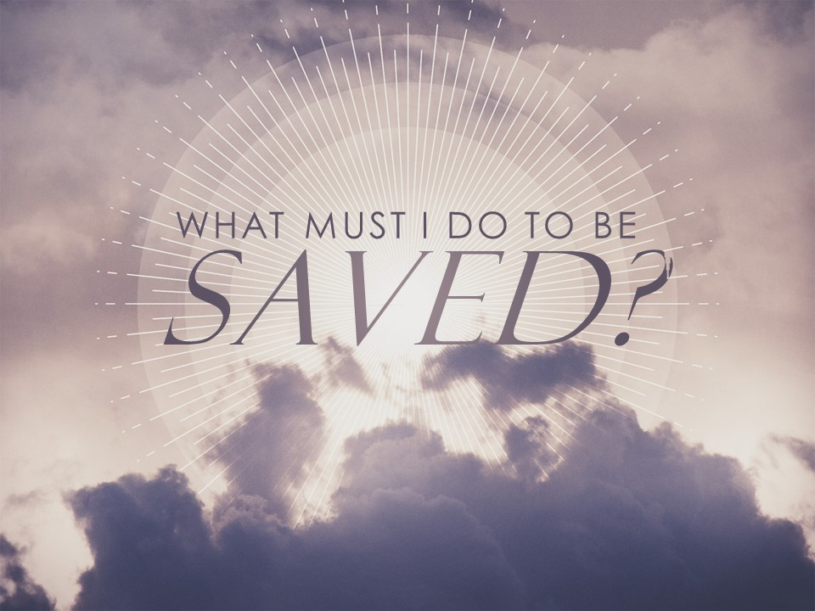

Slide 2
HEAR
Deuteronomy 5:1
And Moses summoned all Israel and said to them, “Hear, O Israel, the statutes and the rules that I speak in your hearing today, and you shall learn them and be careful to do them.
See also Ex. 15:26; Deut. 4:1-2; 7:12

Slide 3
BELIEVE
Deuteronomy 7:12
And because you listen to these rules and keep and do them, the Lord your God will keep with you the covenant and the steadfast love that he swore to your fathers.
See also Ex. 14:30-31; Num. 20:11-13;
2 Chr. 20:20-21; Ps. 119:66

Slide 4
BELIEVE
Numbers 14:11-12
¹¹ And the Lord said to Moses, “How long will this people despise me? And how long will they not believe in me, in spite of all the signs that I have done among them? ¹² I will strike them with the pestilence and disinherit them, and I will make of you a nation greater and mightier than they.”

Slide 5
REPENT
Deuteronomy 30:9-10
⁹ The Lord your God will make you abundantly prosperous in all the work of your hand, in the fruit of your womb and in the fruit of your cattle and in the fruit of your ground. For the Lord will again take delight in prospering you, as he took delight in your fathers, ¹⁰ when you obey the voice of the Lord your God, to keep his commandments and his statutes that are written in this Book of the Law, when you turn to the Lord your God with all your heart and with all your soul.

Slide 6
REPENT
Ezekiel 18:30
“Therefore I will judge you, O house of Israel, every one according to his ways, declares the Lord God. Repent and turn from all your transgressions, lest iniquity be your ruin.
See also Deut. 30:1-3; 1 Kgs. 8:46-48;
2 Chr. 6:37-39; Ezk. 14:6

Slide 7
CONFESS
1 Kings 8:35-36
³⁵ “When heaven is shut up and there is no rain because they have sinned against you, if they pray toward this place and acknowledge your name and turn from their sin, when you afflict them, ³⁶ then hear in heaven and forgive the sin of your servants, your people Israel, when you teach them the good way in which they should walk, and grant rain upon your land, which you have given to your people as an inheritance.

Slide 8
CONFESS
Isaiah 33:13
Hear, you who are far off, what I have done;
and you who are near, acknowledge my might.

Slide 9
HEAR
John 4:40-42
⁴⁰ So when the Samaritans came to him, they asked him to stay with them, and he stayed there two days. ⁴¹ And many more believed because of his word. ⁴² They said to the woman, “It is no longer because of what you said that we believe, for we have heard for ourselves, and we know that this is indeed the Savior of the world.”

Slide 10
BELIEVE
John 8:24
I told you that you would die in your sins, for unless you believe that I am he you will die in your sins.

Slide 11
REPENT
Matthew 4:17
From that time Jesus began to preach, saying, “Repent, for the kingdom of heaven is at hand.”

Slide 12
REPENT
Luke 24:46-47
⁴⁶ and said to them, “Thus it is written, that the Christ should suffer and on the third day rise from the dead, ⁴⁷ and that repentance for the forgiveness of sins should be proclaimed in his name to all nations, beginning from Jerusalem.
⁴⁸ You are witnesses of these things.

Slide 13
CONFESS
Matthew 10:32-33
³² So everyone who acknowledges me before men, I also will acknowledge before my Father who is in heaven, ³³ but whoever denies me before men, I also will deny before my Father who is in heaven.

Slide 14
BE BAPTIZED
Mark 16:15-16
¹⁵ And he said to them, “Go into all the world and proclaim the gospel to the whole creation.
¹⁶ Whoever believes and is baptized will be saved, but whoever does not believe will be condemned.

Slide 15
BAPTISM FORESHADOWED
IN THE OT
1 Peter 3:20-21 (Gen. 7-8)
Heb. 10:22; Titus 3:5; Eph. 5:16 (Ezk. 36:25)
1 Cor. 10:1-6 (Ex. 14)

Slide 16
HEAR
Rom. 10:17
BELIEVE
Heb. 11:6
REPENT
Acts 2:38
CONFESS
Rom. 10:10
BE BAPTIZED
Mark 16:16

