Slide 2
Wise Up Wisdom From Proverbs
Proverbs 1-9
4:7, “Above all and before all, do this: Get Wisdom! Write this at the top of your list: Get Understanding!”

Slide 3
When you have wisdom, you have just about anything else…

Slide 4
When you have wisdom, you have just about anything else… …And everything you have will be good!

Slide 5
Proverbs 14:12 There is a way that seems right to a man, but in the end it leads to death.

Slide 6
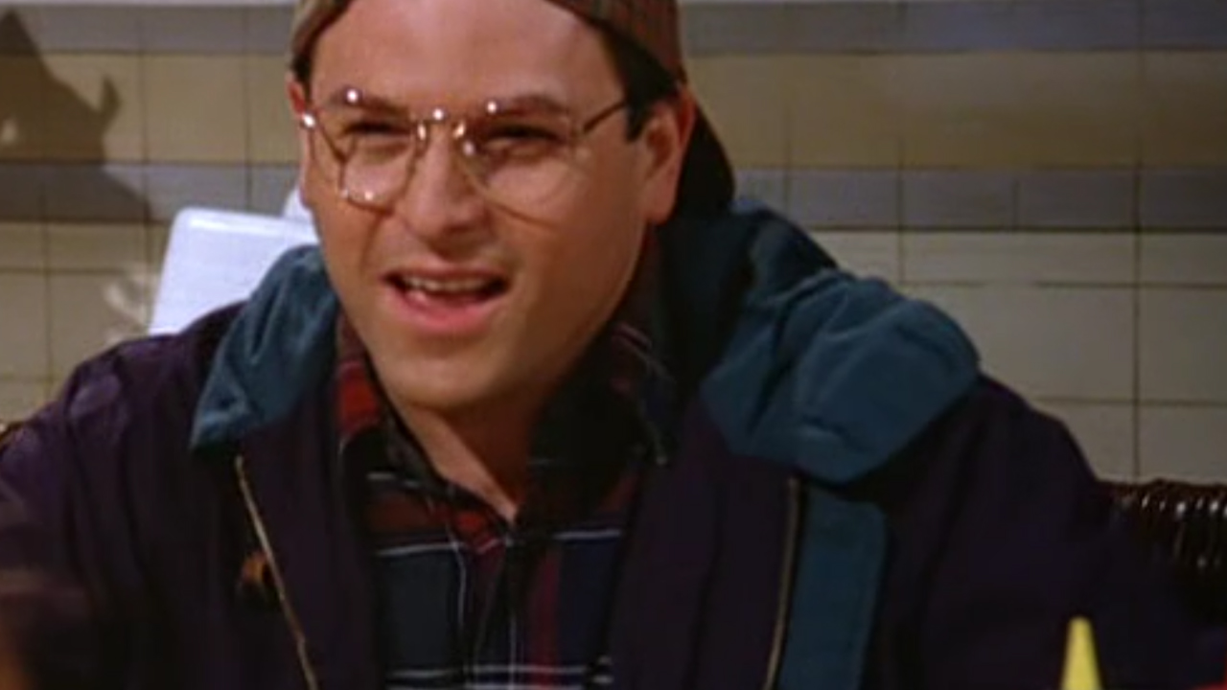

Slide 7
Proverbs 14:12 There is a way that seems right to a man, but in the end it leads to death.

Slide 8
Definition:
Benefits:
Perception (Pro. 2:9-10)
Prevention (Pro. 2:12, 16; 3:23)
Prolong your life (Pro. 3:1-2, 8, 16; 9:11)
Peace (Pro. 3:17, 24)
Prosperity (Pro. 3:2, 16)
Poise (Pro. 3:26-27)
Protection (Pro. 4:6)
Precision (Pro. 4:12)
Prudence (Pro. 8:12)
Wisdom Pays (Pro. 9:12)
Ability to make great choices.
To make skillful at daily living.
Life is a series of recurring choices.
Life is a series of accumulated results.
Life is a series of individual days.

Slide 9
Beginning of Wisdom:
Putting Wisdom To Work:
Believe in consequence.
(Pro. 6:27; 13:11, 18; 14:23)
Rules of The Road – (Deut. 10:12-13)
Fear the Lord – (Psa. 25:12)
Learn by example.
(Pro. 13:20)
Immerse yourself in God’s wisdom.
(Pro. 2:6; 30:5)
Psa. 19:7b, “The Testimony of The Lord is Sure, making wise the simple.”
Psa. 19:8b, “The commandment of the Lord is pure, enlightening the eyes.”
If you say so – (Psa. 119:9-11)
The fear of the Lord is the beginning of Wisdom. (Pro. 9:10)
Fear is the attitude of heart that seeks a right relationship to the fear source.

