Slide 1
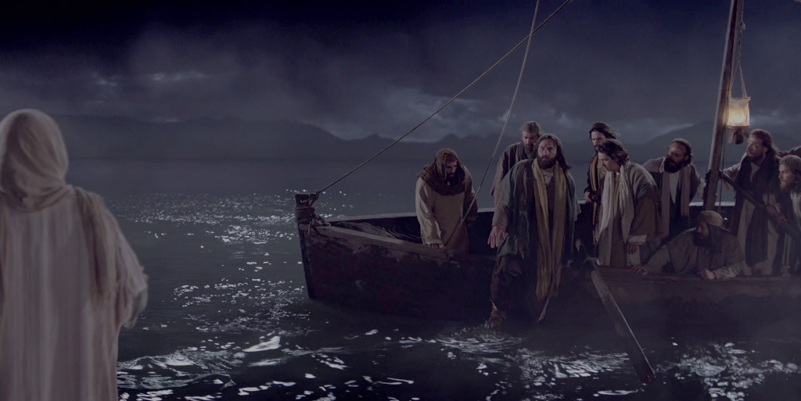

Slide 2
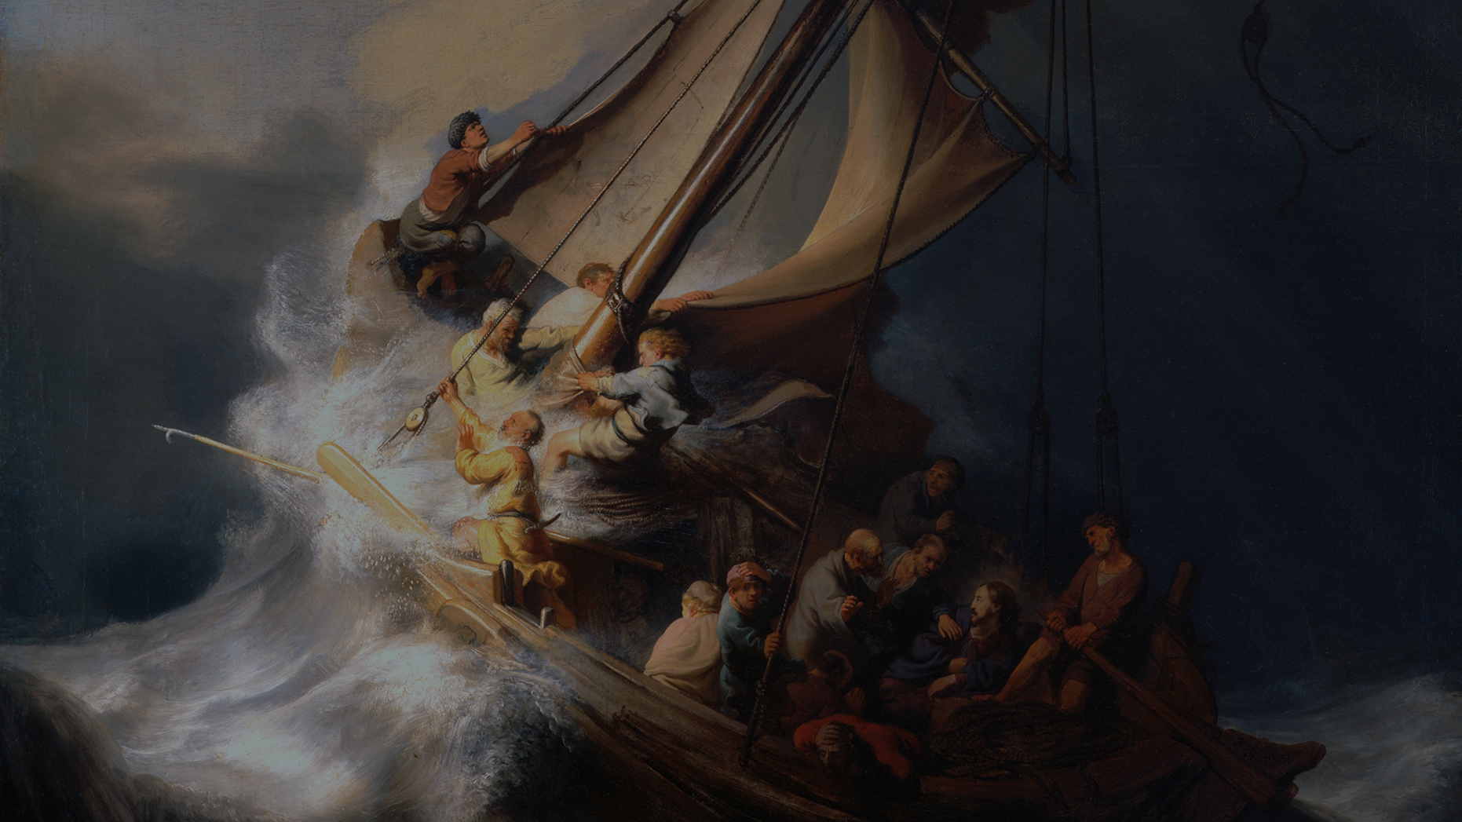
Trust The Lord
Proverbs 3:5-6; Matthew 6:24-35
Trust in the Lord with all your heart, and do not lean on your own understanding. ⁶ In all your ways acknowledge him, and he will make straight your paths.

Slide 3
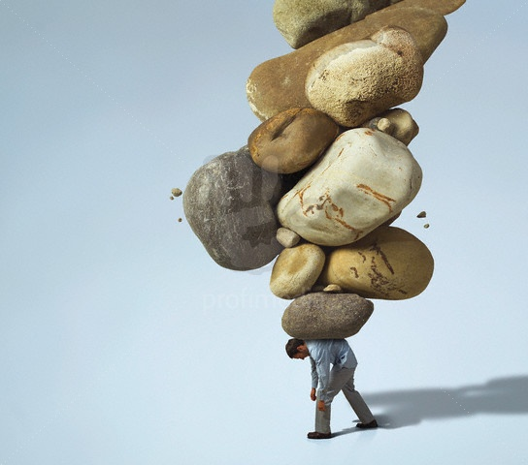
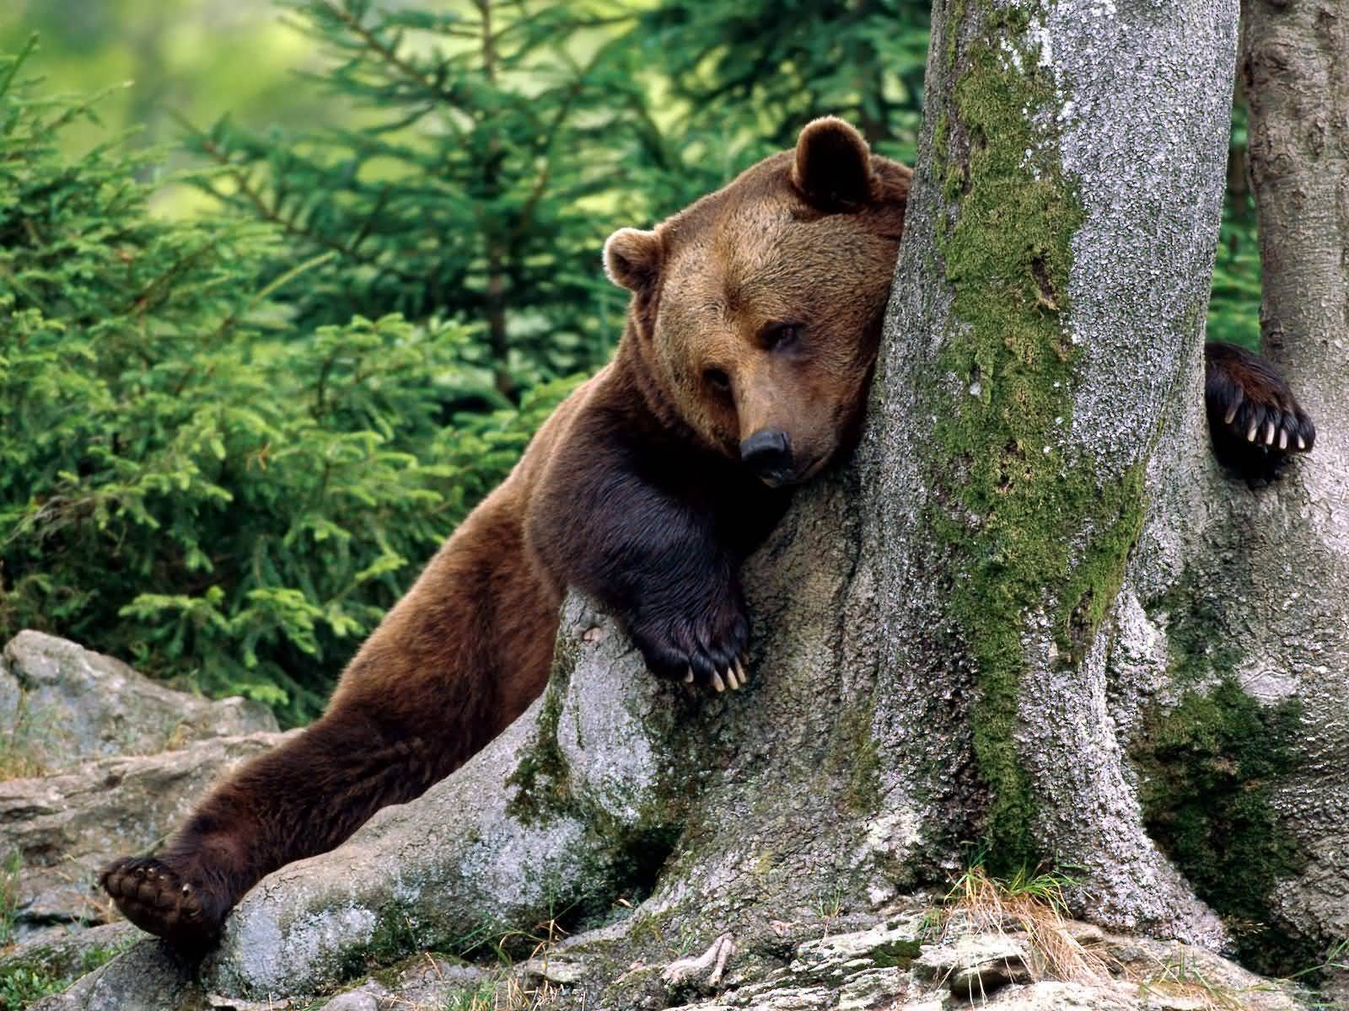

Slide 4
The Word on Anxiety
1
PAST
2
Present
3
Future
Matthew 6:34 “Therefore do not be anxious about tomorrow, for tomorrow will be anxious for itself. Sufficient for the day is its own trouble.”
One translation says, “Each day has enough trouble of its own” ( NASB).
Worry. It comes from an old German word that means “to choke.”
Fear. This response is more visceral. (1 Tim. 1:7)
Anxiety. Jesus Himself mentions anxiety three times in our text, so you know He was making an important point: “Therefore do not be anxious” (Matthew 6:34). Anxiety literally means “to divide the mind.”

Slide 5
I Cannot Control The Future.
Worry focuses on what you cannot control:
My health future
My family’s future
My financial future
My environmental future
My organizational future
Or the church, or my community, or the country.
Jesus told us not to worry about tomorrow because “tomorrow will be anxious for itself” (Matthew 6:34 b).
WORRY KEEPS YOU FROM DOING WHAT YOU CAN DO TODAY TO AFFECT A BETTER FUTURE.

Slide 6
Don’t Worry!
Worry costs us a tragic loss of energy and effort.
1. When God says, “Don’t!” He means, “Don’t hurt yourself.”
For example, when God says, “Be anxious for nothing” (Philippians 4:6 NASB), He is issuing a protective statement for you.
2. Choose to sin; choose to suffer.
Every choice comes with multiple, often unintended consequences.
We can’t say to God, “I’ll choose to sin; Your job is to protect me from the bad consequences of my choices.”
He loves us too much to accept that arrangement.
Jesus told us not to worry about tomorrow because “tomorrow will be anxious for itself” (Matthew 6:34 b).
WORRY KEEPS YOU FROM DOING WHAT YOU CAN DO TODAY TO AFFECT A BETTER FUTURE.

Slide 7
Don’t Worry!
I will always face uncertainty.
Matthew 8:23-24, “When he got into the boat, his disciples followed him. And behold, there arose a great storm.”
So they “woke him, saying, ‘Save us, Lord; we are perishing’” (v. 25).
He said, “Why are you afraid, O you of little faith?” (v. 26).
Jesus told us not to worry about tomorrow because “tomorrow will be anxious for itself” (Matthew 6:34 b).
WORRY KEEPS YOU FROM DOING WHAT YOU CAN DO TODAY TO AFFECT A BETTER FUTURE.

Slide 8
Don’t Worry!
I can bring my burden to the Lord.
Psalm 116:1–2, “I love the LORD, because he has heard my voice . . . Because He inclined his ear to me, therefore I will call on him as long as I live.”
TRUST IS THE ACT OF MY WILL, TO GIVE MY BURDENS TO GOD.
Big Prayer – big peace!
Phil. 4:6-7
Just a little - goes a long way
Luke 17:5-6
Acts 12:15
Jesus told us not to worry about tomorrow because “tomorrow will be anxious for itself” (Matthew 6:34 b).
WORRY KEEPS YOU FROM DOING WHAT YOU CAN DO TODAY TO AFFECT A BETTER FUTURE.

Slide 9
Don’t Worry!
“I trust God” statements from Matthew 6:25-34.
“Therefore I tell you, do not be anxious about your life, what you will eat or what you will drink, nor about your body, what you will put on.Is not life more than food, and the body more than clothing?” (v. 25).
“Look at the birds of the air: they neither sow nor reap nor gather into barns, and yet your heavenly Father feeds them. Are you not of more value than they?” (v. 26).
“And which of you by being anxious can add a single hour to his span of life?” (v. 27).
“And why are you anxious about clothing? Consider the lilies of the field, how they grow: they neither toil nor spin” (v. 28).
Jesus told us not to worry about tomorrow because “tomorrow will be anxious for itself” (Matthew 6:34 b).
WORRY KEEPS YOU FROM DOING WHAT YOU CAN DO TODAY TO AFFECT A BETTER FUTURE.

Slide 10
Don’t Worry!
“I trust God” statements from Matthew 6:25-34.
“Yet I tell you, even Solomon in all his glory was not arrayed like one of these. But if God so clothes the grass of the field, which today is alive and tomorrow is thrown into the oven, will he not much more clothe you, O you of little faith? Therefore do not be anxious, saying, ‘What shall we eat?’ or ‘What shall we drink?’ or ‘What shall we wear?’ For the Gentiles seek after all these things, and your heavenly Father knows that you need them all. But seek first the kingdom of God and his righteousness, and all these things will be added to you” (vv. 29–33).
Matthew 6:34: “Therefore do not be anxious about tomorrow, for tomorrow will be anxious for itself. Sufficient for the day is its own trouble.”
Jesus told us not to worry about tomorrow because “tomorrow will be anxious for itself” (Matthew 6:34 b).
WORRY KEEPS YOU FROM DOING WHAT YOU CAN DO TODAY TO AFFECT A BETTER FUTURE.

Slide 11
Trust The Lord
Proverbs 3:5-6
Trust in the Lord with all your heart, and do not lean on your own understanding. ⁶ In all your ways acknowledge him, and he will make straight your paths.

