Slide 2

FROM A FOOL TO A KING

Slide 3
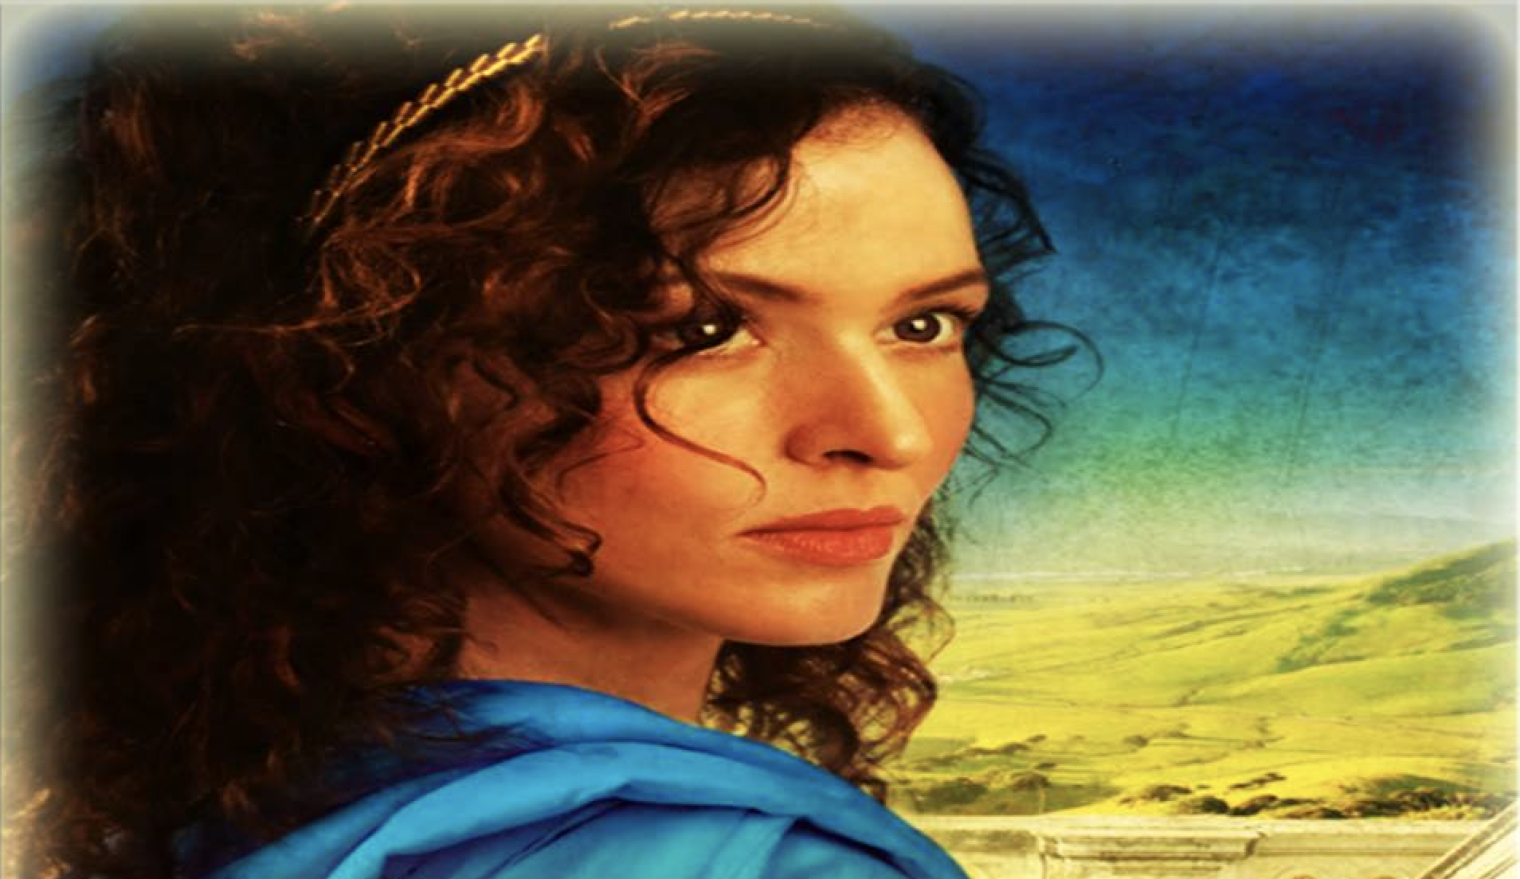
LESSONS LEARNED FROM ABIGAIL
Abigail Refused to be a Victim

Slide 4
LESSONS LEARNED FROM ABIGAIL
Abigail Chose Commitment

Slide 5
LESSONS LEARNED FROM ABIGAIL
Abigail saw the importance of Humility

Slide 6
LESSONS LEARNED FROM ABIGAIL
Abigail chose to be the only one to do the right thing.

Slide 7
LESSONS LEARNED FROM ABIGAIL
Abigail looked to God for her Reward

Slide 8
LESSONS LEARNED FROM ABIGAIL
One day, we too will be with the King.

