Slide 1
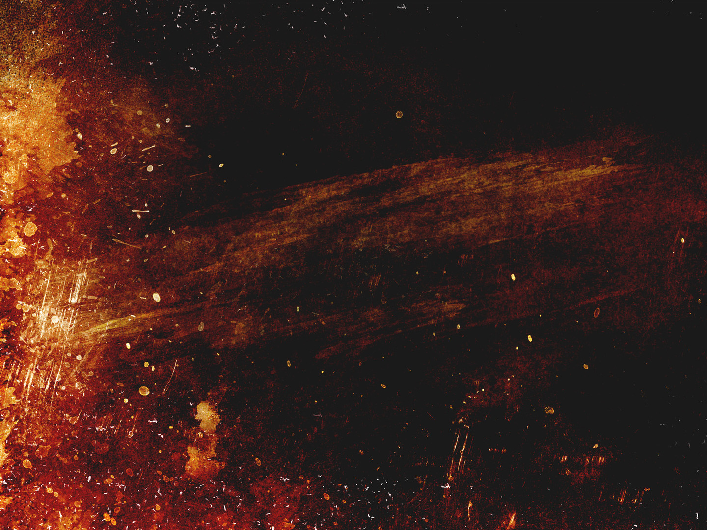
KORAH’S
REBELLION
NUMBERS 16

Slide 2
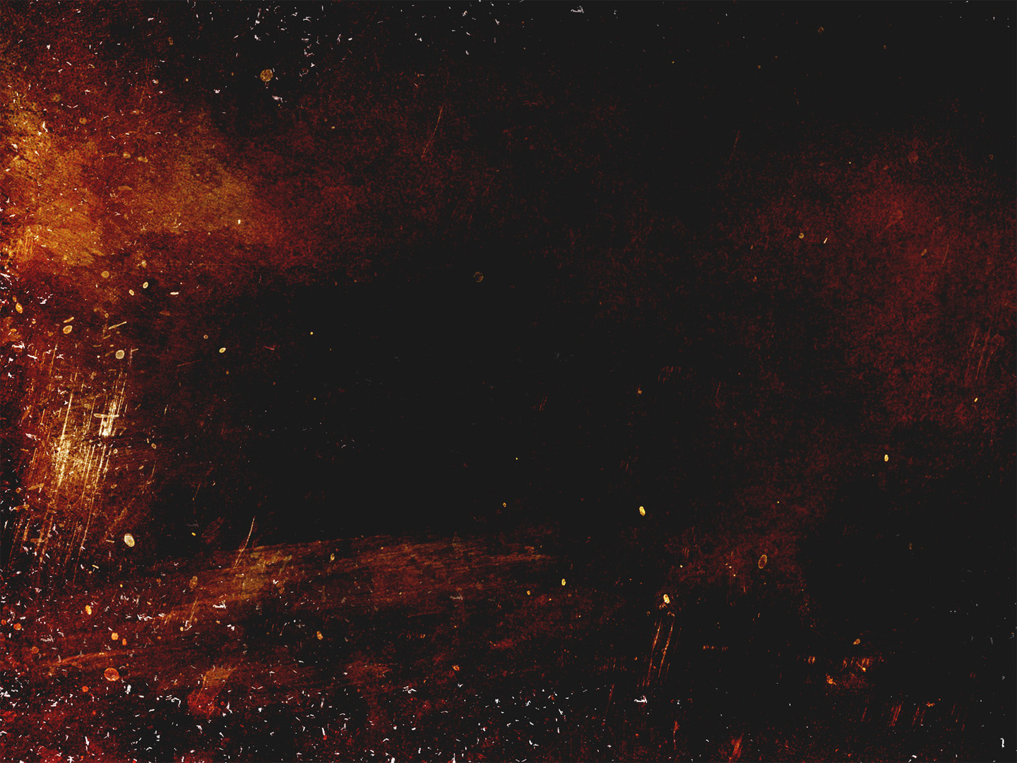
Numbers 16:3
³ They assembled themselves together against Moses and against Aaron and said to them, “You have gone too far! For all in the congregation are holy, every one of them, and the Lord is among them. Why then do you exalt yourselves above the assembly of the Lord?”

Slide 3
Numbers 16:3, 4
³ They assembled themselves together against Moses and against Aaron and said to them, “You have gone too far! For all in the congregation are holy, every one of them, and the Lord is among them. Why then do you exalt yourselves above the assembly of the Lord?”
⁴ When Moses heard it, he fell on his face,

Slide 4
Numbers 16:4-7
⁴ When Moses heard it, he fell on his face, ⁵ and he said to Korah and all his company, “In the morning the Lord will show who is his, and who is holy, and will bring him near to him. The one whom he chooses he will bring near to him. ⁶ Do this: take censers, Korah and all his company; ⁷ put fire in them and put incense on them before the Lord tomorrow, and the man whom the Lord chooses shall be the holy one. You have gone too far, sons of Levi!”

Slide 5
Numbers 16:11
¹¹ Therefore it is against the Lord that you and all your company have gathered together. What is Aaron that you grumble against him?”

Slide 6
Numbers 16:13, 14
¹³ Is it a small thing that you have brought us up out of a land flowing with milk and honey, to kill us in the wilderness, that you must also make yourself a prince over us? ¹⁴ Moreover, you have not brought us into a land flowing with milk and honey, nor given us inheritance of fields and vineyards. Will you put out the eyes of these men? We will not come up.”

Slide 7
Numbers 16:15
¹⁵ And Moses was very angry and said to the Lord, “Do not respect their offering. I have not taken one donkey from them, and I have not harmed one of them.”

Slide 8
Numbers 16:18, 19
¹⁸ So every man took his censer and put fire in them and laid incense on them and stood at the entrance of the tent of meeting with Moses and Aaron. ¹⁹ Then Korah assembled all the congregation against them at the entrance of the tent of meeting. And the glory of the Lord appeared to all the congregation.

Slide 9
Numbers 16:20, 21
²⁰ And the Lord spoke to Moses and to Aaron, saying, ²¹ “Separate yourselves from among this congregation, that I may consume them in a moment.”

Slide 10
Numbers 16:20-22
²⁰ And the Lord spoke to Moses and to Aaron, saying, ²¹ “Separate yourselves from among this congregation, that I may consume them in a moment.”
²² And they fell on their faces and said, “O God, the God of the spirits of all flesh, shall one man sin, and will you be angry with all the congregation?”

Slide 11
Numbers 16:28, 29
²⁸ And Moses said, “Hereby you shall know that the Lord has sent me to do all these works, and that it has not been of my own accord. ²⁹ If these men die as all men die, or if they are visited by the fate of all mankind, then the Lord has not sent me.

Slide 12
Numbers 16:30
³⁰ But if the Lord creates something new, and the ground opens its mouth and swallows them up with all that belongs to them, and they go down alive into Sheol, then you shall know that these men have despised the Lord.”

Slide 13
Numbers 16:31-35
³¹ And as soon as he had finished speaking all these words, the ground under them split apart. ³² And the earth opened its mouth and swallowed them up, with their households and all the people who belonged to Korah and all their goods. ³³ So they and all that belonged to them went down alive into Sheol, and the earth closed over them, and they perished from the midst of the assembly. ³⁴ And all Israel who were around them fled at their cry, for they said, “Lest the earth swallow us up!” ³⁵ And fire came out from the Lord and consumed the 250 men offering the incense.

Slide 14
Numbers 16:41
⁴¹ But on the next day all the congregation of the people of Israel grumbled against Moses and against Aaron, saying, “You have killed the people of the Lord.”

Slide 15
Numbers 16:46
⁴⁶ “Take your censer, and put fire on it from off the altar and lay incense on it and carry it quickly to the congregation and make atonement for them, for wrath has gone out from the Lord; the plague has begun.”

Slide 16
Numbers 16:47-50
⁴⁷ So Aaron took it as Moses said and ran into the midst of the assembly. And behold, the plague had already begun among the people. And he put on the incense and made atonement for the people. ⁴⁸ And he stood between the dead and the living, and the plague was stopped. ⁴⁹ Now those who died in the plague were 14,700, besides those who died in the affair of Korah. ⁵⁰ And Aaron returned to Moses at the entrance of the tent of meeting, when the plague was stopped.

Slide 17
We are to respect God-ordained leadership
- Heb. 13:17; Eph. 5:22-24; 6:1-3; Rom. 13:1, 2
Godly leaders are servant leaders
- Jn. 13:3-5; Lk. 22:25, 26; 1 Pet. 5:1-4
We need to respect our roles
- 1 Cor. 14:26-35; Pet. 5:5; Pr. 1:8; Col. 3:20
4. Sin destroys like the plague
- 1 Cor. 5:6; Rom. 3:23; Ezk. 18:4, 20
Don’t let jealousy take hold
- Gal. 5:19-21; Js. 3:15-17

Slide 18
KORAH’S
REBELLION
NUMBERS 16

