Slide 2
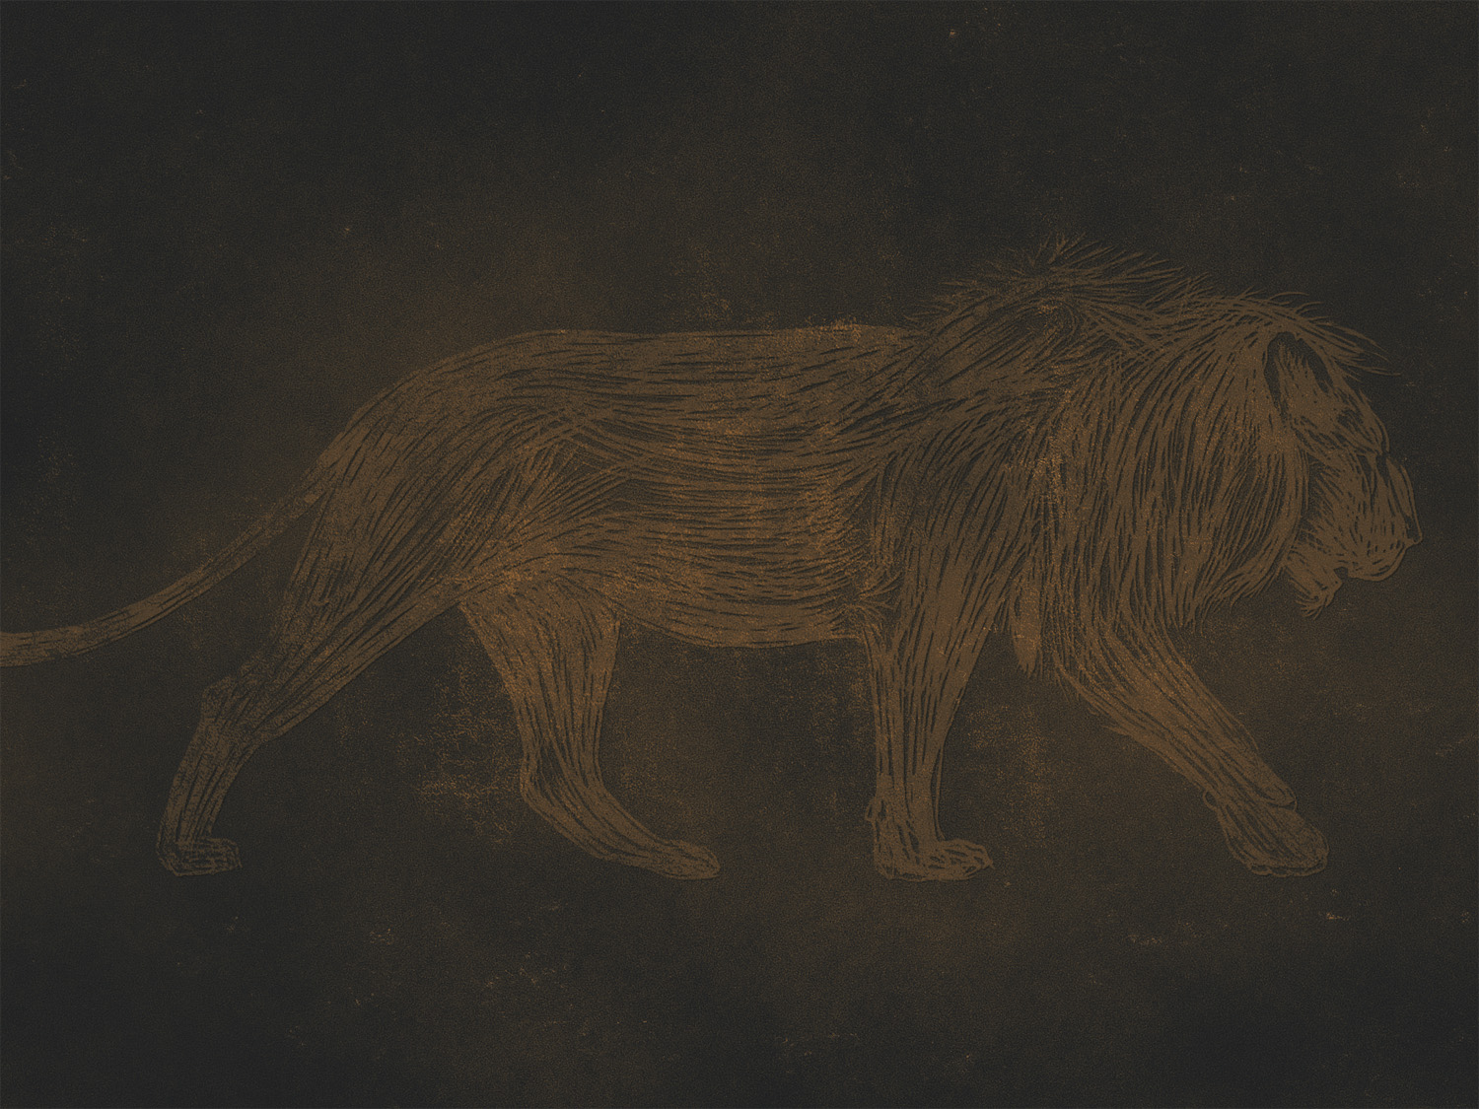
1 Kings 13:1
And behold, a man of God came out of Judah by the word of the Lord to Bethel. Jeroboam was standing by the altar to make offerings.

Slide 3
1 Kings 13:2-3
² And the man cried against the altar by the word of the Lord and said, “O altar, altar, thus says the Lord: ‘Behold, a son shall be born to the house of David, Josiah by name, and he shall sacrifice on you the priests of the high places who make offerings on you, and human bones shall be burned on you.’” ³ And he gave a sign the same day, saying, “This is the sign that the Lord has spoken: ‘Behold, the altar shall be torn down, and the ashes that are on it shall be poured out.’”

Slide 4
1 Kings 13:4-5
⁴ And when the king heard the saying of the man of God, which he cried against the altar at Bethel, Jeroboam stretched out his hand from the altar, saying, “Seize him.” And his hand, which he stretched out against him, dried up, so that he could not draw it back to himself. ⁵ The altar also was torn down, and the ashes poured out from the altar, according to the sign that the man of God had given by the word of the Lord.

Slide 5
1 Kings 13:7
⁷ And the king said to the man of God, “Come home with me, and refresh yourself, and I will give you a reward.”

Slide 6
1 Kings 13:8-10
⁸ And the man of God said to the king, “If you give me half your house, I will not go in with you. And I will not eat bread or drink water in this place, ⁹ for so was it commanded me by the word of the Lord, saying, ‘You shall neither eat bread nor drink water nor return by the way that you came.’” ¹⁰ So he went another way and did not return by the way that he came to Bethel.

Slide 7
1 Kings 13:15-17
¹⁵ Then he said to him, “Come home with me and eat bread.” ¹⁶ And he said, “I may not return with you, or go in with you, neither will I eat bread nor drink water with you in this place, ¹⁷ for it was said to me by the word of the Lord, ‘You shall neither eat bread nor drink water there, nor return by the way that you came.’”

Slide 8
1 Kings 13:18
¹⁸ And he said to him, “I also am a prophet as you are, and an angel spoke to me by the word of the Lord, saying, ‘Bring him back with you into your house that he may eat bread and drink water.’”

Slide 9
1 Kings 13:18
¹⁸ And he said to him, “I also am a prophet as you are, and an angel spoke to me by the word of the Lord, saying, ‘Bring him back with you into your house that he may eat bread and drink water.’”
But he lied to him.

Slide 10
1 Kings 13:21-22
²¹ And he cried to the man of God who came from Judah, “Thus says the Lord, ‘Because you have disobeyed the word of the Lord and have not kept the command that the Lord your God commanded you, ²² but have come back and have eaten bread and drunk water in the place of which he said to you, “Eat no bread and drink no water,” your body shall not come to the tomb of your fathers.’”

Slide 11
1 Kings 13:24-25
²⁴ And as he went away a lion met him on the road and killed him. And his body was thrown in the road, and the donkey stood beside it; the lion also stood beside the body. ²⁵ And behold, men passed by and saw the body thrown in the road and the lion standing by the body. And they came and told it in the city where the old prophet lived.

Slide 12
The Primary Message of 1 Kings 13
HOLD FAST TO THE WORD OF GOD

Slide 13
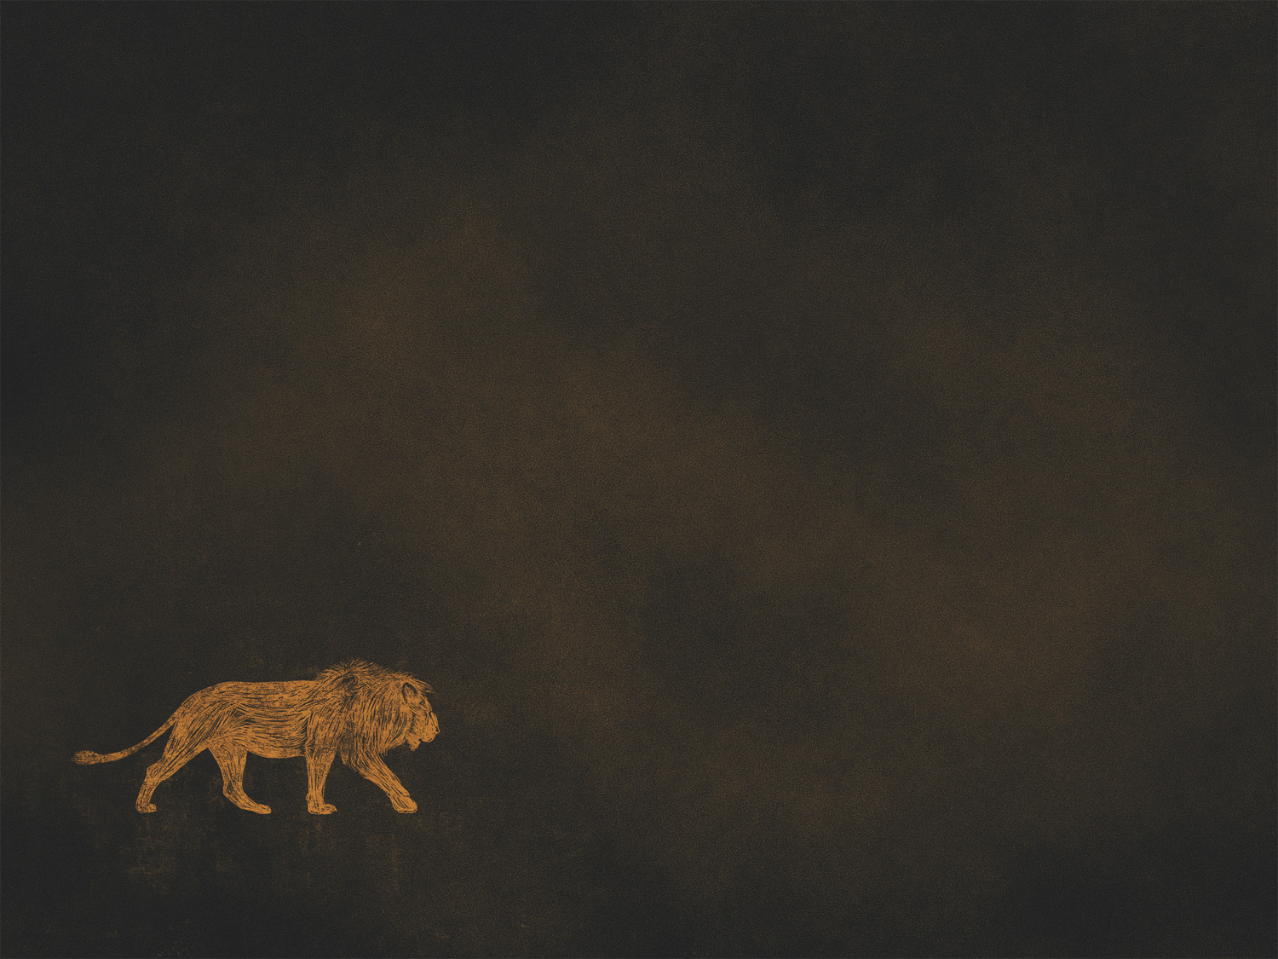
Trust God’s Word, not man’s
- Deut. 13:1-4; Gal.1:6-9
We are accountable for our actions
- Matt. 12:36; 16:27; Rom. 14:12; 1 Pet. 4:5
The authority of God’s Word can be seen, yet still rejected (33, 34)
- Num. 14:6-12; Matt. 12:22-29

