Slide 2
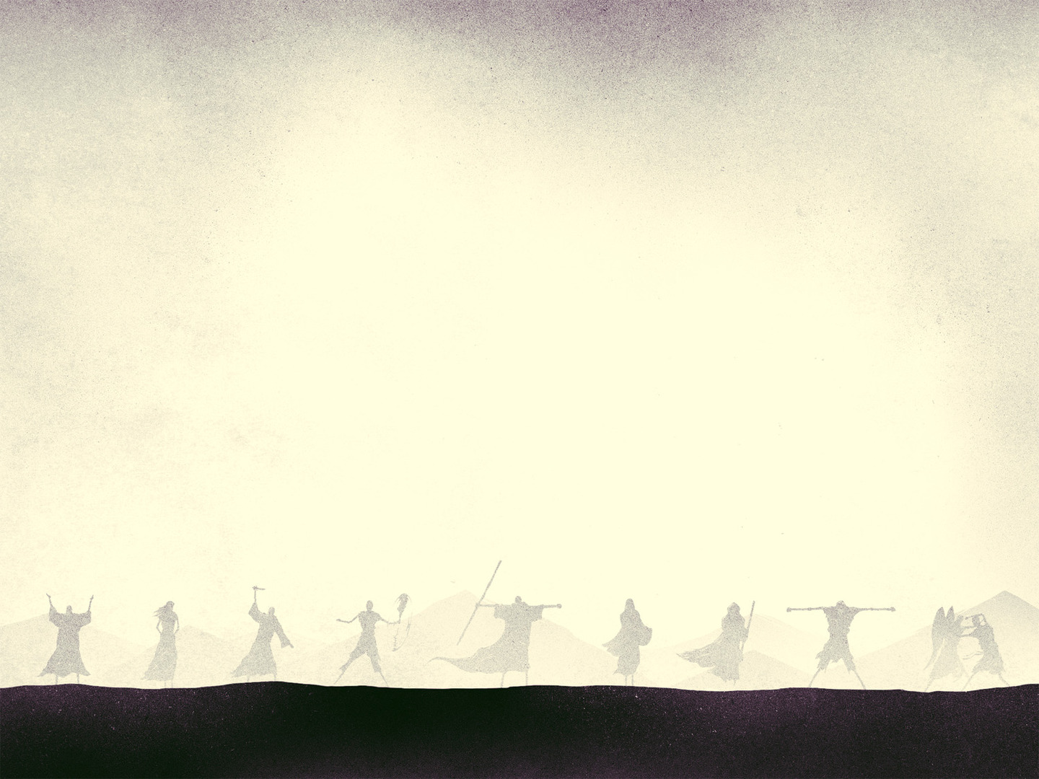
King Asa
3rd king of Judah after the division
Reigned 41 years
Can be read about in 1 Kings 15:9-24 and 2 Chronicles 14-16

Slide 3
A Godly King
2 Chronicles 14:1, 2
¹ Abijah slept with his fathers, and they buried him in the city of David. And Asa his son reigned in his place. In his days the land had rest for ten years.
² And Asa did what was good and right in the eyes of the Lord his God.

Slide 4
A Proactive King
2 Chronicles 14:3-5a
³ He took away the foreign altars and the high places and broke down the pillars and cut down the Asherim ⁴ and commanded Judah to seek the Lord, the God of their fathers, and to keep the law and the commandment. ⁵ He also took out of all the cities of Judah the high places and the incense altars.

Slide 5
A Blessed King
2 Chronicles 14:5b-6 (see. V. 1)
^{5b} And the kingdom had rest under him. ⁶ He built fortified cities in Judah, for the land had rest. He had no war in those years, for the Lord gave him peace.

Slide 6
2 Chronicles 14:11
¹¹ And Asa cried to the Lord his God, “O Lord, there is none like you to help, between the mighty and the weak. Help us, O Lord our God, for we rely on you, and in your name we have come against this multitude. O Lord, you are our God; let not man prevail against you.”

Slide 7
2 Chronicles 14:12, 13
¹² So the Lord defeated the Ethiopians before Asa and before Judah, and the Ethiopians fled. ¹³ Asa and the people who were with him pursued them as far as Gerar, and the Ethiopians fell until none remained alive, for they were broken before the Lord and his army.

Slide 8
A Self-Reliant King
2 Chronicles 16:1
¹ In the thirty-sixth year of the reign of Asa, Baasha king of Israel went up against Judah and built Ramah, that he might permit no one to go out or come in to Asa king of Judah.

Slide 9
A Self-Reliant King
2 Chronicles 16:2, 3
² Then Asa took silver and gold from the treasures of the house of the Lord and the king's house and sent them to Ben-hadad king of Syria, who lived in Damascus, saying, ³ “There is a covenant between me and you, as there was between my father and your father. Behold, I am sending to you silver and gold. Go, break your covenant with Baasha king of Israel, that he may withdraw from me.”

Slide 10
A Self-Reliant King
2 Chronicles 16:4, 5
⁴ And Ben-hadad listened to King Asa and sent the commanders of his armies against the cities of Israel, and they conquered Ijon, Dan, Abel-maim, and all the store cities of Naphtali. ⁵ And when Baasha heard of it, he stopped building Ramah and let his work cease.

Slide 11
A Self-Reliant King
2 Chronicles 16:6
⁶ Then King Asa took all Judah, and they carried away the stones of Ramah and its timber, with which Baasha had been building, and with them he built Geba and Mizpah.

Slide 12
A Unrepentant King
2 Chronicles 16:7, 8
⁷ At that time Hanani the seer came to Asa king of Judah and said to him, “Because you relied on the king of Syria, and did not rely on the Lord your God, the army of the king of Syria has escaped you.
⁸ Were not the Ethiopians and the Libyans a huge army with very many chariots and horsemen? Yet because you relied on the Lord, he gave them into your hand.

Slide 13
A Unrepentant King
2 Chronicles 16:9, 10
⁹ For the eyes of the Lord run to and fro throughout the whole earth, to give strong support to those whose heart is blameless toward him. You have done foolishly in this, for from now on you will have wars.” ¹⁰ Then Asa was angry with the seer and put him in the stocks in prison, for he was in a rage with him because of this. And Asa inflicted cruelties upon some of the people at the same time.

Slide 14
A Faithless King
2 Chronicles 16:12
¹² In the thirty-ninth year of his reign Asa was diseased in his feet, and his disease became severe. Yet even in his disease he did not seek the Lord, but sought help from physicians.

