Slide 1
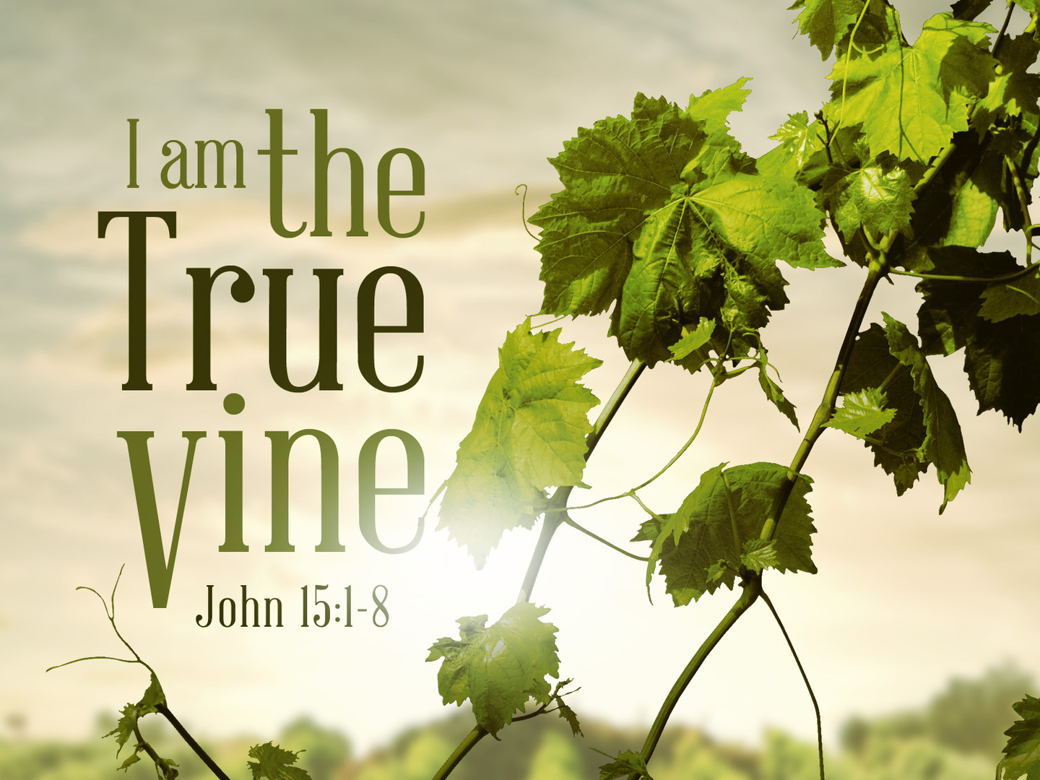

Slide 2
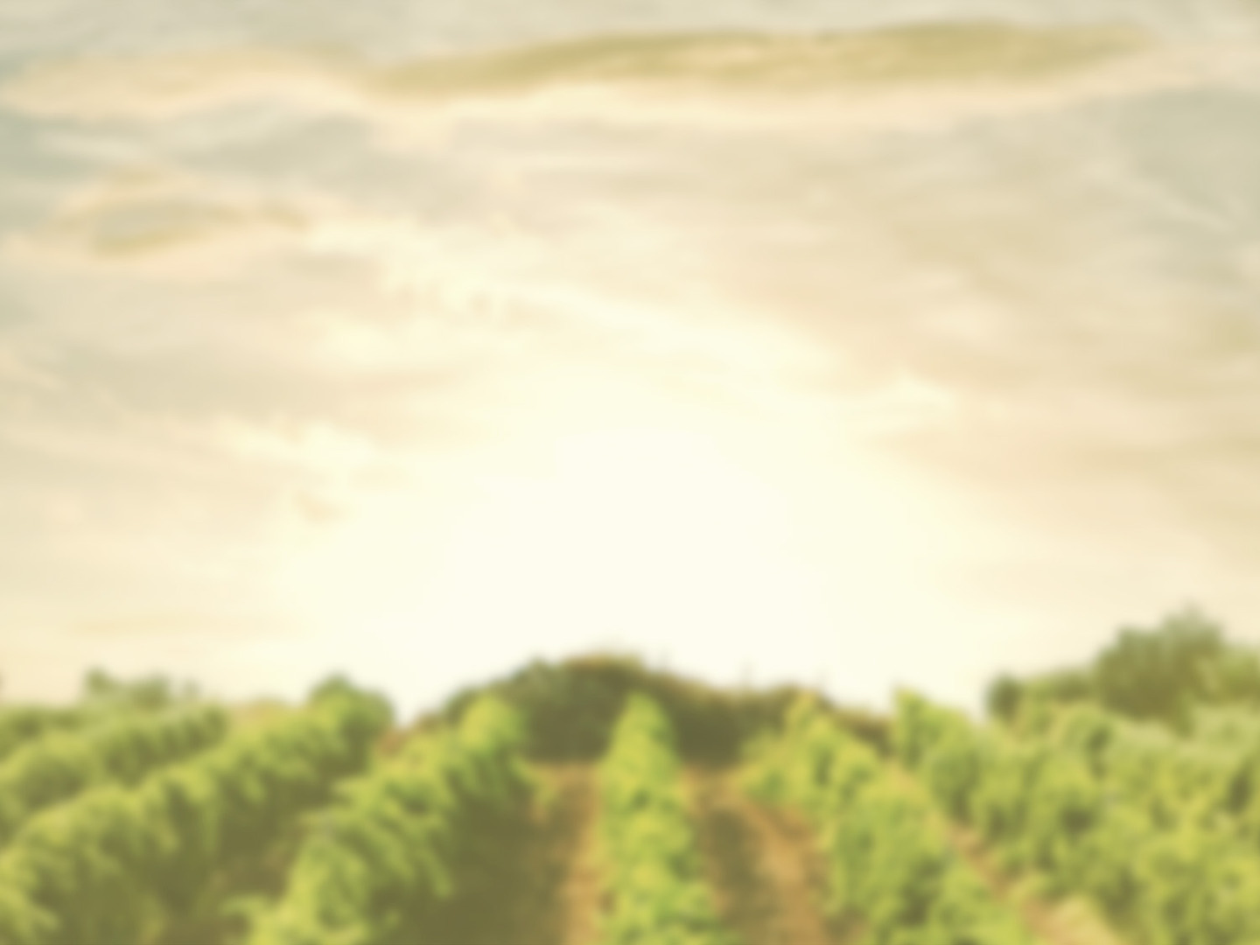
John 15:1-5
¹ “I am the true vine, and my Father is the vinedresser. ² Every branch in me that does not bear fruit he takes away, and every branch that does bear fruit he prunes, that it may bear more fruit. ³ Already you are clean because of the word that I have spoken to you. ⁴ Abide in me, and I in you. As the branch cannot bear fruit by itself, unless it abides in the vine, neither can you, unless you abide in me. ⁵ I am the vine; you are the branches. Whoever abides in me and I in him, he it is that bears much fruit, for apart from me you can do nothing.

Slide 3
John 15:6-9
⁶ If anyone does not abide in me he is thrown away like a branch and withers; and the branches are gathered, thrown into the fire, and burned. ⁷ If you abide in me, and my words abide in you, ask whatever you wish, and it will be done for you. ⁸ By this my Father is glorified, that you bear much fruit and so prove to be my disciples. ⁹ As the Father has loved me, so have I loved you. Abide in my love.

Slide 4
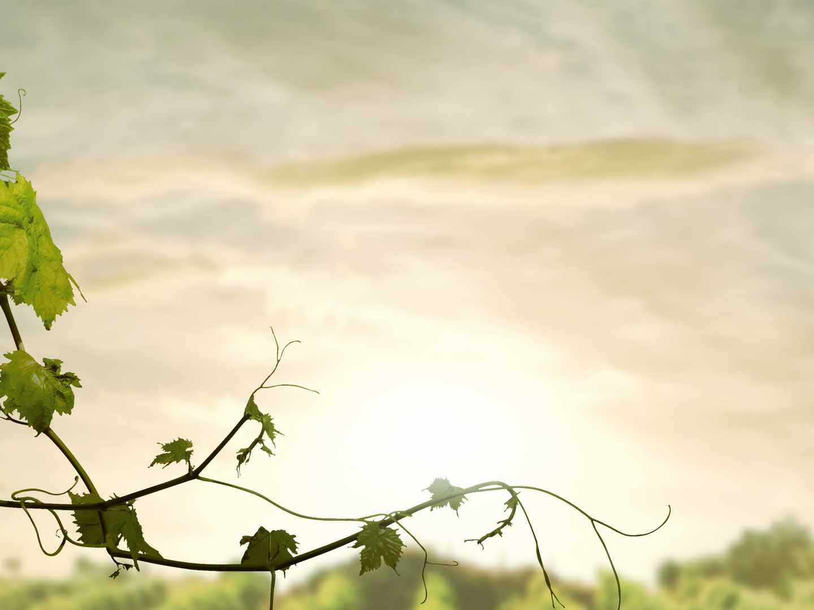
The True Vine (v. 1, 5)
Jesus Christ
Israel had been called a vine
(Ps. 8:8-9; Is. 5:1-7; Jer. 2:21)
Disobedience and rebellion caused them to produce “wild grapes”
Jesus is the true vine who won’t fail!

Slide 5
The Vinedresser (vv. 1-2)
God the Father
Two Primary Tasks (v. 2)
Remove fruitless branches
Prune fruit-bearing branches

Slide 6
The Branches (vv. 1-2)
Those who profess to be disciples of Christ
Two types of branches (v. 2)
Fruitless
- It is impossible to bear fruit outside of
the vine
Fruit-bearing
- It is impossible to NOT bear
fruit in the vine

Slide 7
The Fruit
Characteristics of The Vine that manifest themselves in our lives
Galatians 5:22-23
love, joy, peace, patience, kindness, goodness, faithfulness, gentleness, self-control
These “attitude” fruits can be seen in our actions (Eph. 2:10; Titus 2:14; James 2)

Slide 8
Benefits of Abiding in The Vine
- Production of fruit (v. 5)
- Answered prayers (v. 7)
- Glory to God (v. 8)
- Evidence of true discipleship (v. 8)
- Unity among believers (Ph. 2:2)

Slide 9
The Curse of Not Abiding in The Vine
⁶ If anyone does not abide in me he is thrown away like a branch and withers; and the branches are gathered, thrown into the fire, and burned.
Rev. 21:8; Matt. 13:59; 25:46; 2 Thess. 1:9

Slide 10
How Does The Vinedresser Prune?
Allowing us to endure suffering
2 Cor. 12:7-10; Job 1:9-12
Exposing and removing sin (Ps. 139:23-24)
Prunes with The Word (Heb. 4:12)

