Slide 2
Esther 1:1-4
¹ Now in the days of Ahasuerus, the Ahasuerus who reigned from India to Ethiopia over 127 provinces, ² in those days when King Ahasuerus sat on his royal throne in Susa, the citadel, ³ in the third year of his reign he gave a feast for all his officials and servants. The army of Persia and Media and the nobles and governors of the provinces were before him, ⁴ while he showed the riches of his royal glory and the splendor and pomp of his greatness for many days, 180 days.

Slide 3
Esther 2:5-6
⁵ Now there was a Jew in Susa the citadel whose name was Mordecai, the son of Jair, son of Shimei, son of Kish, a Benjaminite, ⁶ who had been carried away from Jerusalem among the captives carried away with Jeconiah king of Judah, whom Nebuchadnezzar king of Babylon had carried away.

Slide 4
Esther 2:7-8
⁷ He was bringing up Hadassah, that is Esther, the daughter of his uncle, for she had neither father nor mother. The young woman had a beautiful figure and was lovely to look at, and when her father and her mother died, Mordecai took her as his own daughter.
⁸ So when the king's order and his edict were proclaimed, and when many young women were gathered in Susa the citadel in custody of Hegai, Esther also was taken into the king's palace and put in custody of Hegai, who had charge of the women.

Slide 5
Esther 2:21-23
²¹ In those days, as Mordecai was sitting at the king's gate, Bigthan and Teresh, two of the king's eunuchs, who guarded the threshold, became angry and sought to lay hands on King Ahasuerus. ²² And this came to the knowledge of Mordecai, and he told it to Queen Esther, and Esther told the king in the name of Mordecai. ²³ When the affair was investigated and found to be so, the men were both hanged on the gallows. And it was recorded in the book of the chronicles in the presence of the king.

Slide 6
Esther 3:12b
^{12b} …an edict, according to all that Haman commanded, was written to the king's satraps and to the governors over all the provinces and to the officials of all the peoples, to every province in its own script and every people in its own language. It was written in the name of King Ahasuerus and sealed with the king's signet ring.

Slide 7
Esther 3:13-14
¹³ Letters were sent by couriers to all the king's provinces with instruction to destroy, to kill, and to annihilate all Jews, young and old, women and children, in one day, the thirteenth day of the twelfth month, which is the month of Adar, and to plunder their goods. ¹⁴ A copy of the document was to be issued as a decree in every province by proclamation to all the peoples to be ready for that day.

Slide 8
Esther 4:14
¹⁴ For if you keep silent at this time, relief and deliverance will rise for the Jews from another place, but you and your father's house will perish. And who knows whether you have not come to the kingdom for such a time as this?”

Slide 9
Esther 4:16
¹⁶ “Go, gather all the Jews to be found in Susa, and hold a fast on my behalf, and do not eat or drink for three days, night or day. I and my young women will also fast as you do. Then I will go to the king, though it is against the law, and if I perish, I perish.”

Slide 10
Esther 5:14
¹⁴ “Let a gallows fifty cubits high be made, and in the morning tell the king to have Mordecai hanged upon it. Then go joyfully with the king to the feast.” This idea pleased Haman, and he had the gallows made.

Slide 11
Esther 7:3-4
³ “If I have found favor in your sight, O king, and if it please the king, let my life be granted me for my wish, and my people for my request. ⁴ For we have been sold, I and my people, to be destroyed, to be killed, and to be annihilated. If we had been sold merely as slaves, men and women, I would have been silent, for our affliction is not to be compared with the loss to the king.”

Slide 12
Esther 7:7
⁷ And the king arose in his wrath from the wine-drinking and went into the palace garden, but Haman stayed to beg for his life from Queen Esther, for he saw that harm was determined against him by the king.

Slide 13
Esther 7:8
⁸ And the king returned from the palace garden to the place where they were drinking wine, as Haman was falling on the couch where Esther was. And the king said, “Will he even assault the queen in my presence, in my own house?” As the word left the mouth of the king, they covered Haman's face.

Slide 14
Esther 7:8
⁸ And the king returned from the palace garden to the place where they were drinking wine, as Haman was falling on the couch where Esther was. And the king said, “Will he even assault the queen in my presence, in my own house?” As the word left the mouth of the king, they covered Haman's face.

Slide 15
Esther 7:9-10
⁹ Then Harbona, one of the eunuchs in attendance on the king, said, “Moreover, the gallows that Haman has prepared for Mordecai, whose word saved the king, is standing at Haman's house, fifty cubits high.” And the king said, “Hang him on that.” ¹⁰ So they hanged Haman on the gallows that he had prepared for Mordecai. Then the wrath of the king abated.

Slide 16
Esther 8:1-2
¹ On that day King Ahasuerus gave to Queen Esther the house of Haman, the enemy of the Jews. And Mordecai came before the king, for Esther had told what he was to her. ² And the king took off his signet ring, which he had taken from Haman, and gave it to Mordecai. And Esther set Mordecai over the house of Haman.

Slide 17
Esther 9:26-27
²⁶ Therefore they called these days Purim, after the term Pur. Therefore, because of all that was written in this letter, and of what they had faced in this matter, and of what had happened to them, ²⁷ the Jews firmly obligated themselves and their offspring and all who joined them, that without fail they would keep these two days according to what was written and at the time appointed every year,

Slide 18
Esther 9:28
²⁸ that these days should be remembered and kept throughout every generation, in every clan, province, and city, and that these days of Purim should never fall into disuse among the Jews, nor should the commemoration of these days cease among their descendants.

Slide 19
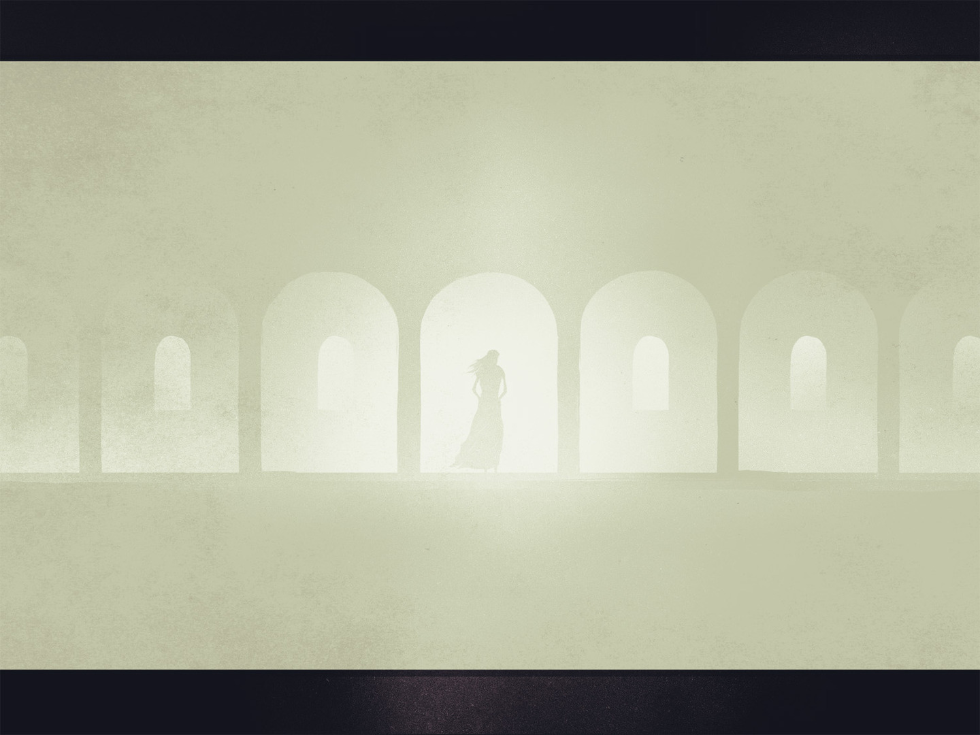
God can use all people and all circumstances to advance His purposes
- Dan. 4:35; Acts 17:26; Rom. 8:28
We must be courageous Christians
- Matt. 10:28; 1 Cor. 15:58; Eph. 6:10
God is faithful and will deliver His people
- Num. 23:19; Deut. 32:4; 2 Thess. 1:5-10

