Slide 2
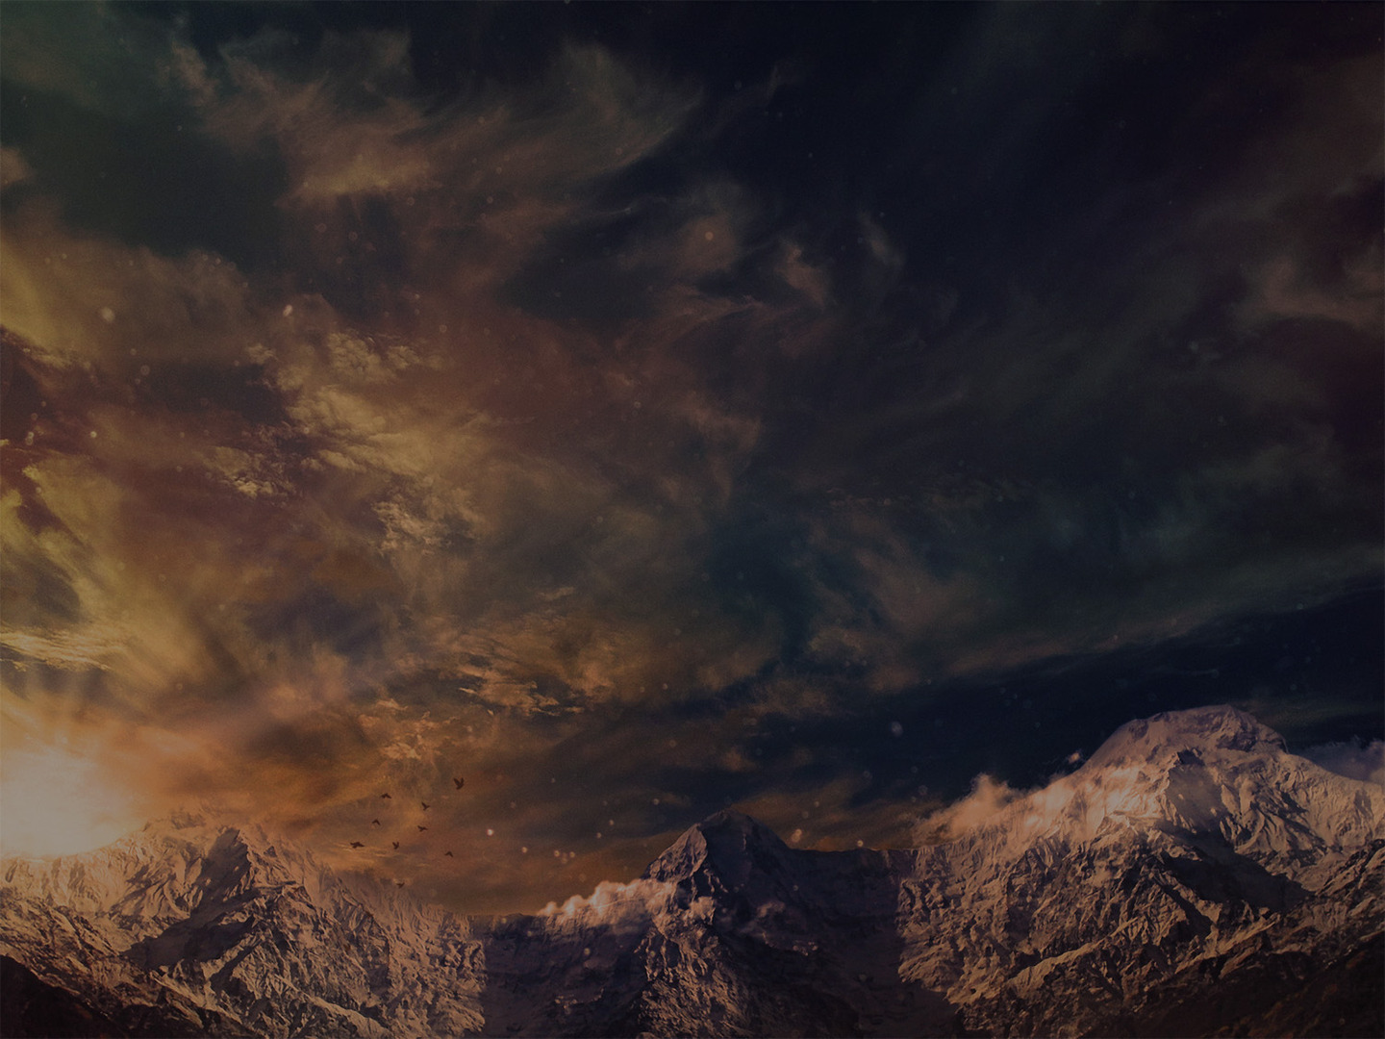
The Wonder of God’s KNOWLEDGE
¹ O Lord, you have searched me and known me!
² You know when I sit down and when I rise up; you discern my thoughts from afar.
³ You search out my path and my lying down
and are acquainted with all my ways.
⁴ Even before a word is on my tongue,
behold, O Lord, you know it altogether.

Slide 3
The Wonder of God’s KNOWLEDGE
⁵ You hem me in, behind and before,
and lay your hand upon me.
⁶ Such knowledge is too wonderful for me;
it is high; I cannot attain it.

Slide 4
The Wonder of God’s KNOWLEDGE
¹ O Lord, you have searched me and known me!
² You know when I sit down and when I rise up; you discern my thoughts from afar.
³ You search out my path and my lying down
and are acquainted with all my ways.
⁴ Even before a word is on my tongue,
behold, O Lord, you know it altogether.

Slide 5
The Wonder of God’s KNOWLEDGE
⁵ You hem me in, behind and before,
and lay your hand upon me.
⁶ Such knowledge is too wonderful for me;
it is high; I cannot attain it.

Slide 6
The Wonder of God’s PRESENCE
⁷ Where shall I go from your Spirit?
Or where shall I flee from your presence?
⁸ If I ascend to heaven, you are there!
If I make my bed in Sheol, you are there!
⁹ If I take the wings of the morning
and dwell in the uttermost parts of the sea,

Slide 7
The Wonder of God’s PRESENCE
¹⁰ even there your hand shall lead me,
and your right hand shall hold me.
¹¹ If I say, “Surely the darkness shall cover me, and the light about me be night,”
¹² even the darkness is not dark to you;
the night is bright as the day,
for darkness is as light with you.

Slide 8
The Wonder of God’s POWER
¹³ For you formed my inward parts;
you knitted me together in my mother's womb.
¹⁴ I praise you, for I am fearfully
and wonderfully made.
Wonderful are your works;
my soul knows it very well.

Slide 9
The Wonder of God’s POWER
¹⁵ My frame was not hidden from you,
when I was being made in secret,
intricately woven in the depths of the earth.
¹⁶ Your eyes saw my unformed substance;
in your book were written, every one of them, the days that were formed for me,
when as yet there was none of them.

Slide 10
The Wonder of God’s POWER
¹⁷ How precious to me are your thoughts, O God! How vast is the sum of them!
¹⁸ If I would count them, they are more than the sand. I awake, and I am still with you.

Slide 11
The Wonder of God’s JUDGMENT
¹⁹ Oh that you would slay the wicked, O God!
O men of blood, depart from me!
²⁰ They speak against you with malicious intent; your enemies take your name in vain.
²¹ Do I not hate those who hate you, O Lord?
And do I not loathe those who rise up against you?
²² I hate them with complete hatred;
I count them my enemies.

Slide 12
The Wonder of God’s JUDGMENT
²³ Search me, O God, and know my heart!
Try me and know my thoughts!
²⁴ And see if there be any grievous way in me, and lead me in the way everlasting!

