Slide 2
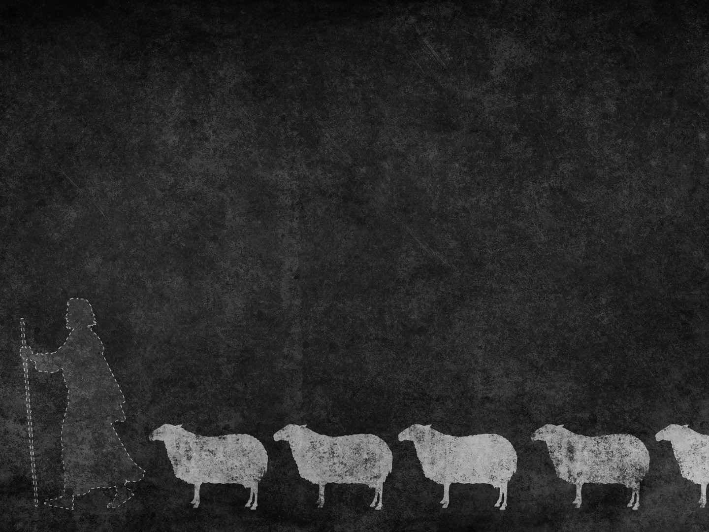
Ezekiel 34:22-24
²² I will rescue my flock; they shall no longer be a prey. And I will judge between sheep and sheep. ²³ And I will set up over them one shepherd, my servant David, and he shall feed them: he shall feed them and be their shepherd. ²⁴ And I, the Lord, will be their God, and my servant David shall be prince among them. I am the Lord; I have spoken.

Slide 3
Ezekiel 34:1-3
The word of the Lord came to me: ² “Son of man, prophesy against the shepherds of Israel; prophesy, and say to them, even to the shepherds, Thus says the Lord God: Ah, shepherds of Israel who have been feeding yourselves! Should not shepherds feed the sheep? ³ You eat the fat, you clothe yourselves with the wool, you slaughter the fat ones, but you do not feed the sheep.

Slide 4
Ezekiel 34:4-6
⁴ The weak you have not strengthened, the sick you have not healed, the injured you have not bound up, the strayed you have not brought back, the lost you have not sought, and with force and harshness you have ruled them. ⁵ So they were scattered, because there was no shepherd, and they became food for all the wild beasts. My sheep were scattered; ⁶ they wandered over all the mountains and on every high hill. My sheep were scattered over all the face of the earth, with none to search or seek for them.

Slide 5
God wants shepherds to…
Feed the flock (vv. 2-3)
Nurture the weak, the sick, and the injured (v. 4)
Seek the lost and straying (v. 4)
Lead with gentleness (v. 4)
Protect from danger (v. 5)

