Slide 2
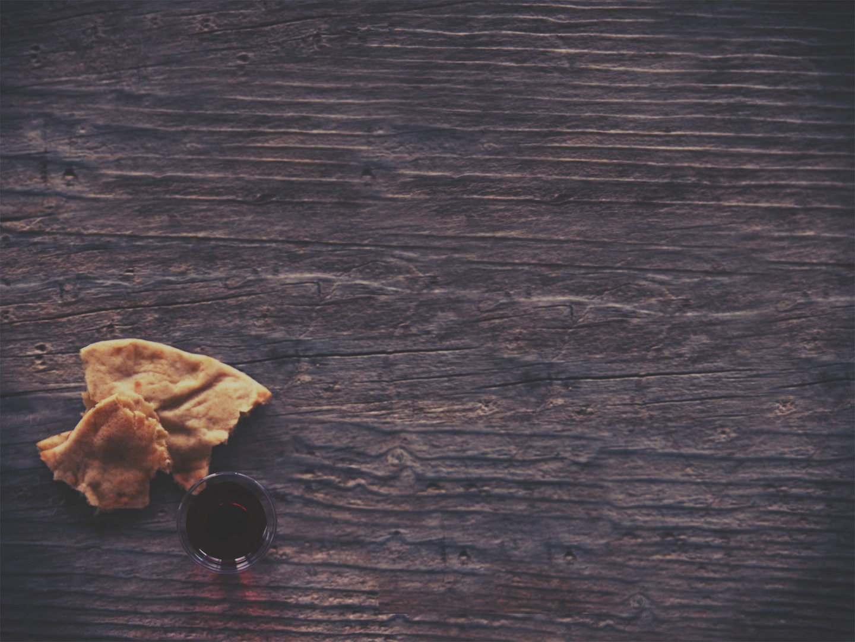
1 Corinthians 11:2
Now I commend you because you remember me in everything and maintain the traditions even as I delivered
them to you.

Slide 3
1 Corinthians 11:17
¹⁷ But in the following instructions I do not commend you, because when you come together it is not for the better but for the worse.

Slide 4
1 Corinthians 11:17-19
¹⁷ But in the following instructions I do not commend you, because when you come together it is not for the better but for the worse.
¹⁸ For, in the first place, when you come together as a church, I hear that there are divisions among you. And I
believe it in part, ¹⁹ for there
must be factions among you in
order that those who are
genuine among you may be
recognized.

Slide 5
1 Corinthians 11:20-22
²⁰ When you come together, it is not the Lord's supper that you eat. ²¹ For in eating, each one goes ahead with his own meal. One goes hungry, another gets drunk. ²² What! Do you not have houses to eat and drink in? Or do you despise the
church of God and humiliate
those who have nothing? What
shall I say to you? Shall I
commend you in this?
No, I will not.

Slide 6
1 Corinthians 11:23-24
²³ For I received from the Lord what I also delivered to you, that the Lord Jesus on the night when he was betrayed took bread,
²⁴ and when he had given thanks, he broke it, and said, “This is my body, which is for you. Do this in remembrance
of me.”

Slide 7
The Lord’s Supper
A Commemoration (vv. 24, 25)

Slide 8
Isaiah 53:4-6
⁴ Surely he has borne our griefs and carried our sorrows; yet we esteemed him stricken, smitten by God, and afflicted. ⁵ But he was pierced for our transgressions; he was crushed for our iniquities; upon him was the chastisement that brought us peace,
and with his wounds we are
healed. ⁶ All we like sheep have
gone astray; we have turned—
every one—to his own way; and
the Lord has laid on him the
iniquity of us all.

Slide 9
1 Corinthians 11:25
In the same way also he took the cup, after supper, saying, “This cup is the new covenant in my blood. Do this, as often as you drink it, in remembrance of me.”

Slide 10
1 Corinthians 11:26
For as often as you eat this bread and drink the cup, you proclaim the Lord's death until he comes.

Slide 11
The Lord’s Supper
A Commemoration (vv. 24, 25)
A Proclamation (v. 26)

Slide 12
The Lord’s Supper
A Commemoration (vv. 24, 25)
A Proclamation (v. 26)
An Anticipation (v. 26)

Slide 13
1 Corinthians 11:27-29
²⁷ Whoever, therefore, eats the bread or drinks the cup of the Lord in an unworthy manner will be guilty concerning the body and blood of the Lord. ²⁸ Let a person examine himself, then, and so eat of the bread and drink of the cup.
²⁹ For anyone who eats and
drinks without discerning the
body eats and drinks judgment
on himself.

Slide 14
The Lord’s Supper
A Commemoration (vv. 24, 25)
A Proclamation (v. 26)
An Anticipation (v. 26)
An Examination (vv. 27-29)

