Slide 2
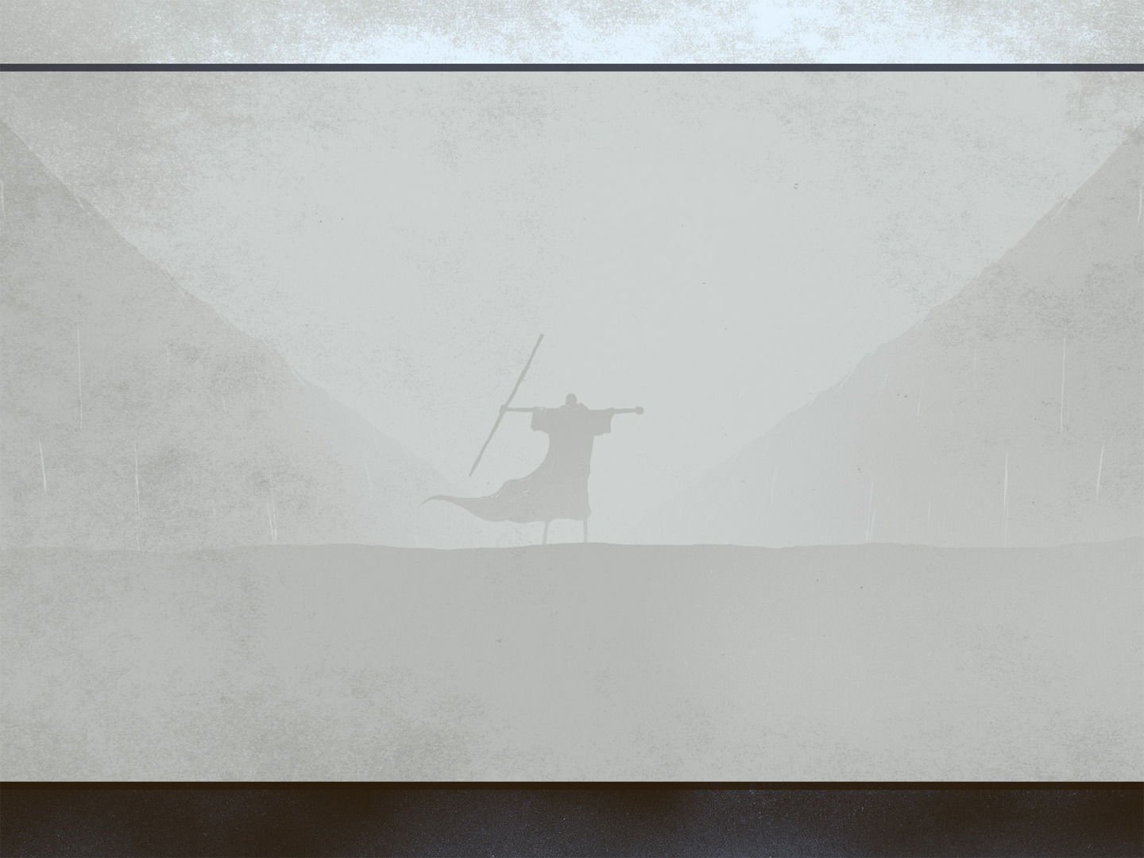
Exodus 3:1-3
¹ Now Moses was keeping the flock of his father-in-law, Jethro, the priest of Midian, and he led his flock to the west side of the wilderness and came to Horeb, the mountain of God. ² And the angel of the Lord appeared to him in a flame of fire out of the midst of a bush. He looked, and behold, the bush was burning, yet it was not consumed. ³ And Moses said, “I will turn aside to see this great sight, why the bush is not burned.”

Slide 3
Exodus 3:4-6
⁴ When the Lord saw that he turned aside to see, God called to him out of the bush, “Moses, Moses!” And he said, “Here I am.” ⁵ Then he said, “Do not come near; take your sandals off your feet, for the place on which you are standing is holy ground.” ⁶ And he said, “I am the God of your father, the God of Abraham, the God of Isaac, and the God of Jacob.” And Moses hid his face, for he was afraid to look at God.

Slide 4
Exodus 3:7-9
⁷ Then the Lord said, “I have surely seen the affliction of my people who are in Egypt and have heard their cry because of their taskmasters. I know their sufferings, ⁸ and I have come down to deliver them out of the hand of the Egyptians and to bring them up out of that land to a good and broad land, a land flowing with milk and honey, to the place of the Canaanites, the Hittites, the Amorites, the Perizzites, the Hivites, and the Jebusites. ⁹ And now, behold, the cry of the people of Israel has come to me, and I have also seen the oppression with which the Egyptians oppress them.

Slide 5
Exodus 3:10
¹⁰ Come, I will send you to Pharaoh that you may bring my people, the children of Israel, out of Egypt.”

Slide 6
Exodus 3:11
¹¹ But Moses said to God, “Who am I that I should go to Pharaoh and bring the children of Israel out of Egypt?”

Slide 7
Exodus 3:11-12
¹¹ But Moses said to God, “Who am I that I should go to Pharaoh and bring the children of Israel out of Egypt?”
¹² He said, “But I will be with you, and this shall be the sign for you, that I have sent you: when you have brought the people out of Egypt, you shall serve God on this mountain.”

Slide 8
1. “Who am I?” (v. 11)
We are made sufficient in Christ
(2 Cor. 3:5-6; Acts 4:13; Phil. 4:13)

Slide 9
Exodus 3:13
¹³ Then Moses said to God, “If I come to the people of Israel and say to them, ‘The God of your fathers has sent me to you,’ and they ask me, ‘What is his name?’ what shall I say to them?”

Slide 10
Exodus 3:14-15
¹⁴ God said to Moses, “I am who I am.” And he said, “Say this to the people of Israel: ‘I am has sent me to you.’” ¹⁵ God also said to Moses, “Say this to the people of Israel: ‘The Lord, the God of your fathers, the God of Abraham, the God of Isaac, and the God of Jacob, has sent me to you.’ This is my name forever, and thus I am to be remembered throughout all generations.

Slide 11
1. “Who am I?” (v. 11)
We are made sufficient in Christ
(2 Cor. 3:5-6; Acts 4:13; Phil. 4:13)
“What shall I say?” (v. 13)
God has provided all we need to say
(Mk. 16:16; 1 Cor. 15:1-4)

Slide 12
Exodus 4:1
¹ Then Moses answered, “But behold, they will not believe me or listen to my voice, for they will say, ‘The Lord did not appear to you.’”

Slide 13
Exodus 4:2-5
² The Lord said to him, “What is that in your hand?” He said, “A staff.” ³ And he said, “Throw it on the ground.” So he threw it on the ground, and it became a serpent, and Moses ran from it. ⁴ But the Lord said to Moses, “Put out your hand and catch it by the tail”—so he put out his hand and caught it, and it became a staff in his hand— ⁵ “that they may believe that the Lord, the God of their fathers, the God of Abraham, the God of Isaac, and the God of Jacob, has appeared to you.”

Slide 14
Exodus 4:6-8
⁶ Again, the Lord said to him, “Put your hand inside your cloak.” And he put his hand inside his cloak, and when he took it out, behold, his hand was leprous like snow.
⁷ Then God said, “Put your hand back inside your cloak.” So he put his hand back inside his cloak, and when he took it out, behold, it was restored like the rest of his flesh. ⁸ “If they will not believe you,” God said, “or listen to the first sign, they may believe the latter sign.

Slide 15
Exodus 4:9
⁹ If they will not believe even these two signs or listen to your voice, you shall take some water from the Nile and pour it on the dry ground, and the water that you shall take from the Nile will become blood on the dry ground.”

Slide 16
1. “Who am I?” (3:11)
We are made sufficient in Christ
(2 Cor. 3:5-6; Acts 4:13; Phil. 4:13)
“What shall I say?” (3:13)
God has provided all we need to say
(Mk. 16:16; 1 Cor. 15:1-4)
“They will not believe me” (4:1)
God has given convincing proofs
(Rom. 10:17; John 20:30, 31)

Slide 17
Exodus 4:10
¹⁰ But Moses said to the Lord, “Oh, my Lord, I am not eloquent, either in the past or since you have spoken to your servant, but I am slow of speech and of tongue.”

Slide 18
Exodus 4:10-11
¹⁰ But Moses said to the Lord, “Oh, my Lord, I am not eloquent, either in the past or since you have spoken to your servant, but I am slow of speech and of tongue.”
¹¹ Then the Lord said to him, “Who has made man's mouth? Who makes him mute, or deaf, or seeing, or blind? Is it not I, the Lord?

Slide 19
Exodus 4:10-12
¹⁰ But Moses said to the Lord, “Oh, my Lord, I am not eloquent, either in the past or since you have spoken to your servant, but I am slow of speech and of tongue.”
¹¹ Then the Lord said to him, “Who has made man's mouth? Who makes him mute, or deaf, or seeing, or blind? Is it not I, the Lord?
¹² Now therefore go, and I will be with your mouth and teach you what you shall speak.”

Slide 20
4. “I am slow of speech and tongue” (4:10)
God can use anyone for His purposes
(1 Cor. 2:1-5)

Slide 21
Exodus 4:13
¹³ But he said, “Oh, my Lord, please send someone else.”

Slide 22
4. “I am slow of speech and tongue” (4:10)
God can use anyone for His purposes
(1 Cor. 2:1-5)
“Please send someone else!” (4:13)
We are not to be ashamed of the gospel
(Rom. 1:16)
All of us are to let our lights shine
(Matt. 5:15-16)

