Slide 1
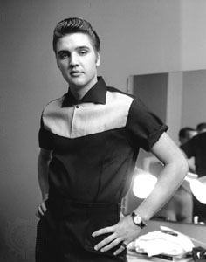
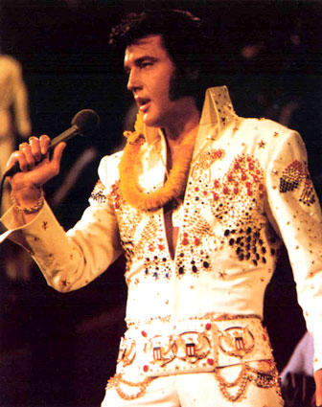
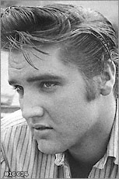
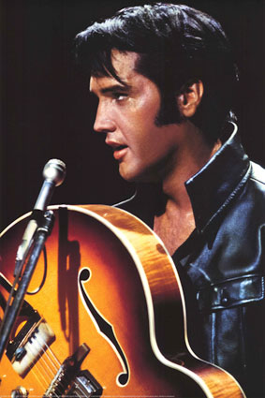
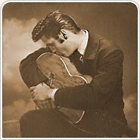
The King is Dead
August 16, 1977

Slide 2
The King Is Alive
The King was Prophesied
Gen.49:9-10
2 Sam.7:12-16
Isaiah 9:6-7
Zech.6:12-13

Slide 3
The King Is Alive
The King was Born
Gal.4:4
Luke 1:26-33
Luke 2:7-11

Slide 4
The King Is Alive
The King was Crucified
John 18:33-19:3
John 19:12-19
Verse 30: The King Dies

Slide 5
The King Is Alive
The King was Raised Up
Matthew 28:1-9
The Resurrection of Jesus

Slide 6
The King Is Alive
The King was Coronated
Acts 1 ---- 10 Days ---- Acts 2
Daniel 7:13-14
Rev.5:1-5
Col.1:13; Heb.12:28; Rev.17:14

Slide 7
The King Is Alive
The King Is Coming
Not As A Babe
Not in Humility
Full Regal Power, Glory
Matthew 25:31-34

Slide 8
Have Bowed Your Knee?
Hear the gospel of Christ, Rom.10:17
Believe in Jesus Christ, Rom.1:16
Repent and Turn to God, Acts 17:30
Confess Jesus Before Men, Acts 8:37
Be Baptized, Acts 2:38
------------------------------------------
Be Thou Faithful Unto Death, Rev.2:10
2nd Law of Pardon: Repent and Pray God, Ac.8:22

