Slide 1
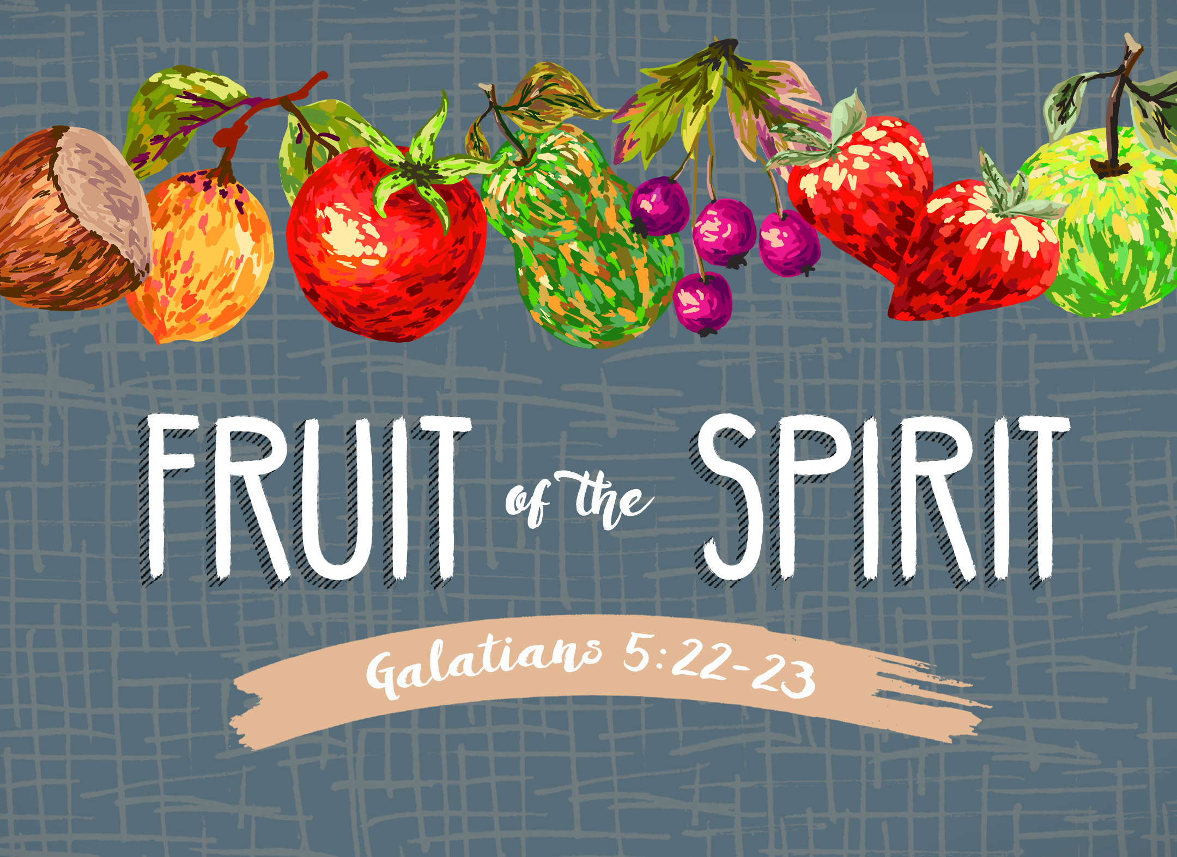

Slide 2
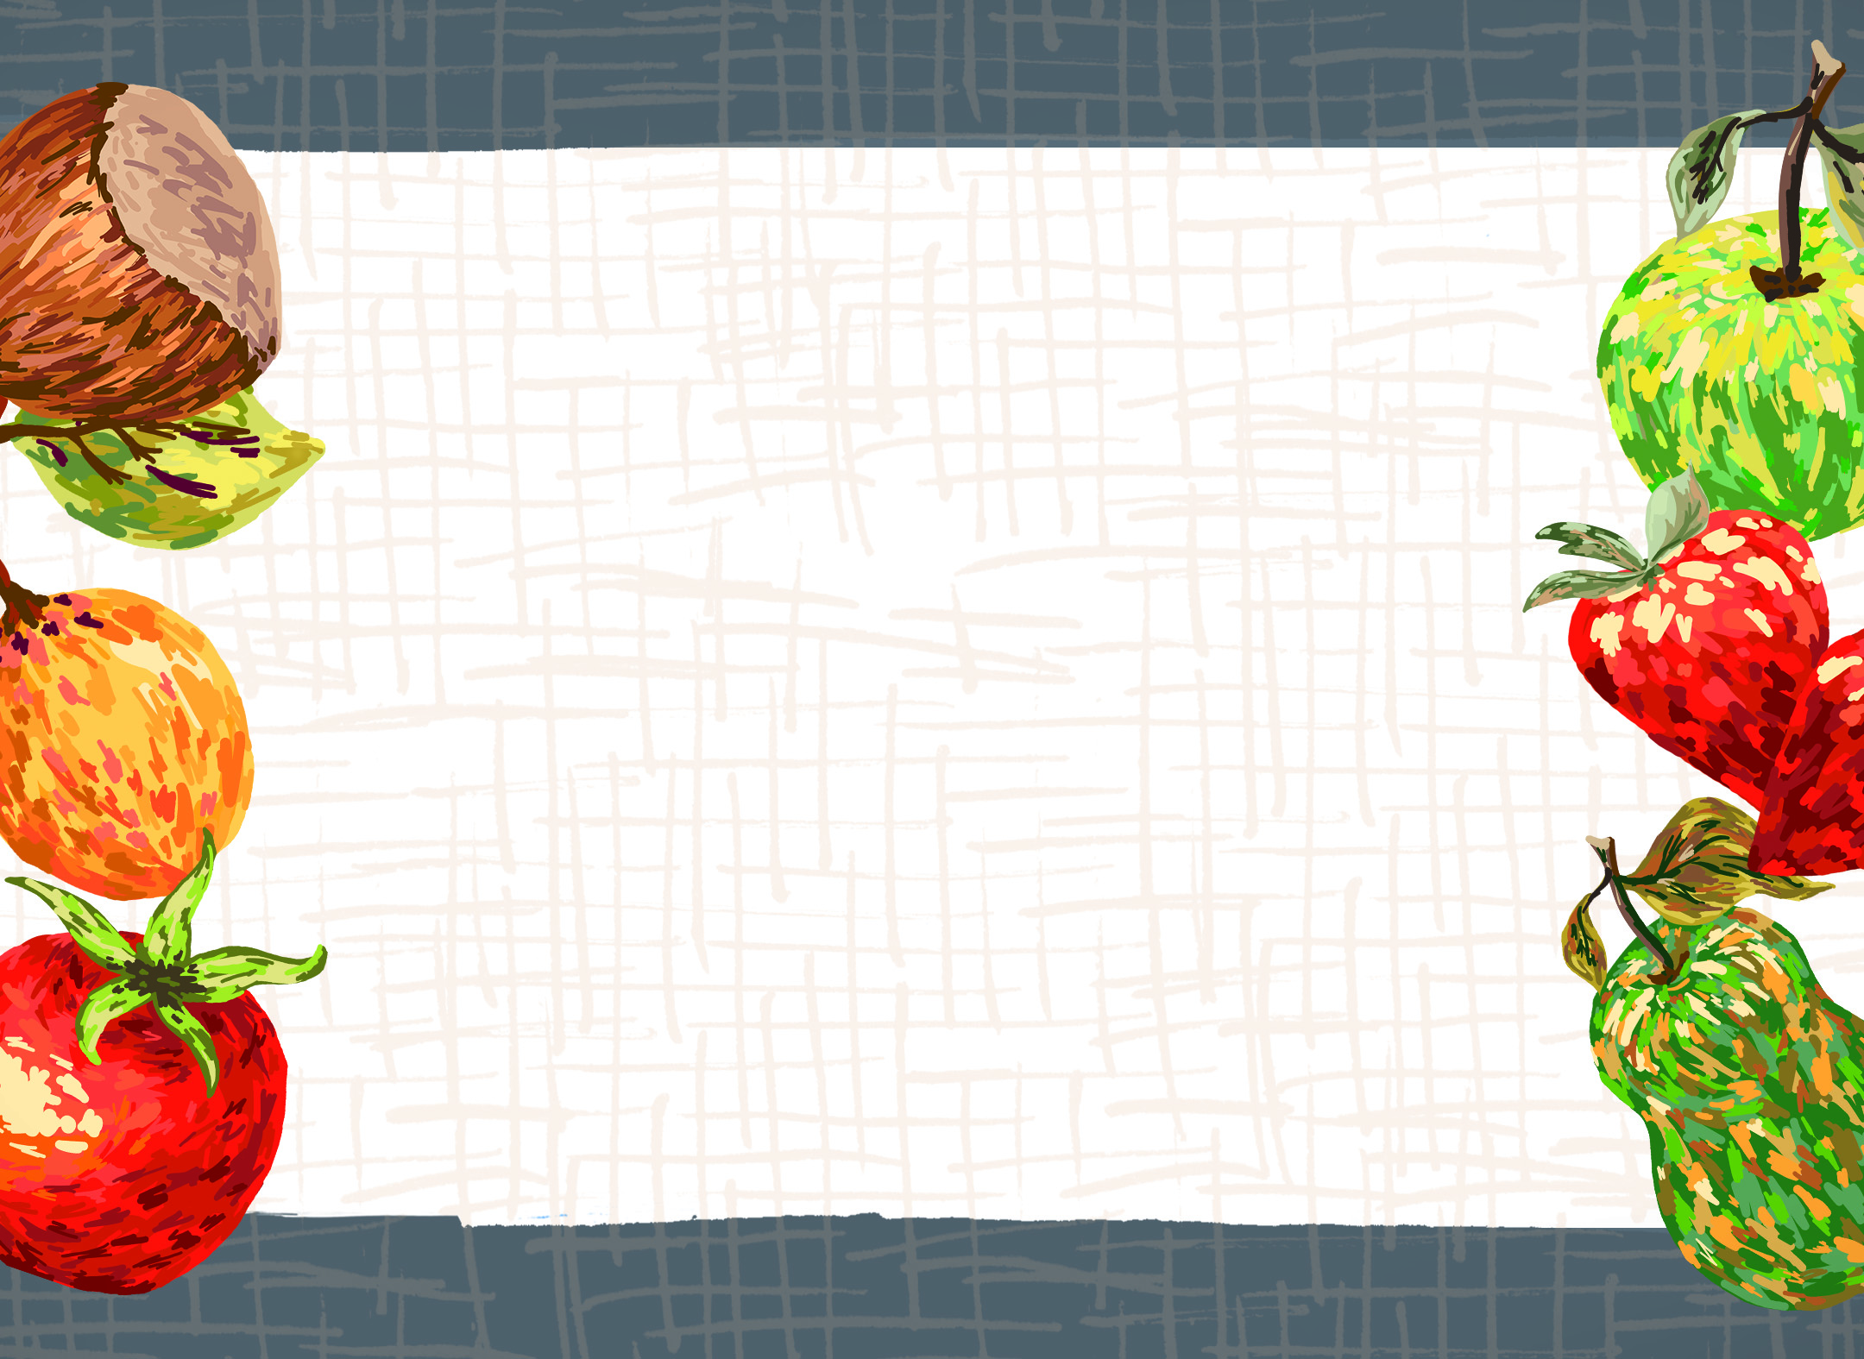
Galatians 5:16
But I say, walk by the Spirit, and you will not gratify the desires of the flesh.
(see Rom. 8:5; Col. 3:1)

Slide 3
John 15:5
I am the vine; you are the branches. Whoever abides in me and I in him, he it is that bears much fruit, for apart from me you can do nothing.

Slide 4
Galatians 5:22-23
But the fruit of the Spirit is love, joy, peace, patience, kindness, goodness, faithfulness, gentleness, self-control; against such things there is no law.

Slide 5
Galatians 5:22-24
But the fruit of the Spirit is love, joy, peace, patience, kindness, goodness, faithfulness, gentleness, self-control; against such things there is no law.
And those who belong to Christ Jesus have crucified the flesh with its passions and desires.

Slide 6
Galatians 5:22-25
But the fruit of the Spirit is love, joy, peace, patience, kindness, goodness, faithfulness, gentleness, self-control; against such things there is no law. And those who belong to Christ Jesus have crucified the flesh with its passions and desires.
If we live with the Spirit, let us also keep in step with the Spirit.

Slide 7
Romans 6:21-22
²¹But what fruit were you getting at that time from the things of which you are now ashamed? For the end of those things is death. ²²But now that you have been set free from sin and have become slaves of God, the fruit you get leads to sanctification and its end, eternal life.

