Slide 2
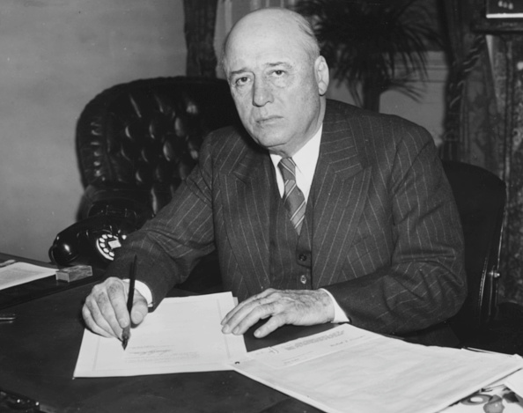

Slide 3
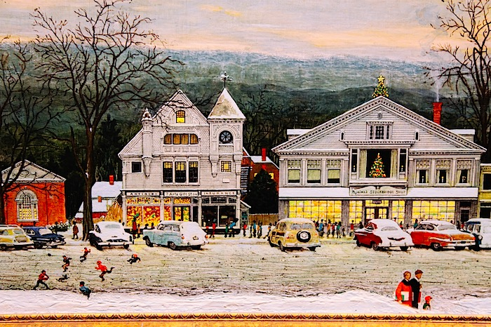

Slide 4
“Sometimes you want to go where everyone know your name and they’re always glad you came. You want to be where you can see our trouble are all the same. You want to be where everybody knows your name.”

Slide 5
Church as Family
Kingdom (I Thes 2:12)
Bride (Rev 18:23)
Body (I Cor 12:12)

Slide 6
Church as Family
Family
Born again (I Pet 1:23)

Slide 7
Church as Family
Family
Born again (I Pet 1:23)
Adoption (Eph 1:5)

Slide 8
Church as Family
Family
Born again (I Pet 1:23)
Adoption (Eph 1:5)
Father (I John 4:14)

Slide 9
Church as Family
Family
Born again (I Pet 1:23)
Adoption (Eph 1:5)
Father (I John 4:14)
Children (Rom 8:16)

Slide 10
Church as Family
Family
Born again (I Pet 1:23)
Adoption (Eph 1:5)
Father (I John 4:14)
Children (Rom 8:16)
Brothers and Sisters (I Cor 7:15)

Slide 11
Church as Family
1 Tim 3:14-15
14These things I write to you, though I hope to come to you shortly;
15 but if I am delayed, I write so that you may know how you ought to conduct yourself in the house of God, which is the church of the living God, the pillar and ground of the truth

Slide 12
Church as Family
1 Tim 3:14-15
14 These things I write to you, though I hope to come to you shortly;
15 but if I am delayed, I write so that you may know how you ought to conduct yourself in the house (family) of God, which is the church (family)of the living God, the pillar and ground of the truth

Slide 13
Church as Family
What it means to be part of Gods Family

Slide 14
Church as Family
What it means to be part of Gods Family
Family: A Place to Belong

Slide 15
Church as Family
What it means to be a part of Gods Family
Family: A Place to Belong
Family: A Place of Sharing

Slide 16
Church as Family
What it means to be a part of Gods Family
Family: A Place to Belong
Family: A Place of Sharing
Share our experiences

Slide 17
Church as Family
What it means to be a part of Gods Family
Family: A Place to Belong
Family: A Place of Sharing
Share our experiences
Share our homes

Slide 18
Church as Family
What it means to be a part of Gods Family
Family: A Place to Belong
Family: A Place of Sharing
Share our experiences
Share our homes
Share our problems

Slide 19
Church as Family
What it means to be part of Gods Family
Family: A Place to Belong
Family: A Place of Sharing
Family: A Place to Serve

Slide 20
Church as Family
What it means to be part of Gods Family
Family: A Place to Belong
Family: A Place of Sharing
Family: A Place to Serve
Family: A Place to Love and Be Loved

