Slide 1
1/1/17 | Brandon Farmer
Notes:
Inquisitive questioning has always been a habit of mine. I was always asking myself, my teachers in school, and perhaps to their annoyance, my parents; “Why?” “How?” “What for?” “What’s the reason?” I’ve always been curious as to the inner workings of things and this is likely why I spend a lot of my time researching. Perhaps the engineers can identify with this as they typically make a living out of figuring out how machines and systems work and how to fix them when they don’t. Perhaps young children or the parents of young children in this room are all too familiar with this method of inquisitive questioning, as young children are prone to ask “Why?” “Why?” repeatedly.
Asking why was sort of a theme for my college experience. Both academically and spiritually I was challenged to figure out why I had come to believe certain things and disbelieve others. Through research, soul searching, various meals with friends who’s opinion I respect and trust, I came to develop my own faith, which I think is essential for any young person to do. Why do I believe in a God? Why do I think that God is the chrisitan God in the bible? How can I be saved from hell? And perhaps on a more secular note; How does the body work? What sustains life? Where do we come from? How did we get here?
Searching out answers to these questions has affected my faith tremendously. I think its an exercise that Paul speaks of to the phillipians in chapter 2:12 to work out their own salvation, as accepting your parents or a preachers isn’t going to grow deep roots.
So this morning/tonight, if you’ll let me I want to answer one of these questions.

Slide 2
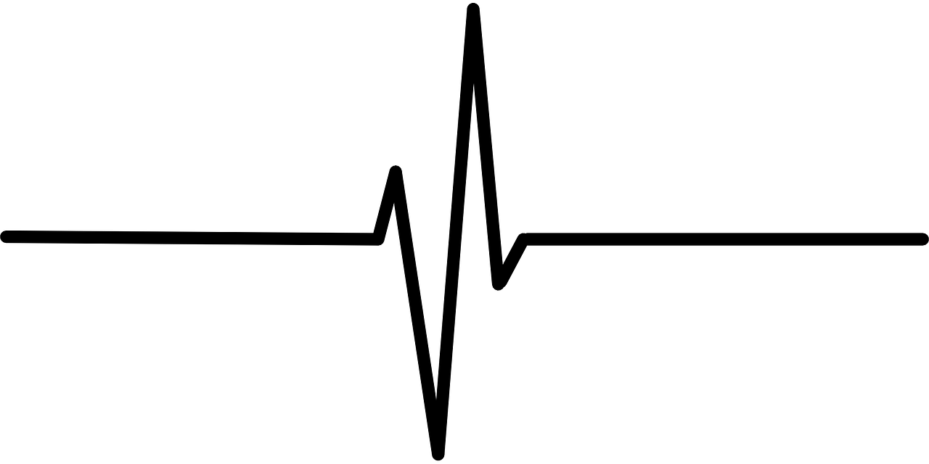
How Are You Living?
Notes:
So this morning/tonight, if you’ll let me I want to answer one of these questions. “How Are You Living?” It’s a questions in the medical field we think about quite often, and particularly a sub-question to that one being “how do I keep my patient living”. It’s a question that after discussing from three different vantage points, I hope will add a little fortification to your faith.

Slide 3
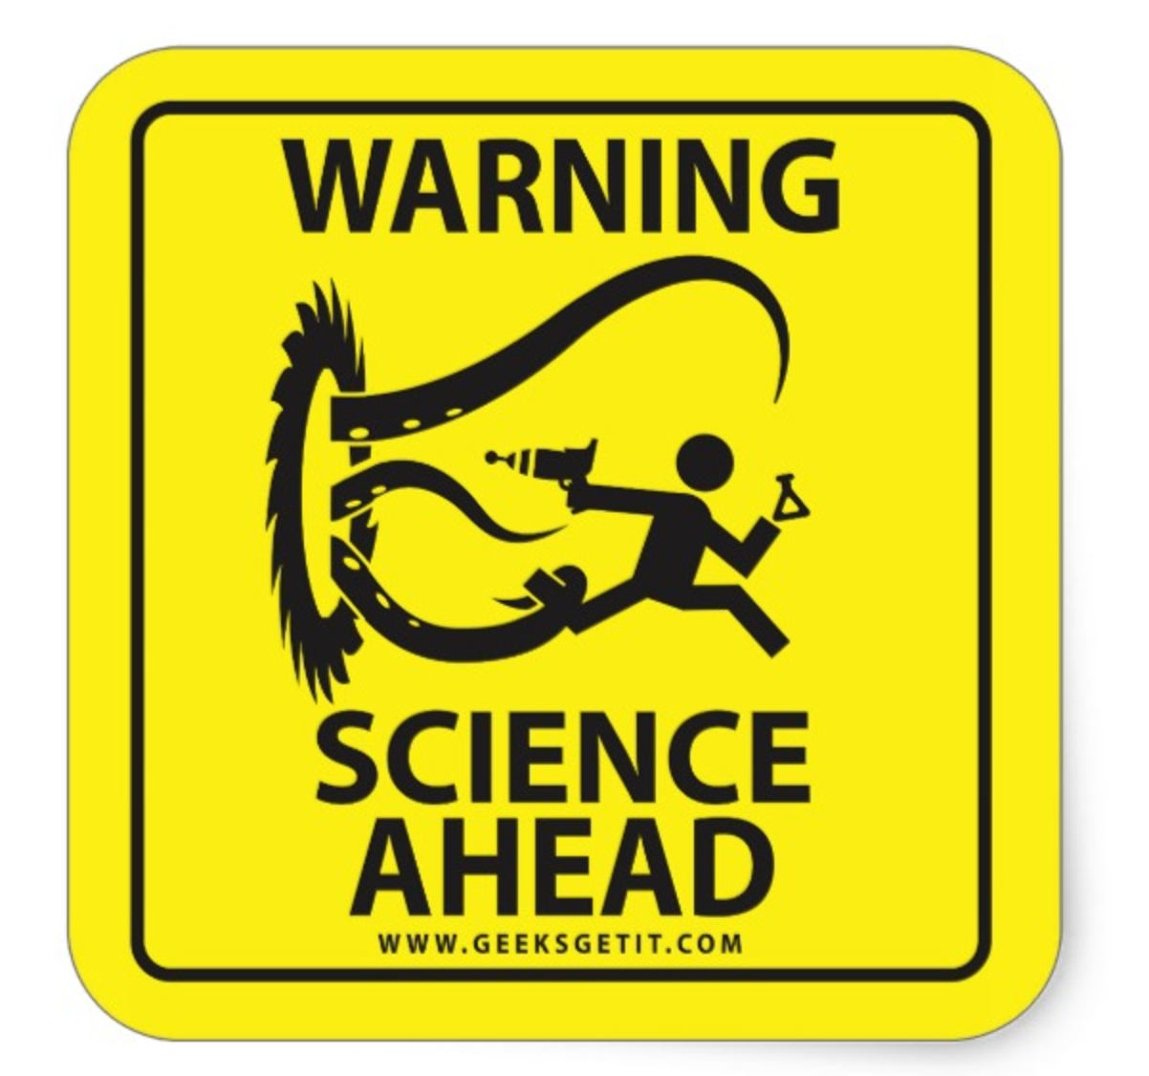
Outline: How Are You Living?
I. Literally, physically, how are you sitting here and breathing? How are you alive?
This BUILDS my faith
II. How can you be living after being dead to sin (Eph 2)?
This IS my faith
III. A question we need to ask each other in 2017
This ENSURES my faith
Notes:
Firstly, In a very physical literal sense, how are you living? How can you be sitting there breathing and not dying? Warning! Science ahead. Some people when they begin to hear scientific terms sort of “shut down” and tune out, which I understand. I’ve tried my best to use analogies and illustration to get the point across. If that doesn’t even work and I begin to speak in a tongue up here, please just appreciate the complexity the body God has made for you. Everyday I get to learn the fascinating intricacies of ourselves and it strengthens my faith so much. I hope you’ll see that these things just can’t logically happen by chance, and intricate design demands an intelligent designer.
Secondly, How are you living a life after death? Ephesians 2:1 says that we were all dead in our sins in which we once walked? What was the crash cart? Who administered CPR? How are we living after being once dead? Folks, this IS my faith.
Thirdly, How are you living? A question we should be asking our brothers and sisters in church more often in 2017. God made the church for a reason folks, we don’t have to go at it alone. He gives us each other to ensure our respective faiths.

Slide 4
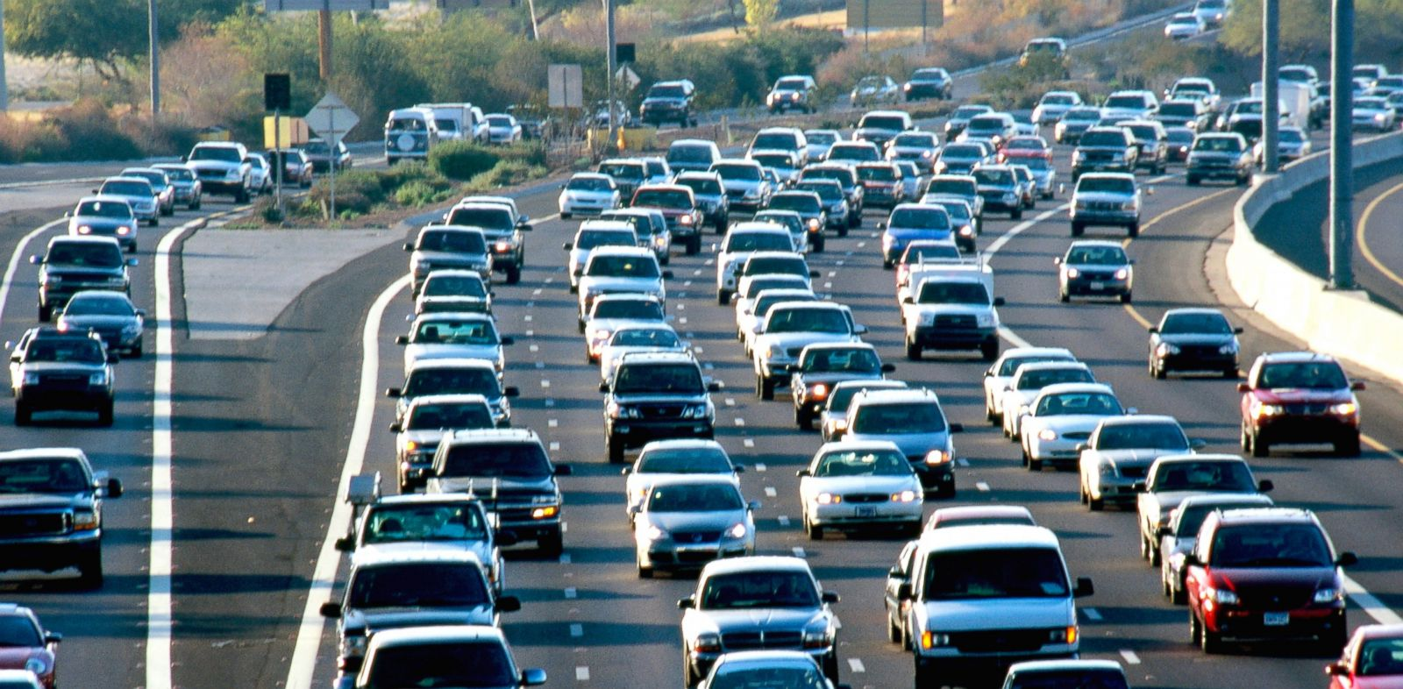
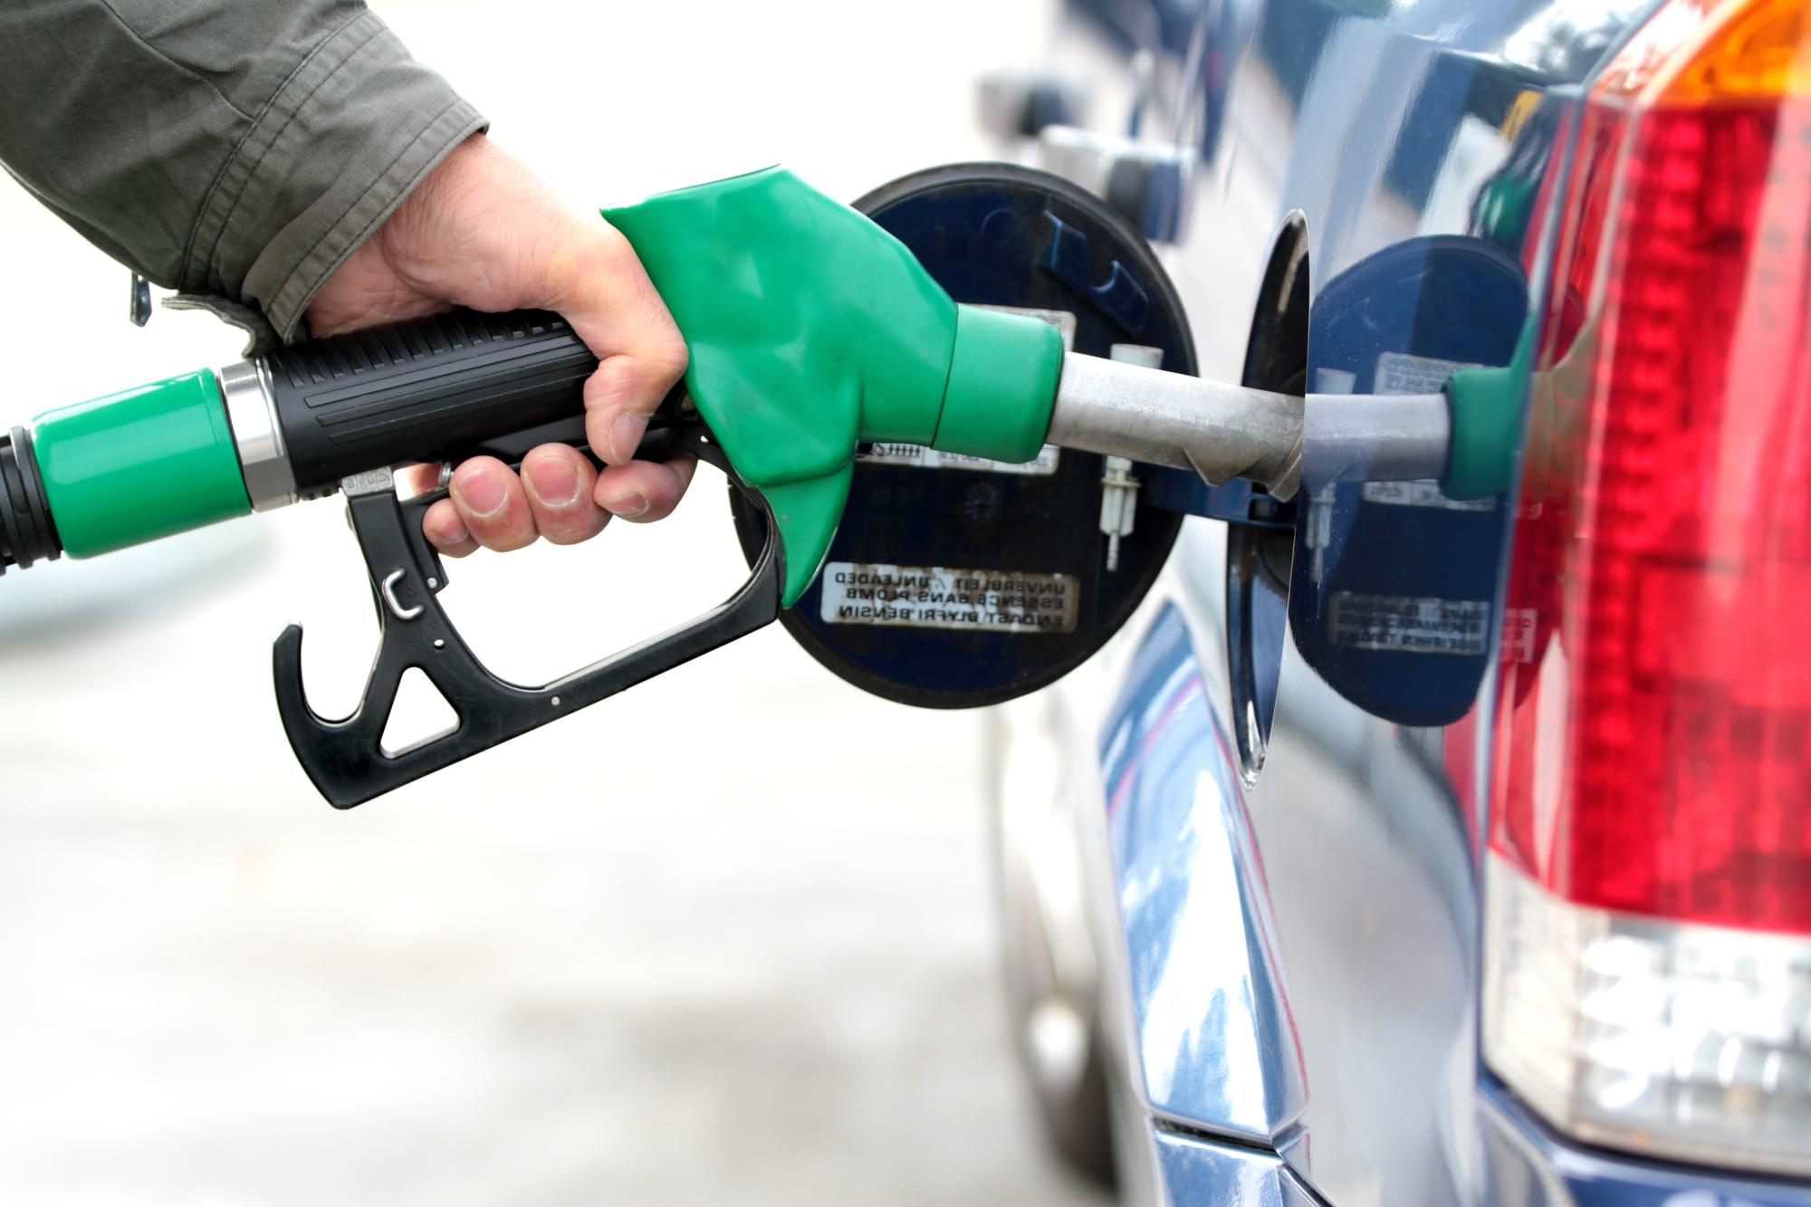
Energy – What makes us… go?
Notes:
So lets jump right in to it. When we consider energy, or what makes us go, we can use the analogy of a car. We all understand that cars break down a certain energy source called gasoline

Slide 5
Our Energy Comes From Food (e.g. glucose)
Glucose
Notes:
. Similarly we injest our food and bread down the sugars in the food for our energy. Glucose is the sugar by which we derive most of our energy from, and if you are a diabetic or know a person with diabetes, you’re probably all too familiar with blood glucose and how important that is for maintining proper energy levels.

Slide 6
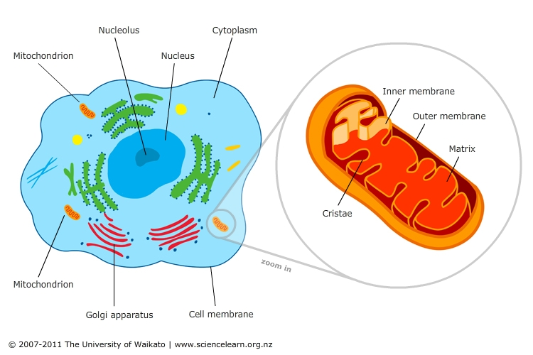
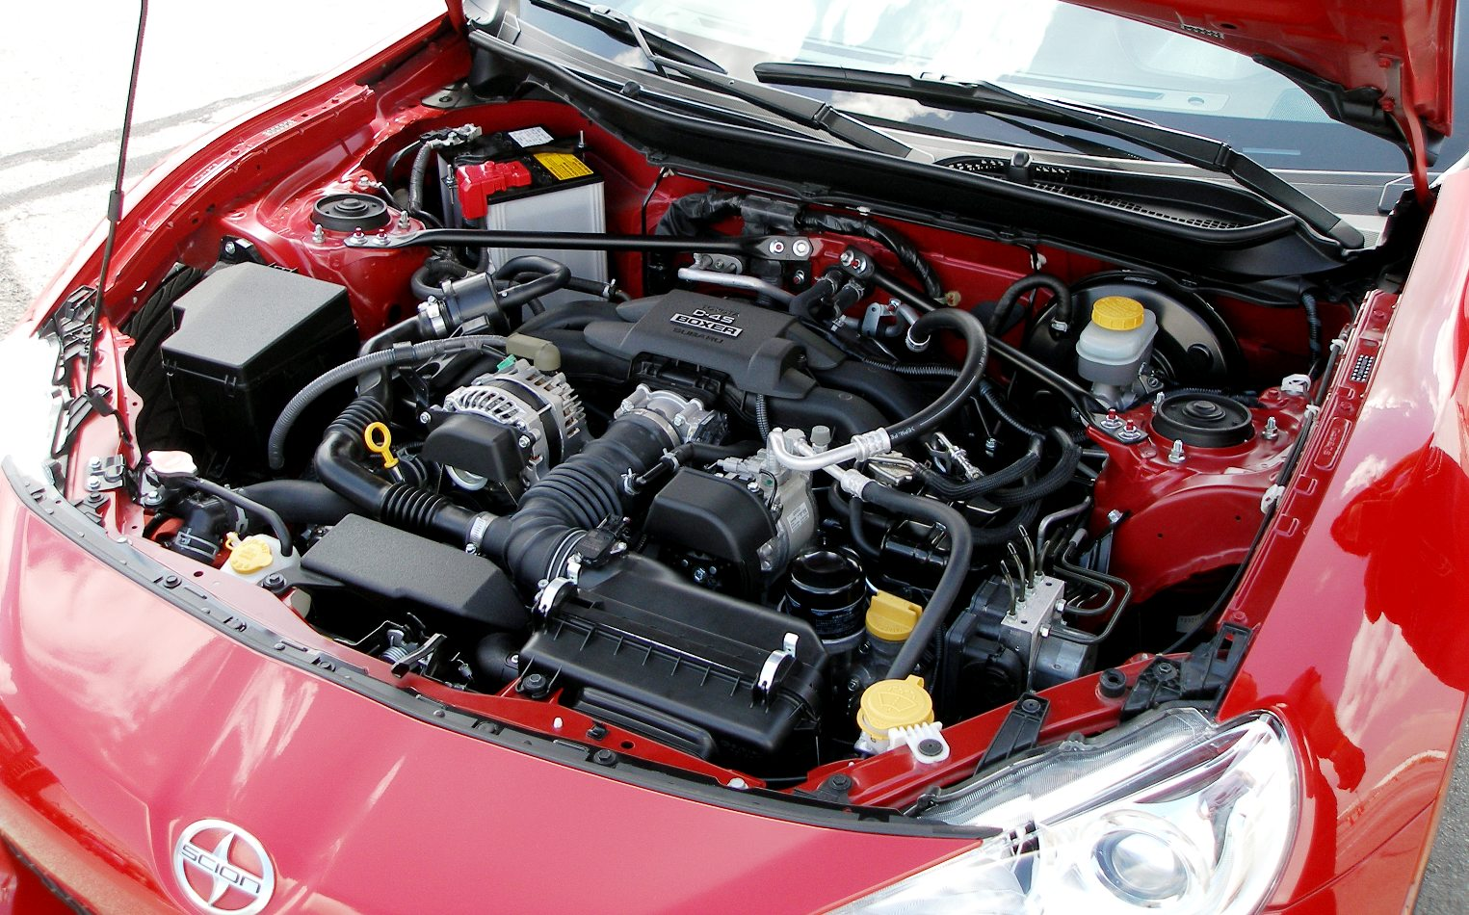
Where do we break down glucose for energy?
The Engine = The Mitochondria
The mitochondria breaks down glucose for energy just like an engine breaks down gasoline for energy
Notes:
We all know that a cars engine is where the gasoline is combusted and the fuel is converted to a form of energy that is going to propel the car. Similarly, the mitochondria, an organelle found within all human cells, is going the be workhorse, the powerhouse, or the engine, if you will, of the cell. You can think of the mitochondria as a sac within a sac, having both an inner and outer membrane, with the inner membrane being contorted and folded back on itself many times. This folding actually is advantageous as it increases the available surface area for biochemical reactions to occur.

Slide 7
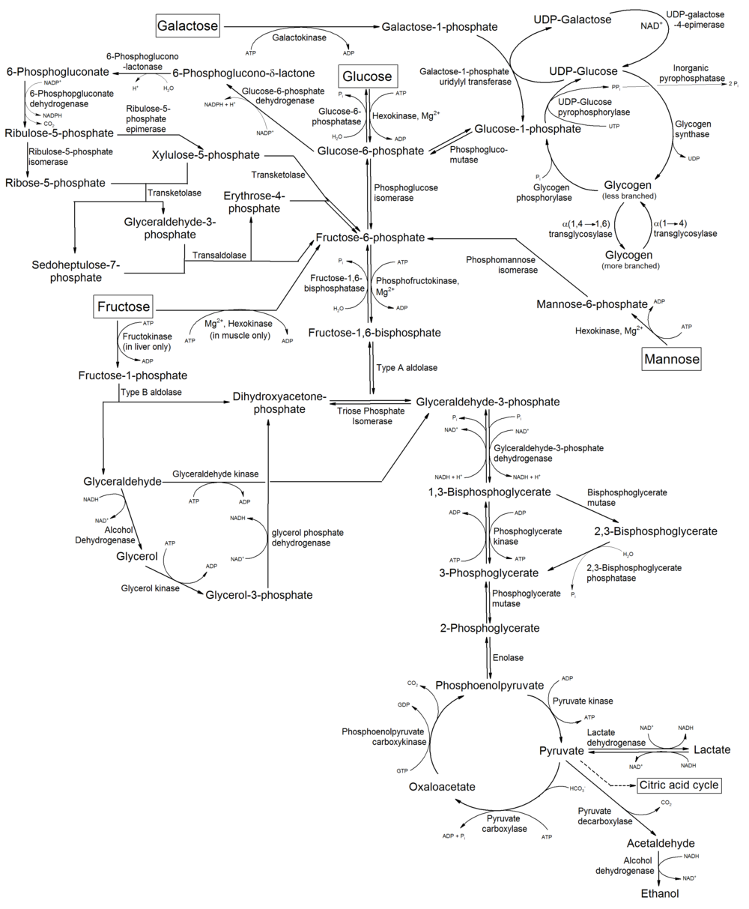
Notes:
Once we have glucose in the cell a number of reactions take place. As much as I would love to walk you through these steps in detail I believe I would be here all day, so I will simplify this whole process into two steps

Slide 8
Through a series of steps…
Glucose
A
P
P
P
Adenosine Tri Phosphate (ATP)
Notes:
Glucose is converted into positively charged hydrogen ions. Then those hydrogen ions are converted into Adenosine tri-phosphate. Adenonsine is this molecule here with the “A” and then each of these circles with “P”s represents one phosphate. What do you get when you put an adenosine with three phosphates and link them all together? ATP.

Slide 9
ATP = Energy
ENERGY!
Heart Beats
Digestion
Brain Function
Muscle Contraction
IMPORTANT!
A
P
P
P
Adenosine Tri Phosphate (ATP)
Di
D
Notes:
This ATP molecule is arguably the most important molecule in the human body. It is going to be the primary source of the majority of reactions that are taking place in our bodies everyday, every minute, and every second. Now, how do we derive energy from this important molecule? This happens by breaking this link, or what we call a “bond”, between the second and third phosphate. Once this happens, the phosphate goes away, and we are left with only two phosphates on the adenosine right? So what is that called? ADP
This breaking of the link is what is going to release energy that is going to drive many reactions and processes in our bodies, including heart contraction, digestion, brain function, muscle contraction. I think we can all agree that these are some very important functions that we must keep going in order to survive.

Slide 10
Through a series of steps…
Glucose
A
P
P
P
Adenosine Tri Phosphate (ATP)
Notes:
So I’ve explained to you what ATP is and how we get energy from it, now you’re likely thinking well how do we make ATP? I told you in the second step of that break down process in the mitochondria we go from positively charged hydrogen ions to ATP, but how does this happen?

Slide 11
Outer Mitochondrial Membrane
High H⁺ Concentration
Intermembrane space
Inner Mitochondrial Membrane
Low H⁺ Concentration
Glucose
Notes:
If we consider the mitochondria once more, you’ll recall that there was an inner and an outer membrane (the sac within a sac). The space in between these membranes is referred to as the intermembrane space. Think of the intermembrane space as the gas tank of this engine. The intermembrane space is where we are going to selectively dump the hydrogen ions that we have gotten as a result of the breakdown of glucose. There’s a series of steps that actually put them there, but all you should know is that most of the hydrogen gets placed within this space after glucose is broken down.
Know you can see that there is way more hydrogen within the intermembrane space than within the inner mitochondrial membrane or that “inner sac”. In other words, there is a higher concentration of hydrogen within the intermembrane space, and lower concentration of hydrogen within the inner mitochondrial membrane. We call this a “concentration gradient” where something is more concentrated across some barrier.

Slide 12
Inner Mitochondrial Membrane
Colorado River | Hoover Dam
Notes:
To better illustrate this, lets look at this. Can anyone tell me what this is? Can anyone tell me what river this is? This is the Hoover Dam and it is a barrier that dams the Colorado River. We can see that behind the dam exist a high concentration of water, while past the dam exist less. This creates a large build up of force behind the dam. Perhaps if you’ve seen Lord of the Rings Two Towers where the ents release the river by pulling apart the dams around Saruman’s tower, you remember the gushing force of water once any hole is put in this barrier.

Slide 13
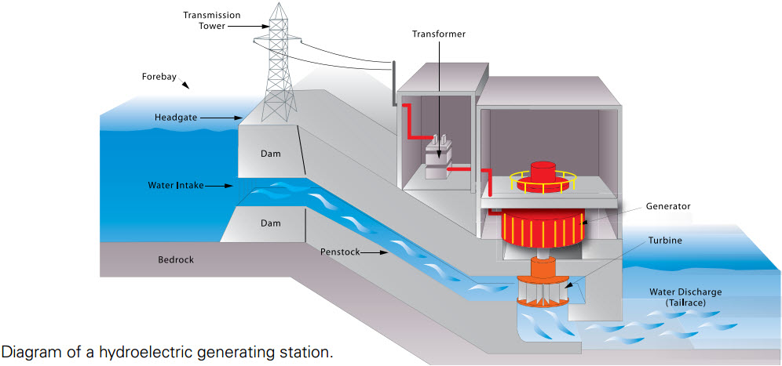
Notes:
I didn’t really know this growing up but dams are actually used as huge electricity generators. This image shows how the force of water behind a dam is harnessed in order to create electricity. Water flows through the dam, and pushes against this fan, or the “turbine”. This is going to make this entire apparatus spin, including this central shaft and the generator, which is going to, by some process I don’t really understand, create electricity. So essentially this large force of water is converted to electricity through this spinning turbine and the generator it is linked to.
Now let me show you how we make ATP and I want you to appreciate not only the complexity, but the similarity between how we make ATP and these advanced systems humans have built.

Slide 14
ATP Synthase
ENERGY!
Heart Beats
Digestion
Brain Function
Muscle Contraction
A
P
P
P
ATP Synthase uses the hydrogen ion concentration gradient across the inner mitochondrial membrane to “crunch” together ADP and P to generate ATP.
ATP
ADP
P
Notes:
The protein that makes ATP is called “ATP Synthase” since its job is to make or “synthesize” ATP. ATP Synthase lies within the inner mitochondrial membrane. Remember that the inner mitochondrial membrane is likened to the dam that is in between these very different concentrations of hydrogen ion. Just like the dam harnesses the water force, ATP Synthase is going to harness this large hydrogen ion force, and create energy from it. Watch what happens here. Initially, we have the concentration gradient set up, we have a free phosphate and an ADP within this top part but they aren’t interacting. If you look closely here you can see that there is an intake pathway that the hydrogen can come in through, and an output path too. So as the first hydrogen comes through ATP Synthase, this portion will spin causing the upper portion to spin with it. This causes the ADP and Phosphate to get closer to one another, and “crunches” them together to form ATP. Another hydrogen ion goes through the protein and this causes the new ATP molecule to shift in position a little bit. A third hydrogen ion goes through the protein and this causes the newly synthesized ATP molecule to leave the protein and be used for energy in those biochemical reactions that we’ve discussed.
Isn’t that fascinating? This protein is working all the time to provide you with ATP so that you can live? This is literally how you are living. To give you some scale here, if you’re familiary with what a millimeter is, that is 1/10th of a centimeter, 100,000 of these can be stacked side by side within 1 millimeter. So this thing is tiny, you have to have special microscopes just to see it, but its so complex and important and to me, shows the wonders of God.

Slide 15
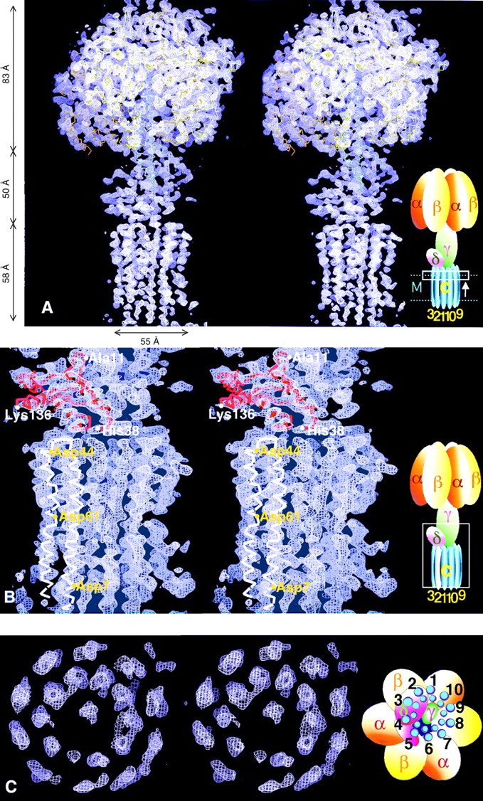
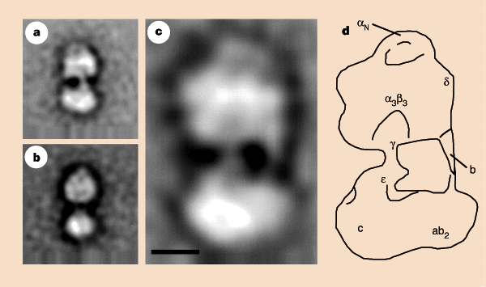
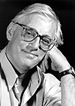
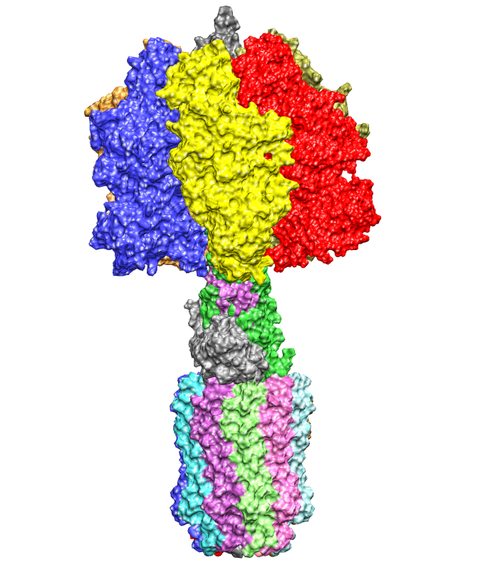
ATP Synthase Structure Data
John E. Walker
Nobel Prize in Chemistry 1997
Generator
Central Shaft
Turbine
Stock et al., Science (1999)
Notes:
How do we know all this? Thanks to some scientists in the late 90s who worked out the structure of this protein. John E. Walker was one of them and he won the Nobel Price in Chemistry for his work in 1997. What we can see looking at the structure and knowing a bit about the function know is that there is a turbine, that is where the hydrogen ions are flowing through and making this thing spin, there is central shaft that is connecting this turbine to this upper part, and lastly this part where the adp and p are crunched together, that is the generator Do these terms sound familiar?

Slide 16
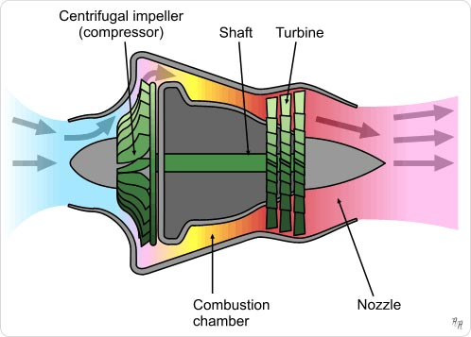
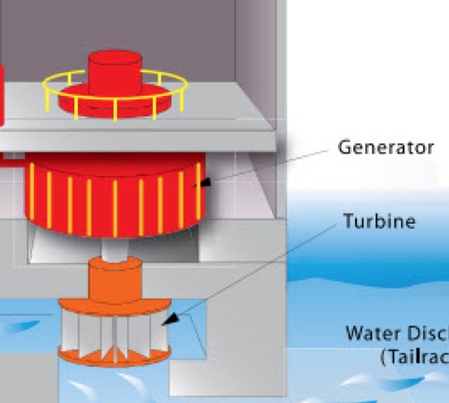
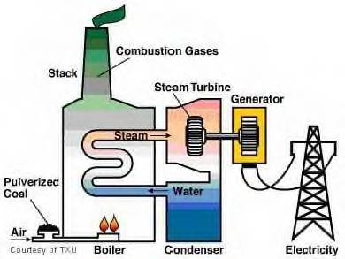
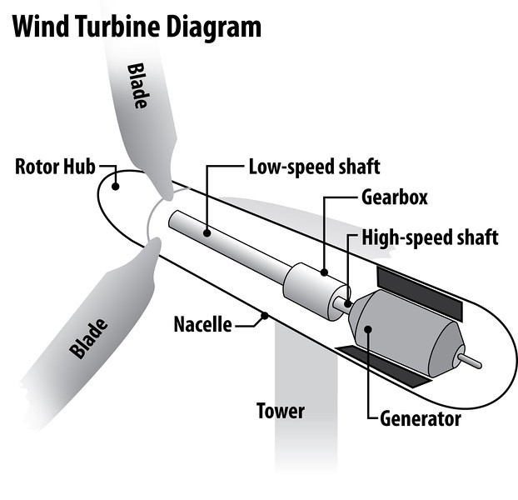
ATP Synthase
is a molecular motor
Generator
Central Shaft
Turbine
Notes:
ATP Synthase is essentially a molecular motor. We saw this exact same structural design with the hoover dam electrical generator. If we look at a wind mill, perhaps you’ve seen these on your way to Chicago or out west perhaps, they harness wind power, turn a central shaft and generator, and create energy. If you look at a jet engine, something my brother looks at everyday, you’ll see that air flow again is harnessed spinning a turbine, transferring that spin through the shaft to the generator, and creating thrust power. And we even see this design in the power plants that we get our electricity from every day. Coal is used fuel a boiler that evaporates water into steam. This steam is then what spins the turbine, along a central shaft, to allow the generator to create energy so that we can plug our phones in and vacuum our house and turn the hall lights on.
Do you see that these man made inventions that took hundreds of years of engineering talent and innovation are essentially mere copies of this ATP Synthase protein that we have millions of in our own bodies? I mean if God put a patent on this protein, we wouldn’t have these inventions without serious copyright infringement, that’s how similar I think these are.

Slide 17
I praise you because I am fearfully and wonderfully made; your works are wonderful, I know that full well.
-Psalm 139:14
Notes:
We are fearfully and wonderfully made. This is just one example of the beautiful complexity of our bodies at the molecular level.

Slide 18
II. How are you living, after once being dead? Ephesians 2:1-10
DEAD
LIVING
v. 1-3
v. 4-10
Notes:
Now that your minds are just blown, or maybe after the nap you just took, I want to move on to my second point, which is the basic gospel message. How are you living, after once being dead? Turn to Ephesians 2, or don’t, it’ll be displayed, but that’ll be where we spend our time for this point. What we are saying here is another process. We were once dead, as we’ll see in verses 1-3, but now we are living. What is this process, this arrow, that transferred us from death to life?

Slide 19
And you were dead in the trespasses and sins in which you once walked, following the course of this world, following the prince of the power of the air, the spirit that is now at work in the sons of disobedience— among whom we all once lived in the passions of our flesh, carrying out the desires of the body and the mind, and were by nature children of wrath, like the rest of mankind.
-Ephesians 2:1-3
Notes:
If we begin in verse 1 of Eph 2, it reads:
We can see here that Paul is referring to a death in the past. Of course this isn’t a literal death, since we see that we were still walking around when we were dead. This is actually the inspiration for the show The Walking Dead. We see that these walking dead follow the prince of the power of the air (Satan), are disobedient, are concerned with the passion of flesh and the desire of the body, and are wrathful.
Us much as I hate to tell you folks, this characterizes all of us before we came to Jesus. We lived for ourselves, we followed Satan and gave into his temptations and lies. We lived lives of trespassing and walked with sin on our back. It was a dead life since we couldn’t do anything ourselves to bring ourselves back to life.

Slide 20
But God, being rich in mercy, because of the great love with which he loved us, even when we were dead in our trespasses, made us alive together with Christ— by grace you have been saved— and raised us up with him and seated us with him in the heavenly places in Christ Jesus, so that in the coming ages he might show the immeasurable riches of his grace in kindness toward us in Christ Jesus. For by grace you have been saved through faith. And this is not your own doing; it is the gift of God, not a result of works, so that no one may boast. For we are his workmanship, created in Christ Jesus for good works, which God prepared beforehand, that we should walk in them.
-Ephesians 2:4-10
Notes:
Read

Slide 21
LIVING
II. How are you living, after once being dead?
God
because of His great love
made us alive
by His grace
and through our faith
DEAD
Notes:
If I can summarize these verses here for you, I would say that this details the mechanism of this resurrecting transformation from death to life. The summary would be: God, because of his great love, made us alive, by His grace and through our faith.
If I could emphasize two of these points here, the first would be because of his great love. I think I will for the rest of my life grapple with why in the world Jesus died for me. I was hostile, sinful, rebellious. I was self-serving, only worried about the pleasures of my own flesh. And too often, that still characterizes me. All have sinned and fallen short Rom 3:23. When I try to come up with a good reason why God would send his only son to take my punishment and die a gruesome painful death, the only answer I can come up with is “because of God’s great love.” A love so unconditional and all-encompassing that he redeems me and forgives my great debt, not on account of my doing right, not as a result of my works, but soley as a gift because he is the ultimate giver.
What we’re talking about here is grace, my second point to emphasize. Grace is the word we use to describe not receiving a punishment that you deserve, or receiving a gift that you don’t deserve.
I got a speeding ticket over winter break on the way to Washington. I was going 10 miles over the speed limit and was pulled over and cited for breaking laws of the state of West Virginia. I had the option to appear before the Harrison County Magistrate Court and plea my case. Lets say I did that and to my surprise, the judge erased my ticket from the books. That would be wonderful wouldn’t it? To not even be on the record anymore. But what if after doing so, he reached into his own wallet, and paid the price of my ticket? You see that adds a whole different layer of grace to the picture right? Its one thing to forgive and erase the debt but to pay it yourself, to right the wrong of another by paying out of your own wallet, that is full grace undeserved.
We are living a new life spiritually because of the unthinkable immeasurable grace of God.

Slide 22
III. How are you living? A question we need ask to each other in 2017
1. The Church was established for our benefit
“Therefore encourage one another and build one another up” (1 Thes 5:11)
“But exhort one another every day … that none of you may be hardened by the deceitfulness of sin.” (Heb 3:13)
2. The Church bears trials together
“Confess your sins to one another, and pray for one another” (James 5:16)
“Bear one another's burdens, and so fulfill the law of Christ” (Gal 6:2)
3. The Church looks out for its own
“Let each of you look not only to his own interests, but also to the interests of others” (Phil 2:4)
“You will know them by their fruits” (Matthew 7:16)
Notes:
Lastly, as we are at the starting line of this new year 2017, I want to leave you with a challenge that I hope we’ll do better at this year. How are you living is a question I believe we should be asking more of each other here in the church.
The first thing we need to realize with this is that the church was established for our benefit. Have you ever wondered why God made the church? Why did God want a group of believers to worship him together rather than individuals worshiping him alone? I think God made the church so that we wouldn’t have to live the Christian life in isolation. The church gives us opportunity to encourage and be encouraged and to build each other up, as 1 Thes. 5:11 says. Hebrews 3:13 says that exhorting each other in the church aids in protecting us from the hardening of sin. If we weren’t getting that exhortation, it’d be much easier to be affected and hardened by the sin which easily entangles us.
Secondly, the church bears trials together. James 5:16 says that Christians confess sins to one another and pray for one another. Again, this is an example of the utility of the church, that we have brothers and sisters to talk to to and pray with about whatever is going on in our lives. This idea of bearing burdens in Galations 6:2 hits at this point as well. Folks we all go through trials. Whether its trouble at your job, problems in your marriage, problems in your relationships, strife in your family, substance abuse, doubting your faith; these are issues that all of us face. I worry sometimes that we come to church and we all look so nice and we put on this façade that everything is all right in our lives when in reality we are all broken and battered and in desperate need of Jesus and in dire need of each other. Can we be more real with each other? Can we have less of the surface level “how about the weather, how about the Cats,” and more of the “what can I pray about for you?” “what are you struggling with?” “how are you living?”
Thirdly, and related to this idea of asking each other about more substantive issues, the church knows its own. Philippians 2:4 instructs us to look out for the interests of others. Simple question: how can you know the interests and the needs of others if you aren’t interacting with them? How can you fulfill Philippians 2:4 to me your brother, if you don’t know my struggles and you don’t know my needs? The minute we go at it alone folks is when the devil wins. The minute we don’t ask a brother or sister about how they are living at a time where they need someone to reach the most is when the devil delivers his bashing blow and leaves a soul stranded. Matthew 7 talks about knowing false teachers in the church by the fruit they produce, and alternatively knowing your brothers and sisters in the church by the fruit they produce. This implies that you have to know one another so well that you can identify someone who doesn’t match in a line up. We need to know each other better. It is, in my opinion, what the church was made for.

Slide 23
We live because of God’s intelligent design and God’s immeasurable grace. Lets watch out for each other in 2017.
Notes:
Thanks for your kind attention. In summary, we live because of God’s intelligent design and because of God’s immeasurable grace. Lets all make a resolution this year to watch out for each other in 2017 and dig deeper in our conversations as we are on the often tempestuous voyage to our home above.

