Slide 2
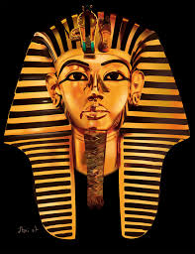
Slaves Ex 1:11
Infanticide Ex 1:15-16
Genocide Ex 1:22

Slide 3
Exodus
2 Moses Is Born
1 And a man of the house of Levi went and took as wife a daughter of Levi.
² So the woman conceived and bore a son. And when she saw that he was a beautiful child, she hid him three months.
³ But when she could no longer hide him, she took an ark of bulrushes for him, daubed it with asphalt and pitch, put the child in it, and laid it in the reeds by the river’s bank.
⁴ And his sister stood afar off, to know what would be done to him.
⁵ Then the daughter of Pharaoh came down to bathe at the river. And her maidens walked along the riverside; and when she saw the ark among the reeds, she sent her maid to get it.

Slide 4
EXODUS
⁶ And when she opened it, she saw the child, and behold, the baby wept. So she had compassion on him, and said, “This is one of the Hebrews’ children.”
⁷ Then his sister said to Pharaoh’s daughter, “Shall I go and call a nurse for you from the Hebrew women, that she
⁸ And Pharaoh’s daughter said to her, “Go.” So the maiden went and called the child’s mother. ⁹ Then Pharaoh’s daughter said to her, “Take this child away and nurse him for me, and I will give you your wages.” So the woman took the child and nursed him. ¹⁰ And the child grew, and she brought him to Pharaoh’s daughter, and he became her son. So she called his name Moses,^{[a]} saying, “Because I drew him out of the water.”

Slide 5
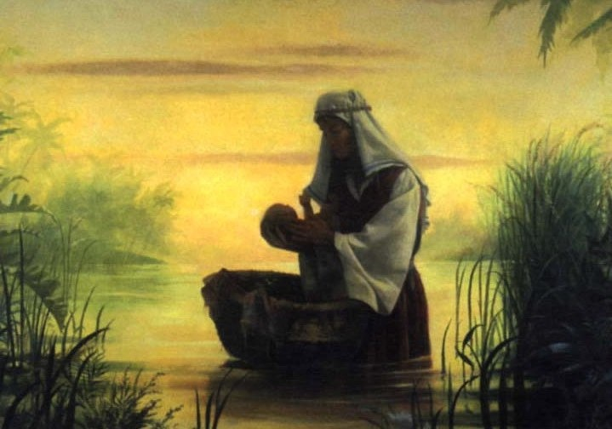

Slide 6
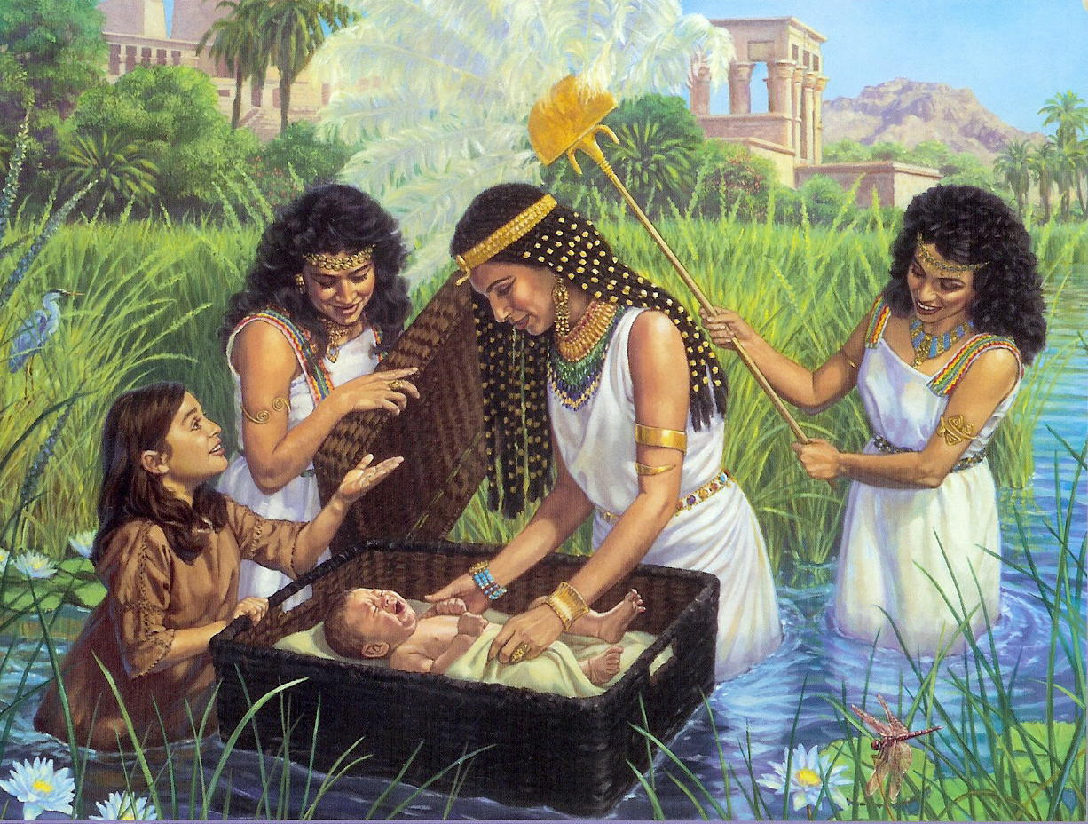

Slide 7
Lessons From Moses
God doesn’t always do what seems logical

Slide 8
Lessons From Moses
God doesn’t always do what seems logical
God makes foolish the wisdom of men

Slide 9
Lessons From Moses
God doesn’t always do what seems logical
God makes foolish the wisdom of men
Faith is willing to follow God in the face of fear

Slide 10
Lessons From Moses
God doesn’t always do what seems logical
God makes foolish the wisdom of men
Faith is willing to follow God in the face of fear
True faith is willing to let go

