Slide 1
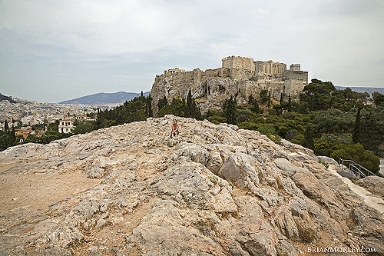
Lessons from the Apostle Paul about studying the scriptures with others (Acts 17)
Reading: Acts 17: 1-5, 10-13, 16-17, 22-28, 32-34

Slide 2
Paul’s Teaching
Paul reasoned with them from the scriptures (Acts 17:2,17) (Acts 18:4)
He explained and proved that Jesus suffered and raised from the dead, and that he is the Christ (Acts 17:3, 32)
Isaiah 1:18 - “Come now, let us reason together, says the Lord: though your sins are like scarlet, they shall be as white as snow; though they are red like crimson, they shall become like wool.”

Slide 3
Many Believed
Many devout Greeks and not a few leading women in Thessalonica (Acts 17:4)
Jews in Berea, not a few Greek women of high standing as well as men (Acts 17:12)
Some men in Athens, including Dionysius the Areopagite and a woman named Damaris (Acts 17:34)

Slide 4
The Gospel is Powerful!
Romans 1:15-16
Hebrews 4:12-13
2 Timothy 3:16-17

Slide 5
Seeking after God (Acts 17:26-28)
Ecclesiastes 3:11
Deuteronomy 4:29-31
Matthew 6:33
Luke 8:15

Slide 6
Bible Study Tips
Find common ground (Acts 17:22-23)
- 1 Cor 9:19-23, Acts 23:6-9
Study with an open mind (Acts 17:11)
Focus on the scriptures (Acts 17: 11)
- Not traditions, "my" preacher, my parents, my church teaching, my feelings, commentaries, etc.
Discussion is necessary (Acts 17:11)
Be patient
Be willing to change if necessary

