Slide 1
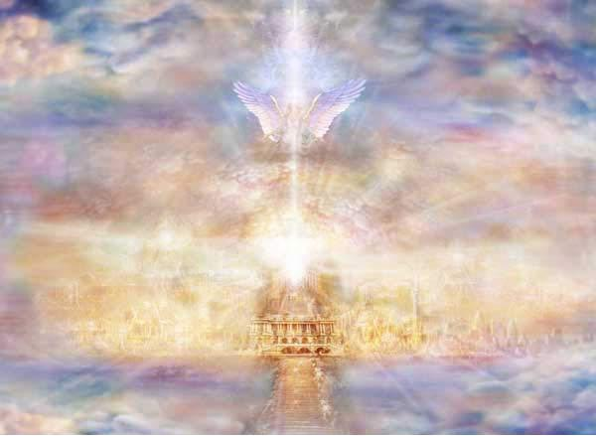
Heaven or Hell
Your greatest choice
(

Slide 2
Heaven
Luke 6:23 Be glad in that day and leap for joy, for behold, your reward is great in Heaven.
From the book of Luke we can see that the kingdom of Heaven is great! God LOVES you wants you to live ETERNALLY with him in HEAVEN!

Slide 3
Hell
Matthew 10:28 Do not fear those who kill the body but are unable to kill the soul; but rather fear him who is able to destroy both soul and body in Hell.
Luke 3:17 His winnowing fork is in his hand to thoroughly clear his threshing floor, and to gather the wheat into his barn; but he will burn the chaff with unquenchable fire.
Satan HATES you and wants you to BURN ETERNALLY!

Slide 4
What you must do to be saved!
1st Hear, Romans 10:17 2nd Believe, Mark 16:16 3rd Repent, Acts 2:38 4th Confess, Romans 10:9-10 5th Be Baptized, Galatians 3:27 And LIVE a GODLY life!

Slide 5
Heaven or Hell
Your greatest choice
(

