Slide 2
A Historical View of Alcohol
Common honesty demands that we interpret the Scriptures with the eye, the taste, and the usages of the ancients and not with the eye, the taste, and the usage of the moderns.

Slide 3
The Laws of Fermentation
There must be sugar matter and yeast available.
The temperature should not be below 50º nor above 70-75º.
The juice must be of a certain consistence; that is thick syrup will not undergo vinous fermentation.
The quantity of yeast or ferment must also be well regulated; too much or too little will impede and prevent fermentation.

Slide 4
Sweet is the natural taste.
Sweet is grateful to the newborn infant, loved by the youth, enjoyed by the middle aged, and cherished by the aged.
Eastern cultures love sweet drinks.
The taste of alcohol is unnatural and wholly acquired.
To the natural instinct, alcohol is universally repugnant.

Slide 5
Fermentation can be prevented.
Grape juice will not ferment when the air is completely excluded.
By evaporating the water from the juice the substance becomes a syrup, which if very thick will not ferment.
If the juice be filtered and deprived of its yeast then the production of alcohol will be impossible.

Slide 6
Did the ancients know this?
Grape juice will not ferment when the air is completely excluded.
By evaporating the water from the juice the substance becomes a syrup, which if very thick will not ferment.
If the juice be filtered and deprived of its yeast then the production of alcohol will be impossible.

Slide 7
“The ancients possessed the secret of preserving wines sweet throughout the whole year.” - Augustine Calmet, b. 1672, The Dictionary of the Bible

Slide 8
Chemical science instructs...
The juice loses its sweetness when, by fermentation, the sugar is converted into alcohol.
Due to the great sweetness of the juice and the heat of the climate at the vintage, that vinous fermentation would be precluded unless by some method prevented.
The acetous (turning into vinegar/sour wine) would certainly and speedily commence.

Slide 9
Four Ancient Methods
Boiling
“By boiling, the juice of the richest grapes loses all its aptitude for fermentation and may afterwards be preserved for years without undergoing any further change.”
- Herman Boerhaave, b. 1668, Elements of Chemistry

Slide 10
Four Ancient Methods
Boiling
“The wine of Arcadia was so thick that it was necessary to scrape it from the skin bottles in which it was contained, and to dissolve the scrapings in water.”
- Aristotle, b. 384 BC

Slide 11
Four Ancient Methods
Boiling
“There is no wine sweeter to drink than that from Lesbos; that it was like nectar and more resembled ambrosia than wine; that it was perfectly harmless and would not produce intoxication”
- Horace, b.65 BC

Slide 12
Four Ancient Methods
Boiling
Filtration
“That we may drink the more wine, we break in pieces the spirit by the filter.”
- Pliny, b. 23 AD

Slide 13
Four Ancient Methods
Boiling
Filtration
“The most useful wine has all its force or strength broken by the filter.”
- Pliny, b. 23 AD

Slide 14
Four Ancient Methods
Boiling
Filtration
Subsidence
“It is produced by care. They plunge the casks, immediately after they are filled from the vat, into water, until winter has passed away and the wine has acquired the habit of being cold.”
- Pliny, b. 23AD

Slide 15
Four Ancient Methods
Boiling
Filtration
Subsidence
Fumigation
“The Romans fumigated their wines with the fumes of sulphur; they also mixed with the unfermented wine the yolks of eggs and other articles containing sulphur.”
- Alexander Adams, b. 1741, Roman Antiquities

Slide 16
Four Ancient Methods
Boiling
Filtration
Subsidence
Fumigation
History records these four methods, all with one objective - to preserve the juice sweet.

Slide 17
Did the ancients use and call these unfermented juices wine?
Whether boiled, filtered, subsided or fumigated, historical records refer to these drinks as wine.
Tirosh, yayin, oinos are all translated as wine.
This fact is not an excuse for our ignorance nor is it permission for any of us to pervert the word of God.

Slide 18
Did the ancients use and call these unfermented juices wine?
As for their use, there is abundance of evidence that the ancients mixed their wines with water, not because they were so strong with alcohol as to require dilution, but because being rich syrups, they needed water to prepare them for drinking.

Slide 19
Did the ancients use and call these unfermented juices wine?
Hesiod, nearly 700 years before Christ, prescribed during the summer months, “three parts water to one part wine” whereas warm water in lesser quantities was used in the winter months.

Slide 20
Did the ancients use and call these unfermented juices wine?
The Passover was celebrated with wine mixed with water when each person - man, woman, and child - drank four cups.

Slide 21
The conclusion...
That unfermented beverages existed and were a common drink among the ancients.
That to preserve their very sweet juices, in their hot climate, they resorted to boiling and other methods which destroyed the power and activity of the yeast, or effectually separated it from the juice of the grape.
That these were called wines, were used, and were highly esteemed.

Slide 22
Which wine fits the character of Jesus?
Alcoholic wine which is...
Non-alcoholic wine which is...
Unnatural - decayed
Mocking, raging and deceiving (Proverbs 20.1)
Unsociable and intoxicating (Habakkuk 2.15)
Unhealthful - poisonous (Deut.32.33; Daniel 1.3-21)
Wasteful (Proverbs 23.21)
Deadly (Proverbs 23.32)
Not for kings and princes (Proverbs 31.4)
A stumbling block (Romans 14.21; 1 Corinthians 8.9)
Bad fruit (Matthew 7.17)
An addictive drug.
Natural, fruit of the vine
Sweet
Non-intoxicating
Healthful
Pleasant
Refreshing
For all people of all ages
Good example for all
Good fruit
Non-addictive
OR

Slide 23
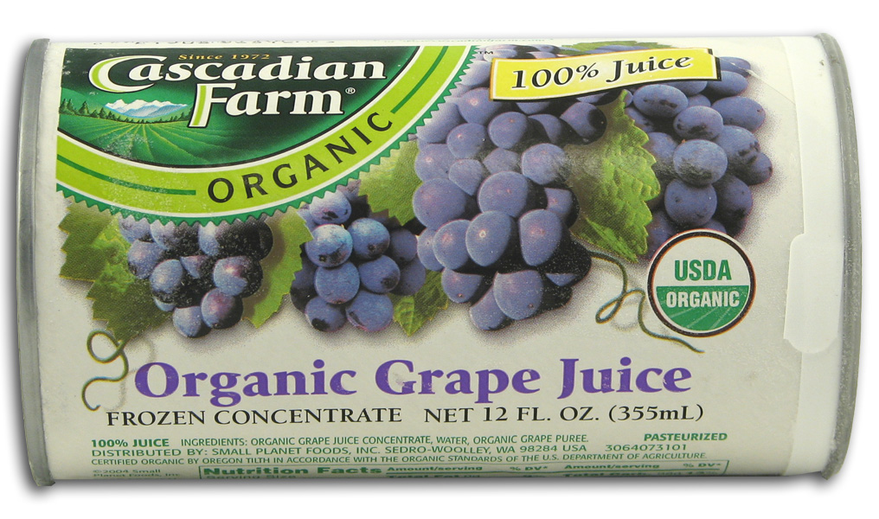

Slide 24
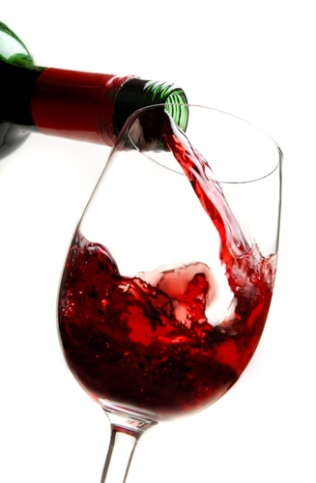
These are NOT equivalent!

