Slide 1
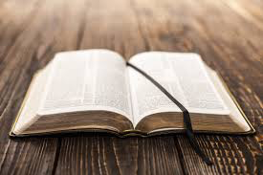
So Ezra the priest brought the Law before the assembly of men and women and all who could hear with understanding on the first day of the seventh month. Then he read from it in the open square that was in front of the Water Gate from morning until midday, before the men and women and those who could understand; and the ears of all the people were attentive to the Book of the Law. Then he took the Book of the Covenant and read in the hearing of the people. And they said, "All that the Lord has said we will do, and be obedient."by which, when you read, you may understand my knowledge in the mystery of Christ), Till I come, give attention to reading, to exhortation, to doctrine.

Slide 3
In the beginning God created the heaven and the earth.
And the earth was without form, and void; and darkness was upon the face of the deep. And the Spirit of God moved upon the face of the waters.
And God said, Let there be light: and there was light.
And God saw the light, that it was good: and God divided the light from the darkness.
And God called the light Day, and the darkness he called Night. And the evening and the morning were the first day.

Slide 4
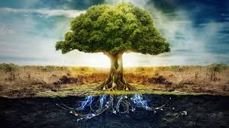
These are the generations of the heavens and of the earth when they were created, in the day that the Lord God made the earth and the heavens,
And the Lord God planted a garden eastward in Eden; and there he put the man whom he had formed.
And out of the ground made the Lord God to grow every tree that is pleasant to the sight, and good for food; the tree of life also in the midst of the garden, and the tree of knowledge of good and evil.

Slide 5
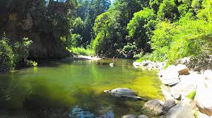
And the Lord God took the man, and put him into the garden of Eden to dress it and to keep it.
And the Lord God commanded the man, saying, Of every tree of the garden thou mayest freely eat: But of the tree of the knowledge of good and evil, thou shalt not eat of it: for in the day that thou eatest thereof thou shalt surely die.

Slide 6
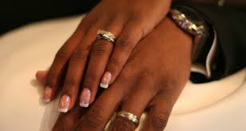
And the rib, which the Lord God had taken from man, made he a woman, and brought her unto the man.
And Adam said, This is now bone of my bones, and flesh of my flesh: she shall be called Woman, because she was taken out of Man.
Therefore shall a man leave his father and his mother, and shall cleave unto his wife: and they shall be one flesh.

Slide 7
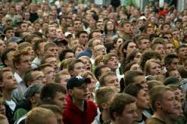
And it came to pass, when men began to multiply on the face of the earth, and daughters were born unto them,
That the sons of God saw the daughters of men that they were fair; and they took them wives of all which they chose.
And the Lord said, My spirit shall not always strive with man, for that he also is flesh: yet his days shall be an hundred and twenty years. And God saw that the wickedness of man was great in the earth, and that every imagination of the thoughts of his heart was only evil continually.
And it repented the Lord that he had made man on the earth, and it grieved him at his heart
.

Slide 8
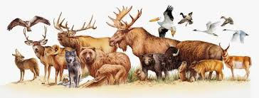
And the Lord said, I will destroy man whom I have created from the face of the earth; both man, and beast, and the creeping thing, and the fowls of the air; for it repenteth me that I have made them.But Noah found grace in the eyes of the Lord.
These are the generations of Noah: Noah was a just man and perfect in his generations, and Noah walked with God.
And Noah begat three sons, Shem, Ham, and Japheth.

Slide 9
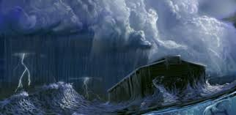
The earth also was corrupt before God, and the earth was filled with violence.
And God looked upon the earth, and, behold, it was corrupt; for all flesh had corrupted his way upon the earth.
And God said unto Noah, The end of all flesh is come before me; for the earth is filled with violence through them; and, behold, I will destroy them with the earth.
Make thee an ark of gopher wood; rooms shalt thou make in the ark, and shalt pitch it within and without with pitch.
Thus did Noah; according to all that God
commanded him, so did he.

Slide 10
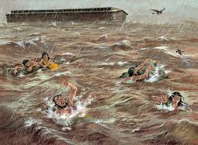
For yet seven days, and I will cause it to rain upon the earth forty days and forty nights; and every living substance that I have made will I destroy from off the face of the earth.
And Noah did according unto all that the Lord commanded him.
And Noah was six hundred years old when the flood of waters was upon the earth.
And the Lord said unto Noah, Come thou and all thy house into the ark; for thee have I seen righteous before me in this generation.

Slide 11
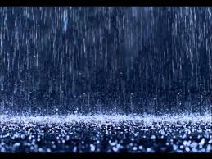
And it came to pass after seven days, that the waters of the flood were upon the earth.
In the six hundredth year of Noah's life, in the second month, the seventeenth day of the month, the same day were all the fountains of the great deep broken up, and the windows of heaven were opened.
And the rain was upon the earth forty days and forty nights.
And they that went in, went in male and female of all flesh, as God had commanded him: and the Lord shut him in.

Slide 12
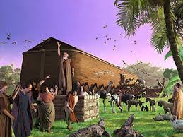
And every living substance was destroyed which was upon the face of the ground, both man, and cattle, and the creeping things, and the fowl of the heaven; and they were destroyed from the earth: and Noah only remained alive, and they that were with him in the ark.
And the waters prevailed upon the earth an hundred and fifty days.
And God spake unto Noah, saying,
Go forth of the ark, thou, and thy wife, and thy sons, and thy sons' wives with thee.

Slide 13
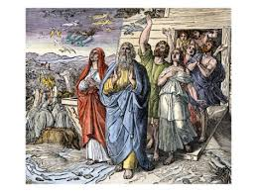
Bring forth with thee every living thing that is with thee, of all flesh, both of fowl, and of cattle, and of every creeping thing that creepeth upon the earth; that they may breed abundantly in the earth, and be fruitful, and multiply upon the earth.
And Noah went forth, and his sons, and his wife, and his sons' wives with him:
Every beast, every creeping thing, and every fowl, and whatsoever creepeth upon the earth, after their kinds, went forth out of the ark.

Slide 14
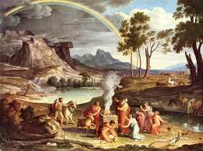
And I will establish my covenant with you, neither shall all flesh be cut off any more by the waters of a flood; neither shall there any more be a flood to destroy the earth.
And God said, This is the token of the covenant which I make between me and you and every living creature that is with you, for perpetual generations:
I do set my bow in the cloud, and it shall be for a token of a covenant between me and the earth.

Slide 15
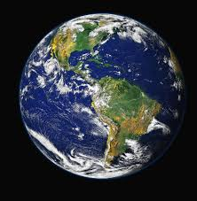
And the sons of Noah, that went forth of the ark, were Shem, and Ham, and Japheth: and Ham is the father of Canaan.
These are the three sons of Noah: and of them was the whole earth was populated. Now these are the generations of Terah: Terah begat Abram, Nahor, and Haran; and Haran begat Lot. And Haran died before his father Terah in the land of his nativity, in Ur of the Chaldees.

Slide 16
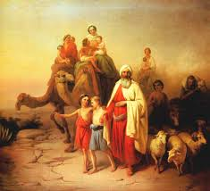
And Abram and Nahor took them wives: the name of Abram's wife was Sarai; and the name of Nahor's wife, Milcah, the daughter of Haran, the father of Milcah, and the father of Iscah.
But Sarai was barren; she had no child.
And Terah took Abram his son, and Lot the son of Haran his son's son, and Sarai his daughter in law, his son Abram's wife; and they went forth with them from Ur of the Chaldees, to go into the land of Canaan; and they came unto Haran, and dwelt there.

Slide 17
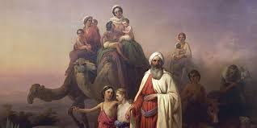
Now the Lord had said unto Abram, Get thee out of thy country, and from thy kindred, and from thy father's house, unto a land that I will shew thee:
And I will make of thee a great nation, and I will bless thee, and make thy name great; and thou shalt be a blessing:
And I will bless them that bless thee, and curse him that curseth thee: and in thee shall all families of the earth be blessed.

Slide 18
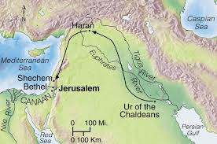
So Abram departed, as the Lord had spoken unto him; and Lot went with him: and Abram was seventy and five years old when he departed out of Haran.
And Abram took Sarai his wife, and Lot his brother's son, and all their substance that they had gathered, and the souls that they had gotten in Haran; and they went forth to go into the land of Canaan; and into the land of Canaan they came.

Slide 19
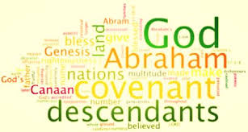
And when Abram was ninety years old and nine, the Lord appeared to Abram, and said unto him, I am the Almighty God; walk before me, and be thou perfect.
And I will make my covenant between me and thee, and will multiply thee exceedingly.
And Abram fell on his face: and God talked with him, saying,
As for me, behold, my covenant is with thee, and thou shalt be a father of many nations.
Neither shall thy name any more be called Abram, but thy name shall be Abraham; for a father of many nations have I made thee.
And I will make thee exceeding fruitful, and I will make nations of thee, and kings shall come out of thee.

Slide 20
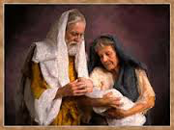
And I will establish my covenant between me and thee and thy seed after thee in their generations for an everlasting covenant, to be a God unto thee, and to thy seed after thee.
And I will give unto thee, and to thy seed after thee, the land wherein thou art a stranger, all the land of Canaan, for an everlasting possession; and I will be their God.
And the Lord visited Sarah as he had said, and the Lord did unto Sarah as he had spoken.
For Sarah conceived, and bare Abraham a son in his old age, at the set time of which God had spoken to him.
And Abraham called the name of his son that was born unto him, whom Sarah bare to him, Isaac.

Slide 21
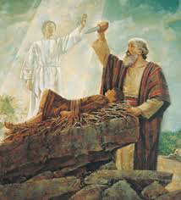
And he said, Take now thy son, thine only son Isaac, whom thou lovest, and get thee into the land of Moriah; and offer him there for a burnt offering upon one of the mountains which I will tell thee of.
And they came to the place which God had told him of; and Abraham built an altar there, and laid the wood in order, and bound Isaac his son, and laid him on the altar upon the wood.
And Abraham stretched forth his hand, and took the knife to slay his son.
And the angel of the Lord called unto him out of heaven, and said, Abraham, Abraham: and he said, Here am I.

Slide 22
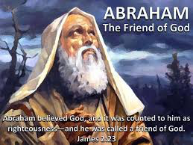
And he said, Lay not thine hand upon the lad, neither do thou any thing unto him: for now I know that thou fearest God, seeing thou hast not withheld thy son, thine only son from me. And in thy seed shall all the nations of the earth be blessed; because thou hast obeyed my voice.
And Abraham gave all that he had unto Isaac.
And these are the days of the years of Abraham's life which he lived, an hundred threescore and fifteen years.

Slide 23
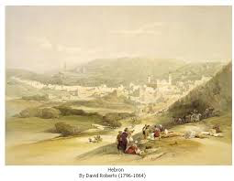
Then Abraham gave up the ghost, and died in a good old age, an old man, and full of years; and was gathered to his people.
The field which Abraham purchased of the sons of Heth: there was Abraham buried, and Sarah his wife.
And it came to pass after the death of Abraham, that God blessed his son Isaac; and Isaac dwelt by the well Lahairoi.

Slide 24
And Issac was forty years old when he took Rebekah to wife
And Isaac intreated the Lord for his wife, because she was barren: and the Lord was intreated of him, and Rebekah his wife conceived.
And the children struggled together within her; and she said, If it be so, why am I thus? And she went to enquire of the Lord.
And the Lord said unto her, Two nations are in thy womb, and two manner of people shall be separated from thy bowels; and the one people shall be stronger than the other people; and the elder shall serve the younger.

Slide 25
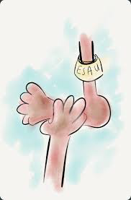
And when her days to be delivered were fulfilled, behold, there were twins in her womb.
And the first came out red, all over like an hairy garment; and they called his name Esau.
And after that came his brother out, and his hand took hold on Esau's heel; and his name was called Jacob: and Isaac was threescore years old when she bare them.
And the boys grew: and Esau was a cunning hunter, a man of the field; and Jacob was a plain man, dwelling in tents.
And Isaac loved Esau, because he did eat of his venison: but Rebekah loved Jacob.

Slide 26
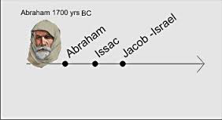
And Isaac called Jacob, and blessed him
And God Almighty bless thee, and make thee
fruitful, and multiply thee, that thou mayest be a
multitude of people;
And give thee the blessing of Abraham, to thee,
and to thy seed with thee; that thou mayest inherit
the land wherein thou art a stranger, which God gave
unto Abraham.
And God appeared unto Jacob again, when he came
out of Padanaram, and blessed him.
And God said unto him, Thy name is Jacob: thy name
shall not be called any more Jacob, but Israel shall be
thy name: and he called his name Israel.

Slide 27
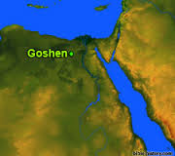
And God said unto him, I am God Almighty: be fruitful and multiply; a nation and a company of nations shall be of thee, and kings shall come out of thy loins;
And the land which I gave Abraham and Isaac, to thee I will give it, and to thy seed after thee will I give the land. And Israel dwelt in the land of Egypt, in the country of Goshen; and they had possessions therein, and grew, and multiplied exceedingly.

Slide 28
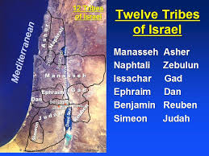
Now these are the names of the children of Israel, which came into Egypt; every man and his household came with Jacob.
Reuben, Simeon, Levi, and Judah,
Issachar, Zebulun, and Benjamin,
Dan, and Naphtali, Gad, and Asher.
And the children of Israel were fruitful, and increased abundantly, and multiplied, and waxed exceeding mighty; and the land was filled with them.

Slide 29
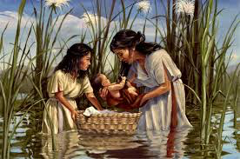
And there went a man of the house of Levi, and took to wife a daughter of Levi.
And the woman conceived, and bare a son: and when she saw him that he was a goodly child, she hid him three months.
And the child grew, and she brought him unto Pharaoh's daughter, and he became her son. And she called his name Moses: and she said, Because I drew him out of the water.
and it came to pass in those days, when Moses was grown, that the Lord said unto him

Slide 30
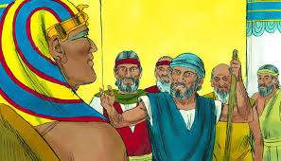
Come now therefore, and I will send thee unto Pharaoh, that thou mayest bring forth my people the children of Israel out of Egypt.
And thou shalt speak unto him, and put words in his mouth: and I will be with thy mouth, and with his mouth, and will teach you what ye shall do
And Moses and Aaron went and gathered together all the elders of the children of Israel:
And Aaron spake all the words which the Lord had spoken unto Moses, and did the signs in the sight of the people.
And the people believed: and when they heard that the Lord had visited the children of Israel, and that he had looked upon their affliction, then they bowed their heads and worshipped.

Slide 31
And the children of Israel journeyed from Rameses to Succoth, about six hundred thousand on foot that were men, beside children.
And a mixed multitude went up also with them; and flocks, and herds, even very much cattle.
And they baked unleavened cakes of the dough which they brought forth out of Egypt, for it was not leavened; because they were thrust out of Egypt, and could not tarry, neither had they prepared for themselves any victual.

Slide 32
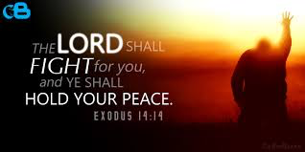
And it came to pass at the end of the four hundred and thirty years, even the selfsame day it came to pass, that all the hosts of the Lord went out from the land of Egypt.
And Moses said unto the people, Fear ye not, stand still, and see the salvation of the Lord, which he will shew to you to day: for the Egyptians whom ye have seen to day, ye shall see them again no more for ever.
The Lord shall fight for you, and ye shall hold your peace.

Slide 33
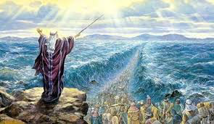
And Moses stretched out his hand over the sea; and the Lord caused the sea to go back by a strong east wind all that night, and made the sea dry land, and the waters were divided.
And the children of Israel went into the midst of the sea upon the dry ground: and the waters were a wall unto them on their right hand, and on their left.
And the Egyptians pursued, and went in after them to the midst of the sea, even all Pharaoh's horses, his chariots, and his horsemen.
And it came to pass, that in the morning watch the Lord looked unto the host of the Egyptians through the pillar of fire and of the cloud, and troubled the host of the Egyptians,

Slide 34
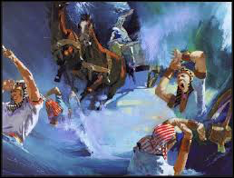
And took off their chariot wheels, that they drave them heavily: so that the Egyptians said, Let us flee from the face of Israel; for the Lord fighteth for them against the Egyptians.
And the Lord said unto Moses, Stretch out thine hand over the sea, that the waters may come again upon the Egyptians, upon their chariots, and upon their horsemen.
And Moses stretched forth his hand over the sea, and the sea returned to his strength when the morning appeared; and the Egyptians fled against it; and the Lord overthrew the Egyptians in the midst of the sea.

Slide 35
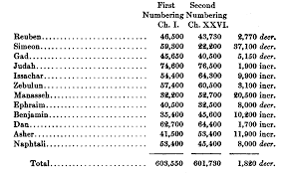
And Israel saw that great work which the Lord did upon the Egyptians: and the people feared the Lord, and believed the Lord, and his servant Moses.And the Lord spake unto Moses in the second year after they were come out of the land of Egypt, saying
Take ye the sum of all the congregation of the children of Israel, after their families, by the house of their fathers, with the number of their names, every male by their polls;
So were all those that were numbered of the children of Israel, by the house of their fathers, from twenty years old and upward, all that were able to go forth to war in Israel;

Slide 36
Even all they that were numbered were six hundred thousand and three thousand and five hundred and fifty.
Now therefore hearken, O Israel, unto the statutes and unto the judgments, which I teach you, for to do them, that ye may live, and go in and possess the land which the Lord God of your fathers giveth you.
Ye shall not add unto the word which I command you, neither shall ye diminish ought from it, that ye may keep the commandments of the Lord your God which I command you.
Your eyes have seen what the Lord did because of Baalpeor: for all the men that followed Baalpeor, the Lord thy God hath destroyed them from among you.

Slide 37
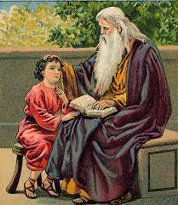
But ye that did cleave unto the Lord your God are alive every one of you this day.
Behold, I have taught you statutes and judgments, even as the Lord my God commanded me, that ye should do so in the land whither ye go to possess it.
Keep therefore and do them; for this is your wisdom and your understanding in the sight of the nations, which shall hear all these statutes, and say, Surely this great nation is a wise and understanding people.
Only take heed to thyself, and keep thy soul diligently, lest thou forget the things which thine eyes have seen, and lest they depart from thy heart all the days of thy life: but teach them thy sons, and thy sons' sons;

Slide 38
When thou shalt beget children, and children's children, and ye shall have remained long in the land, and shall corrupt yourselves, and make a graven image, or the likeness of any thing, and shall do evil in the sight of the Lord thy God, to provoke him to anger:
I call heaven and earth to witness against you this day, that ye shall soon utterly perish from off the land whereunto ye go over Jordan to possess it; ye shall not prolong your days upon it, but shall utterly be destroyed.
And the Lord shall scatter you among the nations, and ye shall be left few in number among the heathen, whither the Lord shall lead you.

Slide 39
And there ye shall serve gods, the work of men's hands, wood and stone, which neither see, nor hear, nor eat, nor smell.
But if from thence thou shalt seek the Lord thy God, thou shalt find him, if thou seek him with all thy heart and with all thy soul.
Hear therefore, O Israel, and observe to do it; that it may be well with thee, and that ye may increase mightily, as the Lord God of thy fathers hath promised thee, in the land that floweth with milk and honey.
Hear, O Israel: The Lord our God is one Lord:

Slide 40
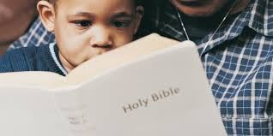
And thou shalt love the Lord thy God with all thine heart, and with all thy soul, and with all thy might.
And these words, which I command thee this day, shall be in thine heart:
And thou shalt teach them diligently unto thy children, and shalt talk of them when thou sittest in thine house, and when thou walkest by the way, and when thou liest down, and when thou risest up.

Slide 41
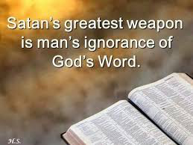
And thou shalt bind them for a sign upon thine hand, and they shall be as frontlets between thine eyes.
And thou shalt write them upon the posts of thy house, and on thy gates.
And it shall be, when the Lord thy God shall have brought thee into the land which he sware unto thy fathers, to Abraham, to Isaac, and to Jacob, to give thee great and goodly cities, which thou buildest not,
Beware that thou forget not the Lord thy God, in not keeping his commandments, and his judgments, and his statutes, which I command thee this day:

Slide 42
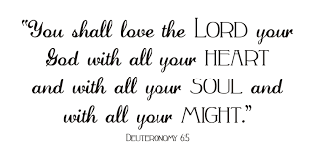
And now, Israel, what doth the Lord thy God require of thee, but to fear the Lord thy God, to walk in all his ways, and to love him, and to serve the Lord thy God with all thy heart and with all thy soul,
To keep the commandments of the Lord, and his statutes, which I command thee this day for thy good?
For thou art an holy people unto the Lord thy God, and the Lord hath chosen thee to be a peculiar people unto himself, above all the nations that are upon the earth.

Slide 43
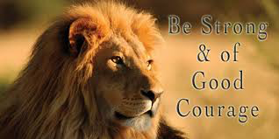
There shall not any man be able to stand before thee all the days of thy life: as I was with Moses, so I will be with thee: I will not fail thee, nor forsake thee.
Be strong and of a good courage: for unto this people shalt thou divide for an inheritance the land, which I swear unto their fathers to give them.
Turn not from it to the right hand or to the left, that thou mayest prosper withersoever thou goest.

Slide 44
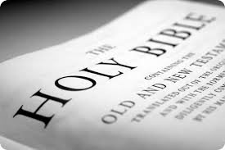
This book of the law shall not depart out of thy mouth; but thou shalt meditate therein day and night, that thou mayest observe to do according to all that is written therein: for then thou shalt make thy way prosperous, and then thou shalt have good success.
And if it seem evil unto you to serve the Lord, choose you this day whom ye will serve; whether the gods which your fathers served that were on the other side of the flood, or the gods of the Amorites, in whose land ye dwell: but as for me and my house, we will serve the Lord.

Slide 45
But ye are a chosen generation, a royal priesthood, an holy nation, a peculiar people; that ye should shew forth the praises of him who hath called you out of darkness into his marvellous light;
Which in time past were not a people, but are now the people of God: which had not obtained mercy, but now have obtained mercy.
Yet the number of the children of Israel shall be as the sand of the sea, which cannot be measured nor numbered; and it shall come to pass, that in the place where it was said unto them, Ye are not my people, there it shall be said unto them, Ye are the sons of the living God.

Slide 46
And I will sow her unto me in the earth; and I will have mercy upon her that had not obtained mercy; and I will say to them which were not my people, Thou art my people; and they shall say, Thou art my God.
He that spared not his own Son, but delivered him up for us all, how shall he not with him also freely give us all things?
So then faith cometh by hearing, and hearing by the word of God.
But without faith it is impossible to please him: for he that cometh to God must believe that he is, and that he is a rewarder of them that diligently seek him.

Slide 47
Therefore let all the house of Israel know assuredly, that God hath made the same Jesus, whom ye have crucified, both Lord and Christ Now when they heard this, they were pricked in their heart, and said unto Peter and to the rest of the apostles, Men and brethren, what shall we do?
Then Peter said unto them, Repent, and be baptized every one of you in the name of Jesus Christ for the remission of sins, and ye shall receive the gift of the Holy Ghost.

Slide 48
And now why tarriest thou? arise, and be baptized, and wash away thy sins, calling on the name of the Lord. And the Spirit and the bride say, Come. And let him that heareth say, Come. And let him that is athirst come. And whosoever will, let him take the water of life freely.

