Slide 1
Put to
DEATH
EARTHLY
In you
What is

Slide 2
“And let us not grow weary of doing good, for in due season we will reap, if we do not give up.”
—Galatians 6:9
“As for you, brothers, do not grow weary in doing good.”
—II Thessalonians 3:13

Slide 3
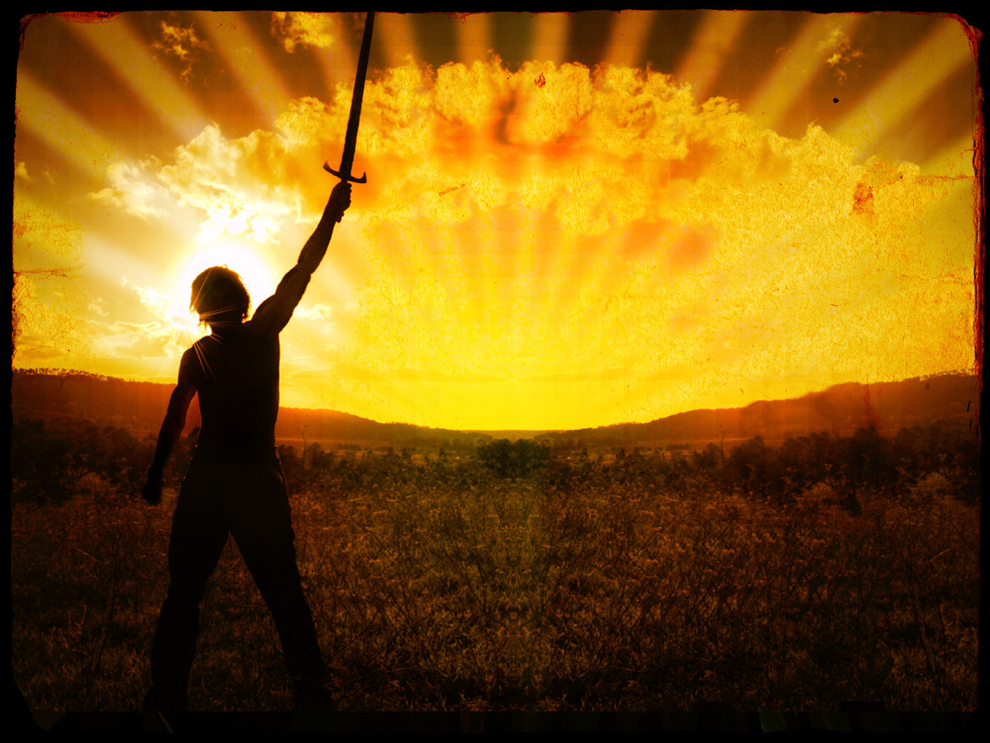
Don’t Grow Weary
of the Fight

Slide 4
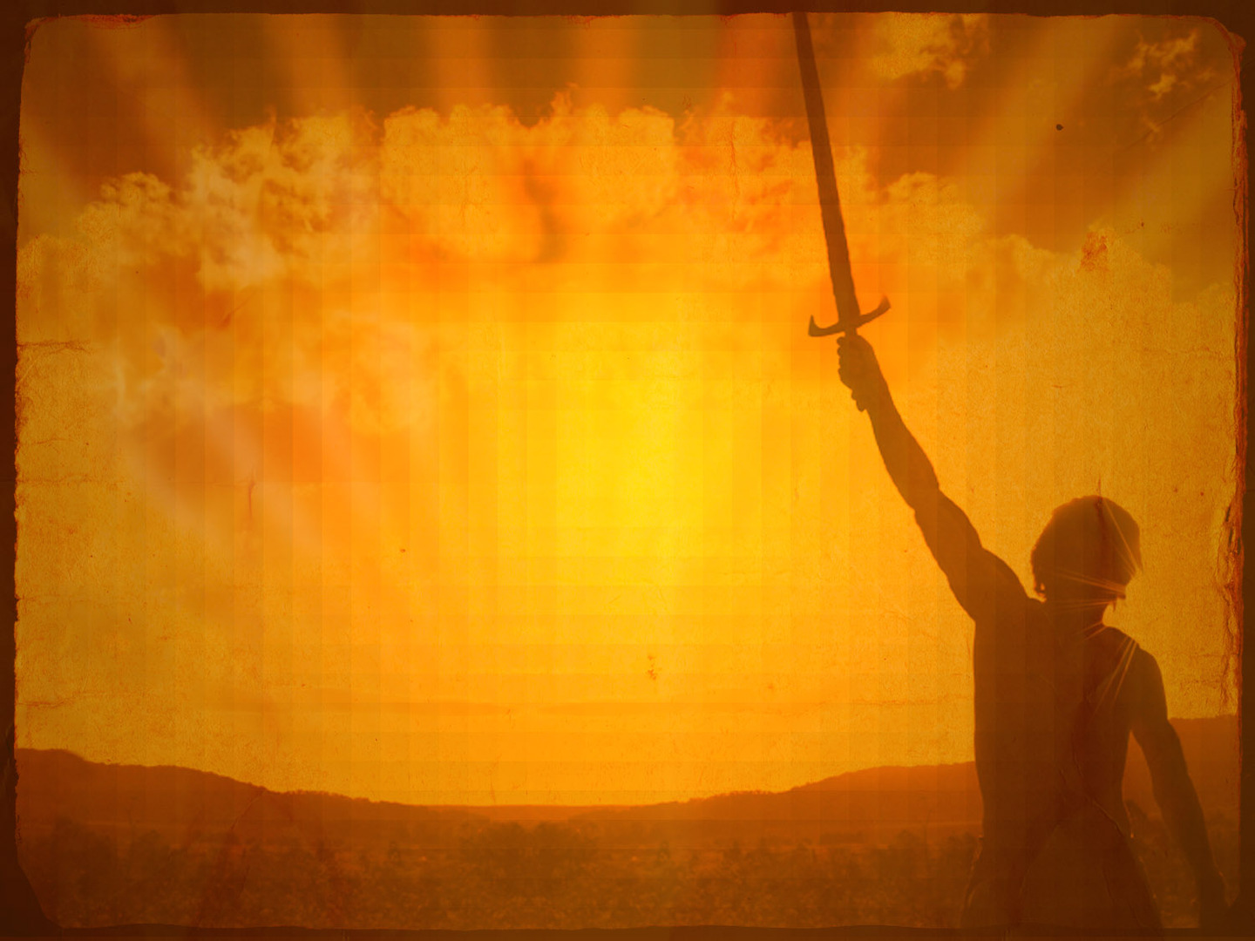
Sources of
Weariness

Slide 5
Time
Difficulty
Mockery and Persecution
Seeming Success of Sinners
Saboteurs
Improper Motivation and Goals
Euphoric Recall of Sin
Slips and Falls
Comparisons

Slide 6
Combatting
Weariness

Slide 7
Keep drinking from the refreshing well of living waters

Slide 8
“The Lord is my shepherd; I shall not want. He makes me lied down in green pastures. He leads me beside still waters. He restores my soul. He leads me in paths of righteousness for his name’s sake.”
—Psalm 23:1-3

Slide 9
“But when I thought how to understand this, it seemed to me a wearisome task, until I went into the sanctuary of God...”
—Psalm 73:16-17

Slide 10
Confess your weariness to others

Slide 11
“Therefore, confess your sins to one another and pray for one another, that you may be healed. The prayer of a righteous person has great power as it is working.”
—James 5:16

Slide 12
Remember God’s presence

Slide 13
“Keep your life free from the love of money, and be content with what you have, for he has said, ‘I will never leave you nor forsake you.’”
—Hebrews 13:5

Slide 14
“For this reason I bow my knees before the Father, from whom every family in heaven and on earth is named, that according to the riches of his glory he may grant you to be strengthened with power through his Spirit in your inner being, so that Christ may dwell in your hearts through faith—that you, being rooted and grounded in love, may have strength to comprehend with all the saints…”
—Ephesians 3:14-21

Slide 15
“…what is the breadth and length and height and depth, and to know the love of Christ that surpasses knowledge, that you may be filled with all the fullness of God. Now to him who is able to do far more abundantly than all that we ask or think, according to the power at work within us, to him be glory in the church and in Christ Jesus throughout all generations, forever and ever. Amen.”
—Ephesians 3:14-21

Slide 16
“Have you not known? Have you not heard? The Lord is the everlasting God, the Creator of the ends of the earth. He does not faint or grow weary; his understanding is unsearchable. He gives power to the faint, and to him who has no might he increases strength. Even youths shall faint and be weary, and young men shall fall exhausted; but they who wait for the Lord shall renew their strength; they shall mount up with wings like eagles; they shall run and not be weary; they shall walk and not faint.”
—Isaiah 40:28-31

Slide 17
Consider the saints of old (especially Jesus)

Slide 18
“Therefore, since we are surrounded by so great a cloud of witnesses, let us also lay aside every weight, and sin which clings so closely, and let us run with endurance the race that is set before us, looking to Jesus the founder and perfecter of our faith, who for the joy that was set before him endured the cross, despising the shame, and is seated at the right hand of the throne of God. Consider him who endured from sinners such hostility against himself, so that you may not grow weary or fainthearted.”
—Hebrews 12:1-3

Slide 19
Remember
past victories

Slide 20
“Be gracious to me, O Lord! See my affliction from those who hate me, O you who lift me up from the gates of death…”
—Psalm 9:13

Slide 21
“I will give thanks to the Lord with my whole heart; I will recount all of your wonderful deeds. I will be glad and exult in you; I will sing praise to your name, O Most High. When my enemies turn back, they stumble and perish before your presence. For you have maintained my just cause; you have sat on the throne, giving righteous judgment. You have rebuked the nations; you have made the wicked perish; you have blotted out their name forever and ever. The enemy came to an end in everlasting ruins.”
—Psalm 9:1-6

Slide 22
Recognize
progress

Slide 23
“Not that I have already obtained this or am already perfect, but I press on to make it my own, because Christ Jesus has made me his own. Brothers, I do not consider that I have made it my own. But one thing I do: forgetting what lies behind and straining forward to what lies ahead, I press on toward the goal for the prize of the upward call of God in Christ Jesus.”
—Philippians 3:12-14

Slide 24
Remembers God’s promises

Slide 25
“But the fruit of the Spirit is love, joy, peace, patience, kindness, goodness, faithfulness, gentleness, self-control; against such things there is no law.”
—Galatians 5:22-23

Slide 26
“God shows his own love toward us in that while we were still sinners, Christ died for us. Since, therefore, we have now been justified by his blood, much more shall we be saved by him from the wrath of God.”
—Romans 5:8-9

Slide 27
One day
at a time

Slide 28
“If anyone would come after me, let him deny himself and take up his cross daily and follow me.”
—Luke 9:23

Slide 29
Put to
DEATH
EARTHLY
In you
What is

