Slide 1
Do I offend Others?
Matt 18:1-7

Slide 2
Do I offend Others?
Mat 18:1 At the same time came the disciples unto Jesus, saying, Who is the greatest in the kingdom of heaven?

Slide 3
Do I offend Others?
Mat 18:2 And Jesus called a little child unto him, and set him in the midst of them,

Slide 4
Do I offend Others?
Mat 18:3 And said, Verily I say unto you, Except ye be converted, and become as little children, ye shall not enter into the kingdom of heaven.
Mat 18:4 Whosoever therefore shall humble himself as this little child, the same is greatest in the kingdom of heaven.

Slide 5
Do I offend Others?
Mat 18:5 And whoso shall receive one such little child in my name receiveth me.

Slide 6
Do I offend Others?
Mat 18:6 But whoso shall offend one of these little ones which believe in me, it were better for him that a millstone were hanged about his neck, and that he were drowned in the depth of the sea.

Slide 7
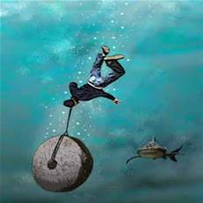

Slide 8
Do I offend Others?
Mat 18:7 Woe unto the world because of offences! for it must needs be that offences come; but woe to that man by whom the offence cometh!

Slide 9
Assembling
Shamefacedness
Parenting
Do not Defraud
Applications

Slide 10
Assembling
Shamefacedness
Parenting
Do not Defraud
Applications

Slide 11
Hebrews 10:25 not neglecting to meet together, as is the habit of some, but encouraging one another, and all the more as you see the Day drawing near.

Slide 12
Hebrews 10:25 not neglecting to meet together, as is the habit of some, but encouraging one another, and all the more as you see the Day drawing near.
C H _ _CH

Slide 13
Assembling
Shamefacedness
Parenting
Do not Defraud
Applications

Slide 14
In like manner also, that women adorn themselves in modest apparel, with shamefacedness and sobriety; not with broided hair, or gold, or pearls, or costly array;
1 Tim 2:9

Slide 15
Were they ashamed when they had committed abomination? nay, they were not at all ashamed, neither could they blush: therefore they shall fall among them that fall: at the time that I visit them they shall be cast down, saith the LORD.
Jer 6:15

Slide 16
I counsel you to buy from me gold refined by fire, so that you may be rich, and white garments so that you may clothe yourself and the shame of your nakedness may not be seen, and salve to anoint your eyes, so that you may see.
Rev 3:18

Slide 17
Vines- unclothed: scantily or poorly clad. Clad in the undergarment only
Naked

Slide 18
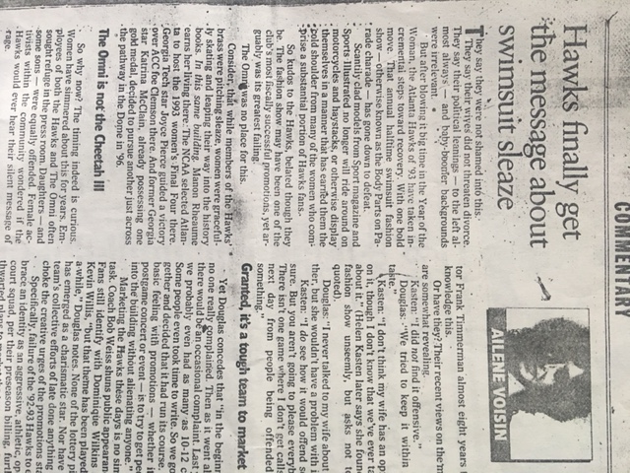
Vines- unclothed: scantily or poorly clad. Clad in the undergarment only
1. Newspaper Article
Naked

Slide 19
Lascivious
Where in the Bible is Lasciviousness mentioned?

Slide 20
Gal 5:19 Now the works of the flesh are manifest, which are these; Adultery, fornication, uncleanness, lasciviousness,
Gal 5:21 …., and such like: of the which I tell you before, as I have also told you in time past, that they which do such things shall not inherit the kingdom of God.

Slide 21
Vines- unclothed: scantily or poorly clad. Clad in the undergarment only
Newspaper Article
Revealing the thigh
Naked

Slide 22
Isa 47:2 Take the millstones, and grind meal: uncover thy locks, make bare the leg, uncover the thigh, pass over the rivers.
Isa 47:3 Thy nakedness shall be uncovered, yea, thy shame shall be seen: I will take vengeance, and I will not meet thee as a man.
Phillips' lesson on June 28th 2015

Slide 23
Vines- unclothed: scantily or poorly clad. Clad in the undergarment only
Do You go into public naked?

Slide 24
In like manner also, that women adorn themselves in modest apparel, with shamefacedness and sobriety; not with broided hair, or gold, or pearls, or costly array;
1 Tim 2:9

Slide 25
Assembling
Shamefacedness
Parenting
Do not Defraud
Applications

Slide 26
And, ye fathers, provoke not your children to wrath: but bring them up in the nurture and admonition of the Lord.
Eph 6:4

Slide 27
Assembling
Shamefacedness
Parenting
Do not defraud
Applications

Slide 28
Do not deprive one another, except perhaps by agreement for a limited time, that you may devote yourselves to prayer; but then come together again, so that Satan may not tempt you because of your lack of self-control.
1 Cor 7:5

Slide 29
What shall we say then?
Shall we continue in sin, that grace may abound?
Rom 6:1

Slide 30
The Lord ….; but is longsuffering to us-ward, not willing that any should perish, but that all should come to repentance.
2 Pe 3:9

Slide 31
He that believeth and is baptized shall be saved; but he that believeth not shall be damned.
Mar 16:16

