Slide 1
Theistic Evolution

Slide 2
Definition
Theistic evolution, theistic evolutionism, or evolutionary creationism are views that regard religious teachings about God as compatible with modern scientific understanding about biological evolution.
– Wikipedia
It is an allegorical approach to parts of the book of Genesis, thus explaining away anything that contradicts modern “Science” and let’s you believe in evolution and the Bible
– me

Slide 3
Clergy Letter Project
Evolution Sunday, Started in 2006
Annually on the closest Sunday to Charles Darwin's birthday: Feb 12, 1809
Name changed to Evolution weekend to be more inclusive of other world religions
Increased in popularity until best year in 2009, marked 200th anniversary of Darwin’s birthday and 150th anniversary Of “The Origin of Species”

Slide 4
Clergy Letter Project
1,049 congregations from all 50 states, the Dsitrict of Columbia, US Virgin Islands and 15 countries participated in Evolution Weekend 2009.
Officially endorsed by the Presbytery of the Cascades, a governing body that includes 101 Presbyterian Church (U.S.A.) congregations in the states of Washington, Oregon and one in Northern California
Officially endorsed by the Southeast Florida Diocese of the Episcopal Church
Officially endorsed by the Southwestern Washington Synod of the Evangelical Lutheran Church in America

Slide 5
Clergy letter sent to denominations
“We the undersigned, Christian clergy from many different traditions, believe that the timeless truths of the Bible and the discoveries of modern science may comfortably coexist. We believe that the theory of evolution is a foundational scientific truth, one that has stood up to rigorous scrutiny and upon which much of human knowledge and achievement rests. To reject this truth or to treat it as “one theory among others” is to deliberately embrace scientific ignorance and transmit such ignorance to our children…”

Slide 6
Fallacies of Theistic Evolution – Adam and Eve
1Timothy 2:13-14 For it was Adam who was first created, and then Eve. And it was not Adam who was deceived, but the woman being deceived, fell into transgression.
Luke 3:38 the son of Enosh, the son of Seth, the son of Adam, the son of God.
Matthew 19:4 And He answered and said, “Have you not read that He who created them from the beginning made them male and female

Slide 7
Fallacies of Theistic Evolution – Made in God’s image
Genesis 1:27-28 God created man in His own image, in the image of God He created him; male and female He created them. God blessed them; and God said to them, “Be fruitful and multiply, and fill the earth, and subdue it; and rule over the fish of the sea and over the birds of the sky and over every living thing that moves on the earth.”

Slide 8
Fallacies of Theistic Evolution – Creation finished
Genesis 2:1-2 Thus the heavens and the earth were completed, and all their hosts. By the seventh day God completed His work which He had done, and He rested on the seventh day from all His work which He had done.

Slide 9
Fallacies of Theistic Evolution – Noah
Luke_17:27 they were eating, they were drinking, they were marrying, they were being given in marriage, until the day that Noah entered the ark, and the flood came and destroyed them all.
Hebrews_11:7 By faith Noah, being warned by God about things not yet seen, in reverence prepared an ark for the salvation of his household, by which he condemned the world, and became an heir of the righteousness which is according to faith.

Slide 10
Richard Hawkins
-Evolutionary Biologist
“My personal feeling is that understanding evolution led me to atheism.”
Theistic evolution “is a way to smuggle God into the back door”

Slide 11
Science in Scripture - Example #1
The Earth is free floating in space! Job 26:7
“He stretches out the north over empty space And hangs the earth on nothing…”

Slide 12
Science in Scripture - Example #2
The Water Cycle -Amos 5:8, 9:6, Ecclesiastes 1:6-7, Job 36:27-28
Job 36:27-28 “For He draws up the drops of water, They distill rain from the mist, Which the clouds pour down, They drip upon man abundantly.

Slide 13
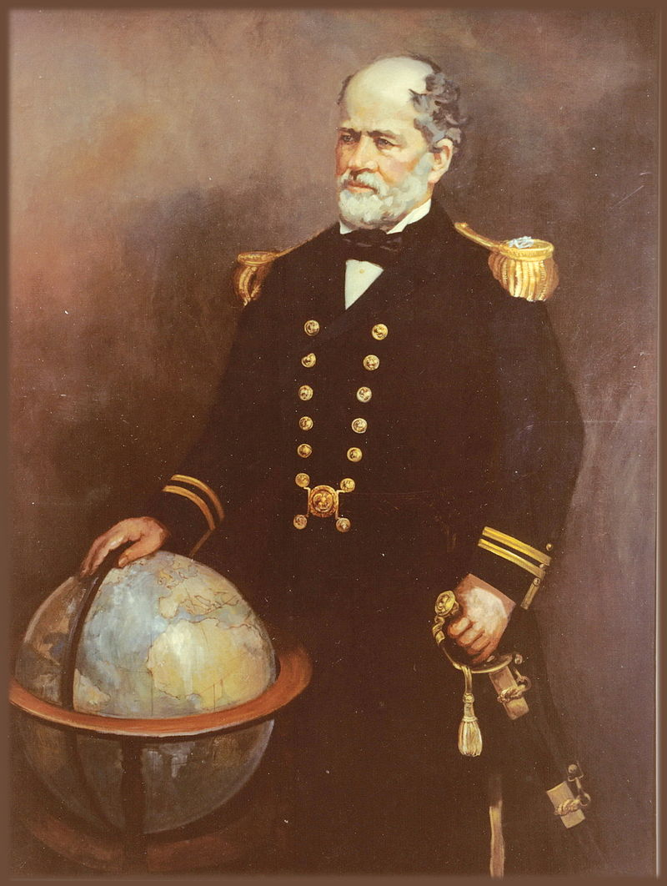
Science in Scripture - Example #3
Matthew Fontaine Maury
"Pathfinder of the Seas"
"Father of Modern Oceanography and Naval Meteorology"
"Scientist of the Seas,"

Slide 14
Science in Scripture - Example #3
Inspired by Psalms 8:8:
“The fowl of the air, and the fish of the sea, and whatsoever passeth through the paths of the seas.”

Slide 15
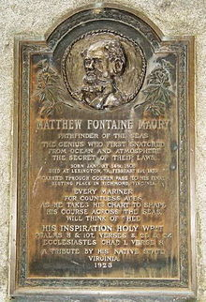
MATTHEW FONTAINE MAURY PATHFINDER OF THE SEAS, THE GENIUS WHO FIRST SNATCHED FROM THE OCEAN AND ATMOSPHERE THE SECRET OF THEIR LAWS, EVERY MARINER FOR COUNTLESS AGES AS HE TAKES HIS CHART TO SHAPE HIS COURSE ACROSS THE SEAS, WILL THINK OF THEE. HIS INSPIRATION HOLY WRIT Psalms 8 and 107, Verses 8, 23 and 24 Ecclesiastes Chap. 1, Verse 8

Slide 16
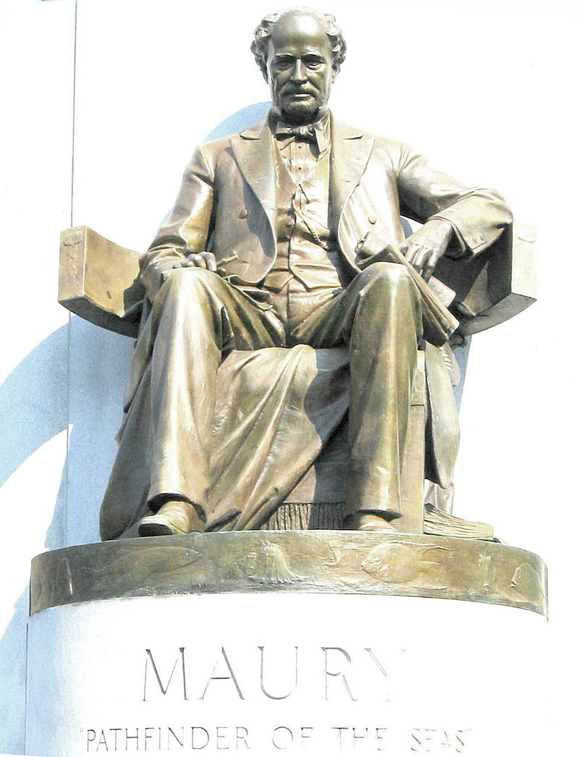
“I have been blamed by men of science, both in this country and in England, for quoting the Bible in confirmation of the doctrines of physical geography. The Bible, they say, was not written for scientific purposes, and is therefore no authority in matters of science.
I beg pardon! The Bible is authority for everything it touches. What would you think of an historian who should refuse to consult historical records of the Bible, because the Bible was not written for the purposes of history? The Bible is true and science is true”
-Matthew Maury

Slide 17
2 Peter 3:1-14 (1-5)
1 My friends, this is the second letter I have written to you. I wrote both letters to you to help your honest minds remember something.
2 I want you to remember the words that the holy prophets spoke in the past. And remember the command that our Lord and Savior gave us. He gave us that command through your apostles.
3 It is important for you to understand what will happen in the last days. People will laugh you Those people will live following the evil things they want to do.
4 Those people will say, “He (Jesus) promised to come again. Where is he? Our fathers have died. But the world continues the way it has been since it was made.”
5 But those people don’t want to remember what happened long ago. The skies were there, and God made the earth from water and with water. All this happened by God’s word.

Slide 18
2 Peter 3:1-14 (6-9)
6 Then that world was flooded and destroyed with water.
7 And that same word God is keeping the skies and the earth that we have now. The skies and the earth are being kept to be destroyed by fire. The skies and the earth are kept for the day of judgment and the destruction of all people who are against God.
8 But don’t forget this one thing, dear friends: To the Lord a day is like a thousand years, and a thousand years is like a day.
9 The Lord is not being slow in doing what he promised—the way some people understand slowness. But God is being patient with you. God doesn’t want any person to be lost. God wants every person to change his heart and stop sinning.

Slide 19
2 Peter 3:1-14 (10-14)
10 But the Day when the Lord comes again will be a surprise like a thief. The sky will disappear with a loud noise. All the things in the sky will be destroyed with fire. And the earth and everything in it will be burned.
11 In that way everything will be destroyed like I told you. So what kind of people should you be? You should live holy lives and do things to serve God.
12 You should wait for the Day of God. You should want very much for that Day to come. When that Day comes, the sky will be destroyed with fire, and everything in the sky will melt with heat.
13 But God made a promise to us. And we are waiting for what he promised—a new sky and a new earth. That will be the place where goodness lives.
14 Dear friends, we are waiting for this to happen. So try as hard as you can to be without sin and without fault. Try to be at peace with God.

Slide 20
1 Peter 3:20-21
²⁰ who once were disobedient, when the patience of God kept waiting in the days of Noah, during the construction of the ark, in which a few, that is, eight persons, were brought safely through the water.
²¹ Corresponding to that, baptism now saves you—not the removal of dirt from the flesh, but an appeal to God for a good conscience—through the resurrection of Jesus Christ,

Slide 21
Salvation
Hear the Word – Romans 10:17
Believe the Word – Mark 16:16
Repent of your sins – Acts 17:30
Confess Jesus is Lord – Romans 10:9&10
Be Baptized for the forgiveness of your sins.
–1 Peter 3:21

