Slide 3
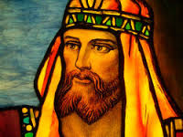
STORY OF SOLOMON
Great Administrator

Slide 4
STORY OF SOLOMON
Great Administrator
Great Financial Manager

Slide 5
STORY OF SOLOMON
Great Administrator
Great Financial Manager
Great Architect

Slide 6
STORY OF SOLOMON
Great Administrator
Great Financial Manager
Great Architect
Great Diplomat

Slide 7
STORY OF SOLOMON
Great Administrator
Great Financial Manager
Great Architect
Great Diplomat
Great Scholar

Slide 8
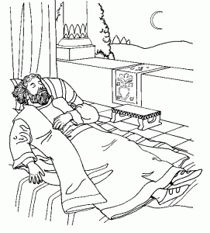
STORY OF SOLOMON

Slide 9
WISDOM
“Involves an integration of knowledge, experience and deep understanding that incorporates tolerance for the uncertainties of life. Provides an awareness of how things play out over time and confers a sense of balance.”

Slide 10
WISDOM
“Wisdom is the ability to think and act using knowledge, experience, understanding, insight and common sense.”

Slide 11
WISDOM
“Wisdom is the right use of knowledge.”

Slide 12
WISDOM
“The ability to see things from God’s point of view.”

Slide 13
WISDOM
James
1:22 Be ye doers of the word
2:1 Don’t show partiality
4:7 Submit to God
4:7 Resist the devil
5:7 Be patient
5:9 Do not grumble
5:12 Do not swear

Slide 14
WISDOM
“If any of you lacks wisdom, let him ask of God…”James 1:5

Slide 15
WISDOM
“If any of you lacks wisdom, let him ask of God, who gives to all liberally…..”James 1:5

Slide 16
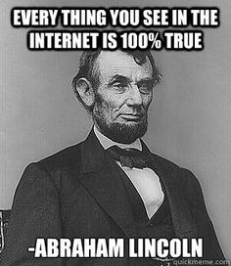

Slide 17
WISDOM
“If any of you lacks wisdom, let him ask of God, who gives to all liberally and without reproach…”James 1:5

Slide 18
WISDOM
“If any of you lacks wisdom, let him ask of God, who gives to all liberally and without reproach, and it will be given to him.” James 1:5

