Slide 1
Evidence from a Tomb

Slide 2
Apologetics: “the branch of theology concerned with the defense or proof of Christianity.” (dictionary.com)

Slide 3
Examples of Apologetics
Biblical consistency
Prophecy
History
Science
Archaeology

Slide 4
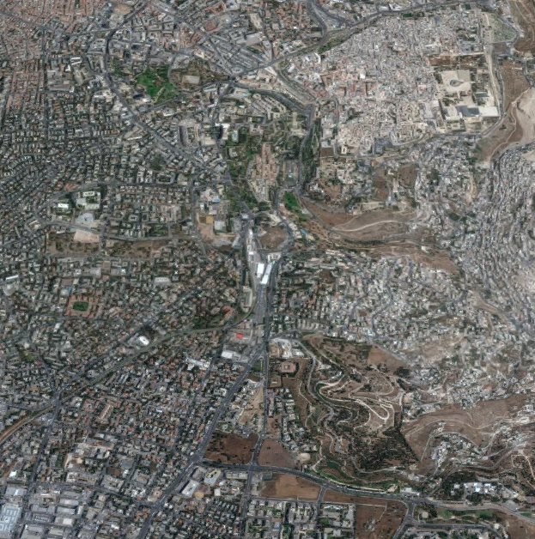
Chance Discovery in Jerusalem
Temple Grounds
Jerusalem Peace Forest

Slide 5
Burial Chamber
Israel Antiquities Authority started excavating the site within hours.
Determined the tomb was from the Second Temple Period (inclusive of the time of Jesus)
12 Ossuaries
Ossuary: Bone Box; Small Burial Box
14.5 inches tall; 29.5 inches long
Commonly used by 1st century affluent Jewish families to store the bones of family members after the flesh had decayed after being placed in a tomb.

Slide 6
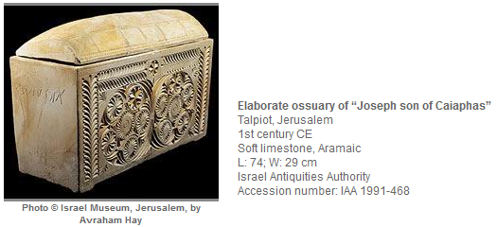
Ossuary of Caiaphas
Bones of a 60 year old man.
Inscription: “Joseph son of Caiaphas”
Josephus: “Joseph Caiaphas” – High Priest 18-36 AD (Jewish Antiquities 18:35)

Slide 7
Legacy of Caiaphas
Led the Jewish trial of Jesus. Matt. 26:57-66
Stated that it would be advantageous that one man should die for the people. Jn. 18:14
With the rest of the Jewish leaders had Jesus delivered to Pilate, who at their insistence, had Jesus crucified.
Provides another example of the historical reliability of the Bible.

Slide 8
Contrasting Caiaphas and Jesus
Caiaphas
Jesus
Opposed the Son of God
Remains have been found.
Bones reburied on the Mt. of Olives.
Ossuary on display in a Jerusalem museum.
Said Jesus death would be expedient for the people. (Jn 18:14)
Representative of death.
Proved Himself to be the Son of God. (Mt 16:16; Mt 27:54; Jn 20:28)
Provisions made to produce the body of Jesus. (Mt 27:62-66) but never found.
Died for all people’s sins. (I Tim 2:5-6)
Provides eternal life. (Jn 11:17)

Slide 9
What will YOU do with Jesus?
“Therefore I said to you that you will die in your sins; for if you do not believe that I am He, you will die in your sins.” (John 8:24)
“I tell you, no; but unless you repent you will all likewise perish.” (Luke 13:3)
“Therefore whoever confesses Me before men, him I will also confess before My Father who is in heaven.” (Matt 10:32)
“He who believes and is baptized will be saved; but he who does not believe will be condemned.” (Mark 16:16)
“Be faithful until death, and I will give you the crown of life.” (Rev 2:10)

