Slide 1
I Timothy 4 - How Do You Train?

Slide 2
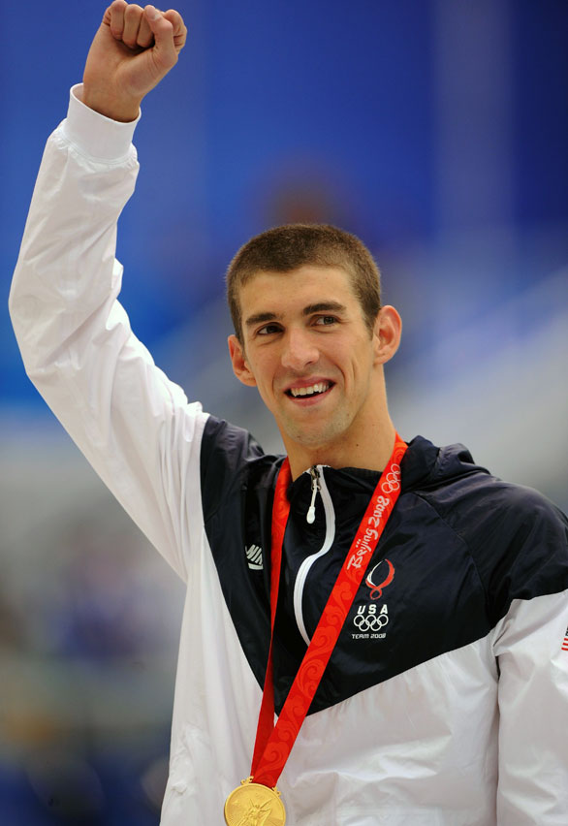
“I think goals should never be easy, they should force you to work, even if they are uncomfortable at the time.”
“If you want to be the best, you have to do things other people aren’t willing to do.”

Slide 3
I Timothy 4:6-7
“If you put these things before the brothers, you will be a good servant of Christ Jesus, being trained in the words of the faith and of the good doctrine that you have followed. Have nothing to do with irreverent, silly myths. Rather train yourself for godliness.”

Slide 4
Evaluate Yourself:
Do I want to be average?
What goals do I have?
What does it take to pursue gold?
Am I in shape spiritually?
Am I measuring myself to others or to Christ?

Slide 5
3 Simple Steps For Spiritual Training:
Proper Spiritual Nutrition
Requires Regular Spiritual Exercise
Requires Spiritual Renewal

Slide 6
Challenge
Choose one spiritual friend
Contact them (call/text) for 1 month
Set a new spiritual goal and hold your friend accountable

Slide 7
I Timothy 4 - How Do You Train?

