Slide 1
Jesus’ Priority In Pleasing The Lord (John 8:29)

Slide 2
God Is Only Pleased With Worship He Approves
“So it came about in the course of time that Cain brought an offering to the Lord of the fruit of the ground. Abel, on his part also brought of the firstlings of his flock and of their fat portions. And the Lord had regard for Abel and for his offering; but for Cain and for his offering He had no regard…”
Genesis 4:3-5
Notes:
Of course God is only pleased with Righteous Worship! God is not pleased with idolatry. God is not pleased with the pagan child sacrifices of the Canannites.
GOD desires worship that is obedient to His commands and comes from an obedient heart.

Slide 3
God Requests Different Worship Under Different Covenants.
“For it was fitting for us to have such a high priest, holy, innocent, undefiled, separated from sinners and exalted above the heavens; who does not need daily, like those high priests, to offer up sacrifices, first for His own sins and then for the sins of the people, because this He did once for all when He offered up Himself.”
Heb. 7:26-27

Slide 4
Christian Worship That Pleases The Lord...
A Different Kind of Passover Meal: 1 Cor. 5:7
A Different Kind of Tithe: 2 Corinthians 9:7
A Different Kind of Teaching: Matthew 28:20
A Different Mediator for Prayer: 1 Timothy 2:5
A Different Kind of Music: Hebrews 13:15

Slide 5
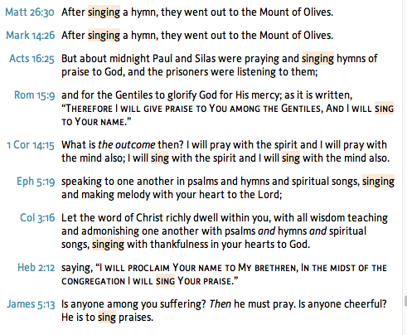
Christians Sing In Worship To God

Slide 6
Why Are Some Churches of Christ Adding Instruments Today?
Because They Are Seeking To Please People.
“Are we replacing the praise team with a rock band?”
Until they’ve experienced the new service, many will have understandable concerns about musical style. Although there is no way to please everyone when it comes to musical preferences, our intent is to choose a musical style that will be accessible and pleasing to the majority of our members while being appealing to those who will hopefully visit our church in the future.
Notes:
Otter Creek Church, Brentwood TN.
Instrumental Service Q & A.
God Is More Concerned About Our Fellowship With HIM, Than Our Appearance Before The World.
We are going to be accused of looking foolish.
We are going to be different.
We must choose between friendship with the world and with God.

Slide 7
Why Are Some Churches of Christ Adding Instruments Today?
Because They Allowed It 1st In Different Venues.
“For many years we have had instrumental music in our Wednesday evening Vespers, special services at Christmas and Easter and our youth group has instrumental music in most of their activities.”
“Some of us and you have seen some of our children leave our tradition because they have enjoyed instrumental services in their youth programs and as they become young adults they prefer that form of music.”
Notes:
Otter Creek Church, Brentwood TN.
Instrumental Service Q & A.

Slide 8
Why Are Some Churches of Christ Adding Instruments Today?
Because The Shepherds Failed To Hold Fast To Sound Doctrine & Refute False Teaching (Titus 1:9-11)
“Let me just add a personal note – I am now 71 years old and have attended acapella Churches of Christ my entire life. I served as a song leader at many churches for more than 40 years – I led my first song during a singing school held at my home church during the summer when I was about 12 years old. I love our acapella tradition but accept that it is just that – a tradition.”
Notes:
Otter Creek Church, Brentwood TN.
Instrumental Service Q & A.

Slide 9
Singing Without Instruments Is More Than Just A Tradition
It Is The Commanded Worship of the NT.
Ephesians 5:19, Colossians 3:16
“speaking to one another…making melody with your heart to the Lord”
“Let the word of Christ…teaching…one another”
It Is The Verifiable Practice in NT Times.
Notes:
Otter Creek Church (Added Instruments last year.) Making the announcement HILTON DEAN said “Let me just add a personal note – I am now 71 years old and have attended acapella Churches of Christ my entire life. I served as a song leader at many churches for more than 40 years – I led my !rst song during a singing school held at my home church during the summer when I was about 12 years old. I love our acapella tradition but accept that it is just that – a tradition.
“

Slide 10
When Churches Want To Please God, They Simply Go Back To The Pattern.
Paul Took The Church Back To The Pattern.
1 Corinthians 11:20-23
We Have God’s Commands. Let Us Always Follow Them Rather Than Our Preferences.
In Making Music: “singing…with your heart”
In Our Purpose: “teaching & admonishing…”
In Our Private or Public Praise: Heb 2:12, Jms. 5:13
Notes:
God MUST Be Worshipped In His Way. He Doesn’t Have To Show Us Every Possible Wrong Choice, Just The Right Way & Ask Us To Do It.
He Is Not Pleased When We Alter His Pattern.
John 4
Cain, Golden Calf, Nadab & Abihu, Idols, Common Meals

Slide 11
Proper Praise & Worship Pleases The Lord.
“And with many other words he solemnly testified and kept on exhorting them, saying, “Be saved from this perverse generation!” “So then, those who had received his word were baptized; and that day there were added about three thousand souls. “They were continually devoting themselves to the apostles’ teaching and to fellowship, to the breaking of bread and to prayer.

Slide 12
Jesus’ Priority In Pleasing The Lord (John 8:29)

