Slide 1
Mt of Transfiguration

Slide 2
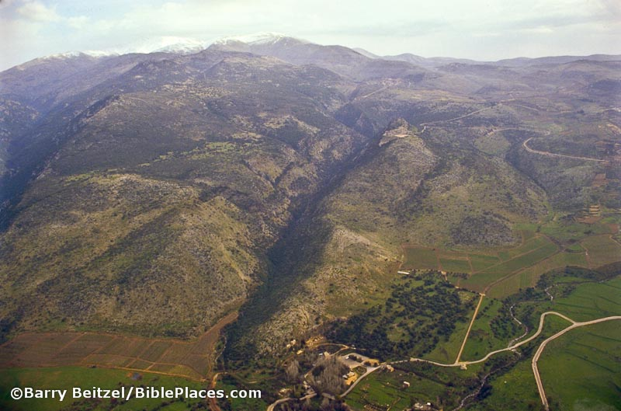
Mt. Hermon & Caesarea Philippi
Notes:
According to Matthew 16:13 and Mark 8:27 – Jesus is near Ceasarea Philippi – thus Near Mt. Hermon.
Mt. Tabor is the traditional site. This is a mountain just under 1,900 ft. Further to the North East is Mt. Hermon over 9,000 ft above sea level.

Slide 3
“We Were Eyewitnesses of His Majesty” 2 Peter 1:16
Peter, James, & John Witness This Miracle.
Matthew 17:1
His Body & His Clothing Are Transfigured.
Matthew 17:2, Mark 9:2-3
Moses & Elijah Appear & Converse About The Death of Jesus.
Luke 9:31
Waking Up, The Disciples Are Afraid & Peter Suddenly Recommends Honoring All Three Men.
Luke 9:32-33
Notes:
JESUS often went away by himself to pray… when selecting the apostles,…early in the morning…during temptation…etc.. This is a key moment that begins with PRAYER.
Transfigured: Metamorphosis of his body and clothign.

Slide 4
“We Were Eyewitnesses of His Majesty” 2 Peter 1:16
God The Father, Declares The Identity & Authority of Jesus.
Matthew 17:5-7
Jesus Instructs Peter, James, and John Not To Tell About This Miracle Until After His Death.
Matthew 17:7-9
Jesus Explains The Role of John & What’s Next For Himself.
Mark 9:9-13

Slide 5
Major Lessons From The Mountain
Miracle Confirms That Jesus Is The Son of God
In Appearance & Association
In Divine Knowledge of The Future
In Declaration from God the Father
Miracle Confirms That The Law of Christ Is Greater Than The Law & Prophets.
Listen To & Worship Jesus, Not Moses & Elijah.
The Disciples Demonstrate Our Weaknesses & Response To God.
Sleeping, Speaking In Ignorance, Terrified
Notes:
CONFIRMS THAT JESUS IS THE SON of GOD: *Can you see that THIS IS JUST A TASTE of the Glory He had in eternity & that He will return with!
Context: This Miracle Is Recorded In Connection With The Identity of Jesus
Luke 9:18-20
A Mountain of Prayer: Luke 9:29. Prayer: Don’t sleep when Jesus is praying!! LOL!
DISCIPLES: In Spiritual Matters So Far Beyond Us, Our Proposal’s Are Just As Pointless. Let Our Hearts Fall Down Before Him.

Slide 6
We Need To Know Jesus As He Really Is
So That We Will Listen To Him.
John 1:14
So That We Will Remember That The One ABOVE All Others, DIED For All Others.
John 15:13
So That We Will Prepare For His Glorious Return.
Acts 1:11, 2 Thessalonians 1:6-12

Slide 7
Mt of Transfiguration

