Slide 1
Be Holy

Slide 3
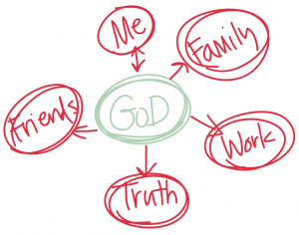

Slide 4
Leviticus 19: 1-19
Establish God’s Standard in Your life
Choose to serve God
Choose to look around you
Choose to remain faithful

Slide 5
Be Holy

