Slide 1
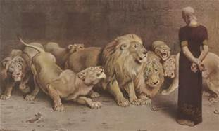
DANIEL IN THE LION’S DEN Daniel 6:1-26

Slide 2
HIGHLIGHTS OF THE STORY
Daniel had an excellent spirit – Verse 3
They could find no charge against him – V. 4
He was Faithful – V. 4
Satraps had to use Daniel’s faith as a Stumbling Block – Verse 5
Daniel was quickly entrapped – Verse 10-12

Slide 3
HIGHLIGHTS OF THE STORY
Daniel Had A Deliverer – Verse 16
Others knew about his deliverer – Verse 16, Verse 5

Slide 4
QUESTIONS FOR US TODAY
DO WE HAVE AN HEART OF EXCELLENCE?
Extraordinary Spirit – (NASB)
Psalms 37:31
Philippians 2:14-16
1 Peter 2:11-20
An excellent heart desires to serve God

Slide 5
QUESTIONS FOR US TODAY
DO WE HAVE AN HEART OF EXCELLENCE?
How is this Excellent Heart Manifested? Submit to every ordinance of man-powers that be
Silence the ignorance of Foolish Men
Honor All People
Fear God
Be good servants

Slide 6
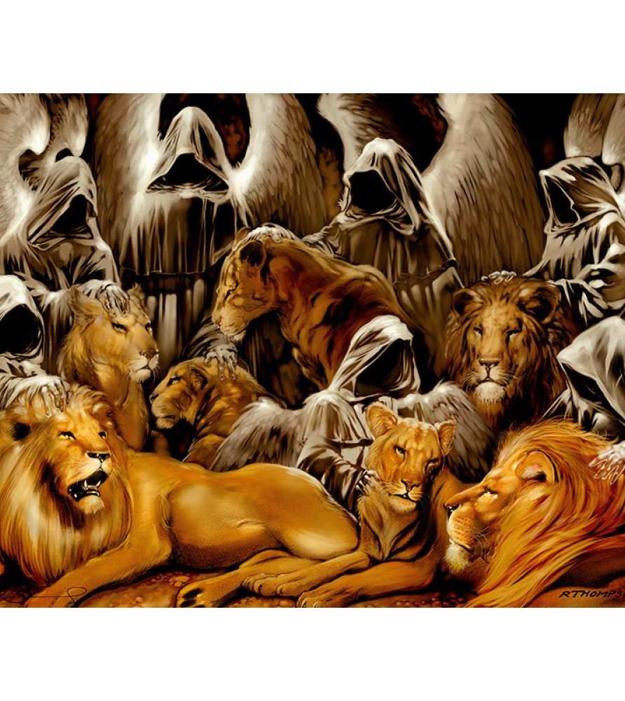
QUESTIONS FOR US TODAY
WHAT WOULD IT TAKE FOR US TO BE CAST INTO A DEN OF LIONS?
A real charge?
Something against our Faith?
1 Peter 3:16-17

Slide 7
QUESTIONS FOR US TODAY
HOW LONG WOULD IT TAKE?
Based On: Service to Others?
Teaching Others?
Bible Study
Prayer?
Attendance?

Slide 8
QUESTIONS FOR US TODAY
HOW LONG WOULD IT TAKE?
1 Thessalonians 5:17
Galatians 6:9-10
I Peter 5:8-9
Hebrews 12:1 - Patience

Slide 9
QUESTIONS FOR US TODAY
DO WE TRUST OUR DELIVER?
God is our deliverer
Psalms 34:15-18
Galatians 1:3-4
2 Chronicles 16:9

Slide 10
QUESTION FOR US TODAY
Do Others Know we Trust Our Deliver?
I Peter 3:14-15
Do others ask us about the reason we have hope?

Slide 11
DANIEL IN THE LION’S DEN Daniel 6:1-26

