Slide 1
Big Questions. Real Answers.
Notes:
Welcome tonight – this is the final lesson in our series this weekend on Big Questions & Real Answers.

Slide 2
What Must I Do To Be Saved?

Slide 3
Let Me Tell You The Story…
God Is Our Creator. (Genesis 1:1)
We Are Special. Our Soul Will Live On. (Genesis 1:26-27)
Satan Is Our Adversary & Tries To Lead Men Into Sin. (Genesis 3:1-7)
Sin Separates Us From God. (Isaiah 59:2, Ephesians 2:1, Romans 6:23, Romans 3:23)

Slide 4
Let Me Tell You The Story…
God Punishes The Wicked & Saves The Righteous. (Genesis 6:17-18)
God Promises His Blessings. (Genesis 12:1-3)
God Promises A New Covenant & The Forgiveness of Sins (Jeremiah 31:31-34 & Isaiah 53:4-6)
Jesus Comes To Bring The New Covenant (Matthew 1:1, Hebrews 8:6)
Notes:
God has a plan to RE-CONNECT us to HIM.

Slide 5
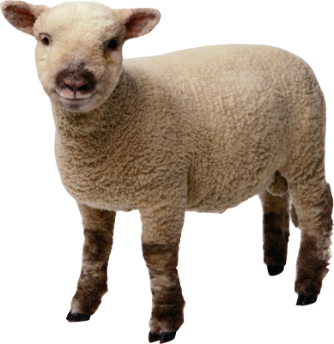
Let Me Tell You The Story…
Jesus Comes To Take Away Our Sins. (John 1:29)
Why Does He Mention A Lamb?
God Saves & Sets Free Those Under The Lamb’s Blood. (Exodus 12:5-7)
The Blood of Jesus Pays For Our Sins. (Isaiah 53:6, 1 John 3:5, Matthew 26:28, 1 Peter 1:18-19, Revelation 1:5)
Notes:
Just as the OLD covenant had a lamb – now JESUS is the LAMB in this new and better covenant.

Slide 6
What Must I Do To Be Saved? “Believe & Be Baptized”
“And He said to them, “Go into all the world and preach the gospel to all creation. He who has believed and has been baptized shall be saved; but he who has disbelieved shall be condemned.”
Mark 16:15-16
Notes:
Jesus tells us how we can receive the blessing of HIS sacrifice. To quote Him – Believe & Be Baptized.
>> This is the culmination of this awesome story and awesome plan God has been unfolding from the beginning of creation!
WE need that soul-saving blood. We need to be cleansed by it. We need to be under it.

Slide 7
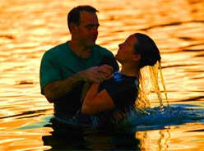
What Must I Do To Be Saved? “Believe & Be Baptized”
“Or do you not know that all of us who have been baptized into Christ Jesus have been baptized into His death?” Romans 6:3
Notes:
Romans 6 explains the connection and convergence between Jesus sacrifice and our baptism….

Slide 8
What Must I Do To Be Saved? “Believe & Be Baptized”
“Therefore we have been buried with Him through baptism into death, so that as Christ was raised from the dead through the glory of the Father, so we too might walk in newness of life.” (Romans 6:4)
Notes:
Our baptism is a pivotal turning point – when we imitate his death, burial and resurrection.
It is the moment when we are lifted up from the DEATH of SIN and into the NEW LIFE of Christ.

Slide 9
What Must I Do To Be Saved? “Believe & Be Baptized”
“For the wages of sin is death, but the free gift of God is eternal life in Christ Jesus our Lord.” (Romans 6:23)
Notes:
So what will you do tonight? Will you remain DEAD in your sins – or will you accept the DEATH of CHRIST and receive the FREE GIFT OF GOD?

Slide 10
What Must I Do To Be Saved? “Believe & Be Baptized”
“For all of you who were baptized into Christ have clothed yourselves with Christ.” Galatians 3:27
Notes:
Romans 6 explains the connection between Jesus sacrifice and our baptism….

Slide 11
Acts 22:16
“Now why do you delay? Get up and be baptized, and wash away your sins, calling on His name.”
Notes:
Jesus is the LAMB. We are WASHED by HIS BLOOD.
I know there are men and women here who have never taken this JOYOUS step.
Don’t delay. Don’t say – maybe some other time.
Don’t cover up your faith in CHRIST – if you believe that He is the Son of God. It is time to confess it openly.
Just get up and be baptized for the forgiveness of your sins RIGHT NOW.

Slide 12
Big Questions. Real Answers.

