Slide 1
The Greatest Gift
Notes:
The night the Son of God was BORN, passed uneventfully for nearly every person on earth. Most people had no idea the Savior had come into the world.
*Contrary to popular practice, The Bible doesn’t even tell us the day. You might wonder, why is that? Well, For one – because his arrival was humble in every way. These were humble parents in a humble place welcoming a humble King…and so it really fits with the entire setting not to emphasize the exact day of his birth.
But even more than being an indicator of His humility, the exact day is unrecorded because the emphasis of the Scriptures is not on WHEN – but on WHO! The few details the Bible does record boldly focus on WHO this amazing child is.
Near Bethlehem – a select few shepherds were told in crystal clear terms WHO had arrived. Luke 2:10-11 records an angel speaking with nearby shepherds.:
10 But the angel said to them, “Do not be afraid; for behold, I bring you good news of great joy which will be for all the people; 11 for today in the city of David there has been born for you a Savior, who is Christ the Lord.
The shepherds quickly came and found Joseph, Mary and the child, and told them what the angel had declared. They were all left in wonderment over the good news…and even though they didn’t fully understand what was ahead, we see clearly, that God had just given THE GREATEST GIFT to the WORLD.
Today, I want us to focus on what Makes JESUS, our Lord, THE GREATEST GIFT…

Slide 2
The Savior Is…
The Most Anticipated Gift
2 Samuel 7:16, Isaiah 9:2-3, 6 Daniel 7:13-14, Matthew 1:21-23
The Most Loving Gift
Romans 5:6-9, John 15:15
The Most Valuable Gift
Matthew 2:9-11, Matthew 13:44-46, 2 Corinthians 9:15, John 1:12-14
Notes:
ANTICIPATED… (Joseph almost missed out. Fear, Disappointment, Confusion…don’t let these things cause you to miss out! Walk with JESUS!)
LOVING: To be His Friend (John 15:15) SELF-LESS Love (Philippians 2:7)
Satisfying Gift: Can we recall even half of the gifts we received last year? Did they bring true contentment. No. But Jesus does.

Slide 3
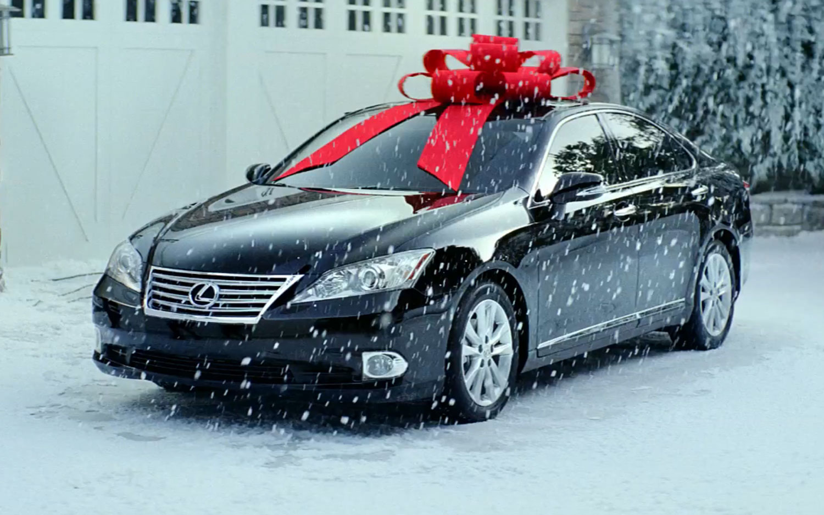
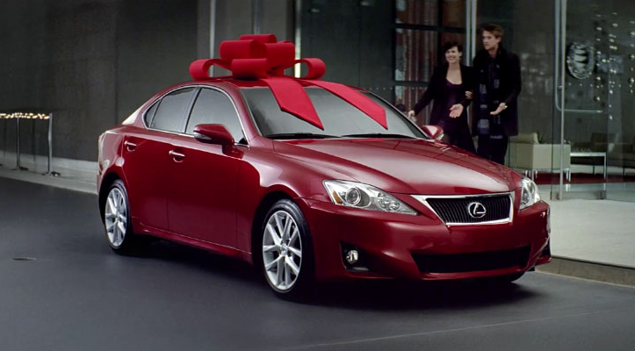
Notes:
What happens when you get A GIFT you’ve been longing for…A Gift given with pure love…a Gift that is extremely valuable…
For instance..what about those people who put the giant bows on a new car…let’s say…like this one….or maybe you wanted red…I’ve got you covered. Either way: When A gift is given that is extremely speical, extremly loving, and extremly valuable THE TRUTH IS: That Gift Carries with it some major responsibilities. And just like we can wreck a new car and hurt yourself or others…we need to understand that BECAUSE the Gift God has given is SO, EXTREMELY Wonderful… it is only natural that we accept it with maturity as well. **Some would say – oh, I knew it was too good to be true…there’s always a catch. Please don’t think that way.
ANY of us would be thrilled to be given a beautiful new car – and we would never DREAM of complaining that we had to fill it with gas, or drive it safely. The same should be true of the GIFT of CHRIST. HE IS THE GREATEST GIFT and we should WELCOME the responsibilities that come along with Following HIM. In fact, when teens are sometime given the responsibility of a vehicle we know they should appreciate the gift as a SIGN of trust that parents believe they are UP TO the task of using the gift well. So it becomes more than just a gift, but actually a complement and a show of confidence! The same is true of God! He has given us His Son, He has given us the Bible to read, study, and obey – Because God knows we are up to it! He has confidence in us!

Slide 4
His Gift Brings
The Greatest Responsibility
“And He was saying to them all, “If anyone wishes to come after Me, he must deny himself, and take up his cross daily and follow Me.” (Luke 9:23)
The Greatest Purpose
Ephesians 2:8-10
The Greatest Satisfaction
Acts 8:38-39
Notes:
So I want you to remember this morning – not just how WONDERFUL God’s gift to us is…but also WHAT IT BRINGS, because it does bring responsibility.
Matthew 16: 26 For what will it profit a man if he gains the whole world and forfeits his soul? Or what will a man give in exchange for his soul? 27 For the Son of Man is going to come in the glory of His Father with His angels, and will then repay every man according to his deeds.
We cannot get so caught up in material gifts that we neglect the SAVIOR. Nor can we be “Neutral” about Jesus. He deserves our complete loyalty, obedience, and faith.
PURPOSE: He has good works for us to perform. Our abilities and our talents have a higher purpose than pursuing power or wealth or fame…our abilities and talents are for us to Love God and Love our fellow man!
Satisfying Gift: Can we recall even half of the gifts we received last year? Did they bring true contentment. No. But Jesus does.

Slide 5
Acts 8:38-39
“And he ordered the chariot to stop; and they both went down into the water, Philip as well as the eunuch, and he baptized him. (39) When they came up out of the water, the Spirit of the Lord snatched Philip away; and the eunuch no longer saw him, but went on his way rejoicing.”
Notes:
You can accept GOD’s GREATEST GIFT today – by doing exactly what the Eunuch did.
Come and confess that Jesus is the Son of God, Turn away from Sin, and be baptized to wash away your sins. Or if you need the prayers of the church, we are happy to pray for you – now is the time, so come to the front pew while we stand and sing.

Slide 6
The Greatest Gift

