Slide 1
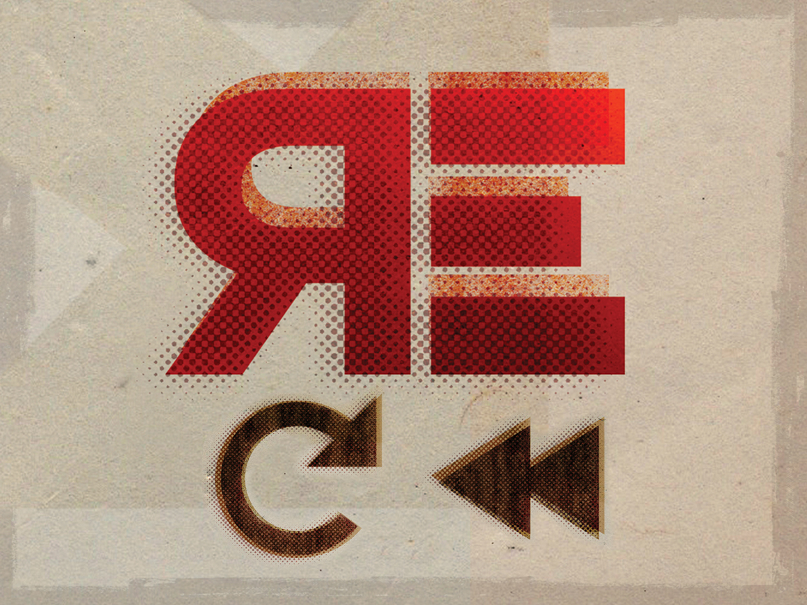
Re
Notes:
Some things are so great – you just have to do them again.
You hear a new song, and like it so much that immediately you RE-play the song.
You look back on a special day with your family or friends – and RE-member. Or, you may even look forward to an upcoming RE-union.
In English we use the prefix “Re” to communicate the idea of going back or again…
In the Bible – we have directions that incorporate this Powerful Idea, and today we are going to explore 4 of those together.
And all four are things we can accomplish Together TODAY.

Slide 2
Remember Our memories of the past, determine our actions in the present. 1 Sam 17:34
Repent
Changing directions only helps when we turn to higher things. Matt 4:17
Renew
Things can be replaced, but People must be renewed. Col 3:5-17
Remain
Disconnection brings dysfunction. John 15:4-5
Notes:
REMEMBER: What happens when people don’t remember? They miss important events, responsibilities or people. ( *remember to pick up kids from school )
1.) Remembering God’s Faithfulness in the Past allows us to TRUST Him in the Present. (Deut. 7:17-18)
2.) Remembering God’s Victories in the Past allows us to ACT BOLDLY in the Present. (1 Sam. 17:34-37)
3.) Remembering God’s Son each Lord’s Day, allows us to HOPE with CONFIDENCE.
Remembering GOD, will determine what we do today, and what memories we will make for the future!
REPENT: You guys have heard me say 1,000 times that repentance is turning around. It was only this week, again studying this awesome concept that I learned one of the secondary definitions, actually includes the concept that it is not just “any” turning – but a Turning Towards Higher Things!!!
**That is the way Jesus used it in Matt 4:17 – turn to a better kingdom! To better promises!
Repentance is a change in mind, that leads to a change in direction. For Christians, that new direction is TOWARD GOD!
*What is your heart set on today? – When we come together it is to course-correct and get it set on Higher Things!
When we make this TURN – suddenly we can see things in a new light: Like driving up to a mountain lookout – you can see everything differently.
When we Truly Turn to higher things - - we will see SIN differently. We see it for it’s lies, it’s ugliness, it’s emptiness. We also see ourselves differently…as a people who have been made for God’s glory. As children he loves and longs to bring home.

Slide 3
Re
Notes:
RENEW: 2 Corinthians 4:16 “inner man…renewed day by day”
Romans 12:2 – renewing of mind
REMAIN: God wants us to be plugged into him. Anywhere and Everywhere. He wants us to “Abide” - to remain obedient. To remain trusting. To remain loyal. To remain connected to HIM. Because He is the source of LIFE for us, and for those we are trying to help save.
Whenever there is disconnection, trouble follows. We can’t be disconnected from God and doing well. Its just not possible. SO REMAIN TRUE. No matter what tempations, persecutions, attacks or accusations come – WE REMAIN in Christ!

