Slide 3
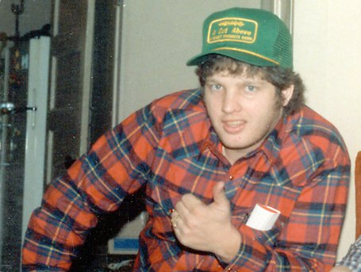

Slide 4
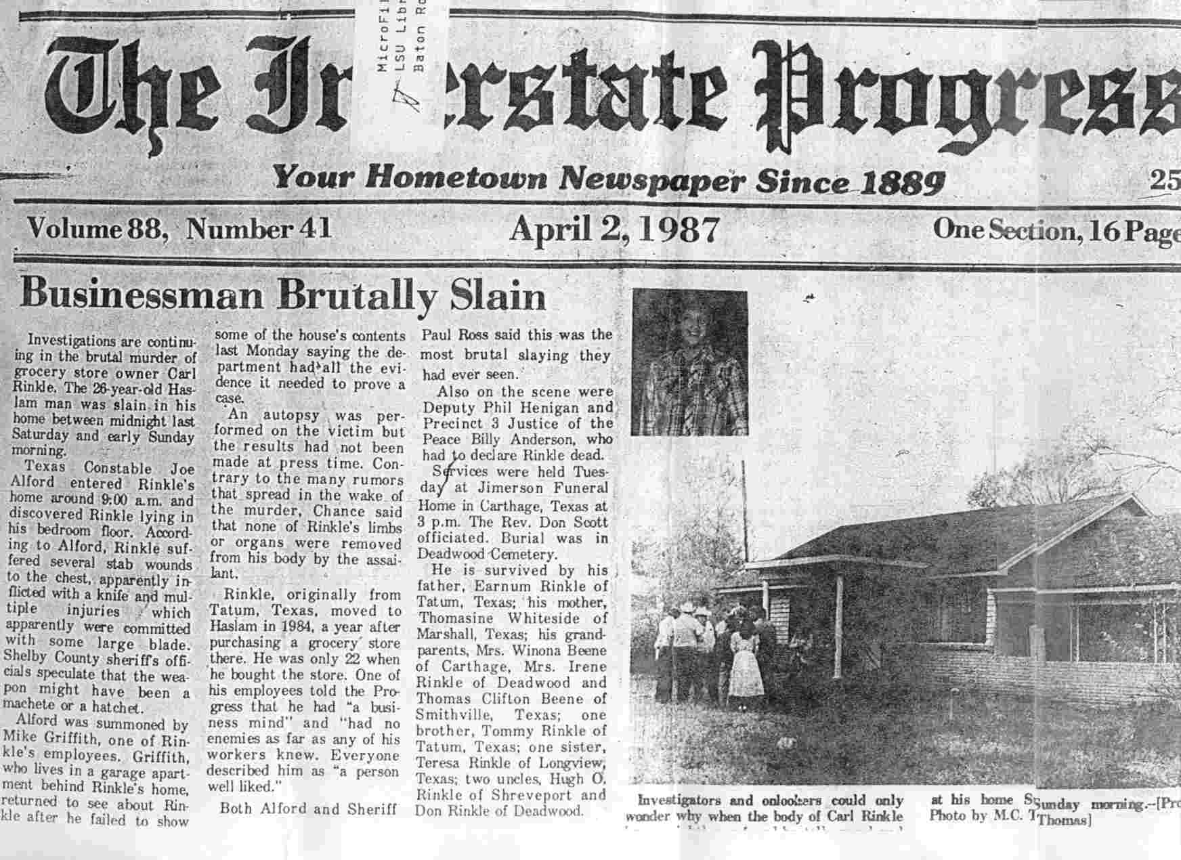

Slide 5
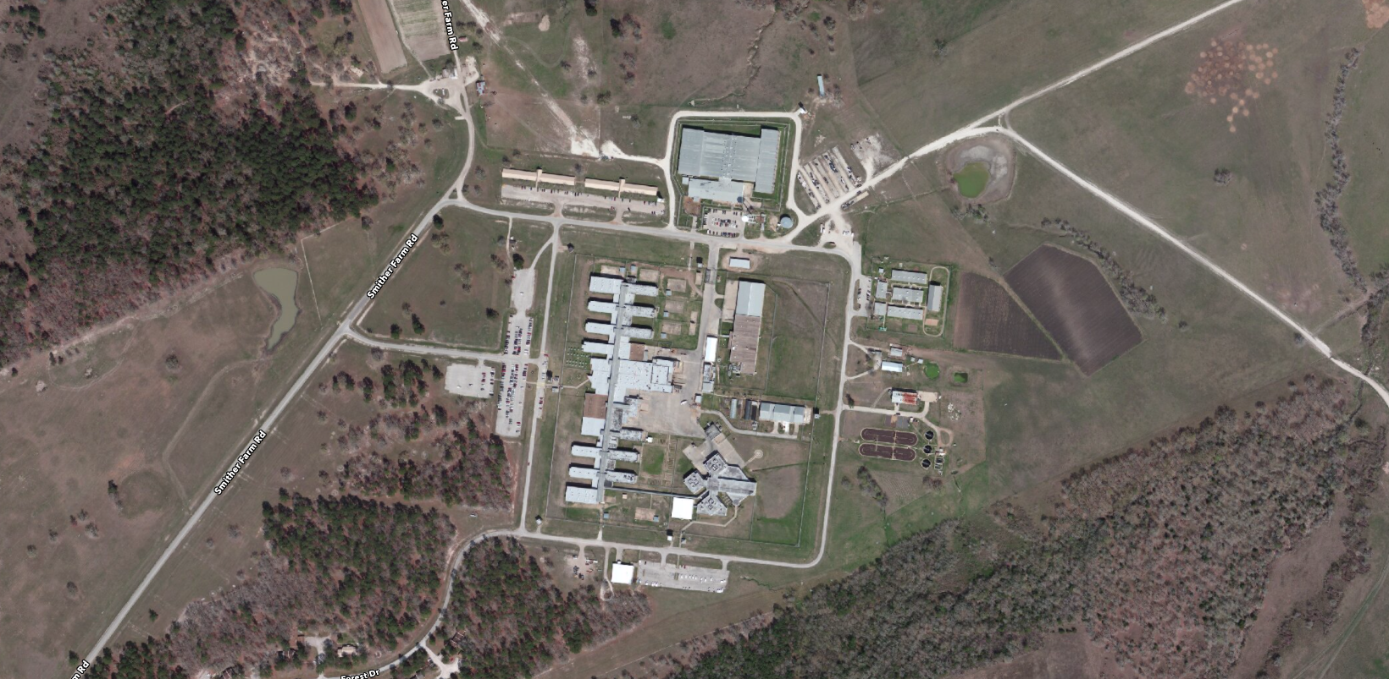

Slide 8
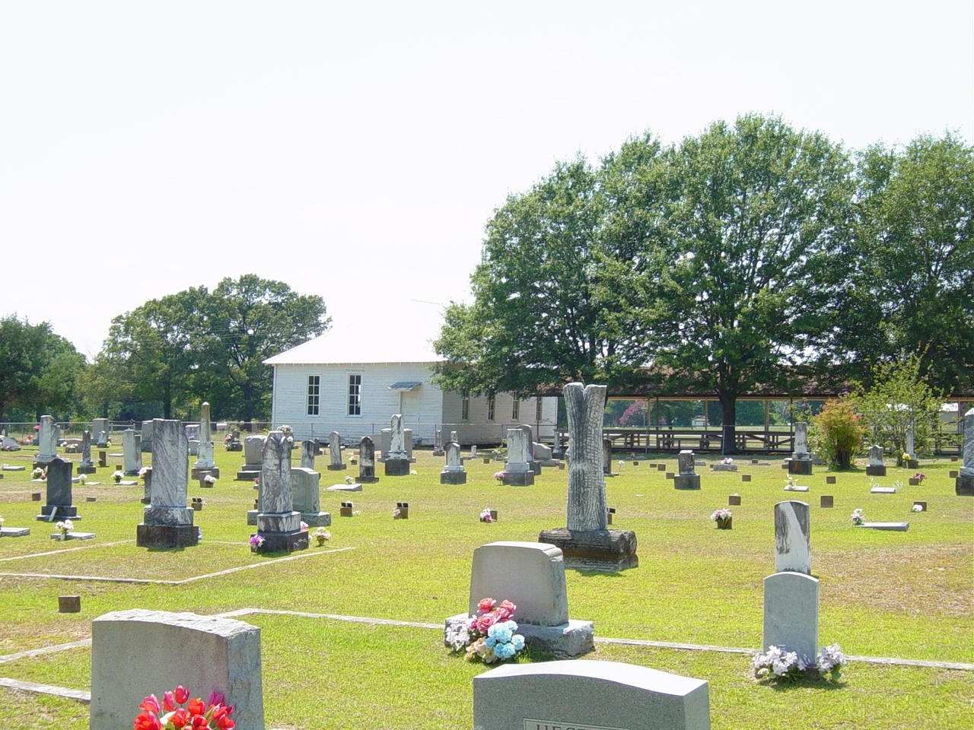

Slide 10
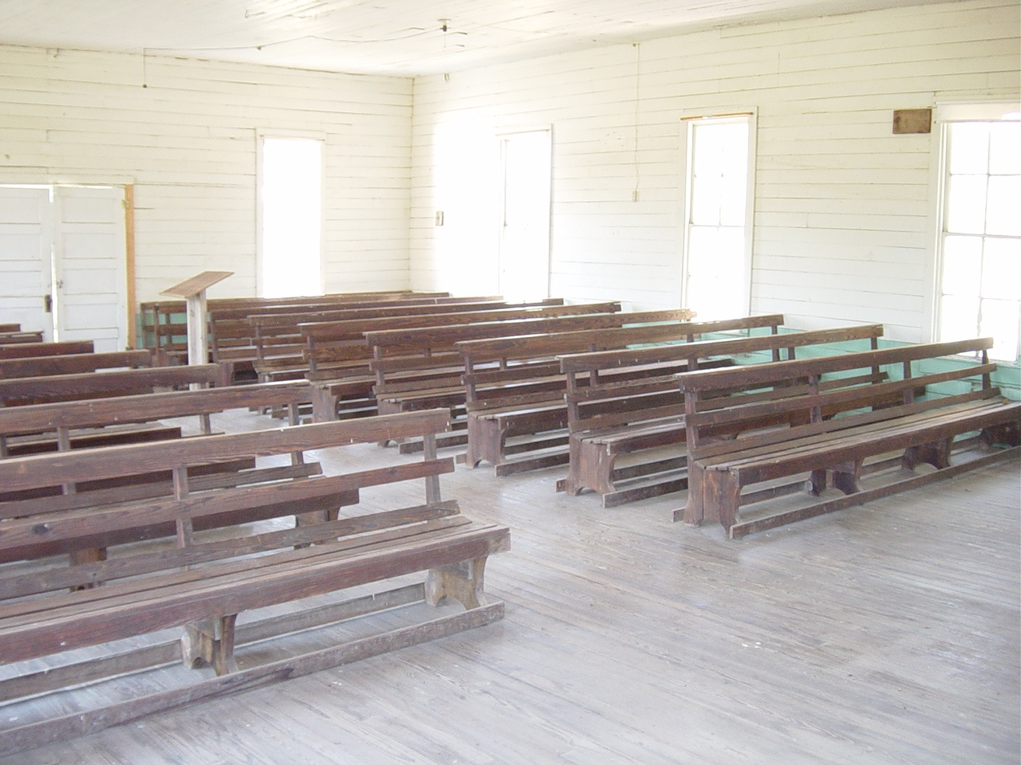

Slide 11
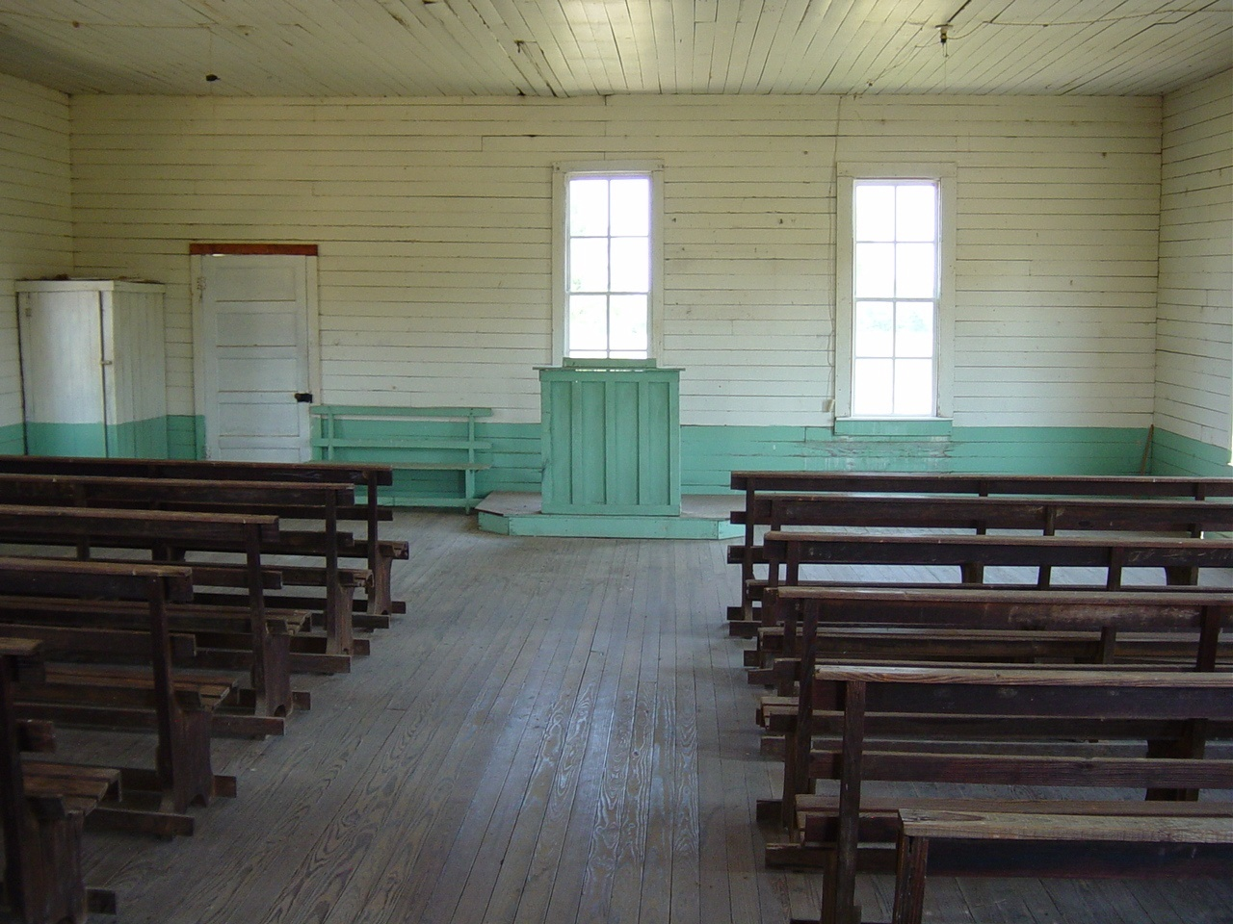

Slide 12
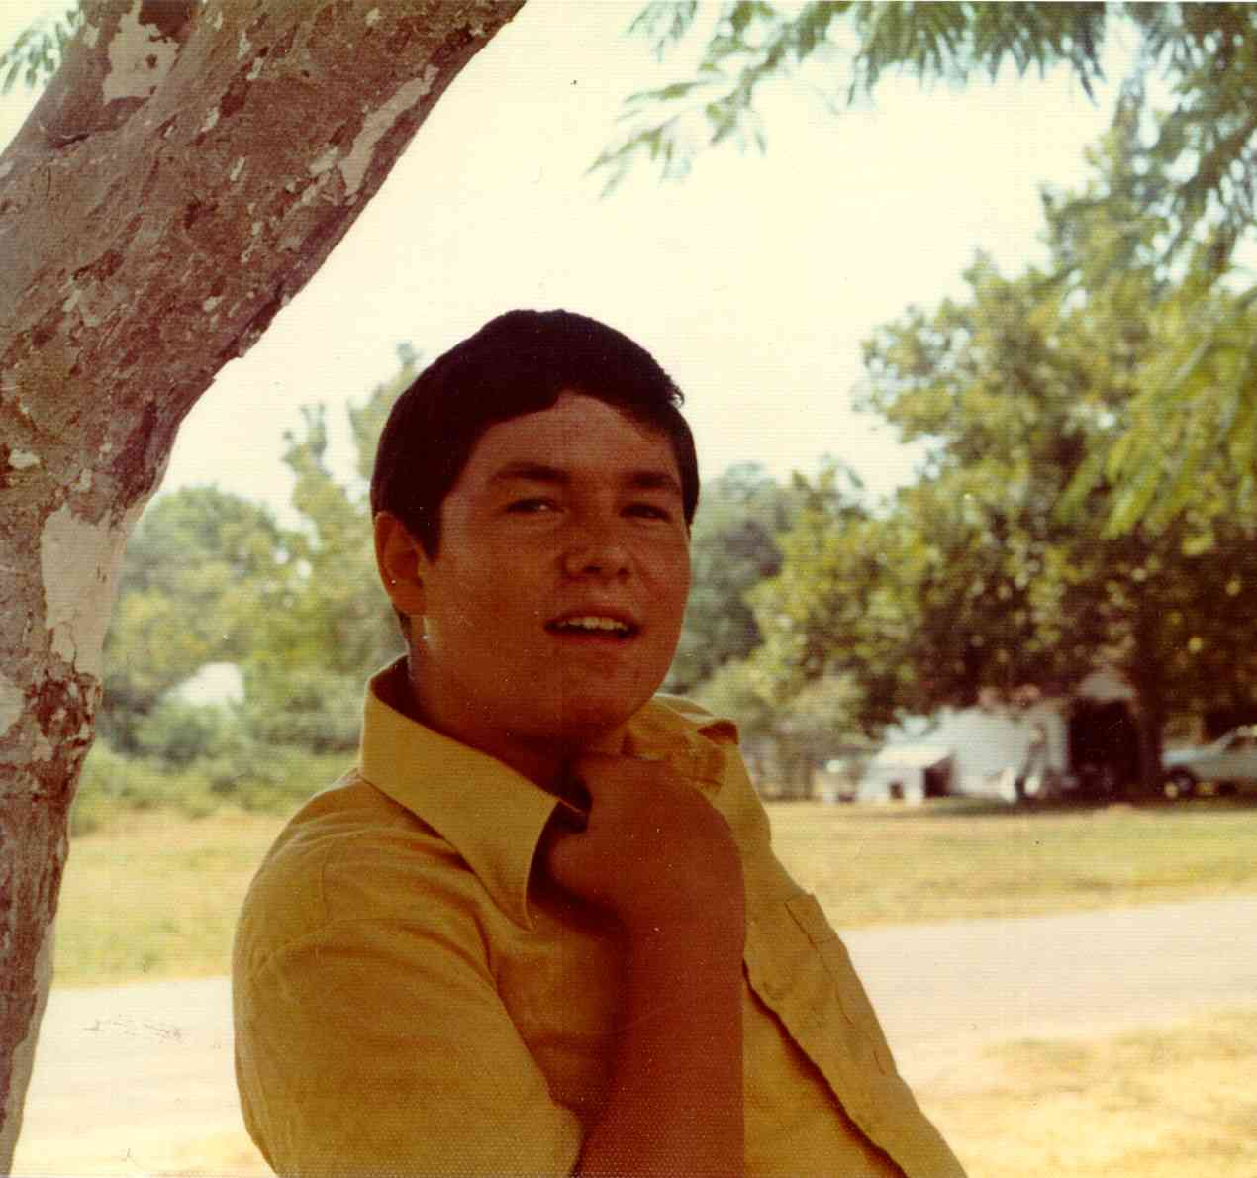
Before I knew it, I was in with the ways of the world. I am talking about sex, dope, drinking and thinking my parents did not know what they were talking about, telling me not to do this or that, and I did not like someone telling me how to run my life. But, as I look back now, my friends were running my life. But, I was having fun the way they did and it seemed I had control. But as I look back now I see I was wrong.

Slide 13
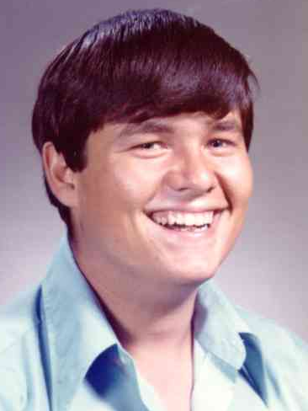

Slide 14
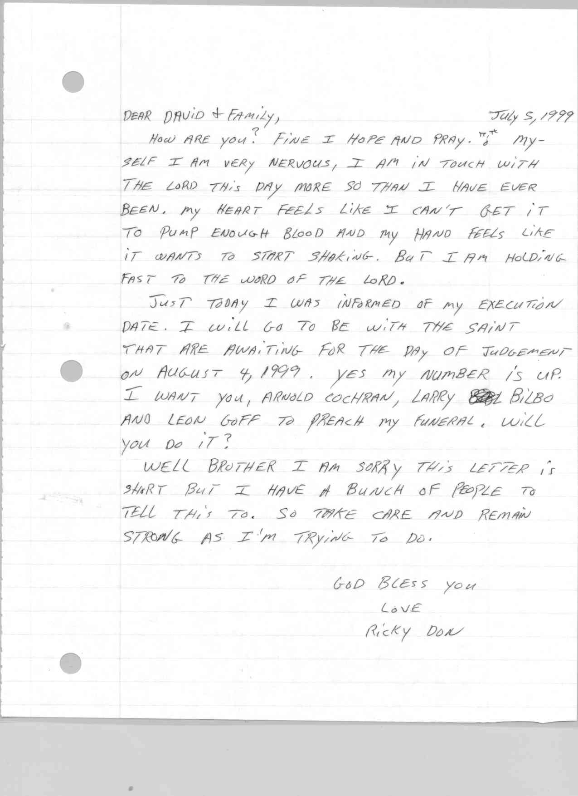

Slide 15
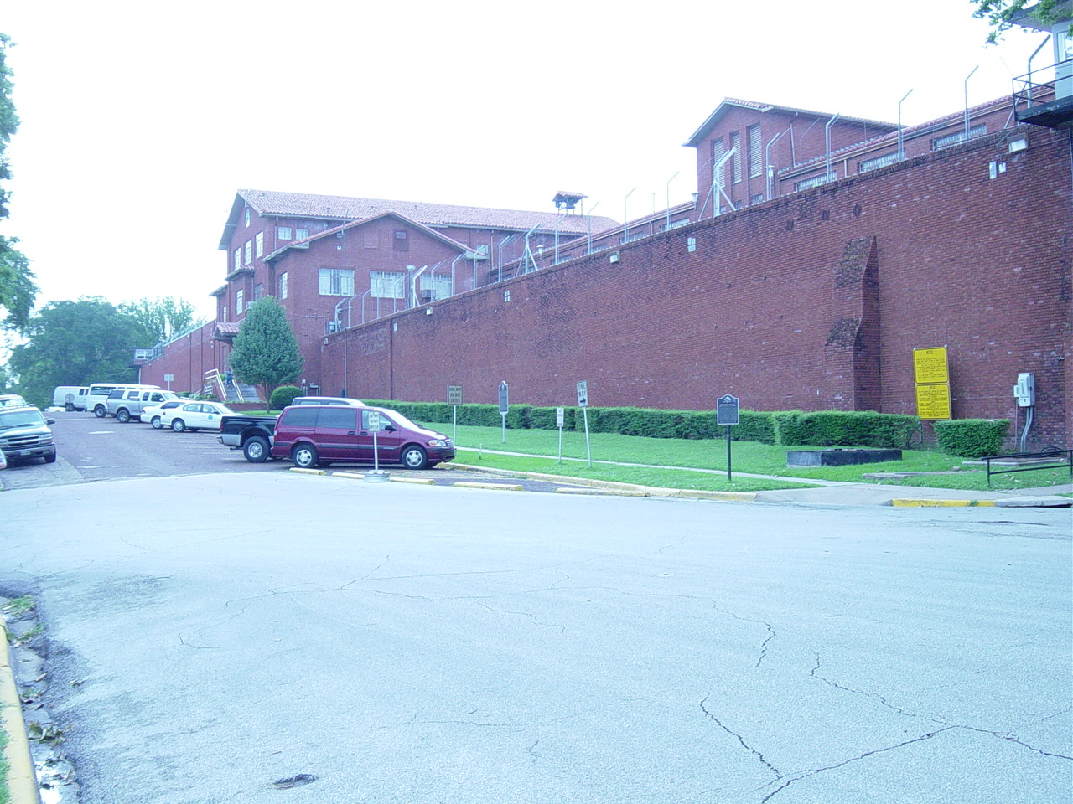
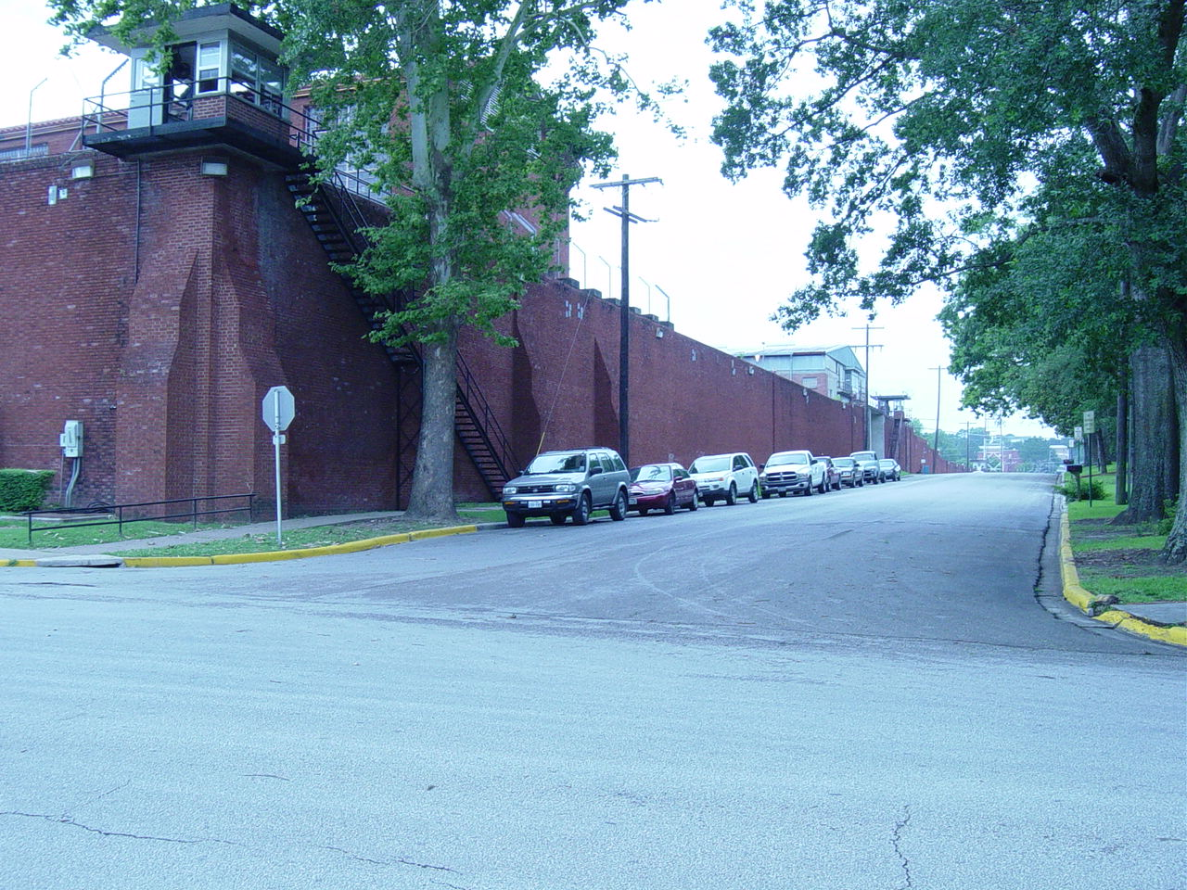

Slide 16
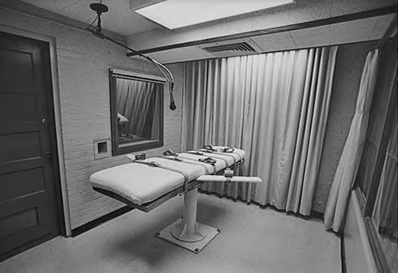

Slide 17
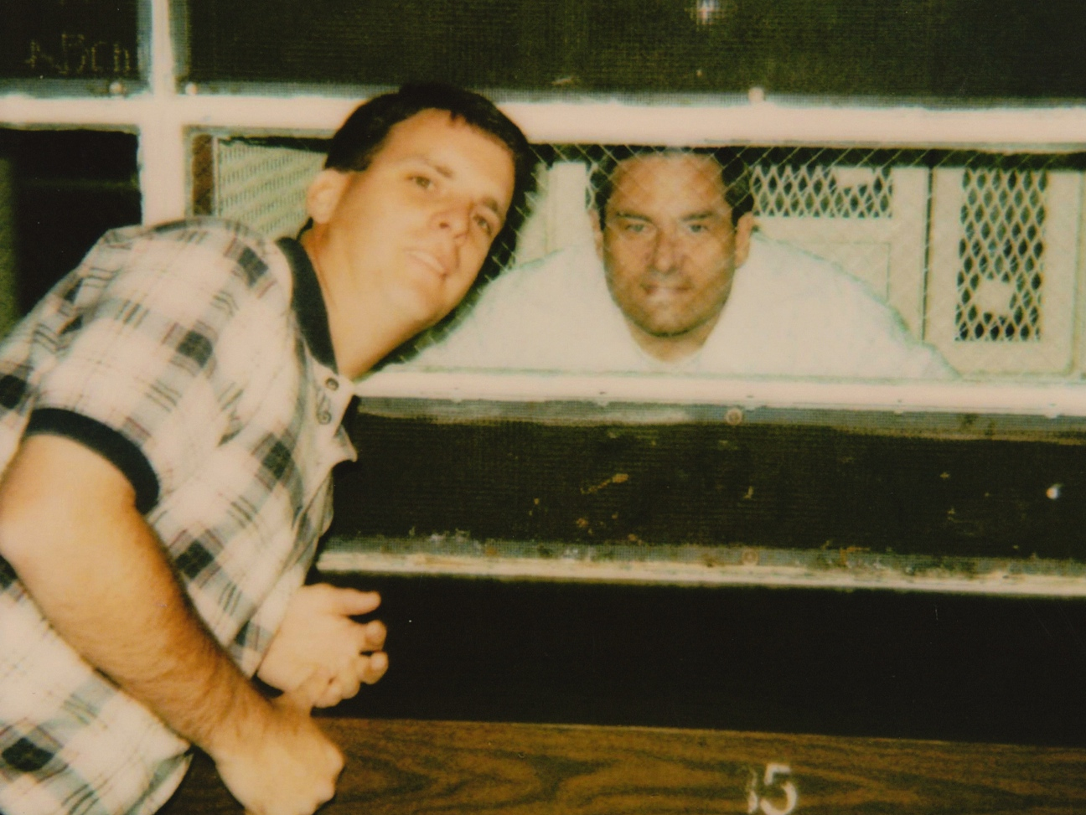

Slide 18
Be careful about the friends you choose.
Listen to your parents.
Stay away from sin.
THE LESSONS
Ricky would want you to learn from his life

