Slide 1
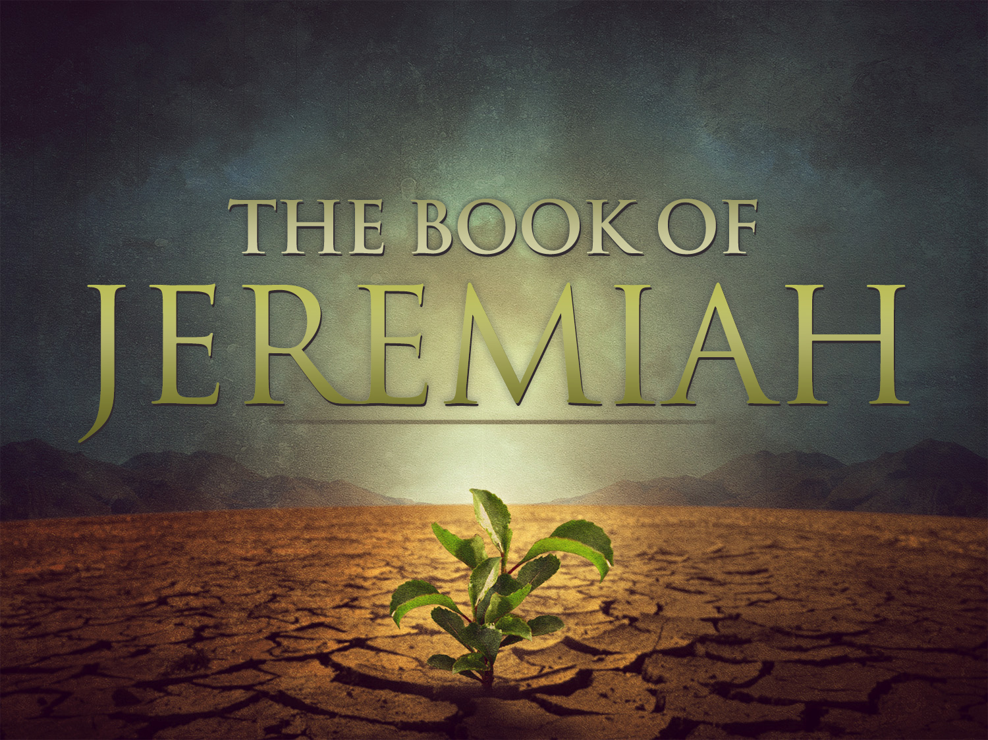
The Book of Jeremiah

Slide 2
Introduction to Jeremiah
Structure: Prophecy Over Chronology
40 Years of Prophecy Delivered During The Reign of 5 Different Kings.
Message of Judgment & Hope
Jeremiah 25:3-11
Jeremiah 25:12-16, 29:4-10
More Lows Than Highs
Threatened, Imprisoned, Beaten, Rejected, Saddened
Notes:
Prophesied to 5 Different Kings in his lifetime.
CERTAIN:
Lows…
Ch 26 – they want to kill him.
Ch 32 – Imprisoned
Ch 37 – beaten and locked up.
Ch 38 – lowered into the bottom of a muddy well.
Ch 52:13-14 – Jerusalem & the Temple is destroyed

Slide 3
Jeremiah’s Impact (As Seen In Three Chapter)
Jeremiah Was Called & Protected By God To Prophesy About Many Nations.
Jeremiah 1:1-19
Jeremiah Delivered A Bold Message
To The People (7:1-2)
To Truly Repent (7:3-8)
Not To Trust In The Temple (7:9-15)
To Respond In Faith & Obedience (7:23-26)
Jeremiah’s Prophecy Was Vigorously Rejected.
Chapter 36:21-25, 32
Notes:
Jeremiah was a prophet during the LAST DECADES of the kingdom of JUDAH.

Slide 4
Jeremiah’s New Testament Legacy
His Prophecy of Heartache
Jeremiah 38:15 (Matthew 2:18)
His Description of God’s House
Jeremiah 7:11 (Mark 11:7)
His Prophecy of A New Covenant
Jeremiah 31:31-34 (Hebrews 8:8-12)
His Description of God’s Judgment
Jeremiah 17:10 (Revelation 2:23)
Notes:
Herod’s Attempt To Murder Jesus

Slide 5
Applications For Us
Serving God Is Not A Guarantee of “Health & Wealth.”
God’s Messengers Must Address The Sins of The Day.
Idolatry, Immorality, Lying Prophets
God’s People Can’t Simply Know Their Sins or Even Regret Them. We Must Repent of Them.
Notes:
God’s Messenger: Jeremiah is the opposite of a “health & wealth” preaching. & His life is a good model of this. We must be like Jeremiah and HOPE in theLORD and stand in the TRUTH no matter what difficulty follows.
** So Beware anyone who says it is! Don’t get pulled into False teachers today who have mega-followings because they promise nothing but blessings!

Slide 6
The Book of Jeremiah

