Slide 1
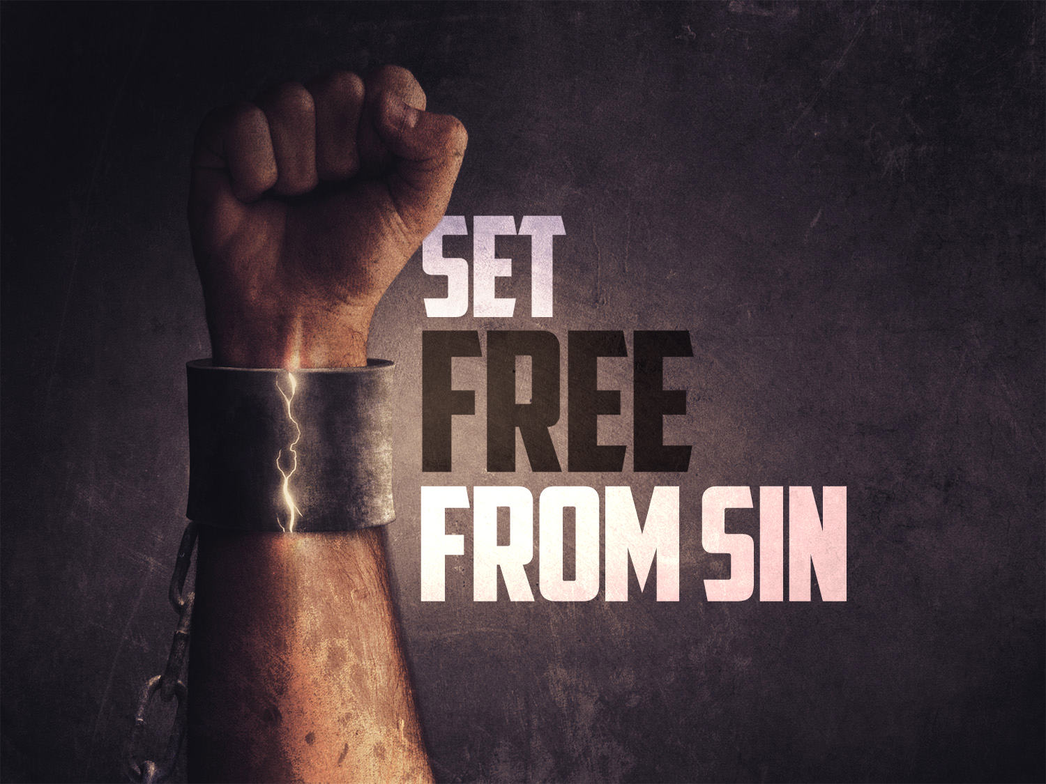
Notes:
In Romans, Paul addresses the problem of sin...
a. In the first two and a half chapters, he demonstrates that all have sinned – cf. Ro 3:23
b. In the next two and a half chapters, he declares how we can be justified through faith in Jesus Christ - cf. Ro 5:1-2
c. He concludes that where sin abounded, grace abounded much more - Ro 5:20-212.
Paul then anticipates an erroneous inference...
a. "Let's continue in sin, that grace may abound!" - Ro 6:1
a. A conclusion that is repulsive to him - Ro 6:2a

Slide 2
We Are Set Free In Christ
During Baptism (vs. 3-4)
We Are Placed “Into Christ Jesus”
We Are Sharing In “His Death”
We Are Raised To “Walk In Newness of Life”
Christian Baptism (vs. 5-9)
Imitates The Death & Resurrection of Jesus
Unites Us With His Sacrifice
Crucifies Our Old Man & Body of Sin
Sets Us Free From Sin & Gives Hope!
Notes:
Where We Receive Our Spiritual Blessings (Eph. 1:3,8 & Gal. 3:26-29))
Vs 6!!! OUR old self was crucified. OUR body of sin was done away with.
Vs 7-8. We are set Free and because of Christ – we now have unshakeable HOPE. (vs 9) Not even death can defeat us IN CHRIST.
IMITATES: Just as Jesus was placed in the tomb – and raised up – we are also immersed in the water and raised up.
UNITES: What so many fail to appreciate is that baptism is more than a re-enactment…it is the method chosen by God to unite us with Jesus blood!
CRUCIFY: *Many slaves are slaves their whole lives. Their masters are so cruel, they will never be set free. Satan is that evil. But Thanks to GOD, we can die, become free, and still live.
HOPE: Not only in our new spiritual life – but in heavenly home.
In this chapter, God wants us to KNOW our baptism is an CRITICAL, TRANSFORMATIVE event that is ESSENTIAL to our FREEDOM because it is the method He has selected to UNITE US WITH JESUS CHRIST!

Slide 3
I Am Not A Slave To Sin
Slavery Is Characterized By Ownership, Direction, Progress, & Results.
1. Sin Is No Longer My Master. (vs. 6,7,14)
It Does Not Own Me. I Belong To God.
2. Sin No Longer Direct My Actions. (vs. 11)
I Am Dead To Sin. I Am Alive To God.
I Can Freely Tell My Old Master (Sin) “No.”
I Never Have To Go Work In The Fields of Sin Again! I Run The Other Way! (vs. 12-13)
Notes:
Sometimes Christians struggle with this teaching because temptations can be really strong. So strong we may feel enslaved. We face struggles and old habits that die hard and we wonder – Am I really free? Today – I want us to understand the freedom we have from sin and the good news this is as we battle temptation.
OWNERSHIP: Master….if we go work on a farm, and even if we do identical jobs – it is better to be FREE! To do those jobs as a choice, rather than a slave. So I want to tell you – today if you are a Christian – you are no longer owned by sin. You may still have sinful habits to break free from but FIRST AND FOREMOST KNOW SOMETHING AWESOME. God has set you free from your slavery to Sin. He has paid the price for you. You never have to be a slave to sin again! *We can look at the history of God’s people and see that when they were slaves in Egypt they were at the ruthless mercy of Pharoh and they desperately wanted to be set Free. Before they ever got to the promise land – they rejoiced simply to be FREE!
DIRECTION: A slave has no choice – they have to obey their master. (Death & Life: Being a slave kills a person from the inside out because it daily stripps away their sense of self-worth and love of life. Slaves can quickly become hopeless and hollow. They know the only way they will ever escape their enslavement is death – and so Paul tells us – that spiritually – this is exactly what has happened. Spiritually, you have died and been raised up. You are now fully released from that old enslavement! That is certainly true of being a slave of sin. Sin promises us the world – but it leaves us empty and dead inside. For some slaves – death is the only “release” they have – thus Paul says – guess what. You have died, and now you are alive. The

Slide 4
I Am Not A Slave To Sin
Slavery Is Characterized By Ownership, Direction, Progress, & Results.
3. Sin No Longer Controls My Progress.
I Have Charted A New Course For My Life. (vs. 19)
4. Sin No Longer Determines My Destiny.
I Am Ashamed of My Sin & The Fake Benefits That I Pursued. (vs. 20-21)
I Am Fully Committed To God & The Eternal Benefits He Has Proven. (vs. 22-23)
Notes:
PROGRESS/AIM: Before, I was getting good at being bad. My only development was from lawlessness to even greater lawlessness. Satan was pulling me deeper, and deeper and deeper into his traps. But God has come along and changed all of that. Now – I am growing and maturing in righteousness. Now, as I follow Jesus, I become more and more sanctified! More holy, I reach more of my potential. Rather than drowning in sin – I am soaring with the Lord.
DESTINY: As a slave to sin, the payment is terrible. Where a free person might be given a generous wage – the only outcome of slavery is a life drained until death. When vs 23 tells us the wages of sin is death – the word “wages” is not just figurative… Sin drains the life out of us. For all we give it – the only repayment we get is being LOST.
*** THANKS BE TO GOD – We’ve been set free!***
I am no longer Controlled.
I am no longer Condemned.
I am no longer Corrupted. (I’m talking about more than the stain of sin…I’m talking about sin eating away at our life – corroding, destroying like rust.) We now have an inner man that is being renewed day by day.

Slide 5
I Am Set Free To Serve God
Slavery to sin may have left me with scars and will surely try to lure me back, but I will remember…
My new Master: I belong to GOD.
My new Direction: I am led by the SPIRIT.
My new Progress: I am growing in CHRIST.
My new Destiny: I am bound for HEAVEN.
Notes:
We’ve been set free in Christ – but that freedom is not to be a stumbling block to others or a freedom to be or do nothing. It is a freedom to achieve our greatest purpose.
Some sins carry lifelong consequences…but EVEN LIFELONG SCARS – will be over soon enough, because our hope is in heaven.
Lure me back… 1 Cor. 6:12…no wonder Paul said he would never be mastered by anything again.
So…if you’ve not been baptized…what are you waiting for? Or if you’re a Christians who has turned back to sin and want forgiveness – we are here for you!
Why in the world would anyone stay enslaved to a cruel, deadly, lying, hopeless, evil master – even one second longer than necessary?!!
Friends – today is the day to confess your faith in Jesus and be baptized INTO Him for the forgiveness of your sins so that you can receive His wonderful grace!
* I know Satan makes sin seem appealing – but friends – it always ends in DEATH. You can be SET FREE FROM SIN – right now – just come forward to the front row and we will help you – as we stand and sing.

