Slide 1
Notes:
It is shocking to me, how little attention is sometimes given to the subject of edification. For example…this is the entire article in the Zondervan Encyclopedia (and that’s a good encyclopedia!)

Slide 2
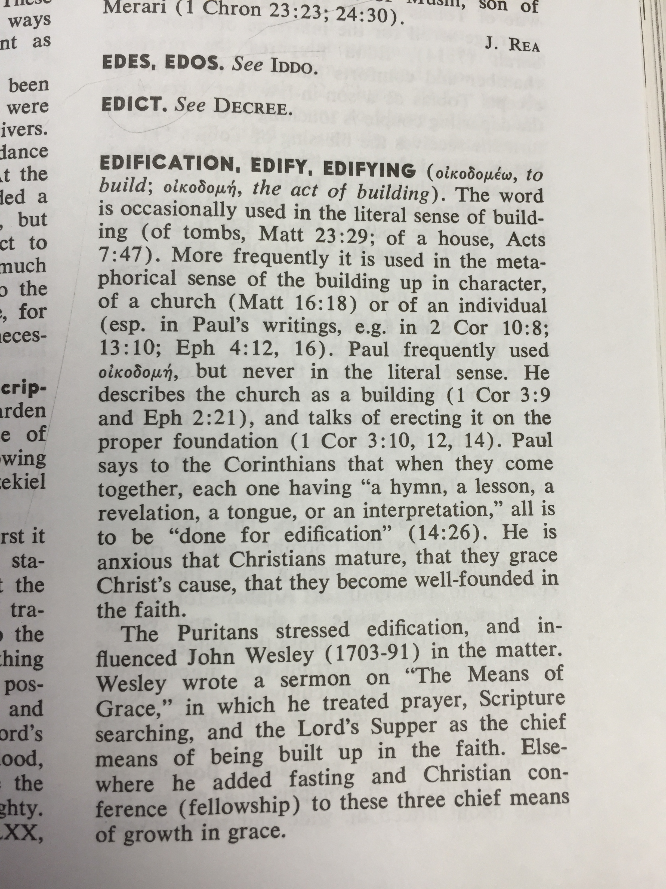
Zondervan Encyclopedia of the Bible Vol. 2
Notes:
Only 2 paragraphs – and the second paragraph is just a summary one of Wesley’s sermons.
Today, we are going to do better than this because Edification is SUCH an important concept that Paul taught us to make sure everything we do in our worship produces edification!

Slide 3
Edification Is A Construction Term
The Greek Word: oikodomeo
Literally: to build a house
Metaphorically: to promote the spiritual growth and development of character of believers.
Jesus Used This Term In His Parables
Matthew 7:24, Matthew 21:33
Luke 12:18, Luke 14:28
Paul Continues With This Figurative Application
1 Corinthians 14:12, 26
2 Corinthians 12:19, 13:10
Notes:
Jesus…building houses or towers…
Paul…think about the PEOPLE within the church as something to be built up. He wanted to establish a mindset that everyone was working to build up one another. He wanted to impress upon them – that like a group of people building a physical building – we are to be working together and BUILDING UP one another in the Lord.
Even in 2 Corinthians when things were getting difficult – Paul reminded them that everything he did, was for building them up.
This was his aim, so that their lives would honor God.

Slide 4
Edification In The Book of Ephesians
Edification Is Building Up Christians Upon The Foundation of Christ & His Apostles.
Ephesians 2:19-22
Edification Is Enhanced Through Servants Who Are Teaching The Truth In Love.
Ephesians 4:12-16
Edification Is The Motivation In Our Speech, Our Tender Hearts, & Our Forgiving Spirit.
Ephesians 4:29-32
Notes:
The core of our understanding of what BIBLICAL edification involves can be seen as Paul developes the theme in the book of Ephesians… We Edify By Building On Jesus!!!
FOUNDATION: 19-22…notice it is construction, and it impacts each one of us individually, but also how we FIT and work TOGETHER in the honor being built up to God through the church.
Then in Ch 3 paul pray for them to grow in knowledge and understanding, and begins ch 4 discussing their unity…making his way to verse 11 where he brings into view the various roles of servants within the church and wants us to understand – that in the same way a physical building project has ‘project managers, architects, framers, electricians etc…” that each help the building come together – the church has apostles, and prophets, and apostles and pastors and evangelist – who all work together to BUILD UP the body of Christ.
THIS Buildling up is towards MATURITY. This Building up is accompliesh via teaching (aka speaking the truth in love.) And This Building up brings an increase in love.
***As you can imagine - in any construction project there are going to be times people mis-read the blueprints, order the wrong parts, say the wrong thing, get exhausted and lose their cool. Hang out on a construction site long enough and you see some amazing things accomplished, but you also see the only way these projects are ever successfully finished is when people choose to keep working together. Well – hang out in the church long enough and you’ll see the same things. But we choose to keep working together. We choose to find something beneficial to say, we choose not to close our hearts, we choose to forgiven and keep going together. Because we all want to build one another up to be more like Christ.
((Transition…this is something we are all responsible to particiate in..)

Slide 5
The Charge To Edify One Another
Given To All Christians
1 Thessalonians 5:11, Romans 14:19
Especially Important When Fulfilling The Roles of Elders or Evangelists
Ephesians 4:11-12, 2 Corinthians 10:8
We Cannot Become Distracted From The Importance of Genuine Edification.
1 Timothy 1:4
Notes:
Rom 14:19 – in matters of judgment we pursue things that bring peace.
2 Cor. 10:8 – proper use of authority

Slide 6
Actions That Edify
We Edify By Teaching The Scriptures
Romans 15:20, 1 Corinthians 8:1
We Edify By Giving Care & Comfort To One Another
Romans 15:2, 1 Corinthians 14:3, 1 Thessalonians 5:11
We Edify By Cooperating In An Orderly Manner.
1 Corinthians 14:26
We Edify By Making Thoughtful Decisions
1 Corinthians 8:10, 1 Corinthians 10:23
We Edify By Using Our Talents To Bless Others
1 Corinthians 14:4, 17
Notes:
TEACHING: This is the primary work of building up. It can be teaching in song, at home, during worship, teaching the lost, teaching the saints – any of these – but it always begins with and has an element of teaching.
MORE THAN KNOWLEDGE: Teaching That Imparts Much More Than Knowledge. There is loving Humility being demonstrated.

Slide 7
Notes:
So today, we want to help you become more like Christ.
If you are already a Christian but you need the prayers of the church, we are here to help build you up.
If you are not a Christian – then your journey begins with confessing your faith that Jesus is the Son of God, committing to turn away from sin, and being baptized so that your sins will be washed away by the power of the blood of Jesus.
Please come to the Lord right now, while we stand and sing.

