Slide 2
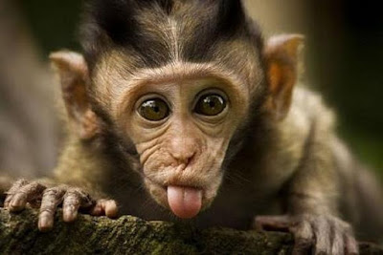
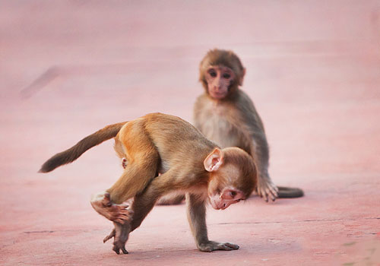
Animal Associations

Slide 3
Animal Associations

Slide 4
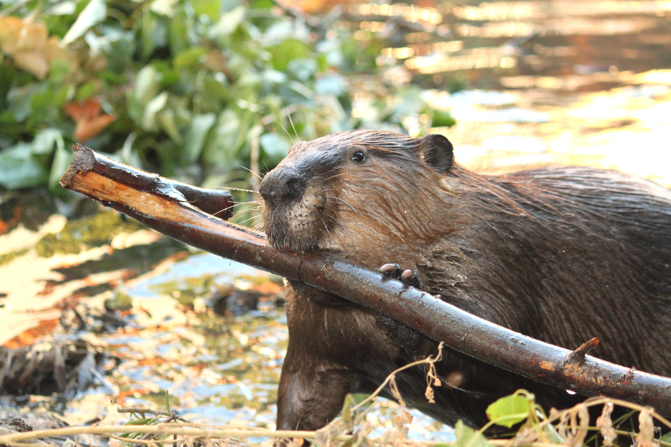
Animal Associations

Slide 5
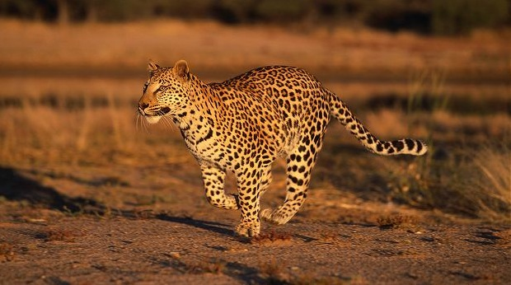
Animal Associations

Slide 6
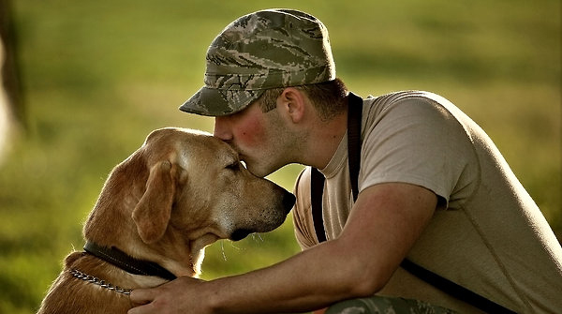
Animal Associations

Slide 7
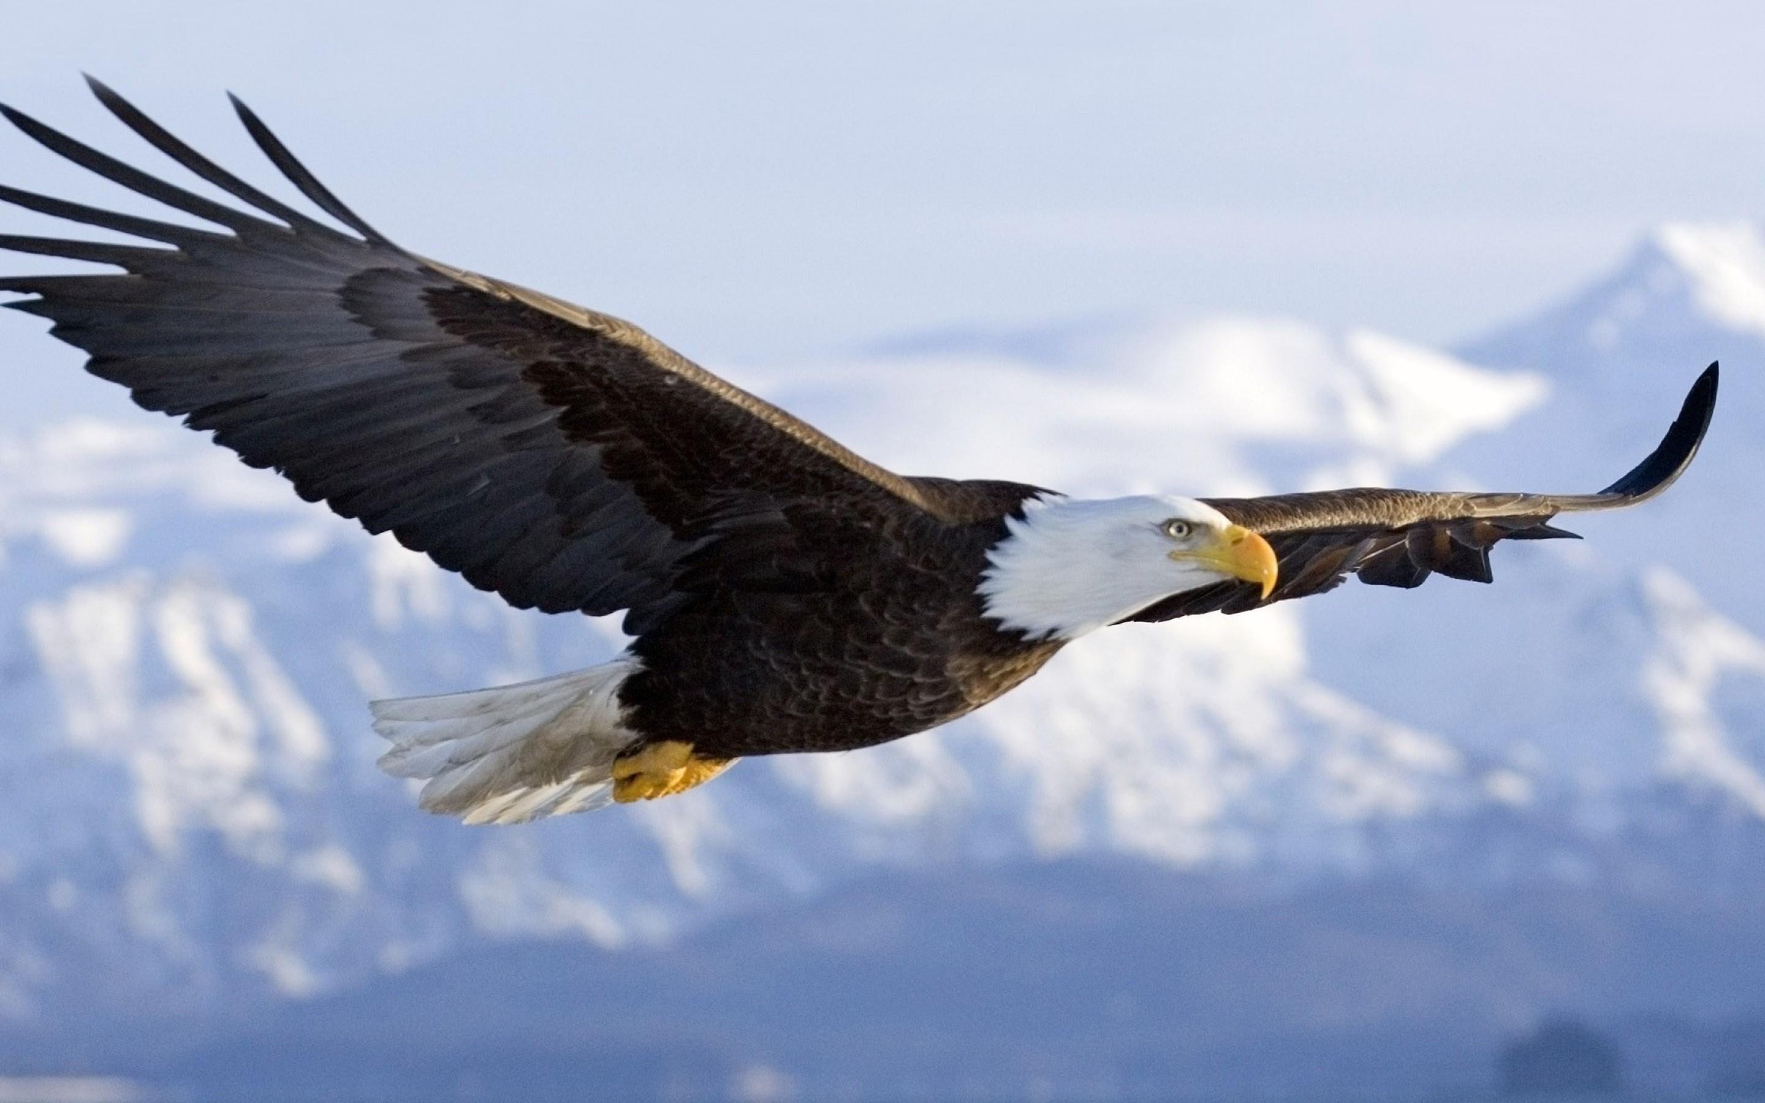
Animal Associations

Slide 8
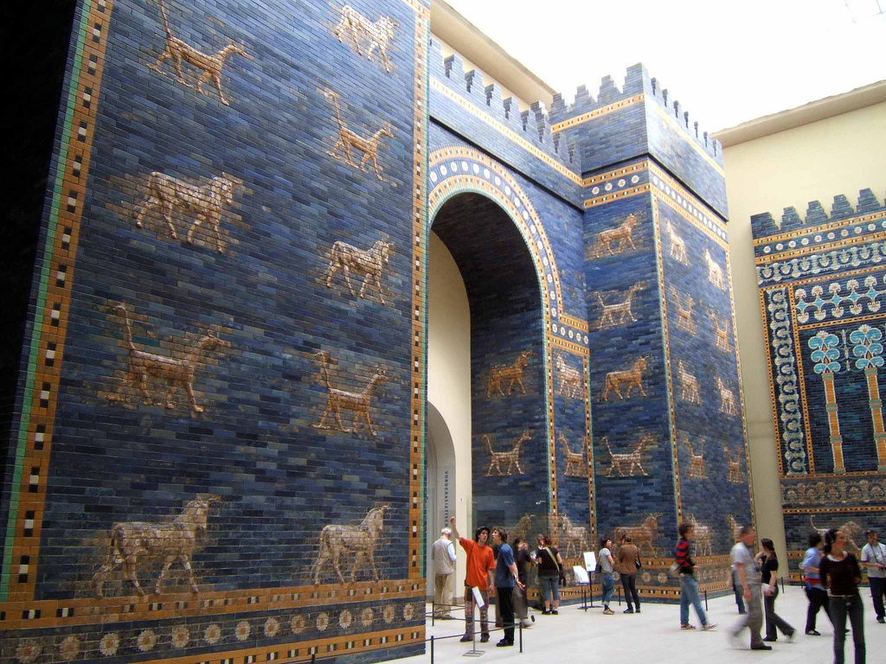
The Ishtar Gate

Slide 9
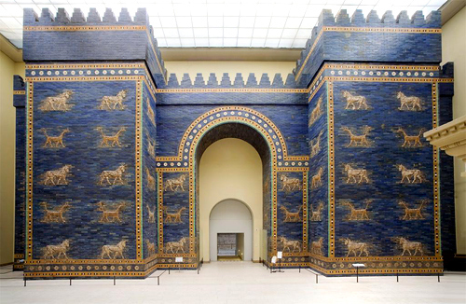

Slide 10
You Can Be With God Forever
“These great beasts, which are four in number, are four kings who will arise from the earth. But the saints of the Highest One will receive the kingdom and possess the kingdom forever, for all ages to come.”
Daniel 7:17-18
Notes:
This verse is an excellent summary of the chapter.
In this chapter we are going to study about 4 great beast, which represent 4 great kingdoms.
In this chapter we are going to see how as powerful and impressive as they are – not one of them is equal to God’s Eternal Kingdom.

Slide 11
Chapter Outline
Part 1 – A Vision of 4 Earthly Kingdoms
Part 2 – A Vision of Jesus’ Superior Kingdom
Part 3 – An Explanation of the Vision
Just as the parable of the Sower provides a foundation for interpreting other parables, Daniel 7 gives a foundation for interpreting other apocalyptic prophecies.

Slide 12
The Explanation of the Vision
Animals/Beasts (vs 3) = Kingdoms (vs 17, 23)
Horns (vs 8) = Kings (vs 24)
Sea (vs 3) = From the Earth (vs 17)
Ancient of Days (vs 9) = God the Father (vs 13)
Son of Man (vs 13) = Jesus (Matthew 9:6)

Slide 13
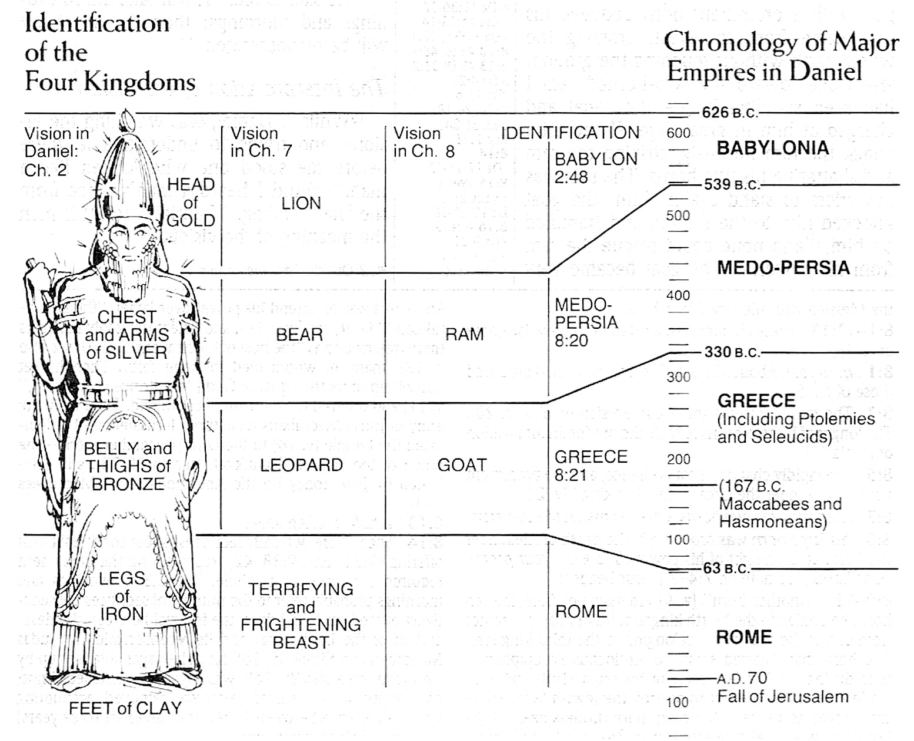
Identifying The Earthly Kingdoms 3-7

Slide 14
The First Kingdom
Notes:
Great & Powerful – yet with a changed heart – likely referring to Neb.’s humbling experience.

Slide 15
The Second Kingdom
Notes:
3 Ribs – may be attributed to 3 greatest military victories of the Medo-Persians
LYDIA
BABYLON
EGYPT

Slide 16
The Third Kingdom
Notes:
Great Wings – The Speed & Distance of Alexander the Great’s conquests.
> 4 Heads corresponding to the 4 four main divisions of his empire when he died.

Slide 17
The Fourth Kingdom
Notes:
10 Horns – you can look back at 2:42 and notice that the statues 10 toes are actually specifically mentioned.

Slide 18
Identifying The Kingdoms
The Eternal Kingdom of God: Vs 9-10, 13-14
What Traits of God’s Kingdom Are Highlighted In This Passage?
Based On Ch 7:17-18, What Differences Make God’s Kingdom Superior To The Earthly Ones?

Slide 19
The Fourth Kingdom
How Were God’s People Treated?
Daniel 7:19-23
Notice The Traits of These Ruthless Rulers Revealed In Vs 8.
“three of the first horns were pulled out…”
“eyes like the eyes of a man and a mouth uttering great boasts.”
How Did Daniel Feel After Being Shown This Vision? (vs 15, 28)
Notes:
The 4th Kingdom captures much of Daniel’s attention and curiosity….
While Ch 2 mentions 4 kingdoms – there is no mention of persecution. This is new information for Daniel…

Slide 20
Lessons for Today
Daniel Was More Than An Interpreter.
Life Has Hard Times, Including Evil Nations. Thankfully, The Evil Is Limited & Temporary.
God Wants Us To Be With Him Forever.
Hebrews 6:19-20
God Is In Control of History.
The Bible Is Its Own Best Commentary.
God Gave Daniel A Peak…

