Slide 1
The Snowball of Sin

Slide 2
King David’s Snowball of Sin
Where Did David’s Trouble Begin?
2 Samuel 11:1-2, Matthew 15:19
Explain How David’s Sin Snowballed…
2 Samuel 11:3-17,27
How Could David Have Avoided This Snowball of Sin? (2 Samuel 12:7-8)
How Long Did David Suffer The Consequences of These Sins? (2 Samuel 12:9-23)
Notes:
IN HIS HEART (Not just “on His roof”)
Avoided: He could have taken his desires to God! Instead of trying to meet them via sin. He could have learned contentment.

Slide 3
Warning Signs Your Sins Are Snowballing
You Ignore Truthful Information From Godly Friends or Family To Minimize or Dismiss The Long-Term Consequences of Your Choices. (2 Samuel 11:3)
You Arrange A Time & Place Where The Temptation To Sin Will Be Amplified. (2 Samuel 11:4a)
You Begin Facing Consequences That Escalate From Bad To Worse. (2 Samuel 11:5)
You Manipulate & Deceive Others. (2 Samuel 11:13)
To You Feel Desperate To Cover Up Your Sin. (2 Samuel 11:15)
Notes:
Hiding or Embarrassed For Others To Know…

Slide 4
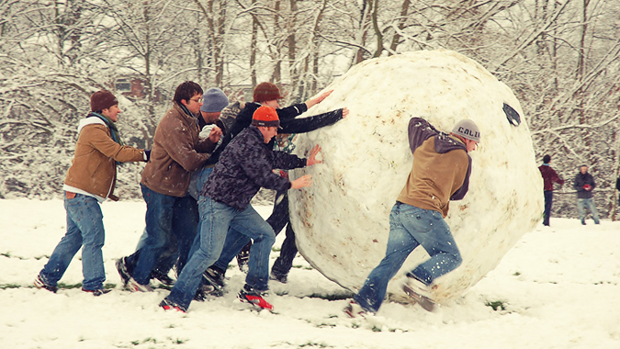
One More Big Lesson From David

Slide 5
When You Become Crushed By The Burden of Your Sins, There Is Only One Thing To Do: Turn To God!
2 Samuel 12:13
Psalm 51:14-17
Notes:
David’s story teaches us one more EXTREMELY IMPORTANT LESSON… TURN TO GOD.
*Ideally we will learn from Jacob and David and stop sin sooner rather than later – but if we ever find ourselves spiraling out of control. The only way out – is with God.
Satan will tell us – that we can’t turn to God. He’s the one we’ve so deeply rejected.
But the truth is: ONLY GOD can get us out of the mess we’ve made.

Slide 6
The Bible Is FULL of Similar Stories
Lot’s Location (Genesis 19:12-16, 23-26, 32)
Balaam’s Greed (Revelation 2:14)
Peter’s Denials (Mark 14:66-72)
Jacob’s Selfishness (Genesis 25, 27, 32)
*Involves The Whole Family
*Shows You Can’t Run From Your Own Thinking
*Includes Elements of Peer Pressure
Notes:
LOT: Pursuing Worldly Treasure – Neglecting Family – Untrained Children – Immorality Multiplies
Point – It can begin with any sin, at any time…
** So they will have covered David upstairs – I want to equip you to teach your students about Jacob TOO… This is a special case you can study as a family some time in the future to reinforce Today’s lessons.

Slide 7
Rolling In The Wrong Direction
What Initial Evil Behaviors Are Seen In Jacob’s Family Relationships?
Genesis 25:27-34
How Have These Grown Into Bigger Troubles?
Genesis 27:1-13
Even Years Later, How Does Jacob Respond To Confronting The Sins of His Past?
Genesis 32:13-23, Genesis 33:1-3
Notes:
25:27-34 *Unhealthy behaviors here… Favoritism and Extortion and Impatience/Come home before starving and Bad Priorities (Despising Birthright)
27:1-13
Favoritism (snowballs into) Dishonoring Husband, Deception, Stealing from your own Son.
Taking Advantage of Someone Else’s Moment of Weakness. Exhortion (snowballs into) Outright Stealing by means of Lying. And Lying (snowballs into) vs 20 Invoking God into his LIE!
32:3-8 – Fear and Guilt after all these years.
32:13-23 – Give Up All His Wealth & Spend 2 Restless Nights thinking Your Wifes & Children Will Be Murdered.
33:1-3 – Disgusting “Planning” By Sending out Least Loved Children as a Buffer. (The mind and thinking that seeks to “get ahead” at the expense of others is now acting the same way with his own household!)
What Unforeseen Consequences Did Jacob Face From His Sin?
** The consequences of this scheme are obvious to those looking from the outside. Any reasonable person can expect that Esau is going to be furious, but they are acting quickly without thought to the long term damage this hiest is going to create.

Slide 8
How To Get Out of This Mess Matthew 10:24-42
Seek To Be Like Our Teacher, Not Like The World
Don’t Worry About The Name Calling
Look Beyond Fear, To The Day God Exposes Everything
Stay Busy Doing The Good Works of God
Think of The Eternal Consequences
Dwell On God’s Care of You, Because You Are Valuable To Him
Confess Christ In Our Actions & Words
Be Ready To Be Divided & Set Apart
Give Ourselves Fully To Following Jesus
Look Ahead To Our Awesome Reward
Notes:
Guard Our Heart From Under-handed or Corrupt Ideas.
Matthew 10:16
Open Up To Family & Friends About Doubts & Struggles.
Establish Personal Boundaries To Reduce The Consequences of

Slide 9
1 Peter 5:6-11
6 Therefore humble yourselves under the mighty hand of God, that He may exalt you at the proper time, 7 casting all your anxiety on Him, because He cares for you.
8 Be of sober spirit, be on the alert. Your adversary, the devil, prowls around like a roaring lion, seeking someone to devour. 9 But resist him, firm in your faith, knowing that the same experiences of suffering are being accomplished by your brethren who are in the world.
10 After you have suffered for a little while, the God of all grace, who called you to His eternal glory in Christ, will Himself perfect, confirm, strengthen and establish you. 11 To Him be dominion forever and ever. Amen.

Slide 10
The Snowball of Sin

