Slide 1
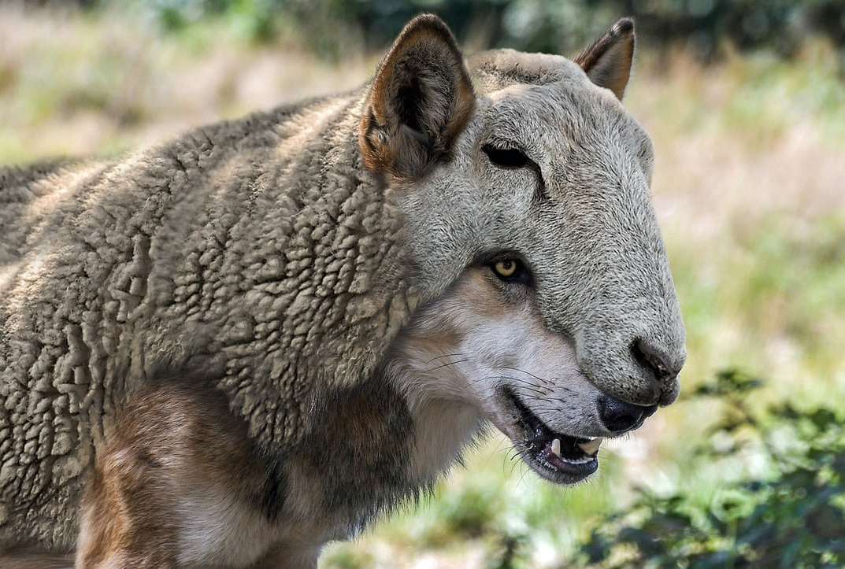
False Teachers
2 Peter 2:1-10

Slide 2
The Threat of False Teachers 2 Peter 2:1-3
There have been and there always will be false teachers!
Peter introduces us to their methods.
They work secretly!
They introduce destructive heresies.
They deny the Master who bought them.
Many will follow their sensuality with the result that the way of truth is maligned! (2 Samuel 12:14; Romans 2:24)
These teachers are motivated by greed! (cf. 1 Thessalonians 2:5)

Slide 3
Three Examples 2 Peter 2:4-8
God did not spare angels. (2 Peter 2:4)
“Now it came about, when men began to multiply on the face of the land, and daughters were born to them, that the sons of God saw that the daughters of men were beautiful; and they took wives for themselves, whomever they chose.” (Genesis 6:1-2)
“And angels who did not keep their own domain, but abandoned their proper abode, He has kept in eternal bonds under darkness for the judgment of the great day, just as Sodom and Gomorrah and the cities around them, since they in the same way as these indulged in gross immorality and went after strange flesh, are exhibited as an example in undergoing the punishment of eternal fire.” (Jude 1:6-7)

Slide 4
Three Examples 2 Peter 2:4-8
God did not spare angels. (2 Peter 2:4)
God did not spare the ancient world, but preserved Noah. (2 Peter 2:5)
Noah was a “preacher of righteousness.”
“...Noah was a righteous man, blameless in his time; Noah walked with God.” (Genesis 6:9)
God preserved or kept watch over Noah! Noah was protected by God’s word and God’s work!

Slide 5
Three Examples 2 Peter 2:4-8
God did not spare angels. (2 Peter 2:4)
God did not spare the ancient world, but preserved Noah. (2 Peter 2:5)
God condemned the cities of Sodom and Gomorrah and rescued Lot. (2 Peter 2:6-8)
Sodom and Gomorrah are an example of what happens to the ungodly!
He rescued righteous Lot! (cf. Genesis 19:7; Ezekiel 9:4)

Slide 6
The Lord Knows How... 2 Peter 2:9-10
The Lord knows how to rescue!
Being godly doesn’t mean we aren’t tempted!
Lot is distinguished not by being perfect or even “good enough!” He is distinguished by orienting himself toward God.
The Lord knows how to judge!
The unrighteous are kept under punishment,
They are characterized by indulging the flesh and despising authority.

